Slide 1
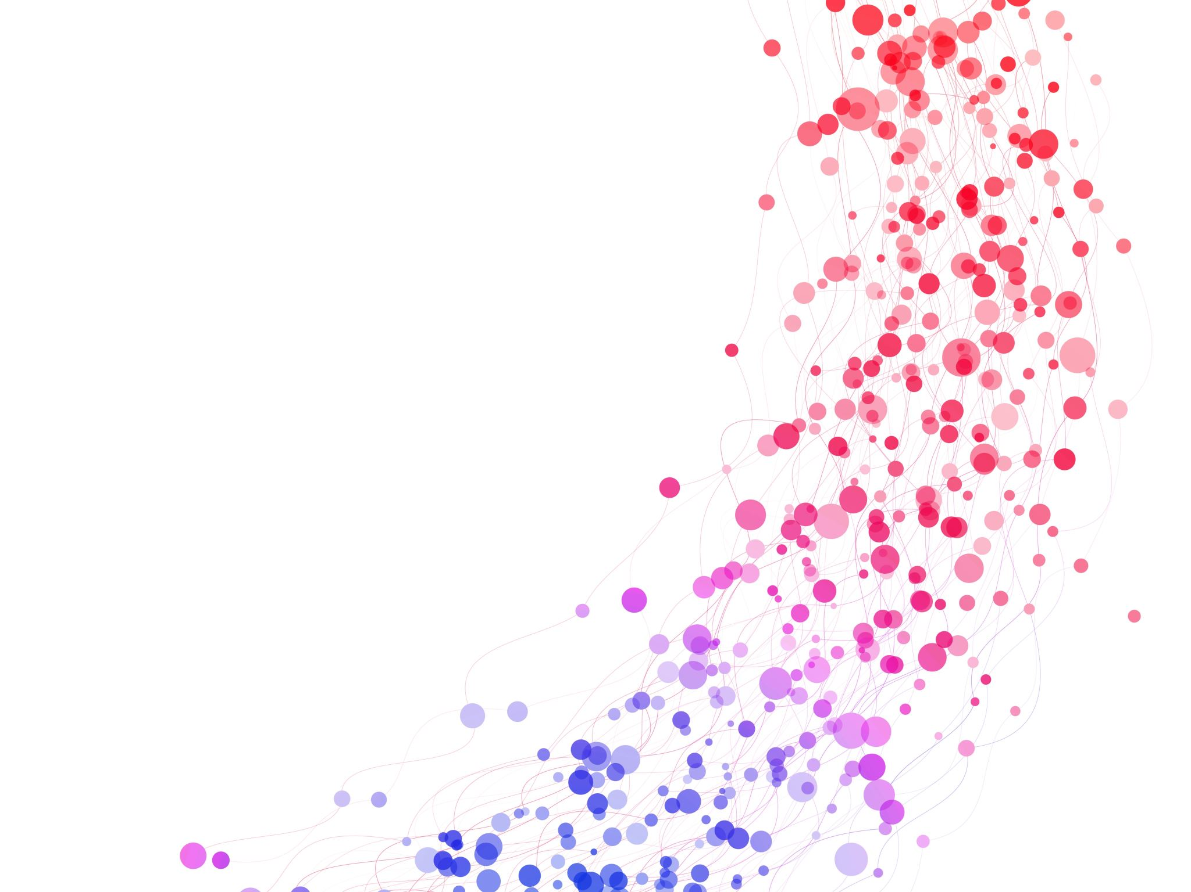
English Flip-Week 2
Watch the video.
Learn how to start a fantastic narrative using different openers.
https://www.youtube.com/watch?v=GUhL_0nJ7sQ&t=101s&ab_channel=TwinklTeachesKS2

