Slide 1
Step 6
Year 2: Sort 2D Shapes

Slide 2
Introduction
Match the name to the correct shape.
triangle
hexagon
rectangle
square
circle
Y2

Slide 3
Introduction
Match the name to the correct shape.
rectangle
circle
triangle
square
hexagon
Y2

Slide 4
Varied Fluency 1
True or false?
These shapes have been ordered by the number of sides.
Y2

Slide 5
Varied Fluency 1
True or false?
These shapes have been ordered by the number of sides.
False, the circle should go at the start.
Y2

Slide 6
Varied Fluency 2
Tick the shape that does not belong in either group.
Quadrilaterals
Blue
B
A
C
D
Y2

Slide 7
Varied Fluency 2
Tick the shape that does not belong in either group.
Quadrilaterals
Blue
B
A
C
D
✓
Y2

Slide 8
Varied Fluency 3
Place the shapes in the correct section of the Carroll diagram.
 | Fewer than 4 sides | 4 sides or more
Green
Not green
B
C
A
D
Y2

Slide 9
Varied Fluency 3
Place the shapes in the correct section of the Carroll diagram.
 | Fewer than 4 sides | 4 sides or more
Green | A
Not green | B | C, D
B
C
A
D
Y2

Slide 10
Varied Fluency 4
Order these shapes by the number of vertices.
A
D
B
C
Y2

Slide 11
Varied Fluency 4
Order these shapes by the number of vertices.
Ascending:
Descending:
D
A
C
B
0
3
4
6
D
A
C
B
0
3
4
6
Y2

Slide 12
Problem Solving 1
Zeek has ordered these shapes based on the number of sides.
One shape is hidden by the splat.
Draw the shape that could be hidden.
Y2

Slide 13
Problem Solving 1
Zeek has ordered these shapes based on the number of sides.
One shape is hidden by the splat.
Draw the shape that could be hidden.
Any shape with more than four sides, for example:
pentagon
hexagon
Y2

Slide 14
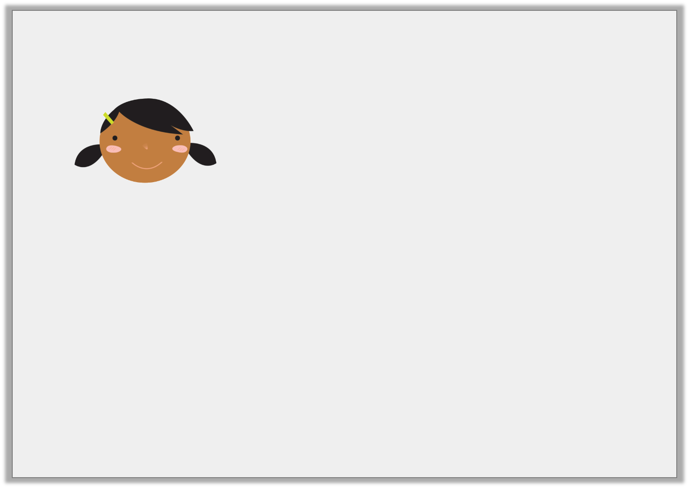
Reasoning 1
Mel says,
Is she correct? Convince me.
A square could fit in any section of this Carroll diagram.
 | Rectangle | Not rectangle
Purple
Not purple
Y2

Slide 15
Reasoning 1
Mel says,
Is she correct? Convince me.
Mel is not correct because…
A square could fit in any section of this Carroll diagram.
 | Rectangle | Not rectangle
Purple
Not purple
Y2

Slide 16
Reasoning 1
Mel says,
Is she correct? Convince me.
Mel is not correct because a square is a type of rectangle so it would fit in either of the left sections, depending on the colour.
A square could fit in any section of this Carroll diagram.
 | Rectangle | Not rectangle
Purple
Not purple
Y2

Slide 17
Reasoning 2
What could the missing label on this Venn diagram be?
Explain your answer.
____________
Blue
Y2

Slide 18
Reasoning 2
What could the missing label on this Venn diagram be?
Explain your answer.
Possible answers:
Triangle because…
3 sides or fewer because…
3 vertices or fewer because…
____________
Blue
Y2

Slide 19
Reasoning 2
What could the missing label on this Venn diagram be?
Explain your answer.
Possible answers: triangle, 3 sides or fewer, 3 vertices or fewer because the blue triangle is in the middle. The green hexagon does not belong in either group because it is neither blue nor a triangle.
____________
Blue
Y2

