Slide 1
Step 6
Year 1: Sort 2D Shapes

Slide 2
Introduction
Match the 2D shape to the correct name.
Which shape name is missing?
triangle
rectangle
circle
Y1

Slide 3
Introduction
Match the 2D shape to the correct name.
Which shape name is missing? Square
triangle
rectangle
circle
Y1

Slide 4
Varied Fluency 1
Choose the shape that would best fit this group.
A
C
D
B
Y1
© Classroom Secrets Limited 2018

Slide 5
Varied Fluency 1
Choose the shape that would best fit this group.
A
C
D
B
Y1

Slide 6
Varied Fluency 2
Sort these shapes into 3 groups.
Y1

Slide 7
Varied Fluency 2
Sort these shapes into 3 groups.
triangle
square
circle
Y1

Slide 8
Varied Fluency 3
Label the two groups below.
Y1

Slide 9
Varied Fluency 3
Label the two groups below.
squares
circles
Y1

Slide 10
Varied Fluency 4
Sort the shapes into two groups.
Squares | Rectangles
A
C
E
D
B
Y1
© Classroom Secrets Limited 2018

Slide 11
Varied Fluency 4
Sort the shapes into two groups.
Squares | Rectangles
A and E | C and B
A
C
E
D
B
Y1

Slide 12
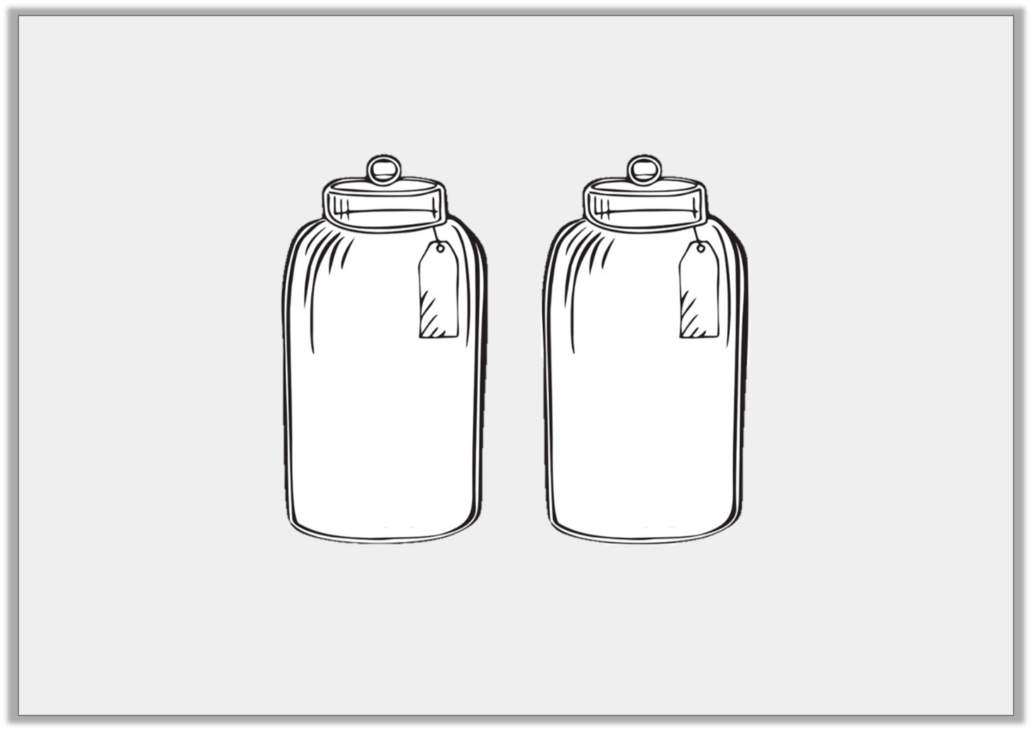
Problem Solving 1
Spot the mistake below.
A
B
circles
triangles
Y1

Slide 13
Problem Solving 1
Spot the mistake below.
Jar A contains a square.
A
B
circles
triangles
Y1

Slide 14
Problem Solving 2
Sort the shapes below.
How many different ways can you sort them?
A
B
D
C
Y1

Slide 15
Problem Solving 2
Sort the shapes below.
How many different ways can you sort them?
There are two ways. You can sort them by colour or shape.
D
B
C
A
Y1

Slide 16
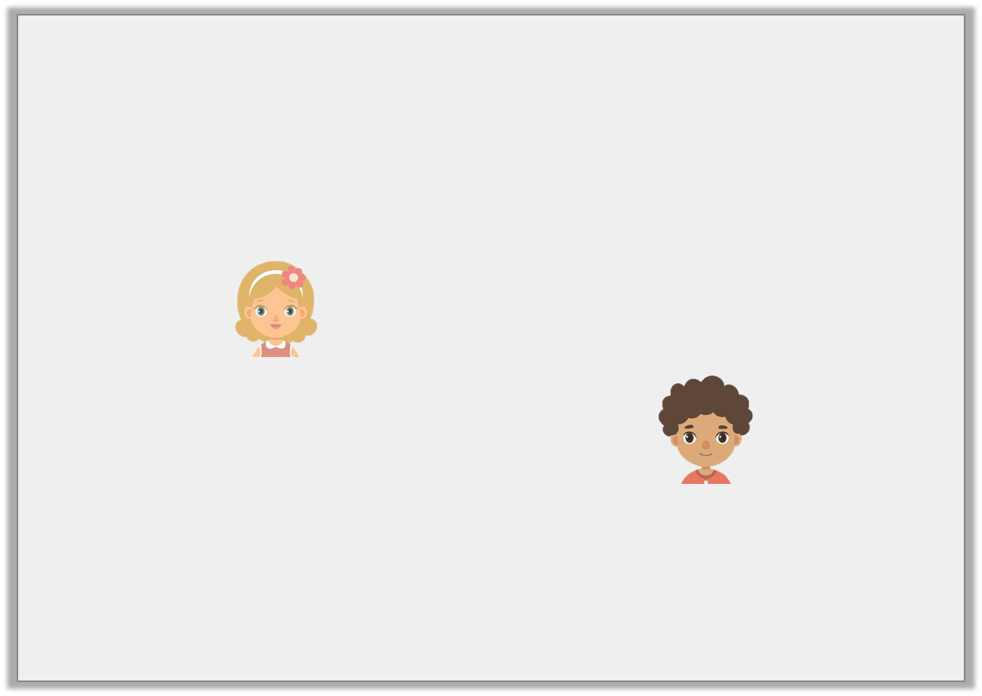
Reasoning 1
The children have five shapes.
Who is correct? Explain your answer.
The shapes can be sorted into 2 groups.
Bex
The shapes can be sorted into 3 groups.
Carl
Y1

Slide 17
Reasoning 1
The children have five shapes.
Who is correct? Explain your answer.
Carl is correct because…
The shapes can be sorted into 2 groups.
Bex
The shapes can be sorted into 3 groups.
Carl
Y1

Slide 18
Reasoning 1
The children have five shapes.
Who is correct? Explain your answer.
Carl is correct because they can be sorted into 3 shape groups (triangle, circle, rectangle) or 3 colour groups (red, yellow, green).
The shapes can be sorted into 2 groups.
Bex
The shapes can be sorted into 3 groups.
Carl
Y1

