Slide 1
Year 1: Make Equal Groups

Slide 2
Introduction
Spot the multiples of 2.
Spot the multiples of 5.
Spot the multiples of 10.
8 | 5 | 1
3 | 12 | 7
15 | 11 | 6
14 | 13 | 10
2 | 5 | 4
10 | 8 | 20
7 | 9 | 1
6 | 15 | 25
30 | 12 | 10
26 | 32 | 5
20 | 25 | 40
8 | 50 | 15
What do multiples of 2 end in?
What do multiples of 5 end in?
What do multiples of 10 end in?
Y1

Slide 3
Introduction
Spot the multiples of 2.
Spot the multiples of 5.
Spot the multiples of 10.
8 | 5 | 1
3 | 12 | 7
15 | 11 | 6
14 | 13 | 10
2 | 5 | 4
10 | 8 | 20
7 | 9 | 1
6 | 15 | 25
30 | 12 | 10
26 | 32 | 5
20 | 25 | 40
8 | 50 | 15
What do multiples of 2 end in?
What do multiples of 5 end in?
What do multiples of 10 end in?
0, 2, 4, 6 and 8
0 and 5
0
Y1

Slide 4
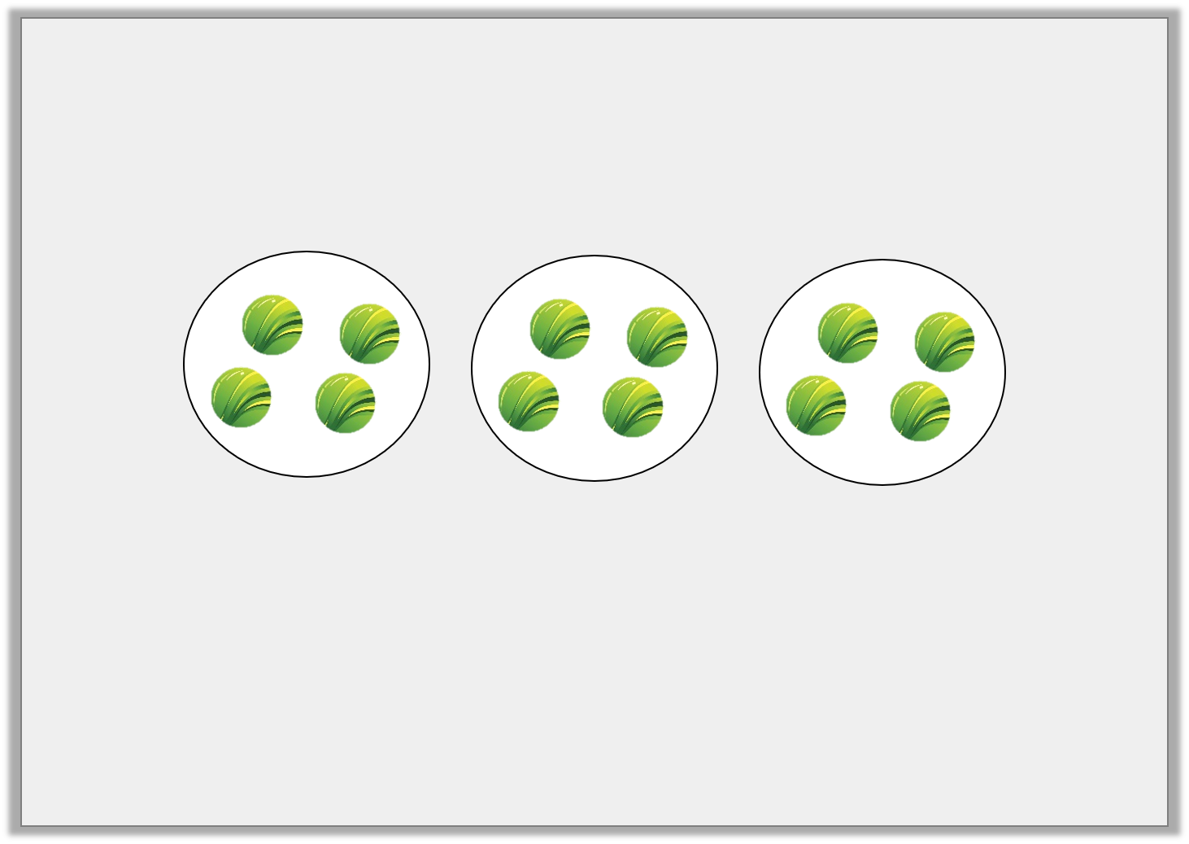
Varied Fluency 1
True or false?
There are 3 groups of 3 marbles.
Y1

Slide 5
Varied Fluency 1
True or false?
There are 3 groups of 3 marbles.
False. There are 3 groups of 4 marbles.
Y1

Slide 6
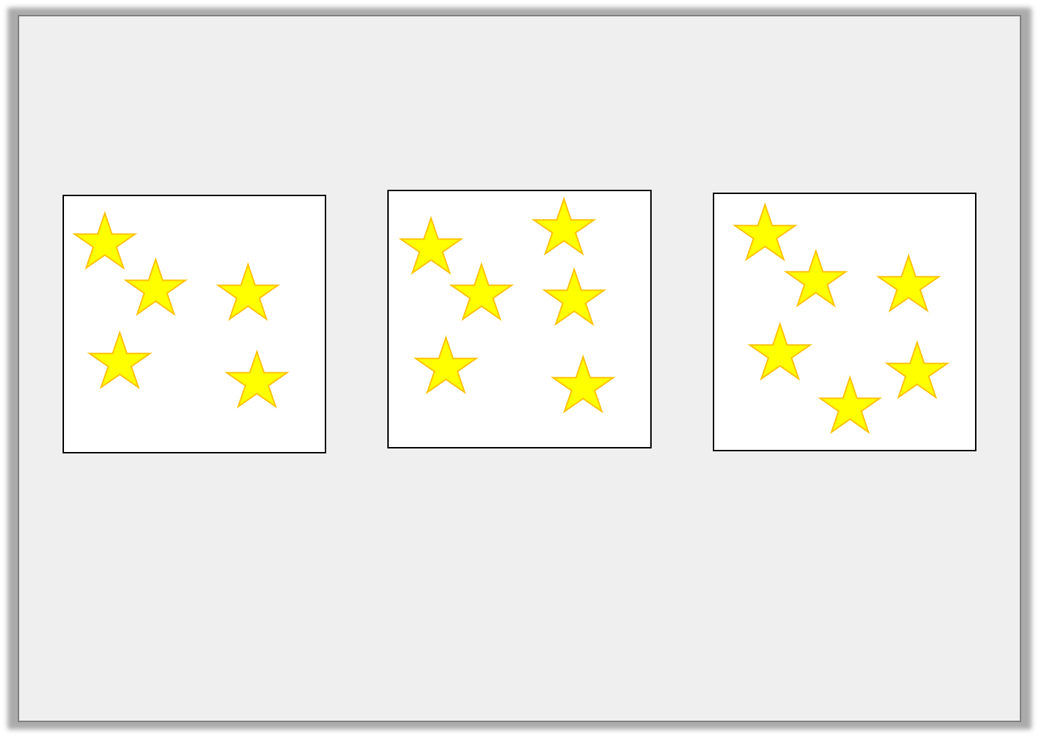
Varied Fluency 2
Are the groups equal?
Y1

Slide 7
Varied Fluency 2
Are the groups equal?
No. The first group has 5 stars and the other groups have 6 stars.
Y1

Slide 8
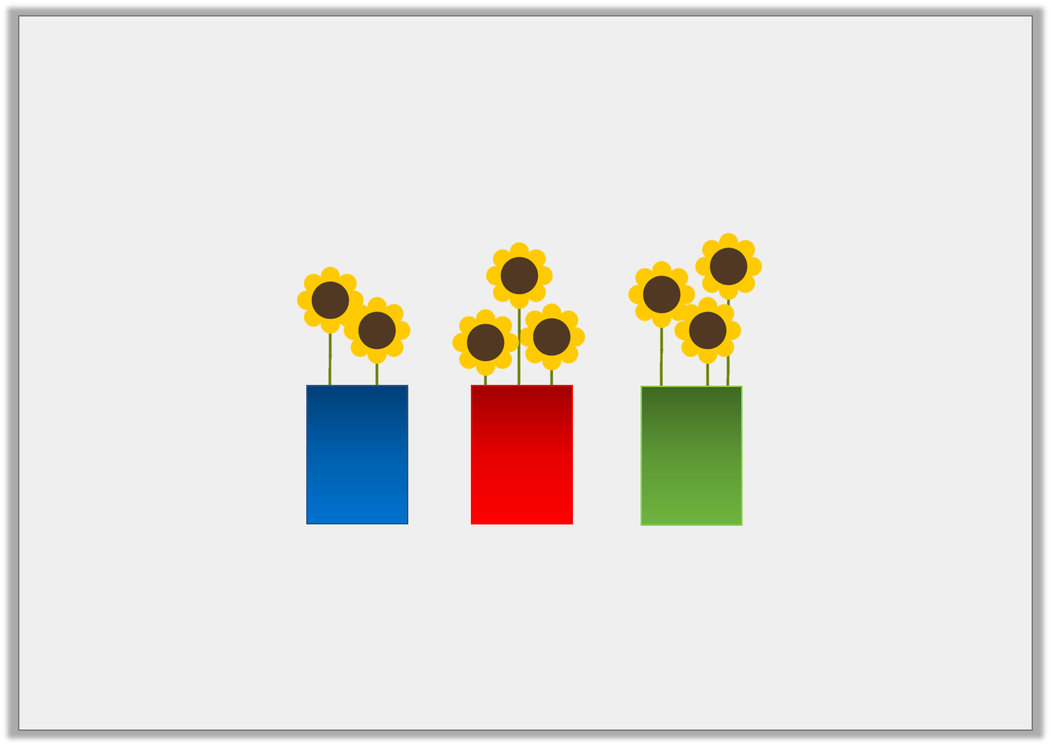
Varied Fluency 3
How many more flowers must you add to the blue vase so that all the groups are equal?
Y1

Slide 9
Varied Fluency 3
How many more flowers must you add to the blue vase so that all the groups are equal?
You must add 1 more flower to the blue vase to have 3 groups of 3 flowers.
Y1

Slide 10
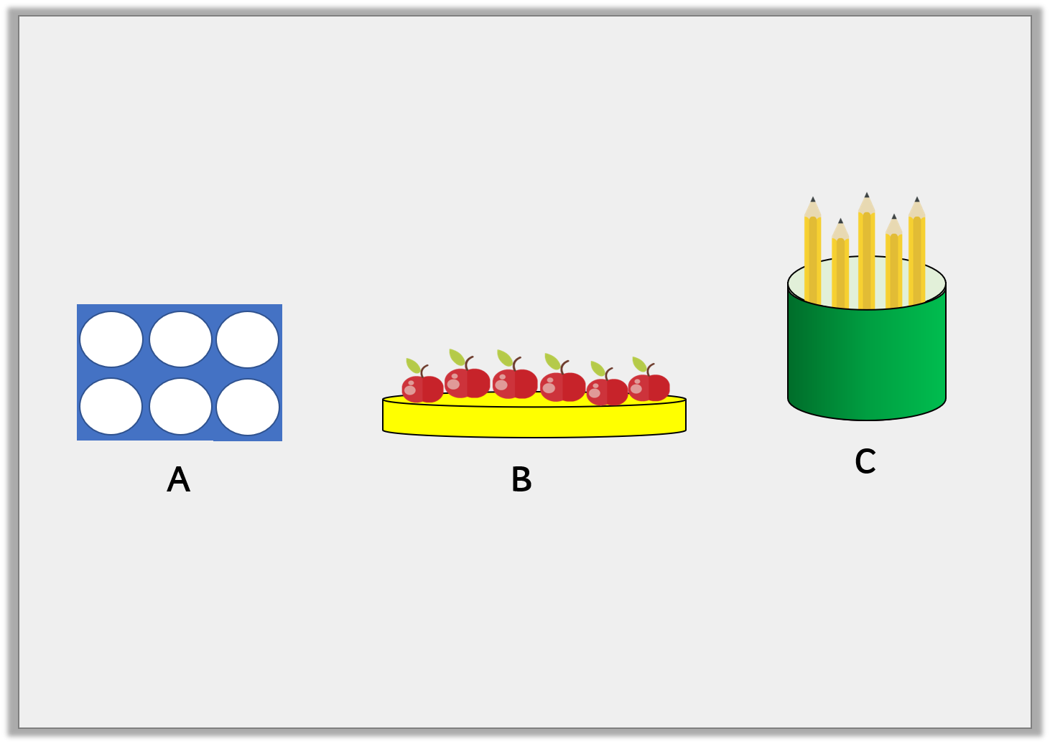
Varied Fluency 4
Which group is not equal to the others?
Y1

Slide 11
Varied Fluency 4
Which group is not equal to the others?
C is not equal. There are only 5 pencils.
Y1

Slide 12
Varied Fluency 1
True or false? These groups are equal.
Y2
© Classroom Secrets Limited 2018

Slide 13
Problem Solving 1
Ella is making 2 equal groups of 10. What combination of numicon can she use to make the 2nd group?
?
Y1

Slide 14
Problem Solving 1
Ella is making 2 equal groups of 10. What combination of numicon can she use to make the 2nd group?
Combinations of numicon could include:
5 and 5
9 and 1
8 and 2
7 and 3
6 and 4
6, 2 and 2
4, 4 and 2
4, 4, 1 and 1
5, 3, and 1
Any combination that totals 10.
?
Y1

Slide 15
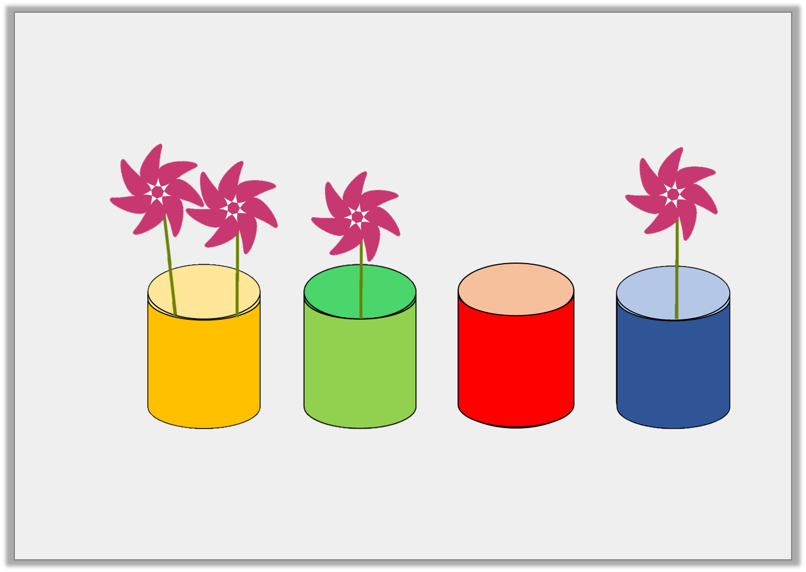
Problem Solving 2
Help make these groups equal.
Y1

Slide 16
Problem Solving 2
Help make these groups equal.
Move a flower from the yellow vase to the red vase.
Y1

Slide 17
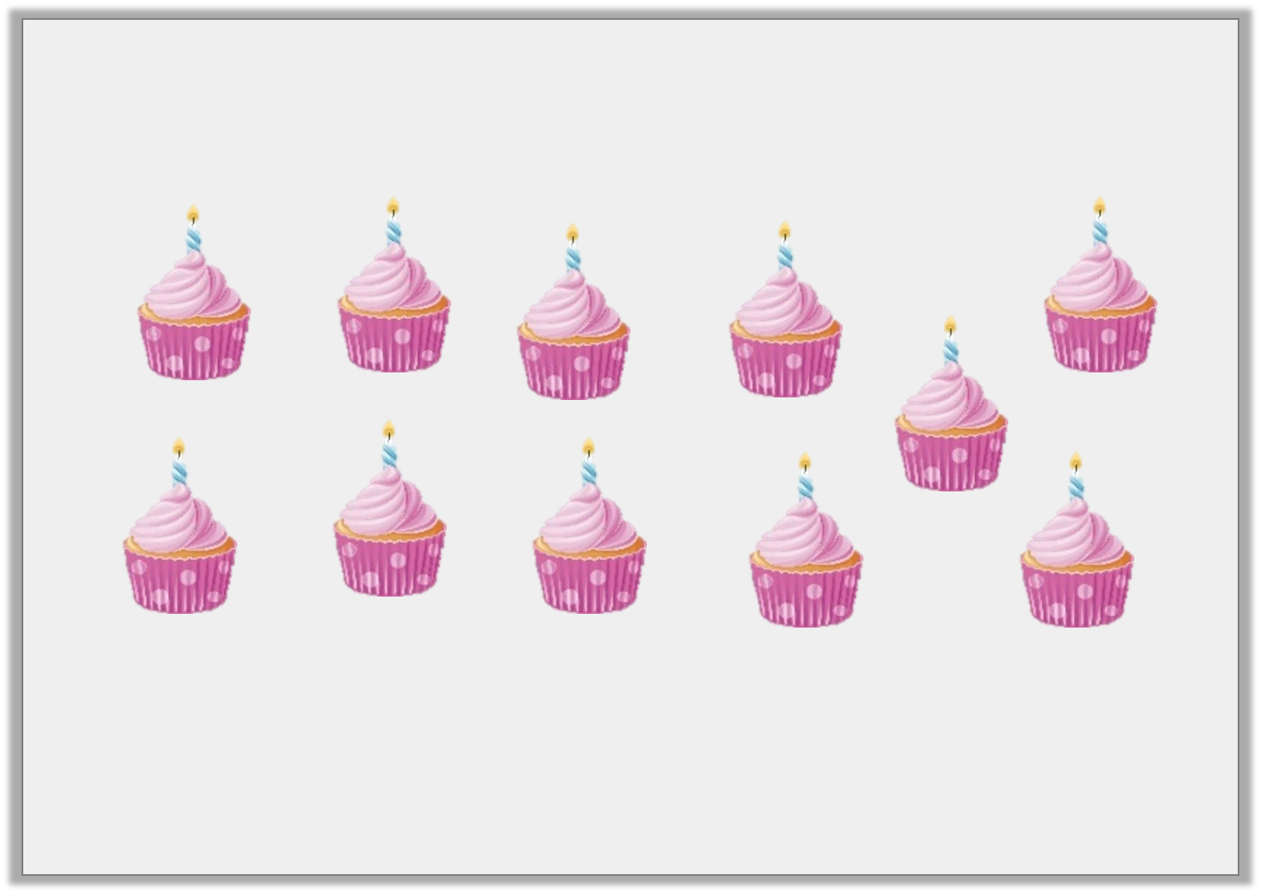
Reasoning 1
Sam has 11 cupcakes. Can he make 2 equal groups of 5?
Explain your answer.

Slide 18
Reasoning 1
Sam has 11 cupcakes. Can he make 2 equal groups of 5?
Explain your answer.
No he can’t because there will be _________ cupcakes in one group and _________ cupcakes in the other.

Slide 19
Reasoning 1
Sam has 11 cupcakes. Can he make 2 equal groups of 5?
Explain your answer.
No he can’t because there will be 5 cupcakes in one group and 6 cupcakes in the other.
Y1

