Slide 1
Year 3/4 – Summer Block 4 – Properties of Shapes
Step 4
Tuesday 14th July 2020
LO: I can recognise and name different triangle

Slide 2
Introduction
What is the same and what is different about these triangles?
What is the name of each triangle?
What do you know about it?
Y4

Slide 3
Introduction
What is the same and what is different about these triangles?
What is the name of each triangle?
What do you know about it?
Answers might include: different colours, different sizes, different shapes, all have 3 sides etc.
Isosceles
Has 2 sides of equal length.
Equilateral
Has 3 sides of equal length.
Scalene
Has 0 sides of equal length.
Y4

Slide 4
Varied Fluency 1
Tick the isosceles triangles.
B
C
A
D
Y4

Slide 5
Varied Fluency 1
Tick the isosceles triangles.
B
C
A
✓
✓
D
Y4

Slide 6
Varied Fluency 2
True or false? Connecting these dots will create a right angled triangle.
B
A
C
Y4

Slide 7
Varied Fluency 2
True or false? Connecting these dots will create a right angled triangle.
True
B
A
C
Y4

Slide 8
Varied Fluency 3
Sort the triangles into the table.
Scalene | Isosceles | Equilateral
C
A
D
B
Y4

Slide 9
Varied Fluency 3
Sort the triangles into the table.
Scalene | Isosceles | Equilateral
B
D
A
C
Y4

Slide 10
Varied Fluency 4
Use a ruler to draw a scalene triangle with one
side measuring 5 cm.
Y4

Slide 11
Varied Fluency 4
Use a ruler to draw a scalene triangle with one
side measuring 5 cm.
Check your partner’s triangle. It MUST be a scalene triangle and have one side that measures 5cm.
This triangle has a base that measures 5cm (but it may appear bigger on the whiteboard).
Y4

Slide 12
Year 4: LO: I can recognise and name different triangle
15-07-20

Slide 13
Problem Solving 1
Colour the triangles in this image which are scalene. Use a ruler to help.
Y4

Slide 14
Problem Solving 1
Colour the triangles in this image which are scalene. Use a ruler to help.
Y4

Slide 15
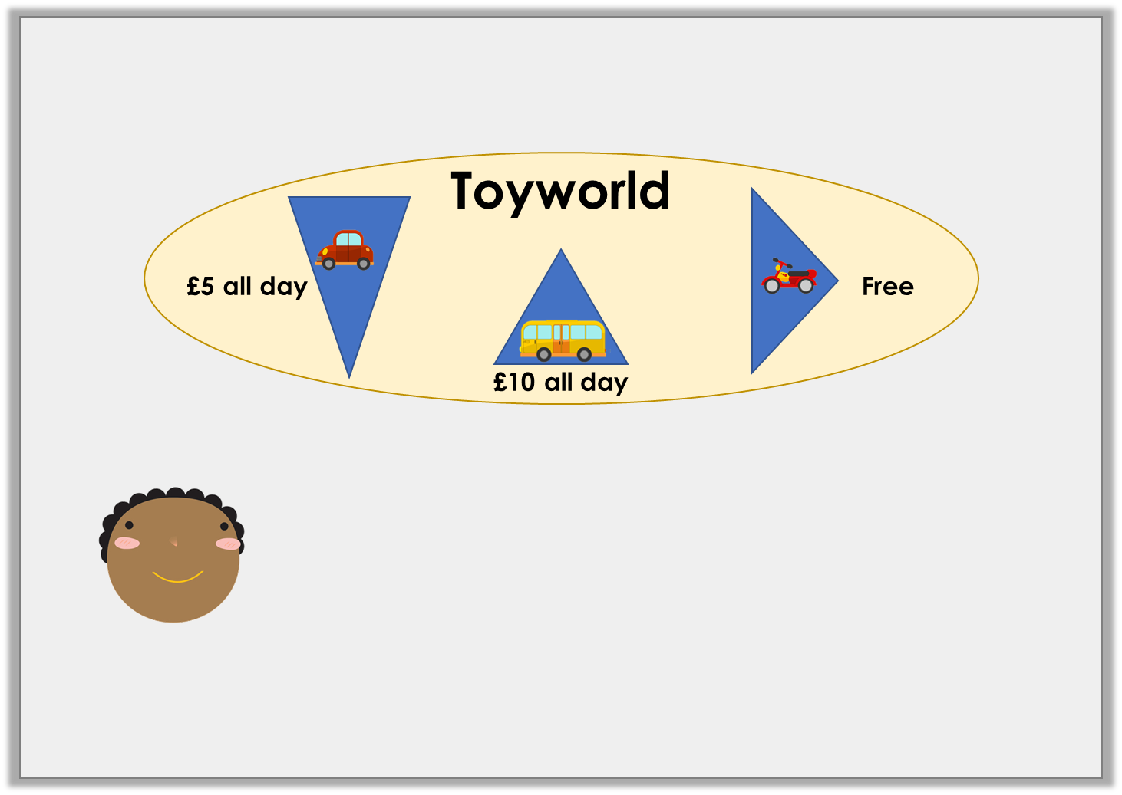
Reasoning 1
Holly is designing a logo for a car park.
She says,
Is she correct? Explain your answer.
The logo includes no scalene triangles.
Y4

Slide 16
Reasoning 1
Holly is designing a logo for a car park.
She says,
Is she correct? Explain your answer.
Yes because…
The logo includes no scalene triangles.
Y4

Slide 17
Reasoning 1
Holly is designing a logo for a car park.
She says,
Is she correct? Explain your answer.
Yes because the left and right triangles are isosceles because they have 2 equal sides and the middle triangle is equilateral because it has 3 equal sides.
The logo includes no scalene triangles.
Y4

Slide 18
Reasoning 2
Which triangle is the odd one out?
Why?
B
A
D
C
Y4

Slide 19
Reasoning 2
Which triangle is the odd one out?
Why?
C because…
B
A
D
C
Y4

Slide 20
Reasoning 2
Which triangle is the odd one out?
Why?
C because it is the only isosceles triangle.
The rest are equilateral.
B
A
D
C
Y4

Slide 21
Year 3 – Summer Block 3 – Properties of Shapes
Step 5
Thursday 16th July 2021
Year 3/4: Lo: To identify horizontal and vertical lines

Slide 22
Introduction
How many horizontal lines are there? How many vertical lines are there?
Y3

Slide 23
Introduction
How many horizontal lines are there? How many vertical lines are there?
5 horizontal
Y3

Slide 24
Introduction
How many horizontal lines are there? How many vertical lines are there?
6 vertical
Y3

Slide 25
Varied Fluency 1
Draw the vertical lines of symmetry in these objects.
W
Y3

Slide 26
Varied Fluency 1
Draw the vertical lines of symmetry in these objects.
W
Y3

Slide 27
Varied Fluency 2
Fill in the table below.
Object | Type of lines – horizontal, vertical or both?
Y3

Slide 28
Varied Fluency 2
Fill in the table below.
Object | Type of lines –horizontal, vertical or both?
 | both
 | vertical
 | horizontal
 | both
Y3

Slide 29
Varied Fluency 3
Which of the images below has a vertical line of symmetry?
Y3

Slide 30
Varied Fluency 3
Which of the images below has a vertical line of symmetry?

Y3

Slide 31
Step 5 Friday 17th July 2021 Year 3/4: Lo: To answer prob-solving and reasoning question to identify horizontal and vertical lines

Slide 32
Reasoning 1
Ruby is looking for horizontal and vertical lines. The time is now:
Is she correct? Explain how you know.
In 10 minutes, one hand will be horizontal and one hand will be vertical.
Y3

Slide 33
Reasoning 1
Ruby is looking for horizontal and vertical lines. The time is now:
Is she correct? Explain how you know.
Ruby is correct because…
In 10 minutes, one hand will be horizontal and one hand will be vertical.
Y3

Slide 34
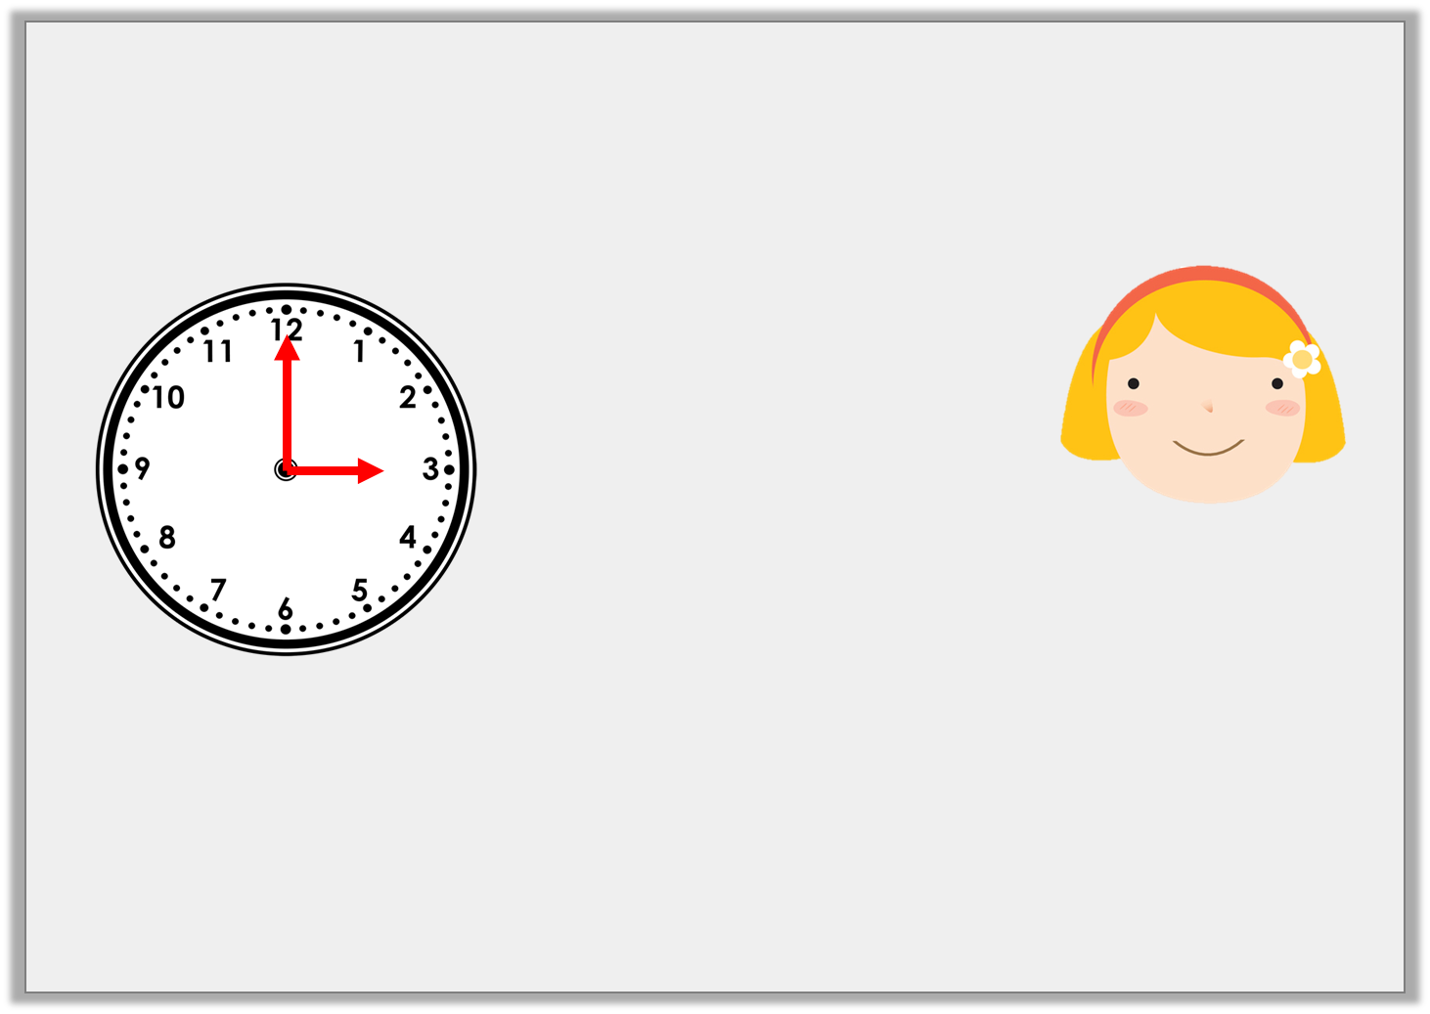
Reasoning 1
Ruby is looking for horizontal and vertical lines. The time is now:
Is she correct? Explain how you know.
Ruby is correct because at 3 o’clock the hour hand will be pointing to 3 so it will be horizontal and the minute hand will be pointing at 12 so it will be vertical.
In 10 minutes, one hand will be horizontal and one hand will be vertical.
Y3

Slide 35
Problem Solving 1
Anna and her friends are writing their names in capital letters.
Which friend has more vertical lines in the
letters of their name than Anna?
ANNA
BILL
TANYA
KYLIE
Y3

Slide 36
Problem Solving 1
Anna and her friends are writing their names in capital letters.
Which friend has more vertical lines in the
letters of their name than Anna?
4
ANNA
4
BILL
4
5
TANYA
KYLIE
Y3

Slide 37
Reasoning 2
Considering the lines of symmetry, which shape
is the odd one out?
Explain your answer.
T
+
Y3

Slide 38
Reasoning 2
Considering the lines of symmetry, which shape
is the odd one out?
Explain your answer.
The cross is the odd one out because…
T
+
Y3

Slide 39
Reasoning 2
Considering the lines of symmetry, which shape
is the odd one out?
Explain your answer.
The cross is the odd one out because it is the only shape with a horizontal and a vertical line of symmetry.
T
+
Y3

