Slide 1
Monday 6th July 2020
L.O: to solve problems involving pairs of values

Slide 2
Reasoning 1
a = 5b ÷ 2
c = a + 5.5
Sophie says:
Is she correct?
Explain your answer.
If b = 8 then c = 25.

Slide 3
Reasoning 1
a = 5b ÷ 2
c = a + 5.5
Sophie says:
Is she correct?
Explain your answer.
Sophie is not correct because…
If b = 8 then c = 25.

Slide 4
Reasoning 1
a = 5b ÷ 2
c = a + 5.5
Sophie says:
Is she correct?
Explain your answer.
Sophie is not correct because a = 40 ÷ 2 = 20, so c = 20 + 5.5 = 25.5.
If b = 8 then c = 25.

Slide 5
Problem Solving 1
Ryan is calculating the perimeter of a rectangle.
He is using the equation P = 2a + 2b.
When a = 12.5cm, he calculates that P = 45cm.
What is the value of b?
a
b
Not to scale

Slide 6
Problem Solving 1
Ryan is calculating the perimeter of a rectangle.
He is using the equation P = 2a + 2b.
When a = 12.5cm, he calculates that P = 45cm.
What is the value of b?
10cm
a
b
Not to scale

Slide 7
Reasoning 2
True or false?
a = (5b ÷ 2) – 8c
When b = 6 and c = 0.25,
a = 28.
Explain your answer.

Slide 8
Reasoning 2
True or false?
a = (5b ÷ 2) – 8c
When b = 6 and c = 0.25,
a = 28.
Explain your answer.
The answer is false because...

Slide 9
Reasoning 2
True or false?
a = (5b ÷ 2) – 8c
When b = 6 and c = 0.25,
a = 28.
Explain your answer.
The answer is false because a = (30 ÷ 2) – 2, so a = 15 – 2 = 13.

Slide 10
Tuesday 7th July 2020
L.O: to recognise and use formulae

Slide 11
Introduction
If = 20 and = 2.5, calculate:
+
+
x (
+ )
3

Slide 12
Introduction
If = 20 and = 2.5, calculate:
+
+
20 + 2.5 + 2.5 = 25
x (
+ )
20 x (2.5 + 2.5) = 100
3
3 x 2.5 = 7.5

Slide 13
Varied Fluency 1
Match each box on the left to the correct label.
R = 2x + p
formula
7 + 2f
calculation
10 = 100 ÷ 10
expression

Slide 14
Varied Fluency 1
Match each box on the left to the correct label.
R = 2x + p
formula
7 + 2f
calculation
10 = 100 ÷ 10
expression

Slide 15
Varied Fluency 2
Work out the perimeter (P) of this shape using the formula P = 2a + 2b, if a = 2.5cm and b = 3.5cm.
a
b

Slide 16
Varied Fluency 2
Work out the perimeter (P) of this shape using the formula P = 2a + 2b, if a = 2.5cm and b = 3.5cm.
12cm
a
b

Slide 17
Varied Fluency 3
Circle the correct formula for finding the area of a shape (A).
A = b x c
A = b + b + c + c
A = b ÷ c

Slide 18
Varied Fluency 3
Circle the correct formula for finding the area of a shape (A).
A = b x c
A = b + b + c + c
A = b ÷ c

Slide 19
Varied Fluency 4
A window cleaner is deciding how to charge for their services. They decide the price should be set at £1.20 per window (w) and £0.40 per mile (m) travelled.
Expressed as the formula:
A house has 10 windows and involves 5 miles travel. How much should the company charge?
C | = | (1.20 | x | w) | + | (0.4 | x | m)

Slide 20
Varied Fluency 4
A window cleaner is deciding how to charge for their services. They decide the price should be set at £1.20 per window (w) and £0.40 per mile (m) travelled.
Expressed as the formula:
A house has 10 windows and involves 5 miles travel. How much should the company charge?
C = (1.20 x 10) + (0.4 x 5) = 12 + 2 = £14
C | = | (1.20 | x | w) | + | (0.4 | x | m)

Slide 21
Wednesday 8th July 2020
L.O: to use formulae to solve problems

Slide 22
Problem Solving 1
Write a formula for the area of this shape.
Use your formula to work out the area if s = 3.5cm and t = 4cm.
t
s

Slide 23
Problem Solving 1
Write a formula for the area of this shape.
Use your formula to work out the area if s = 3.5cm and t = 4cm.
a = s x t = 3.5cm x 4cm = 14cm²
t
s

Slide 24
Reasoning 1
Here is a formula for amount of fabric needed (F) to make a pair of curtains.
A window is 5.4 metres wide (w) and 1 metre high (h). Jamie has 4m² of fabric.
Does Jamie have enough fabric? Convince me!
F | = | 2w | x | h

Slide 25
Reasoning 1
Here is a formula for amount of fabric needed (F) to make a pair of curtains.
A window is 5.4 metres wide (w) and 1 metre high (h). Jamie has 4m² of fabric.
Does Jamie have enough fabric? Convince me!
Jamie does not have enough fabric because…
F | = | 2w | x | h

Slide 26
Reasoning 1
Here is a formula for amount of fabric needed (F) to make a pair of curtains.
A window is 5.4 metres wide (w) and 1 metre high (h). Jamie has 4m² of fabric.
Does Jamie have enough fabric? Convince me!
Jamie does not have enough fabric because:
F = (2 x 5.4) x 1 = 10.8 x 1 = 10.8m²
F | = | 2w | x | h

Slide 27
Reasoning 2
The children’s pocket money (p) is calculated by halving their age (a) and adding 10.
Which two formulae represent this?
Explain how you know.
A. | p | = | 0.5a | + | 10
B. | p | = | 2a | + | 10
C. | p | = | a | + | 10
 |  |  | 2

Slide 28
Reasoning 2
The children’s pocket money (p) is calculated by halving their age (a) and adding 10.
Which two formulae represent this?
Explain how you know.
A and C because…
A. | p | = | 0.5a | + | 10
B. | p | = | 2a | + | 10
C. | p | = | a | + | 10
 |  |  | 2

Slide 29
Reasoning 2
The children’s pocket money (p) is calculated by halving their age (a) and adding 10.
Which two formulae represent this?
Explain how you know.
A and C because finding a half can be achieved by multiplying by 0.5 or dividing by 2.
A. | p | = | 0.5a | + | 10
B. | p | = | 2a | + | 10
C. | p | = | a | + | 10
 |  |  | 2

Slide 30
Thursday 9th July 2020
L.O: to use algebraic equations to represent word problems
(*Varied Fluency for year 5 & 6)
*Today’s lesson has Varied Fluency for year 5 and 6; however, year 6 also has Reasoning and Problem Solving after this Varied Fluency

Slide 31
Introduction
Mason is creating word problems from equations which have been built in stages. Can you match the word problems to the equations?
Can you create a word problem for the remaining equation?
I think of a number. I add 14. My answer is 20.
n | n – 8 | n – 8 = 17
I think of a number. I subtract 8. My answer is 17.
n | 2n | 2n + 10 | 2n + 10 = 18
n | n + 14 | n + 14 = 20

Slide 32
Introduction
Mason is creating word problems from equations which have been built in stages. Can you match the word problems to the equations?
Can you create a word problem for the remaining equation?
I think of a number. I add 14. My answer is 20.
n | n – 8 | n – 8 = 17
I think of a number. I subtract 8. My answer is 17.
n | 2n | 2n + 10 | 2n + 10 = 18
I think of a number. I multiply it by 2. I add 10. My answer is 18.
n | n + 14 | n + 14 = 20

Slide 33
Varied Fluency 1
Use the equation below to fill in the gaps in the word problem.
p ÷ 3 = 9
I think of a number. I divide it by _____ and my answer is _____ .

Slide 34
Varied Fluency 1
Use the equation below to fill in the gaps in the word problem.
p ÷ 3 = 9
I think of a number. I divide it by 3 and my answer is 9.

Slide 35
Varied Fluency 2
In which of the options below does the unknown value equal 4?
A. 25 - w = 21
B.
C. Kerry had 17 sweets. Miles stole some. Kerry has 13 sweets left. How many did Miles steal?
=

Slide 36
Varied Fluency 2
In which of the options below does the unknown value equal 4?
A. 25 - w = 21
B.
C. Kerry had 17 sweets. Miles stole some. Kerry has 13 sweets left. How many did Miles steal?
A and C
=

Slide 37
Varied Fluency 3
Circle the equation which matches the word problem below:
Theo thinks of a number. He multiplies it by 4 and then subtracts 3. His answer is 13. What was his starting number?
3n – 4 = 13 | 4n – 3 = 13 | 4 – 3 = 13

Slide 38
Varied Fluency 3
Circle the equation which matches the word problem below:
Theo thinks of a number. He multiplies it by 4 and then subtracts 3. His answer is 13. What was his starting number?
3n – 4 = 13 | 4n – 3 = 13 | 4 – 3 = 13

Slide 39
Varied Fluency 4
True or false? The equation matches the word problem below.
28 = b + 17
Tana lines up 28 building blocks. The blocks are yellow or blue. She uses 17 yellow blocks. How many blue blocks does she use?

Slide 40
Continued
L.O: to use algebraic equations to represent word problems
(*Reasoning and Problem Solving for year 6)
* The slides from here are for the year 6 to complete - Reasoning and Problem Solving
Y6

Slide 41
Problem Solving 1
Use some of the cards to create an algebraic equation.
Draw an image using concrete materials and write a word problem to match the equation created.
2.5
+
÷
7
4
Y6

Slide 42
Problem Solving 1
Use some of the cards to create an algebraic equation.
Draw an image using concrete materials and write a word problem to match the equation created.
Various answers, for example: n ÷ 7 = 2.5.
The image and word problem must match the equation.
2.5
+
÷
7
4
Y6

Slide 43
Reasoning 1
Which is the odd one out?
A. I think of a number. I multiply it by 4. I add 3. My answer is 11.
B.
C. 3n + 8 = 11
Explain your answer.
=
Y6

Slide 44
Reasoning 1
Which is the odd one out?
A. I think of a number. I multiply it by 4. I add 3. My answer is 11.
B.
C. 3n + 8 = 11
Explain your answer.
Option C because…
=
Y6

Slide 45
Reasoning 1
Which is the odd one out?
A. I think of a number. I multiply it by 4. I add 3. My answer is 11.
B.
C. 3n + 8 = 11
Explain your answer.
Option C because the unknown number is 1. In the other options it is 2.
=
Y6

Slide 46
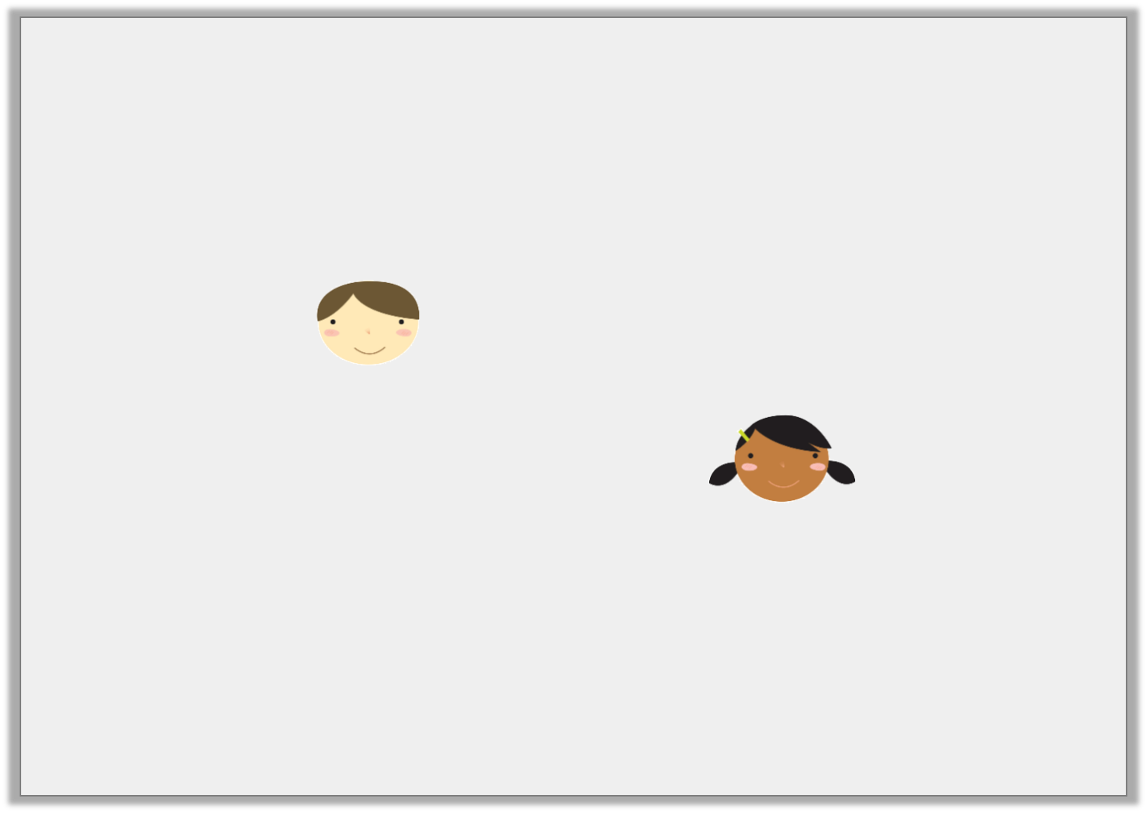
Reasoning 2
Dan and Sangeet are creating word problems based on the equation below.
4e + f = 156
Who is incorrect? Explain your answer.
I put 4 marbles and one toy car on a scale. Together they weigh 156g.
Dan
I think of a number. I add another number to it and multiply by 4 to make 156.
Sangeet
Y6

Slide 47
Reasoning 2
Dan and Sangeet are creating word problems based on the equation below.
4e + f = 156
Who is incorrect? Explain your answer.
Sangeet is incorrect because…
I put 4 marbles and one toy car on a scale. Together they weigh 156g.
Dan
I think of a number. I add another number to it and multiply by 4 to make 156.
Sangeet
Y6

Slide 48
Reasoning 2
Dan and Sangeet are creating word problems based on the equation below.
4e + f = 156
Who is incorrect? Explain your answer.
Sangeet is incorrect because she only needs to multiply e (the marbles) by 4. Her order of operations is incorrect.
I put 4 marbles and one toy car on a scale. Together they weigh 156g.
Dan
I think of a number. I add another number to it and multiply by 4 to make 156.
Sangeet
Y6

Slide 49
Friday 10th July 2020
L.O: to use one step equations
(*Varied Fluency for year 5 & 6)
*Today’s lesson has Varied Fluency for year 5 and 6; however, year 6 also has Reasoning and Problem Solving after the Varied Fluency slides
*Please review how to solve a one-step equation before going through the slides:
https://www.youtube.com/watch?v=L0_K89UJfJY&t=343s

Slide 50
Introduction
Match the word problems to the correct representation.
Can you work out the missing values?
I think of a number and double it. The answer is 10.
6 = a - 12
I think of a number. I divide it by 4 and the answer is 4.
2c = 10
I think of a number. I subtract 12 and the answer is 6.
b ÷ 4 = 4

Slide 51
Introduction
Match the word problems to the correct representation.
Can you work out the missing values? a = 18, b = 16, c = 5
I think of a number and double it. The answer is 10.
6 = a - 12
I think of a number. I divide it by 4 and the answer is 4.
2c = 10
I think of a number. I subtract 12 and the answer is 6.
b ÷ 4 = 4

Slide 52
Varied Fluency 1
True or false?
The value of a is the same in both equations.
5a = 60
120 ÷ 10 = a

Slide 53
Varied Fluency 1
True or false?
The value of a is the same in both equations.
5a = 60
120 ÷ 10 = a
True; a = 12

Slide 54
Varied Fluency 2
Which concrete representation matches the equation m + 5?
A.
B.
C.

Slide 55
Varied Fluency 2
Which concrete representation matches the equation m + 5?
B
A.
B.
C.

Slide 56
Varied Fluency 3
Compare the value of a in each equation using <, > or =.
2a = 30 |  | a – 11 = 10 |  | 4 + a = 20

Slide 57
Varied Fluency 3
Compare the value of a in each equation using <, > or =.
2a = 30 | < | a – 11 = 10 | > | 4 + a = 20

Slide 58
Varied Fluency 4
What numbers would balance these equations?
a. | t x 6 = 36
b. | 12 – a = 3
c. | 11 + n = 19

Slide 59
Varied Fluency 4
What numbers would balance these equations?
t = 6, a = 9, n = 8
a. | t x 6 = 36
b. | 12 – a = 3
c. | 11 + n = 19

Slide 60
Continued
L.O: to use one step equations
(*Reasoning and Problem Solving for year 6)
* The slides from here are for the year 6 to complete - Reasoning and Problem Solving

Slide 61
Reasoning 1
Saif is solving the equation f + 14 = 29.
Saif says:
Is he correct? Explain your answer.
f = 43 because
29 + 14 = 43.
Y6

Slide 62
Reasoning 1
Saif is solving the equation f + 14 = 29.
Saif says:
Is he correct? Explain your answer.
Saif is incorrect because…
f = 43 because
29 + 14 = 43.
Y6

Slide 63
Reasoning 1
Saif is solving the equation f + 14 = 29.
Saif says:
Is he correct? Explain your answer.
Saif is incorrect because you need to balance the equation by taking away 14 from 29, rather than adding it.
f = 43 because
29 + 14 = 43.
Y6

Slide 64
Reasoning 2
Dana has created a concrete representation for the following equation:
Is Dana correct? Convince me!
2b = 8
Y6

Slide 65
Reasoning 2
Dana has created a concrete representation for the following equation:
Is Dana correct? Convince me!
Dana is incorrect because…
2b = 8
Y6

Slide 66
Reasoning 2
Dana has created a concrete representation for the following equation:
Is Dana correct? Convince me!
Dana is incorrect because b = 4. Both cups should therefore contain 4 counters.
2b = 8
Y6

Slide 67
Problem Solving 1
Create three different equations that will balance the scale when
x = 5.
10x + 7
Y6

Slide 68
Problem Solving 1
Create three different equations that will balance the scale when
x = 5.
Various possible answers, for example:
25 x 2 + 7, 50 + 7, 60 – 3.
10x + 7
Y6

