Slide 1
Year 3/4 – Summer Block 3 – Properties of Shape
Tuesday 7th July 2020
Step 2
Year 3: I can identify right angles in shapes

Slide 2
Introduction
Look around your classroom.
Name some objects that have a right angle in them.
Y3

Slide 3
Introduction
Look around your classroom.
Name some objects that have a right angle in them.
Example answers:
Door frames, windowsills, shelves, book covers, walls.
Y3

Slide 4
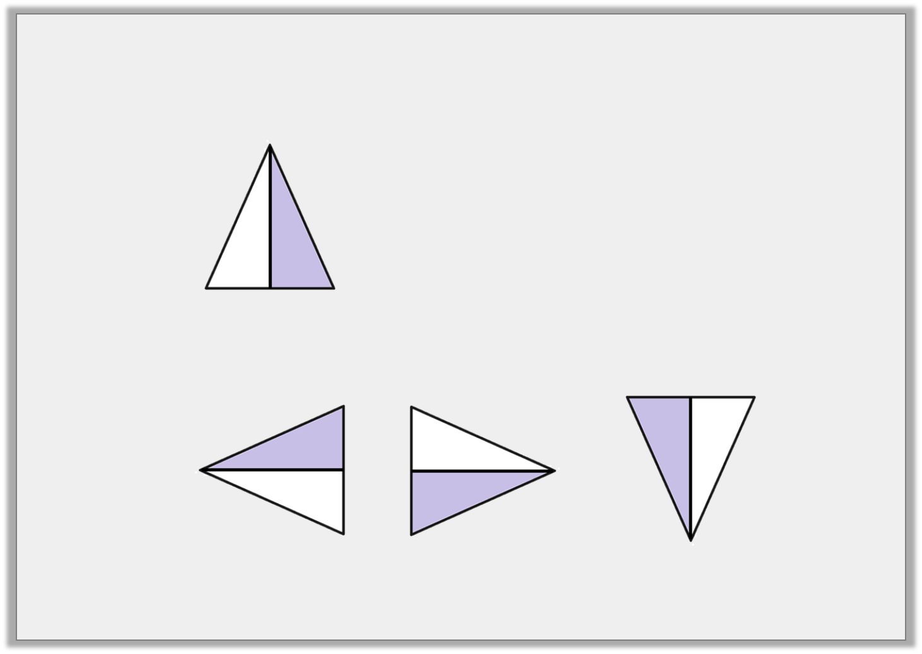
Varied Fluency 1
Tick the shape that has turned one right angle anti-clockwise.
Start:
Finish:
Y3

Slide 5
Varied Fluency 1
Tick the shape that has turned one right angle anti-clockwise.
Start:
Finish:
✓
Y3

Slide 6
Varied Fluency 2
Tick any shapes that contain right angles.
Y3

Slide 7
Varied Fluency 2
Tick any shapes that contain right angles.
✓
✓
Y3

Slide 8
Varied Fluency 3
How many right angles are in each shape?
Y3

Slide 9
Varied Fluency 3
How many right angles are in each shape?
3
2
4
0
Y3

Slide 10
Varied Fluency 4
This shape has 2 right angles. True or false?
Y3

Slide 11
Varied Fluency 4
This shape has 2 right angles. True or false?
True
Y3

Slide 12
I can solve problems and reason to identify right angles in shapes
Wednesday 8th July 2020

Slide 13
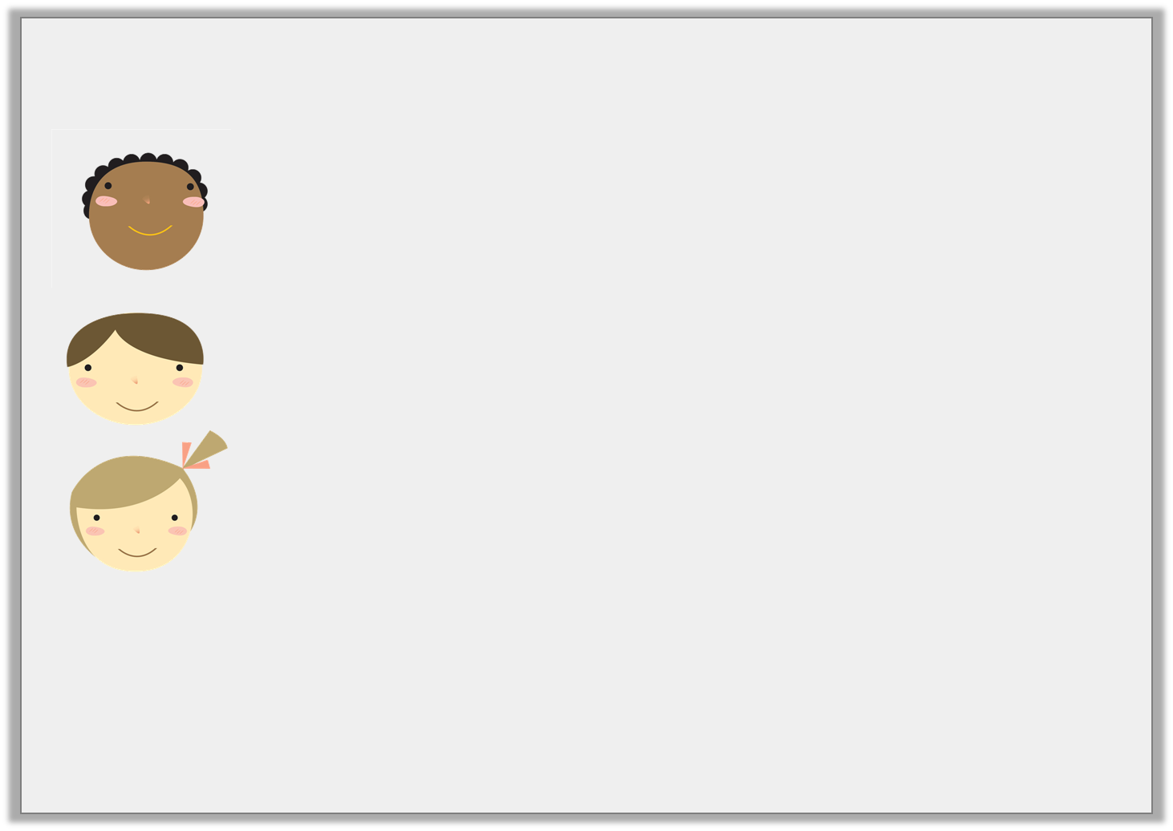
Problem Solving 1
Match the statements to the correct shape.
My shape has half the number of right angles as Sam’s shape.
Courtney
My shape has enough right angles to complete 1 full turn.
Sam
Sam’s shape has four more right angles than mine.
Lila
Y3

Slide 14
Problem Solving 1
Match the statements to the correct shape.
My shape has half the number of right angles as Sam’s shape.
Courtney
My shape has enough right angles to complete 1 full turn.
Sam
Sam’s shape has four more right angles than mine.
Lila
Y3

Slide 15
Problem Solving 2
Sort the shapes into the Carroll Diagram.
 | Has fewer than 3 right angles | Has 3 or more right angles
Has at least 4 sides
Does not have 4 sides
Y3

Slide 16
Problem Solving 2
Sort the shapes into the Carroll Diagram.
 | Has fewer than 3 right angles | Has 3 or more right angles
Has at least 4 sides
Does not have 4 sides
Y3

Slide 17
Reasoning 1
Which shape is the odd one out?
Explain why.
A
B
C
D
Y3

Slide 18
Reasoning 1
Which shape is the odd one out?
Explain why.
D is the odd one out because …
A
B
C
D
Y3

Slide 19
Reasoning 1
Which shape is the odd one out?
Example answer:
Explain why.
D is the odd one out because it is the only shape without right angles.
A
B
C
D
Y3

Slide 20
Y3/4 – Summer Block 4 – Shape
Step 3
Thursday 9th July 2020
Year 3: I can compare angles

Slide 21
Introduction
Make a table to show which times make acute angles,
obtuse angles or right angles between the hour hand
and the minute hand.
9:00
10:45
11:15
8:55
3:40
3:00
Y3

Slide 22
Introduction
Make a table to show which times make acute angles,
obtuse angles or right angles between the hour hand
and the minute hand.
9:00
10:45
11:15
8:55
3:40
3:00
Acute angles | Obtuse angles | Right angles
10:45 8:55 | 3:40 11:15 | 9:00 3:00
Y3

Slide 23
Varied Fluency 1
Label each of these angles as either obtuse, acute or right angle.
Y3

Slide 24
Varied Fluency 1
Label each of these angles as either obtuse, acute or right angle.
obtuse
right angle
acute
Y3

Slide 25
Varied Fluency 2
Draw four different acute angles.
90° angle cut out given for reference.
Y3

Slide 26
Varied Fluency 2
Draw four different acute angles.
Various possible answers, for example:
1
2
3
90° angle cut out given for reference.
4
Y3

Slide 27
Varied Fluency 3
Label all the angles in this shape as obtuse, acute or right angle.
Y3

Slide 28
Varied Fluency 3
Label all the angles in this shape as obtuse, acute or right angle.
right
obtuse
obtuse
obtuse
obtuse
right
Y3

Slide 29
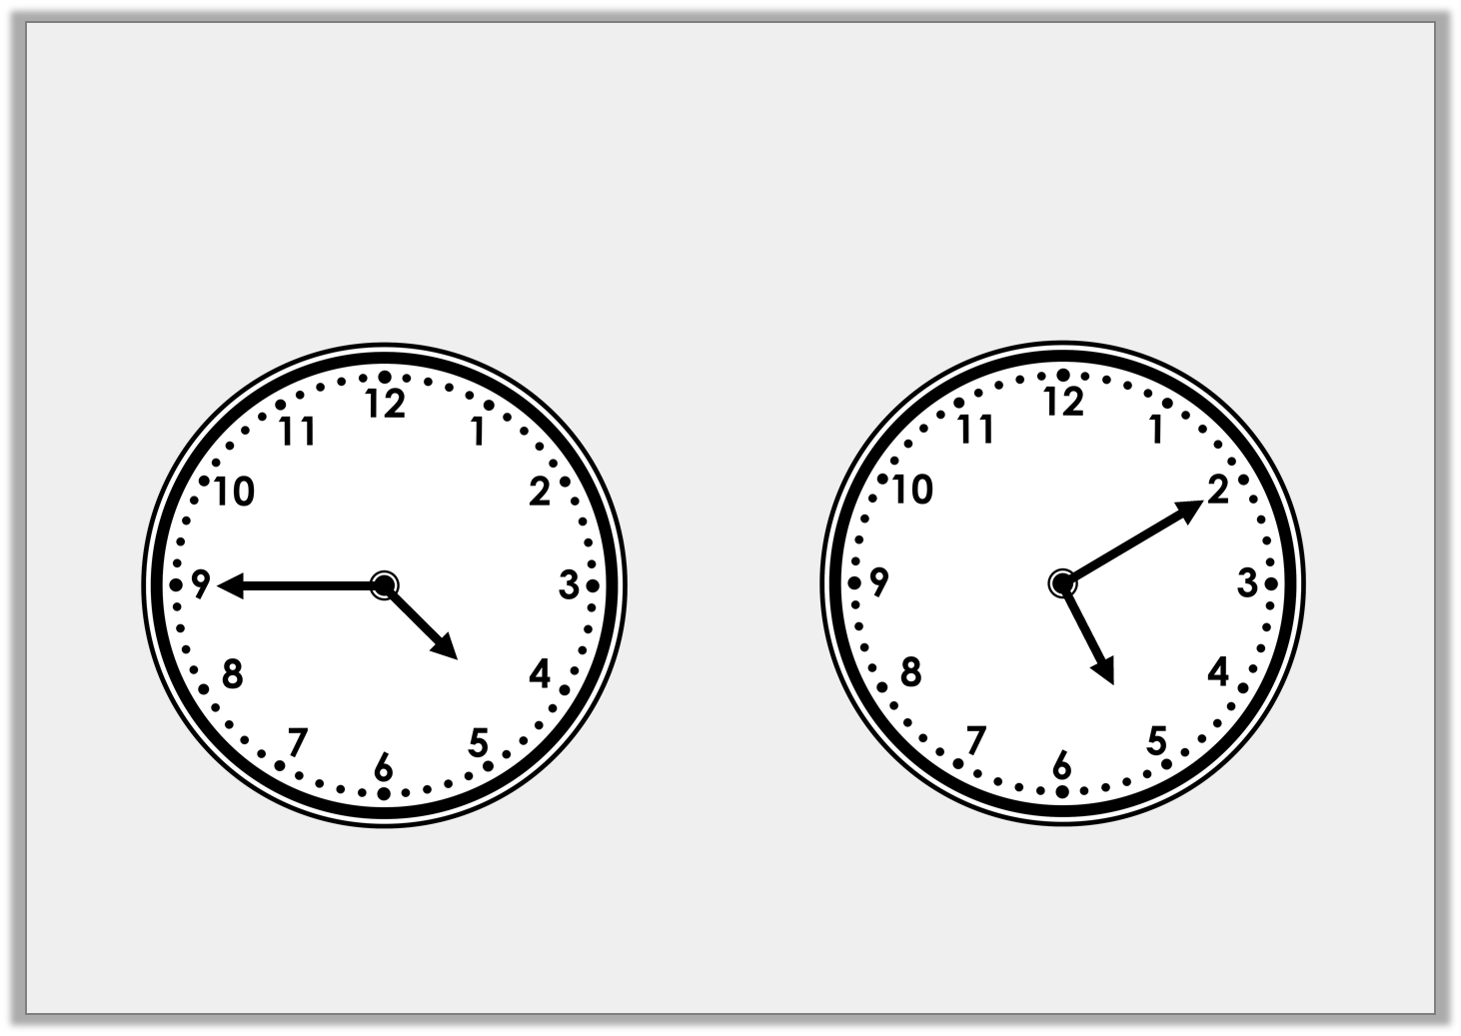
Varied Fluency 4
Has the minute hand moved through an acute or obtuse angle to get from a to b?
a
b
Y3

Slide 30
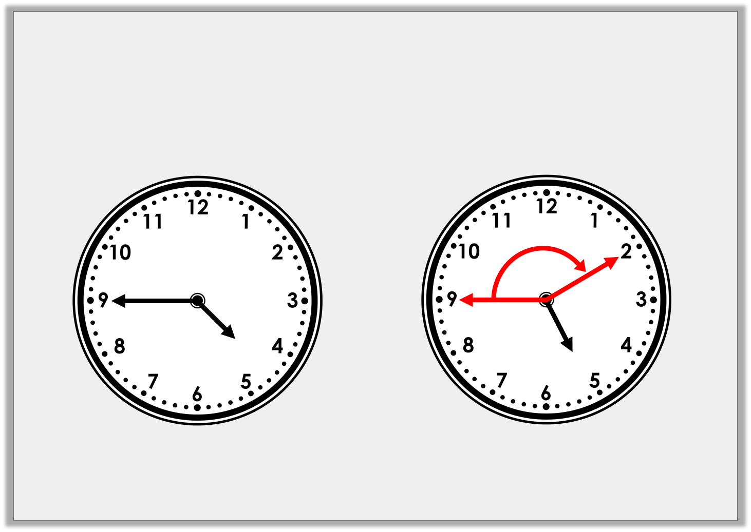
Varied Fluency 4
Has the minute hand moved through an acute or obtuse angle to get from a to b?
Obtuse
a
b
Y3

Slide 31
Step 3 Thursday 9th July 2020 Year 3: I can solve problems by comparing angles

Slide 32
Reasoning 1
Year 3 have been asked to describe the angles in this shape:
Who is correct? Explain how you know.
All of this shape’s internal
angles are right angles.
Mo
This shape has 6 internal
angles altogether.
Lily
Y3

Slide 33
Reasoning 1
Year 3 have been asked to describe the angles in this shape:
Who is correct? Explain how you know.
Lily is correct because…
All of this shape’s internal
angles are right angles.
Mo
This shape has 6 internal
angles altogether.
Lily
Y3

Slide 34
Reasoning 1
Year 3 have been asked to describe the angles in this shape:
Who is correct? Explain how you know.
Lily is correct because this shape has 6 corners. Mo is incorrect because the shape is not a rectangle, therefore, all of its internal angles cannot be 90°.
All of this shape’s internal
angles are right angles.
Mo
This shape has 6 internal
angles altogether.
Lily
Y3

Slide 35
Problem Solving 1
Which of these shapes contains the smallest angle?
A
C
B
Y4

Slide 36
Problem Solving 1
Which of these shapes contains the smallest angle?
A
C
B
Y4

