Slide 1
Year 1/2 – Autumn Block 2 – Addition and Subtraction
Step 2
Year 1: Number Bonds to 10
Year 2: Check Calculations

Slide 2
Introduction
Write four calculations that represent each bar model.
6
5 | 1
14
5 | 9
Y2

Slide 3
Introduction
Write four calculations that represent each bar model.
6
5 | 1
14
5 | 9
1 + 5 = 6
5 + 1 = 6
6 – 1 = 5
6 – 5 = 1
9 + 5 = 14
5 + 9 = 14
14 – 9 = 5
14 – 5 = 9
Y2

Slide 4
Varied Fluency 1
Circle the facts that you could use to check:
20 – 7 = 13
a.
b.
c.
13 + 7 = 20
20 – 17 = 3
7 + 13 = 20
Y2

Slide 5
Varied Fluency 1
Circle the facts that you could use to check:
20 – 7 = 13
a.
b.
c.
13 + 7 = 20
20 – 17 = 3
7 + 13 = 20
Y2

Slide 6
Varied Fluency 2
True or false?
8 + 6 = 12
12 – 6 = 8
 |  |  | 
 |  |  | 
 |  | 
 |  | 
Y2

Slide 7
Varied Fluency 2
True or false?
False. It should be 8 + 6 = 14 and 14 – 6 = 8
8 + 6 = 12
12 – 6 = 8
 |  |  | 
 |  |  | 
 |  | 
 |  | 
Y2

Slide 8
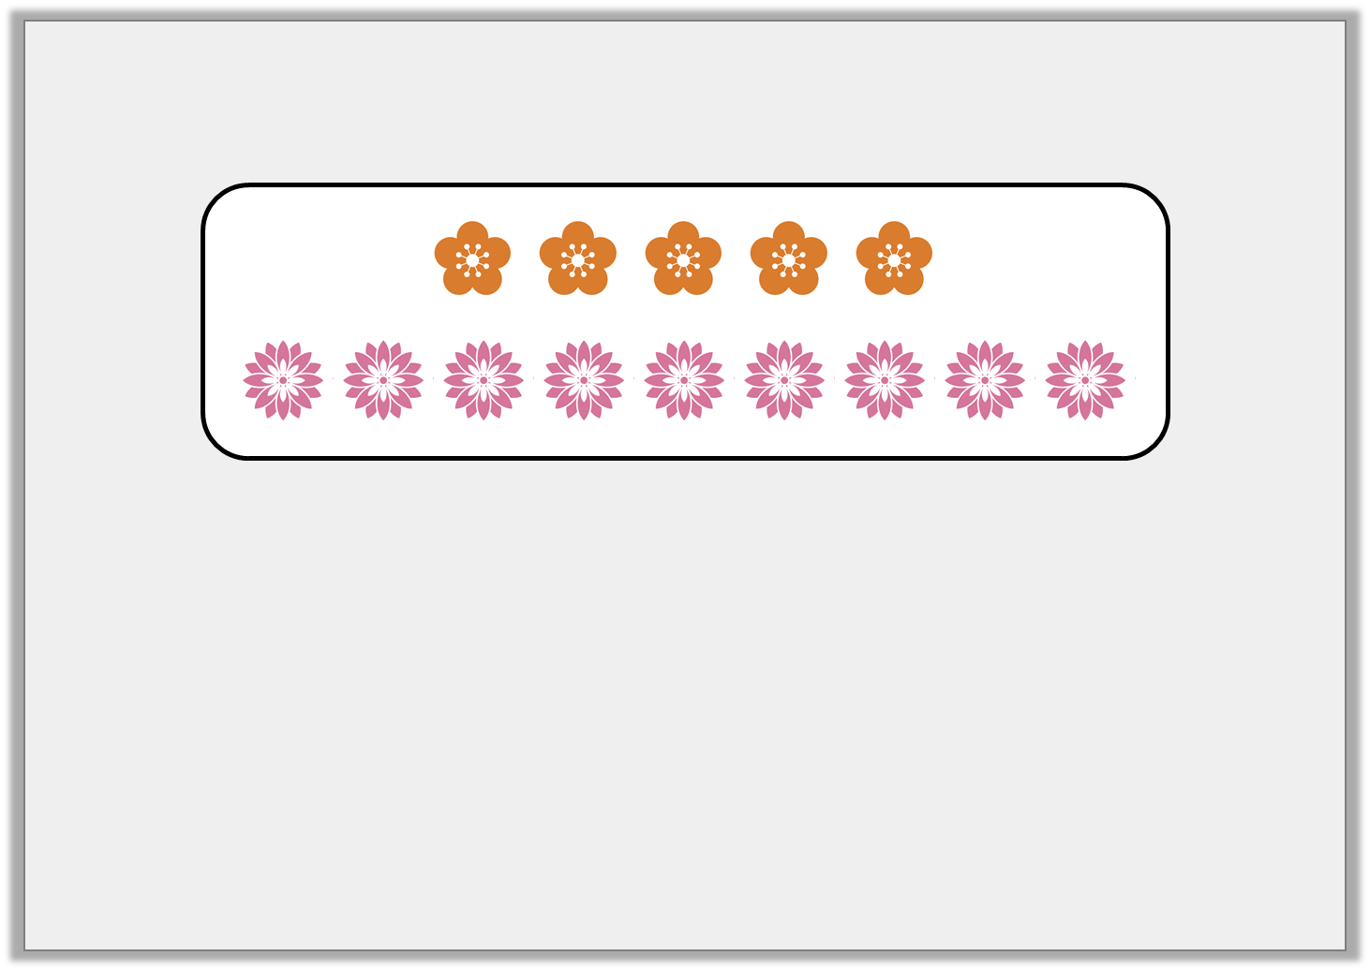
Varied Fluency 3
Tick all of the calculations that match this image.
 | 5 + 9 = 14 |  |  | 10 – 6 = 4
 | 14 – 9 = 5 |  |  | 14 – 5 = 9
Y2

Slide 9
Varied Fluency 3
Tick all of the calculations that match this image.
✓ | 5 + 9 = 14 |  |  | 10 – 6 = 4
✓ | 14 – 9 = 5 |  | ✓ | 14 – 5 = 9
Y2

Slide 10
Varied Fluency 4
How can you check this calculation using addition?
15 – 14 = 1
 |  |  |  | 
 |  |  |  | 
 |  | 
 | 
Y2

Slide 11
Varied Fluency 4
How can you check this calculation using addition?
14 + 1 = 15
1 + 14 = 15
15 – 14 = 1
 |  |  |  | 
 |  |  |  | 
 |  | 
 | 
Y2

Slide 12
Reasoning 1
Which is the odd one out?
Explain your answer.
20
18
18 + 2 = 20
2
20
18 | 2
20 – 5 = 15
Y2

Slide 13
Reasoning 1
Which is the odd one out?
Explain your answer.
20 – 5 = 15 is the odd one out because…
20
18
18 + 2 = 20
2
20
18 | 2
20 – 5 = 15
Y2

Slide 14
Reasoning 1
Which is the odd one out?
Explain your answer.
20 – 5 = 15 is the odd one out because the other three represent number facts for 18 + 2 = 20.
20
18
18 + 2 = 20
2
20
18 | 2
20 – 5 = 15
Y2

Slide 15
Reasoning 2
Kayla says,
I know that 10 + 4 = 14 because 14 – 4 = 10.
 |  |  |  | 
 |  |  |  | 
 | 
 | 
Is her method correct? Convince me.
Y2

Slide 16
Reasoning 2
I know that 10 + 4 = 14 because 14 – 4 = 10.
 |  |  |  | 
 |  |  |  | 
 | 
 | 
Is her method correct? Convince me.
Yes, Kayla is correct because…
Y2

Slide 17
Reasoning 2
I know that 10 + 4 = 14 because 14 – 4 = 10.
 |  |  |  | 
 |  |  |  | 
 | 
 | 
Is her method correct? Convince me.
Yes, Kayla is correct because she has used the inverse operation and her knowledge of fact families for 10, 4 and 14 to check her calculation.
Y2

Slide 18
Problem Solving 1
Rewrite the following to make it a subtraction word problem.
I already have 9 cherries in the tub.
Then I put 6 more cherries in.
Now I have 15 cherries all together.
Y2

Slide 19
Problem Solving 1
Rewrite the following to make it a subtraction word problem.
I already have 9 cherries in the tub.
Then I put 6 more cherries in.
Now I have 15 cherries all together.
I have 15 cherries in the tub.
I take out 6 cherries.
I have 9 cherries left.
Y2

