Slide 1
Year 1/2 – Autumn Block 2 – Addition and Subtraction
Step 2
Year 1: Number Bonds to 10
Year 2: Check Calculations

Slide 2
Introduction
Fill in the missing numbers:
0 | 1 | 2 |  | 4 | 5 |  | 7 | 8 |  | 10
0 | 1 |  | 3 | 4 |  | 6 |  |  | 9 | 10
0 |  | 2 | 3 |  | 5 |  | 7 | 8
Y1

Slide 3
Introduction
Fill in the missing numbers:
0 | 1 | 2 | 3 | 4 | 5 | 6 | 7 | 8 | 9 | 10
0 | 1 | 2 | 3 | 4 | 5 | 6 | 7 | 8 | 9 | 10
0 | 1 | 2 | 3 | 4 | 5 | 6 | 7 | 8 | 9 | 10
Y1

Slide 4
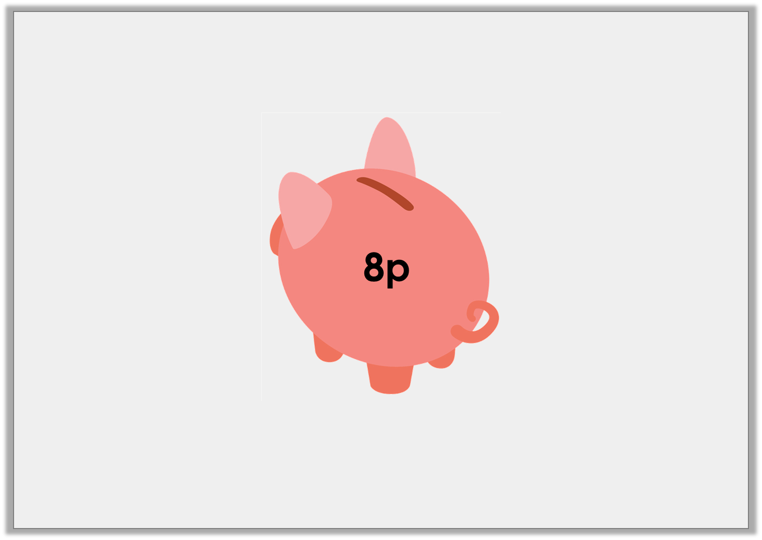
Varied Fluency 1
Molly needs 10p. How many more pennies must she save?
Y1
© Classroom Secrets Limited 2018

Slide 5
Varied Fluency 1
Molly needs 10p. How many more pennies must she save?
Molly must save 2 more pennies.
Y1
© Classroom Secrets Limited 2018

Slide 6
Varied Fluency 2
Match the number cards which bond together to make 10.
3 |  | 8
2 |  | 7
Y1

Slide 7
Varied Fluency 2
Match the number cards which bond together to make 10.
3 + 7 = 10
2 + 8 = 10
3 |  | 8
2 |  | 7
Y1

Slide 8
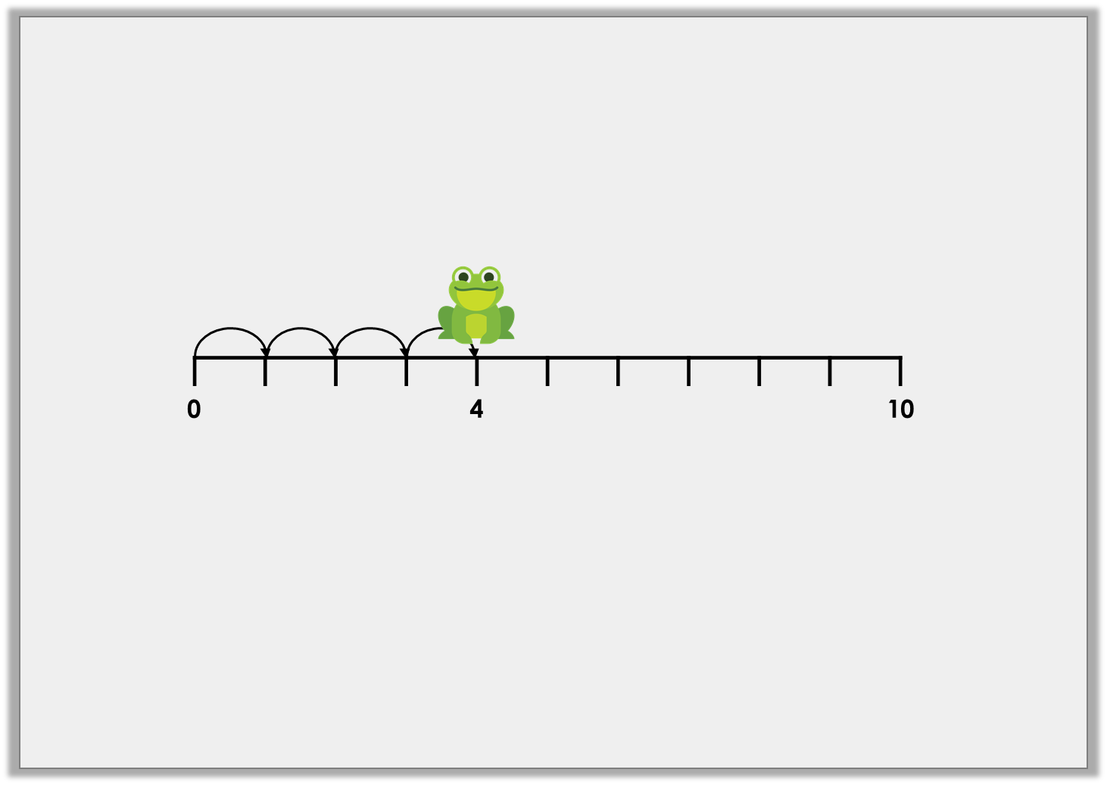
Varied Fluency 3
The frog needs to reach 10. How many more jumps must he make?
4 | + |  | = | 10
Y1

Slide 9
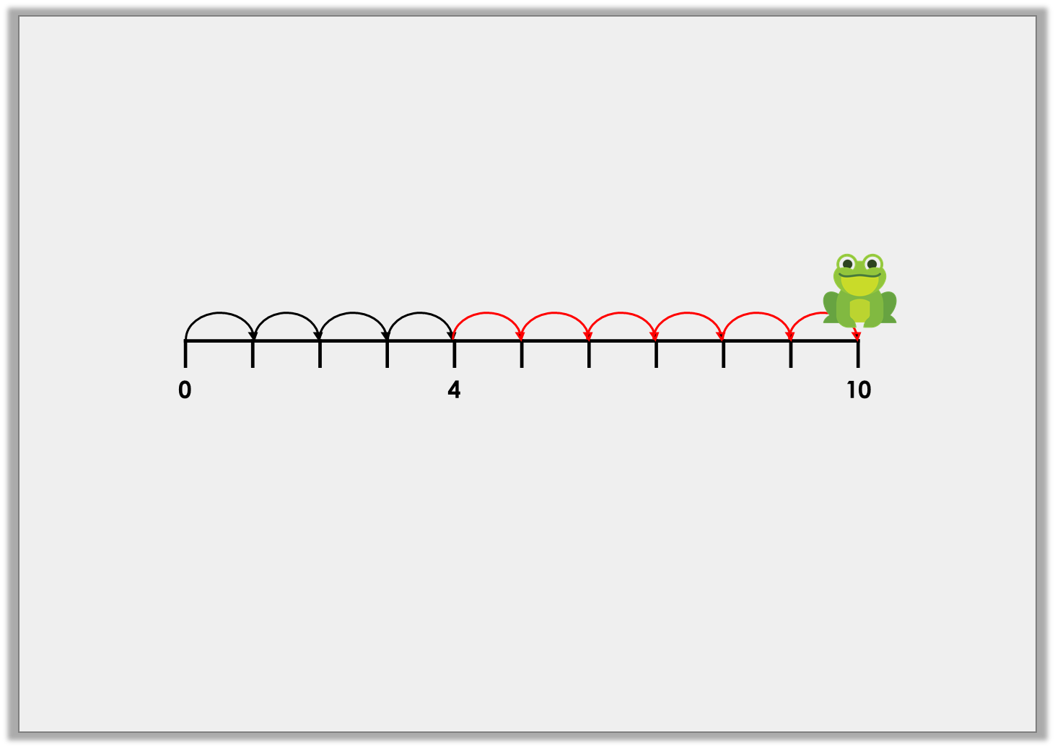
Varied Fluency 3
The frog needs to reach 10. How many more jumps must he make?
4 | + | 6 | = | 10
Y1
© Classroom Secrets Limited 2018

Slide 10
Varied Fluency 4
Find the pattern and fill in the missing numbers.
2 | + |  | = | 10
3 | + |  | = | 10
4 | + |  | = | 10
5 | + |  | = | 10
6 | + |  | = | 10
Y1

Slide 11
Varied Fluency 4
Find the pattern and fill in the missing numbers.
2 | + | 8 | = | 10
3 | + | 7 | = | 10
4 | + | 6 | = | 10
5 | + | 5 | = | 10
6 | + | 4 | = | 10
Y1

Slide 12
Problem Solving 1
Matt collects cards which are worth points.
He wants to collect 10 points.
Find 2 answers.
Y1

Slide 13
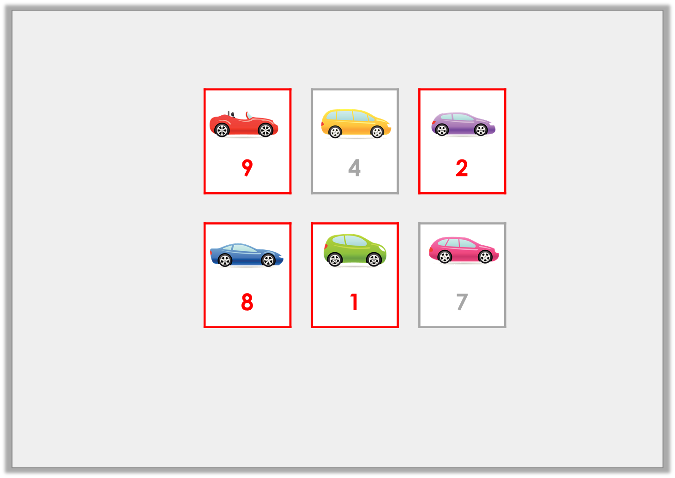
Problem Solving 1
Matt collects cards which are worth points.
He wants to collect 10 points.
Find 2 answers.
9 + 1 = 10 and 2 + 8 = 10
Y1

Slide 14
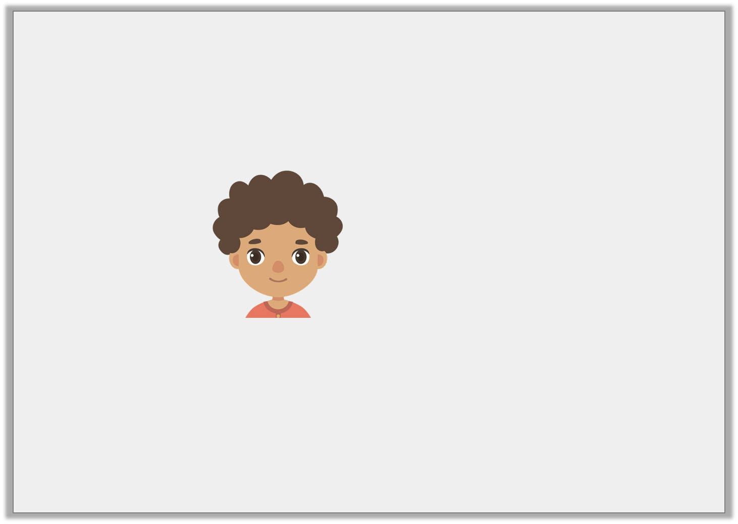
Reasoning 1
Fred needs 10 eggs.
Is he correct? Explain your answer.
I have 1 egg.
I need 8 more.
Y1

Slide 15
Reasoning 1
Fred needs 10 eggs.
Is he correct? Explain your answer.
Fred is not correct because . . .
I have 1 egg.
I need 8 more.
Y1

Slide 16
Reasoning 1
Fred needs 10 eggs.
Is he correct? Explain your answer.
Fred is not correct because 1 + 8 = 9
I have 1 egg.
I need 8 more.
Y1

Slide 17
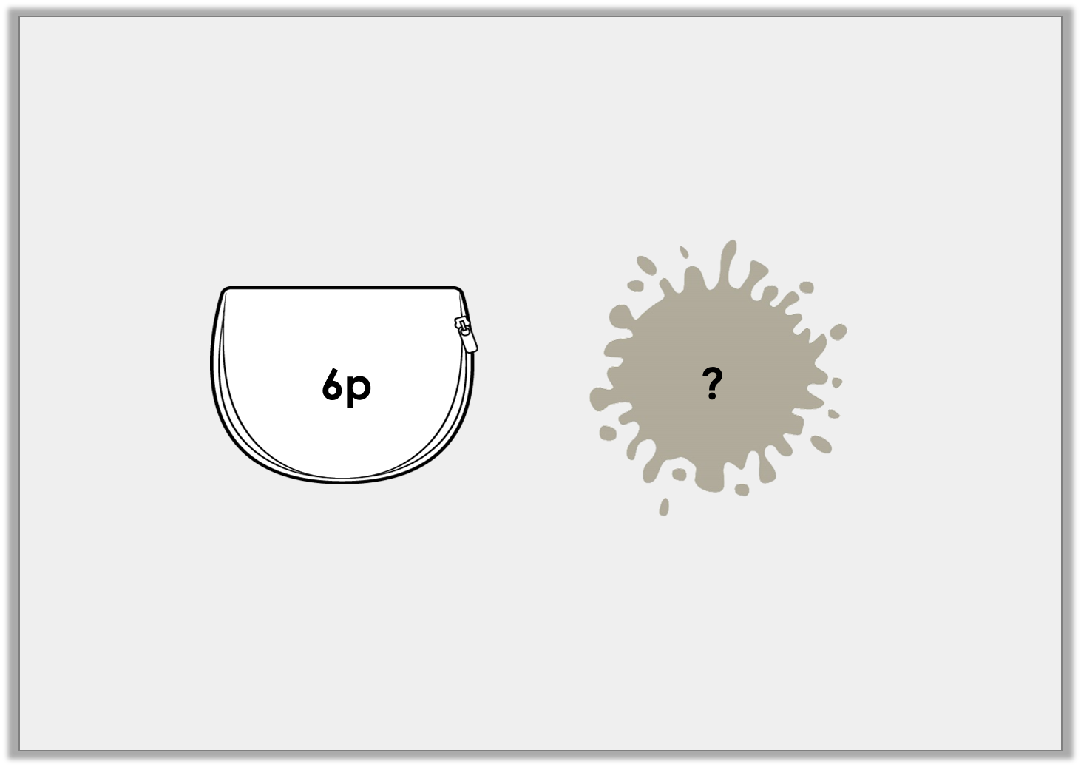
Problem Solving 2
Sam had 10p. He dropped some pennies in the mud. How many did he drop?
Y1

Slide 18
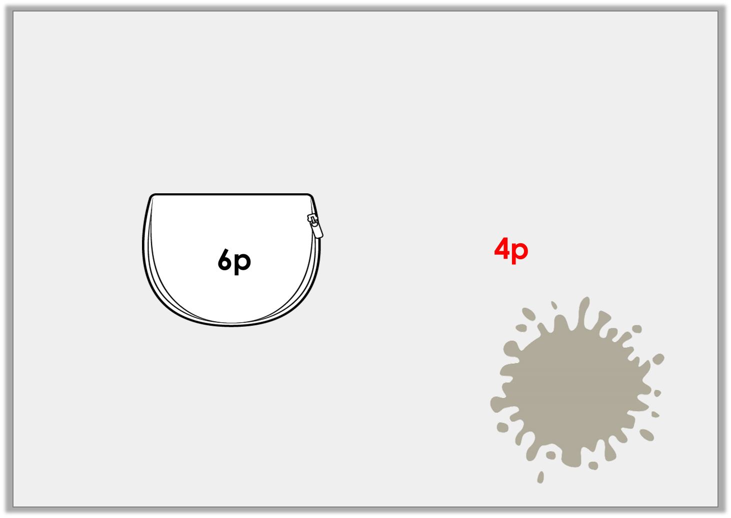
Problem Solving 2
Sam had 10p. He dropped some pennies in the mud. How many did he drop?
Y1

