Slide 1
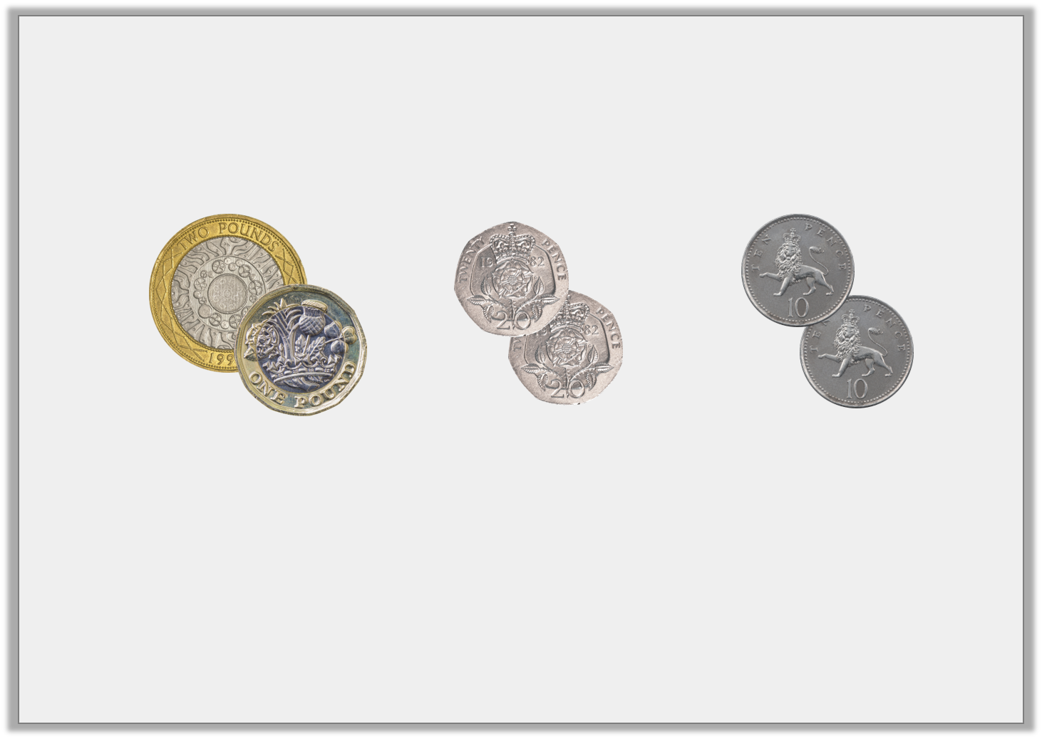
Varied Fluency 3
Circle the set with the most value.
Y1

Slide 2
Varied Fluency 3
Circle the set with the most value.
£3
40p
20p
Y1

Slide 3
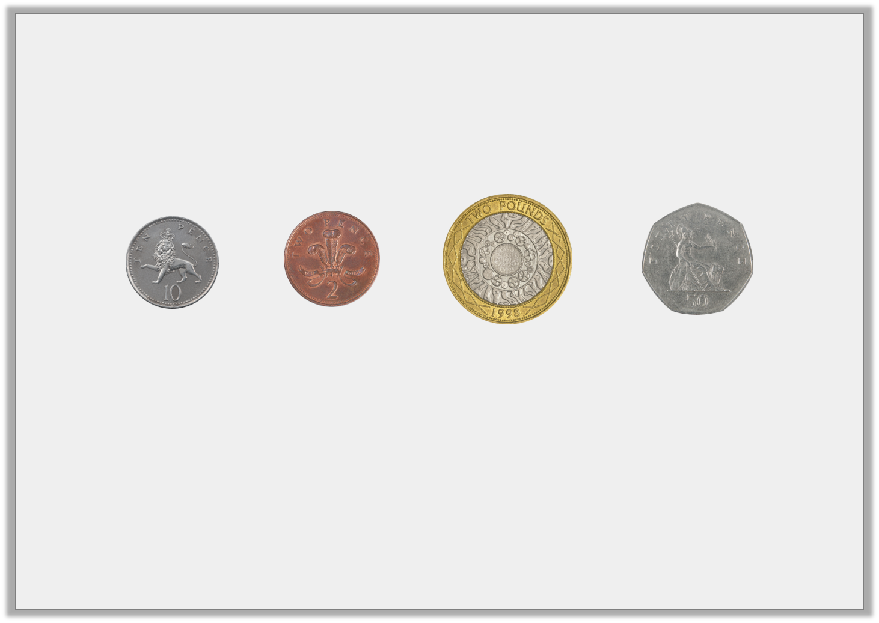
Varied Fluency 4
Order the coins from least to most value.
Y1

Slide 4
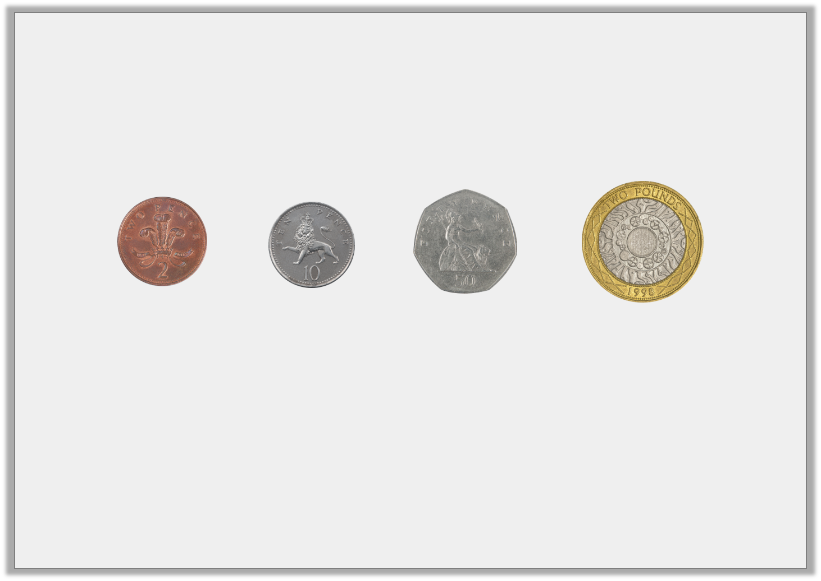
Varied Fluency 4
Order the coins from least to most value.
least
most
Y1

Slide 5
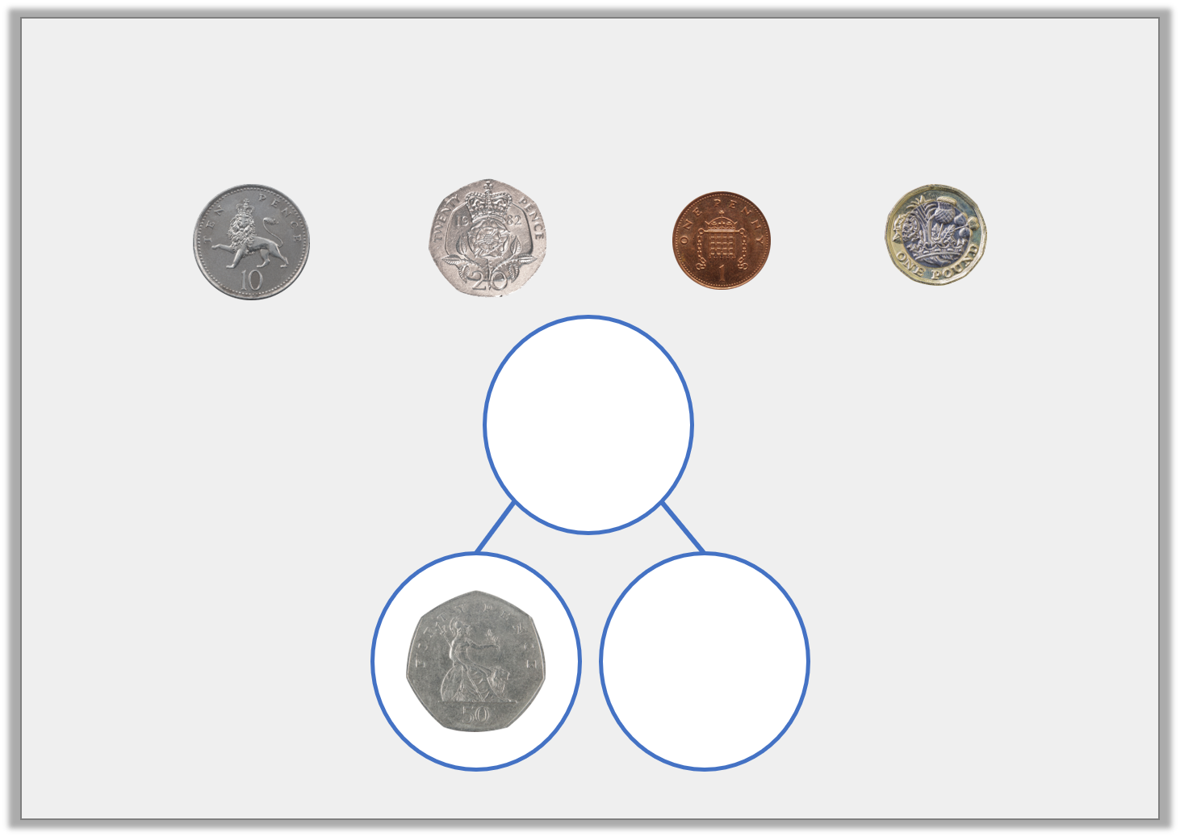
Varied Fluency 5
Use two of these coins to complete the part whole model.
80p
Y1

Slide 6
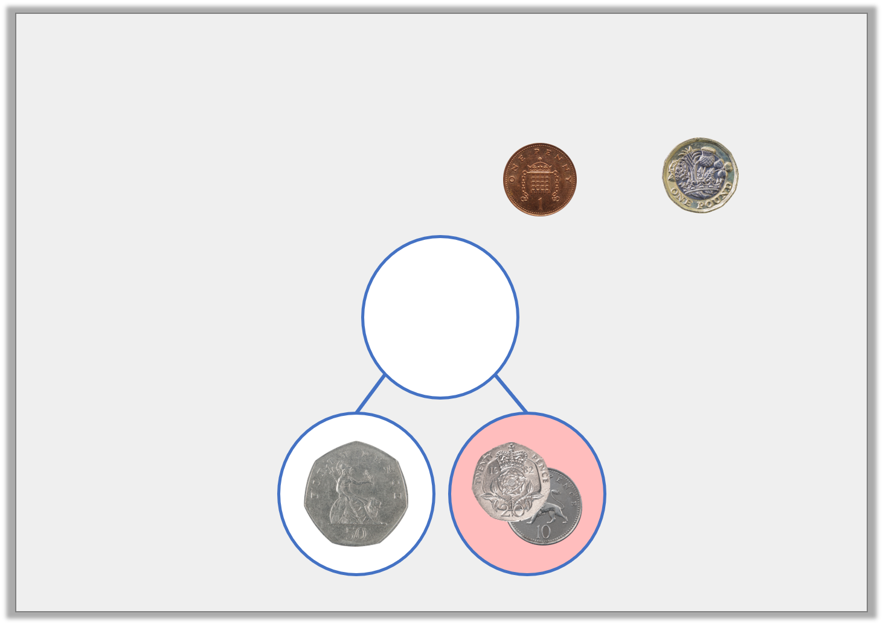
Varied Fluency 5
Use two of these coins to complete the part whole model.
80p
Y1
© Classroom Secrets Limited 2018

Slide 7
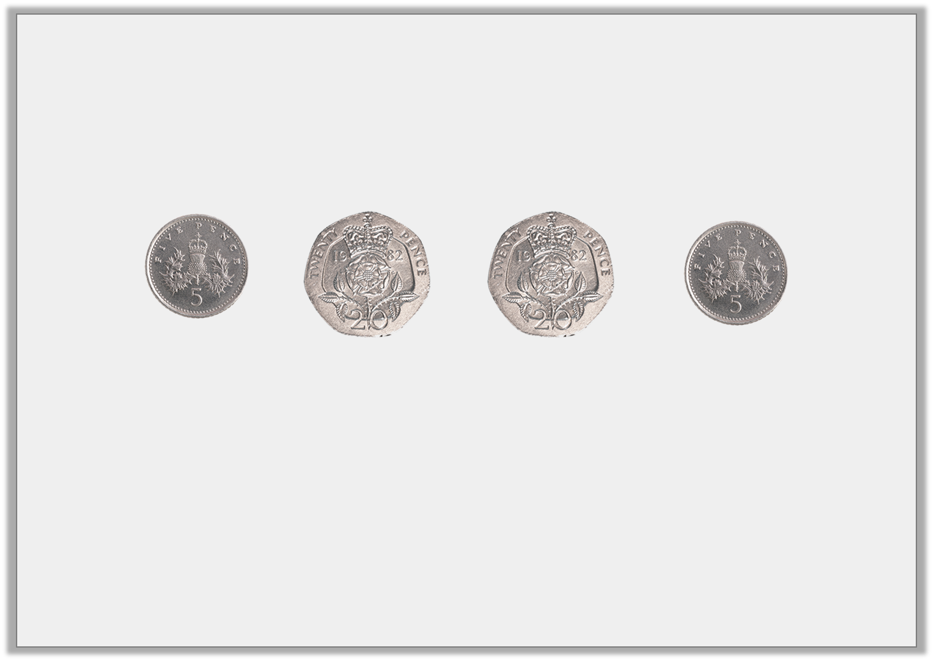
Varied Fluency 1
Circle the correct total for the coins shown.
50p | 40p | 60p
Y2

Slide 8
Varied Fluency 1
Circle the correct total for the coins shown.
50p | 40p | 60p
Y2

