Slide 1
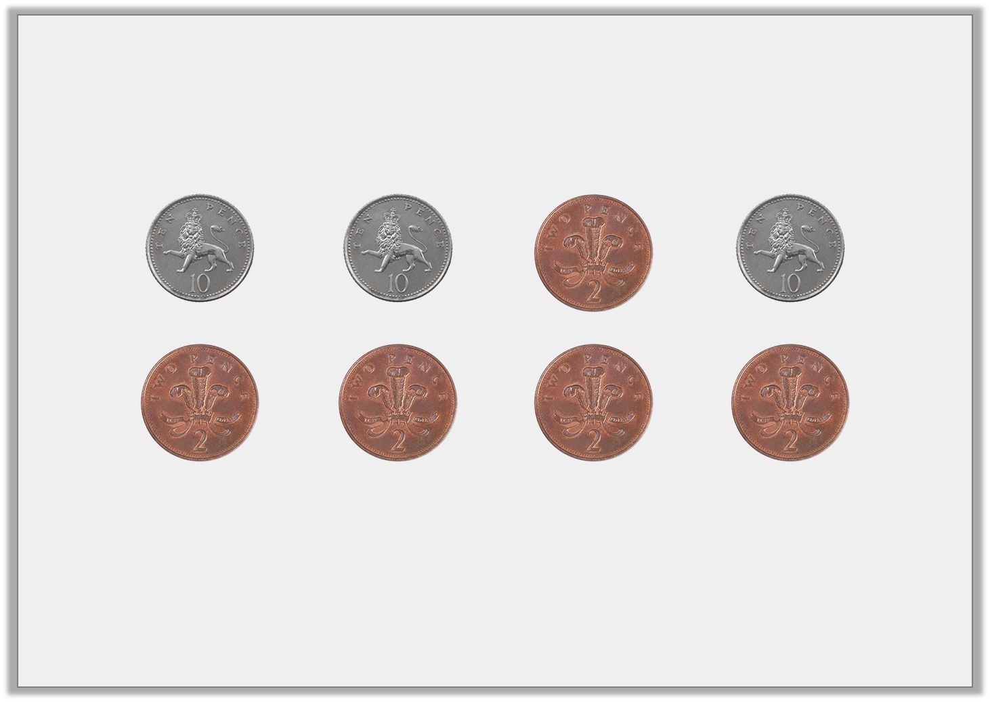
Varied Fluency 2
What is the total of the coins below?
Y2

Slide 2
Varied Fluency 2
What is the total of the coins below?
40p
Y2

Slide 3
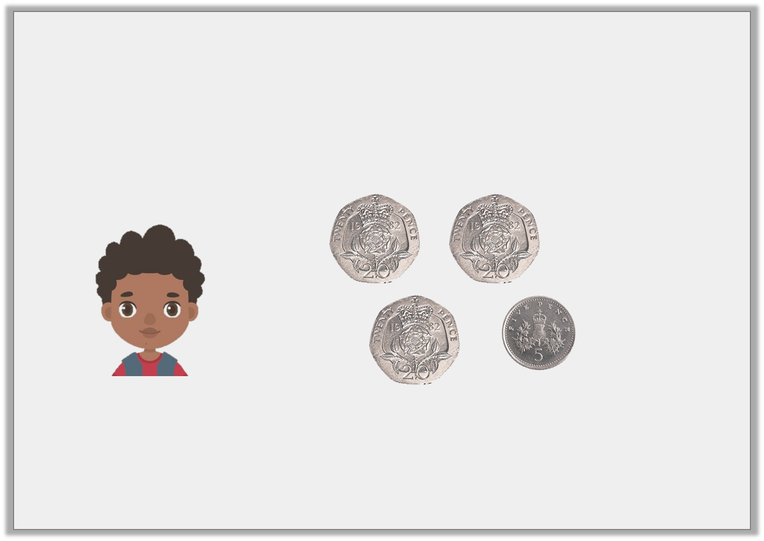
Varied Fluency 3
A box of crayons cost 75p.
Does Gregory have enough money to buy a box of crayons?
Y2

Slide 4
Varied Fluency 3
A box of crayons cost 75p.
Does Gregory have enough money to buy a box of crayons?
No, Gregory will need 10p more.
Y2
© Classroom Secrets Limited 2018

Slide 5
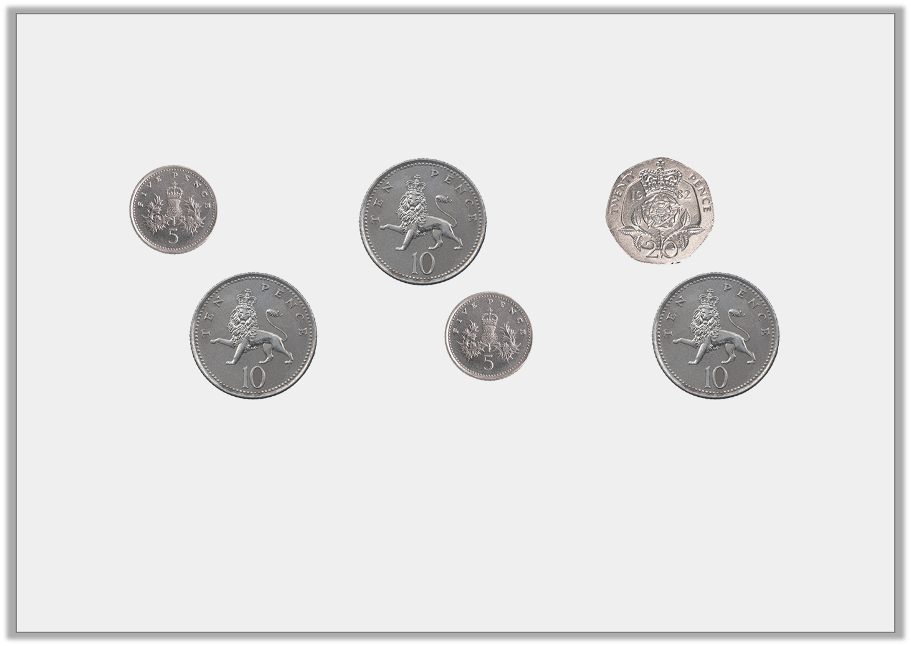
Varied Fluency 4
Circle the coins to make 50p.
Y2

Slide 6
Varied Fluency 4
Circle the coins to make 50p.
20p + 10p + 10p + 10p or
20p + 10p + 10p + 5p + 5p
Y2

Slide 7
Reasoning 1
Sara has two coins in her pocket. They total 55p.
Her friend Hafsah says,
Explain the mistake Hafsah has made.
Sara must have two 5p coins.
Y1
© Classroom Secrets Limited 2018

Slide 8
Reasoning 1
Sara has two coins in her pocket. They total 55p.
Her friend Hafsah says,
Explain the mistake Hafsah has made.
5p and 5p total 10p not 55p.
Sara must have a 50p and a 5p coin.
Sara must have two 5p coins.
Y1
© Classroom Secrets Limited 2018

Slide 9
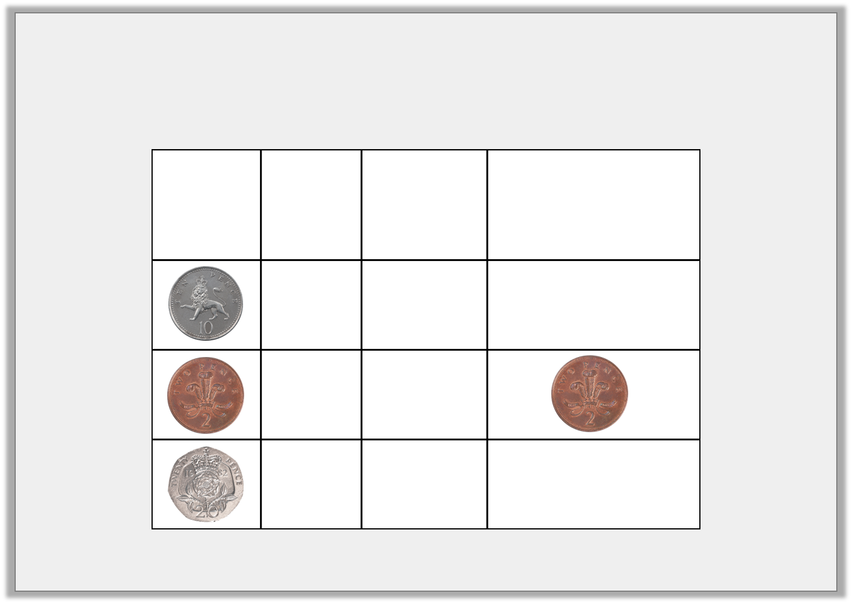
Problem Solving 1
Complete the table.
Coin | Value | Colour | Equivalent value in 2ps
 |  | silver
 | 2p
 | 20p
Y1
© Classroom Secrets Limited 2018

Slide 10
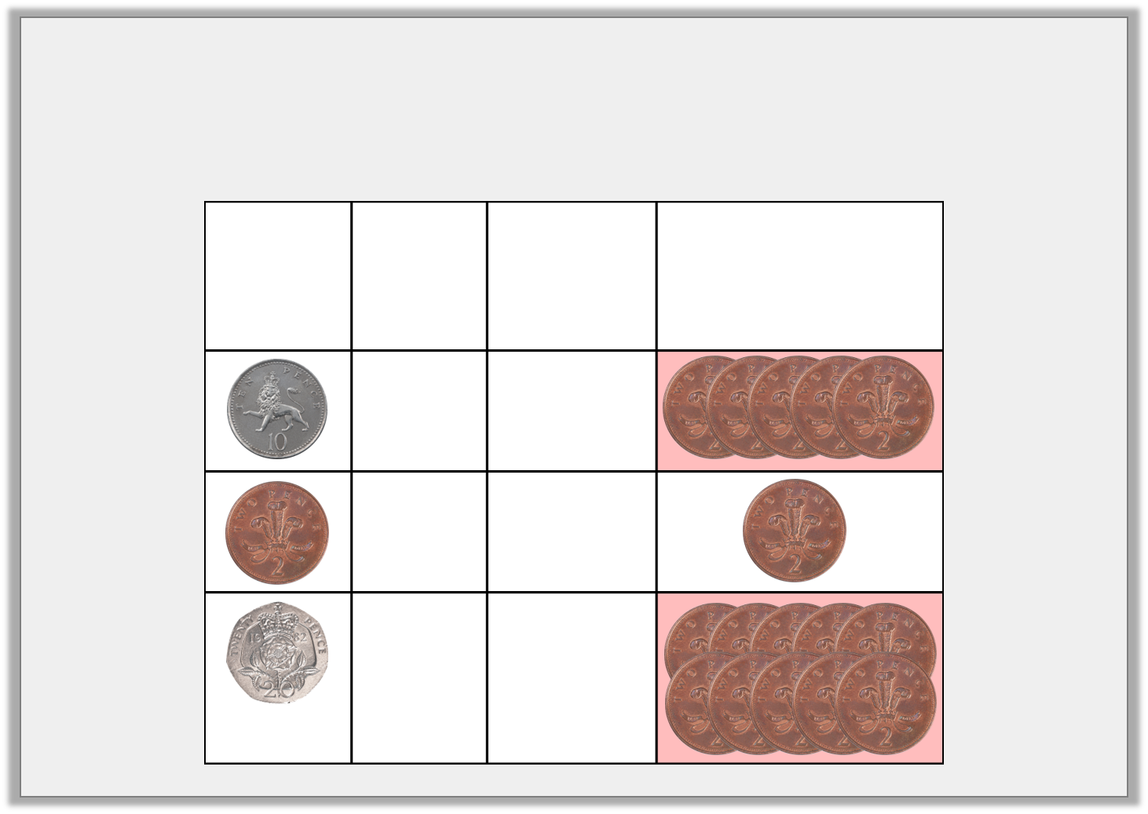
Problem Solving 1
Complete the table.
Coin | Value | Colour | Equivalent value in 2ps
 | 10p | silver
 | 2p | bronze
 | 20p | silver
Y1
© Classroom Secrets Limited 2018

Slide 11
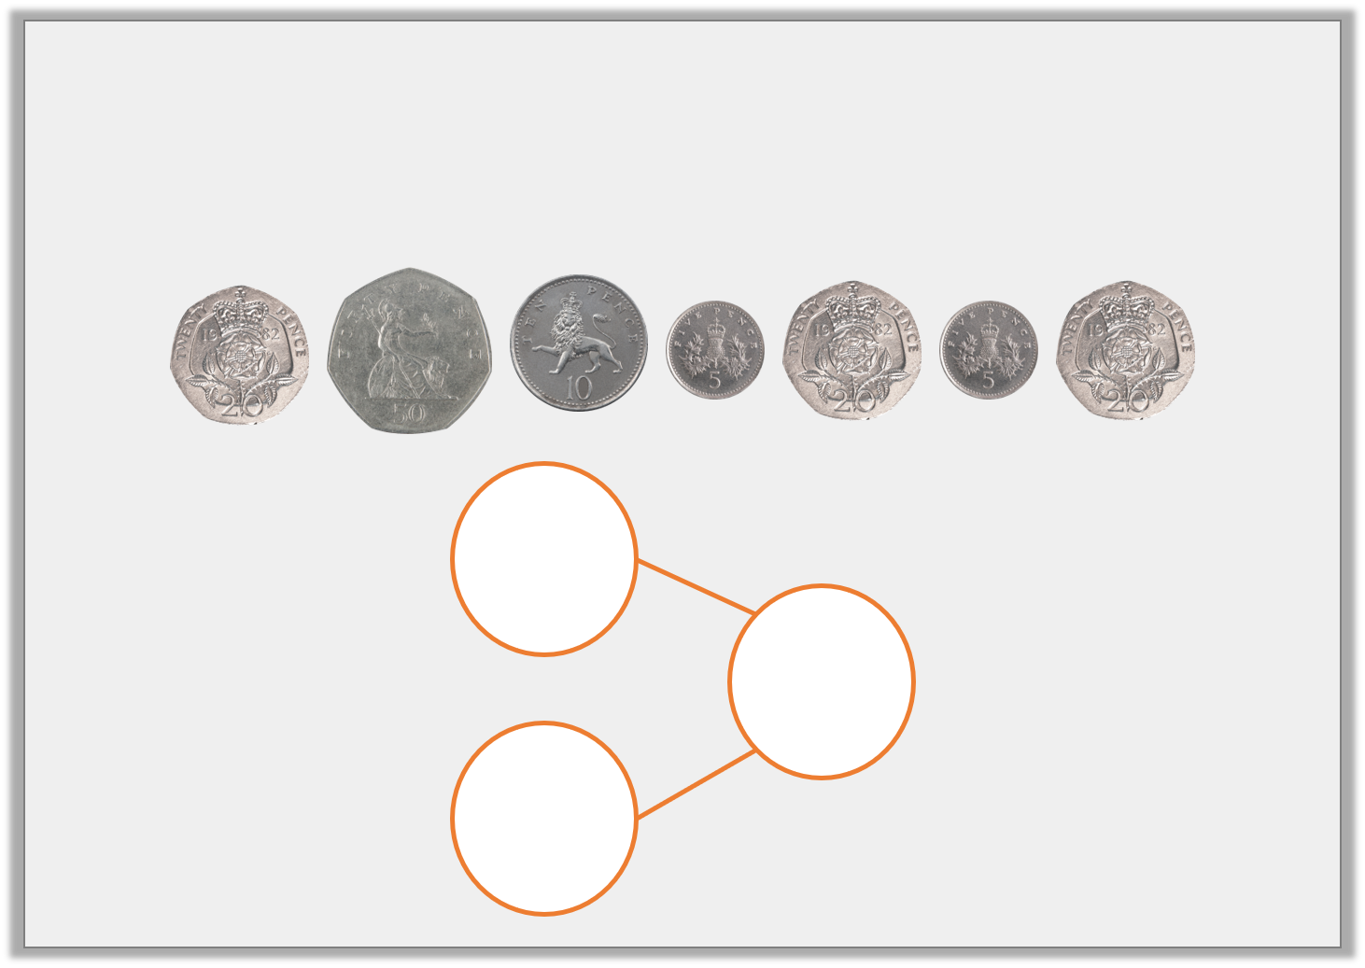
Problem Solving 2
Complete the part whole model in as many different ways as you can using these coins. Use three coins or fewer.
60p
Y1
© Classroom Secrets Limited 2018

Slide 12
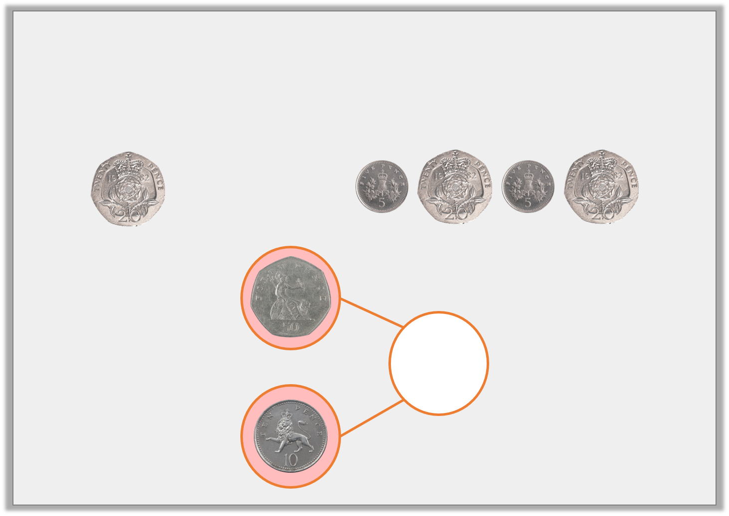
Problem Solving 2
Complete the part whole model in as many different ways as you can using these coins. Use three coins or fewer.
60p
Y1
© Classroom Secrets Limited 2018

