Slide 1
Problem Solving 1
Match the statements to the totals.
I have three coins and they are all different.
Luka
I have two coins and they are both the same.
Phoebe
I have one bronze coin and one silver coin.
Fabian
35p |  | 21p |  | 40p
Y2
© Classroom Secrets Limited 2018

Slide 2
Problem Solving 1
Match the statements to the totals.
I have three coins and they are all different.
35p
Luka
I have two coins and they are both the same.
40p
Phoebe
I have one bronze coin and one silver coin.
21p
Fabian
35p |  | 21p |  | 40p
Y2
© Classroom Secrets Limited 2018

Slide 3
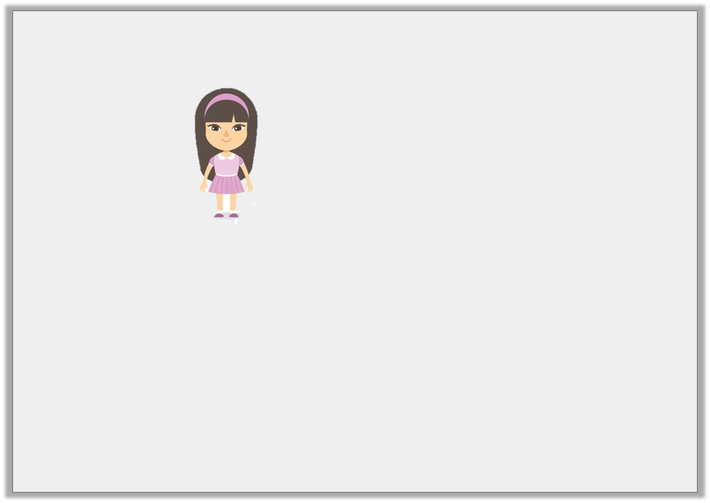
Problem Solving 2
Abilene says,
Which coins could Abilene have?
What is the lowest number of coins she could have?
How can she make the total using only four coins?
I have 30p.
Y2

Slide 4
Problem Solving 2
Abilene says,
Which coins could Abilene have?
Various combinations, for example: 10p + 10p + 10p
What is the lowest number of coins she could have?
2 coins: 20p + 10p
How can she make the total using only four coins?
10p + 10p + 5p + 5p
I have 30p.
Y2

Slide 5
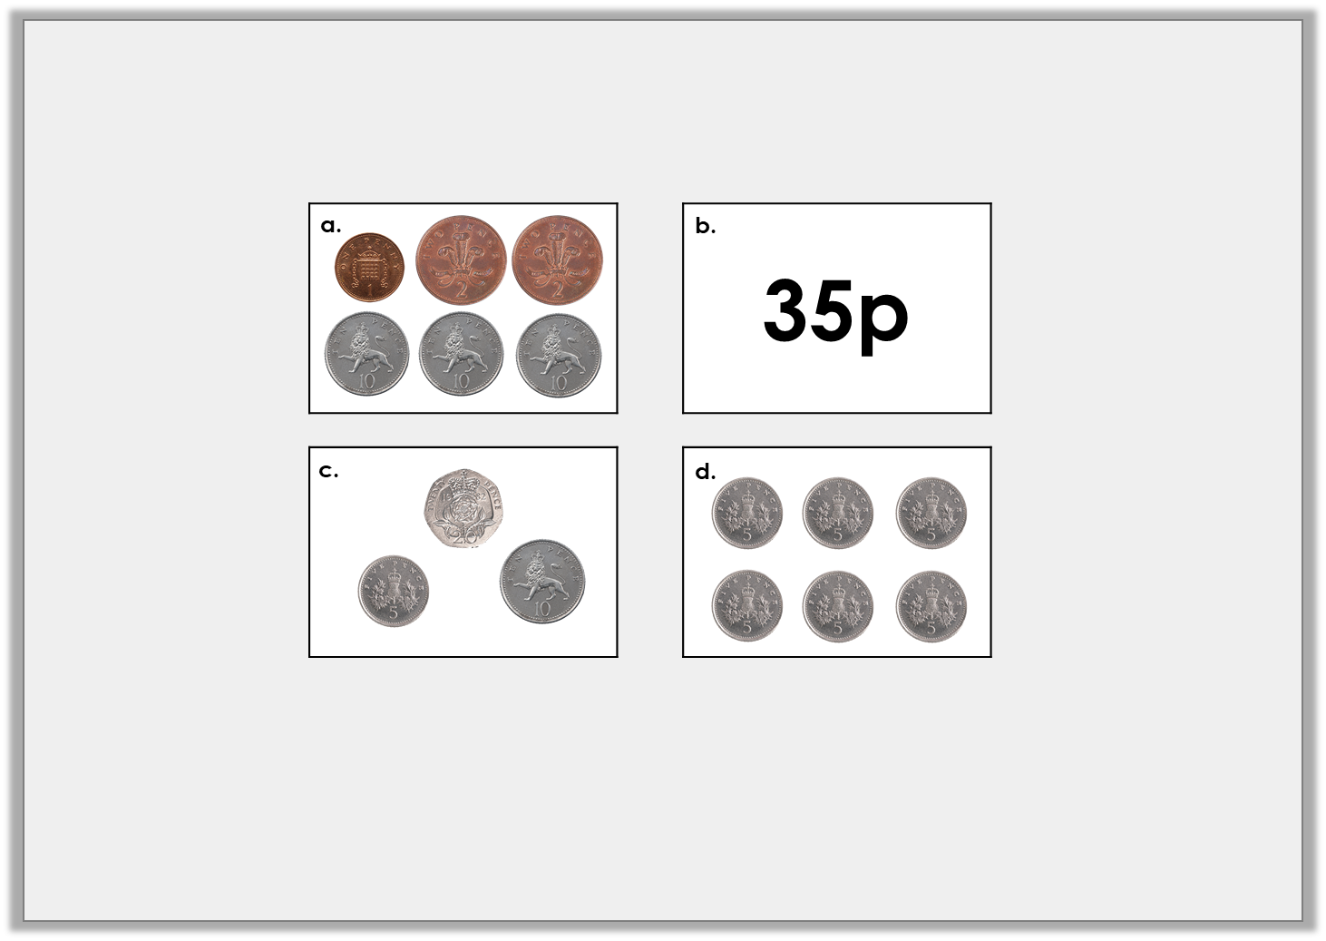
Reasoning 1
Which is the odd one out?
Explain your answer.
Y2

Slide 6
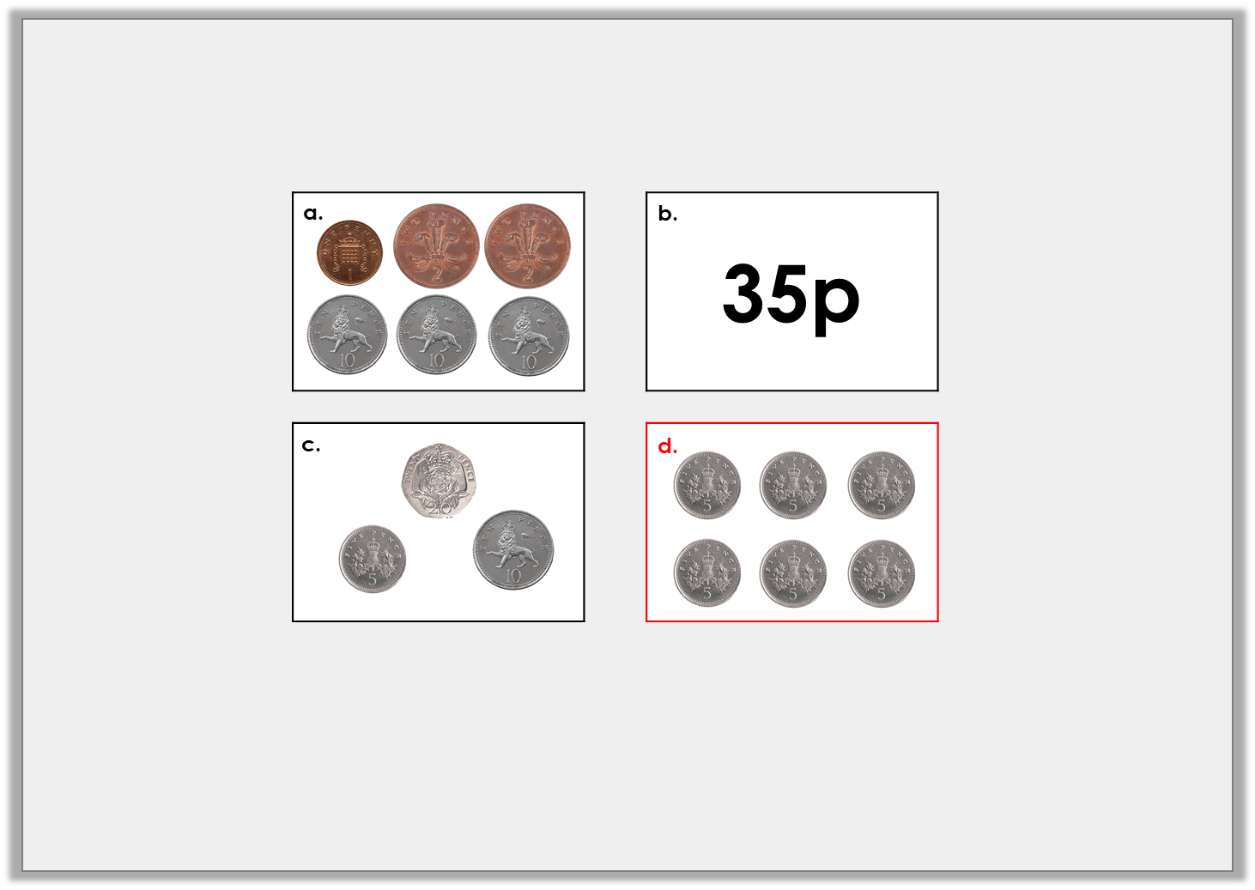
Reasoning 1
Which is the odd one out?
Explain your answer.
D is the odd one out because…
Y2

Slide 7
Reasoning 1
Which is the odd one out?
Explain your answer.
D is the odd one out because the other amounts add up to 35p.
D adds up to 30p.
Y2

