Slide 1
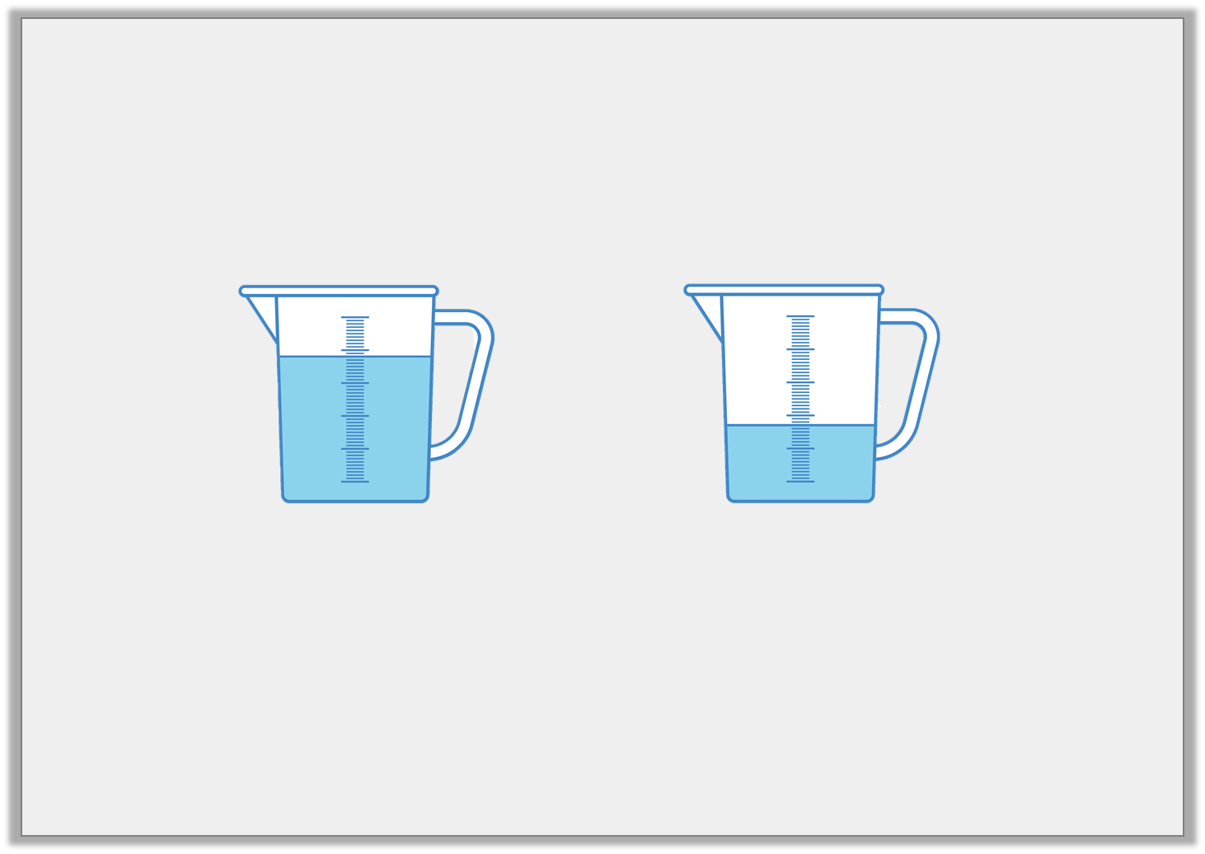
Varied Fluency 3
Which sentence is correct?
1. The capacity of jug A is equal to jug B.
2. The volume of jug A is less than jug B.
A
B
Y1

Slide 2
Varied Fluency 3
Which sentence is correct?
1. The capacity of jug A is equal to jug B.
2. The volume of jug A is less than jug B.
A
B
Y1

Slide 3
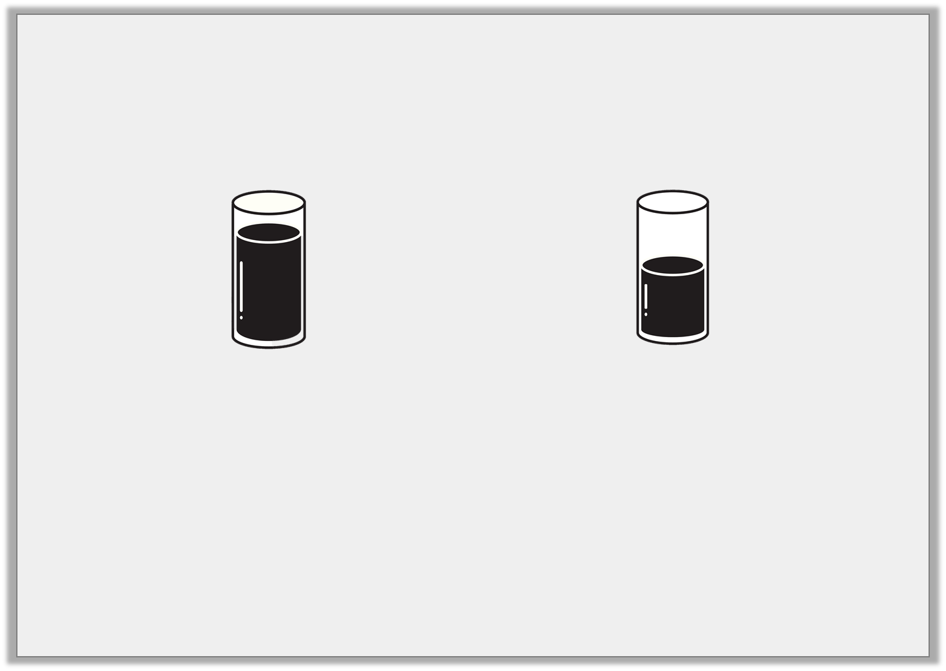
Varied Fluency 4
Complete the sentence.
is ________
greater than
less than
Y1

Slide 4
Varied Fluency 4
Complete the sentence.
is ________
greater than
greater than
less than
Y1

Slide 5
Varied Fluency 1
The volume of the container below is a quarter full.
True or false?
Y2

Slide 6
Varied Fluency 1
The volume of the container below is a quarter full.
True or false?
True
Y2

Slide 7
Varied Fluency 2
Use <, > and = symbols to compare the capacity
of container A with container B.
Y2

Slide 8
Varied Fluency 2
Use <, > and = symbols to compare the capacity
of container A with container B.
<
>
=
Y2

