Slide 1
Year 1/2 – Spring Block 4 – Weight and Volume
Step 4
Year 1: Introduce Capacity
Year 2: Compare Capacity

Slide 2
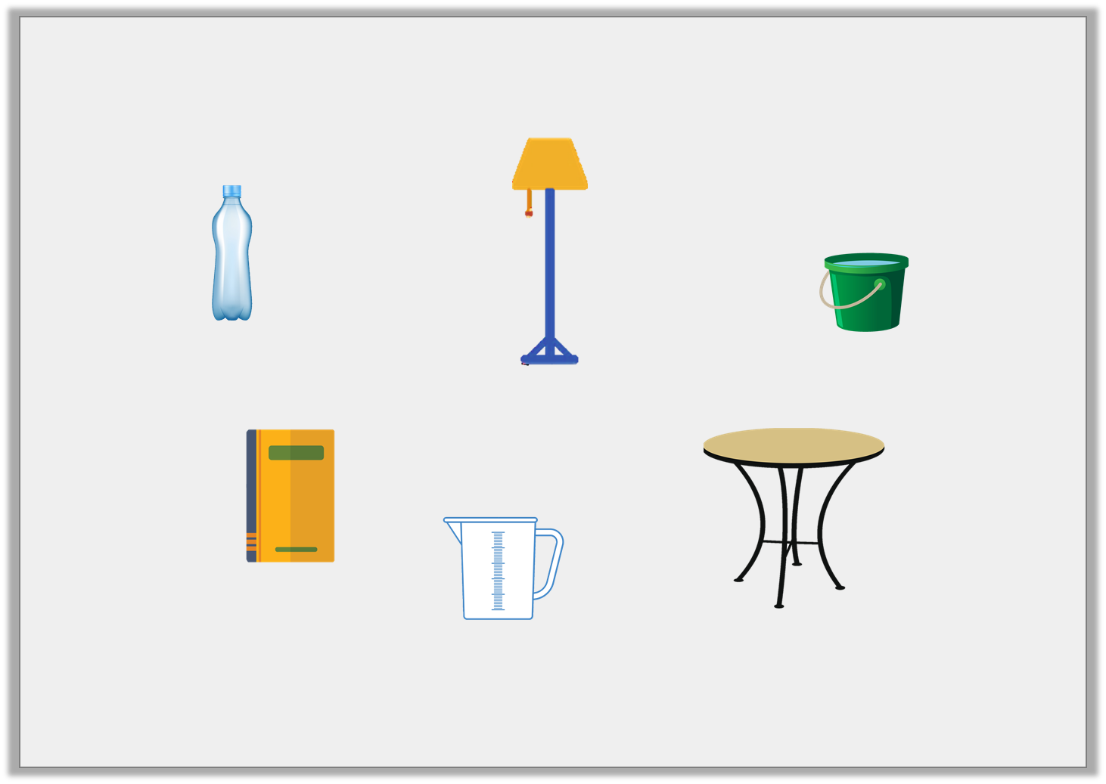
Introduction
Circle the objects that can be filled with water.
Y1

Slide 3
Introduction
Circle the objects that can be filled with water.
You can fill the bottle, jug and bucket with water.
Y1

Slide 4
Introduction
Put the containers in order from smallest to biggest capacity.
Y2

Slide 5
Introduction
Put the containers in order from smallest to biggest capacity.
smallest capacity
biggest capacity
Y2

Slide 6
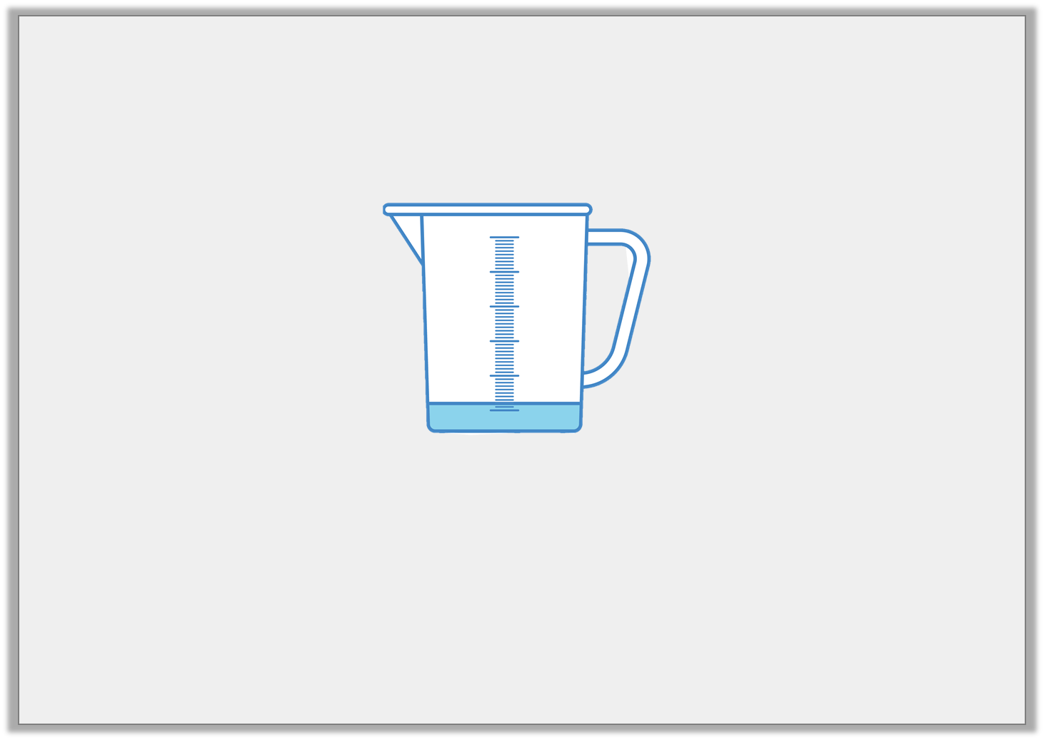
Varied Fluency 1
Tick the box which best describes the volume of the jug below.
nearly empty
nearly full
half full
Y1
© Classroom Secrets Limited 2019

Slide 7
Varied Fluency 1
Tick the box which best describes the volume of the jug below.
nearly empty
nearly full
half full
Y1

Slide 8
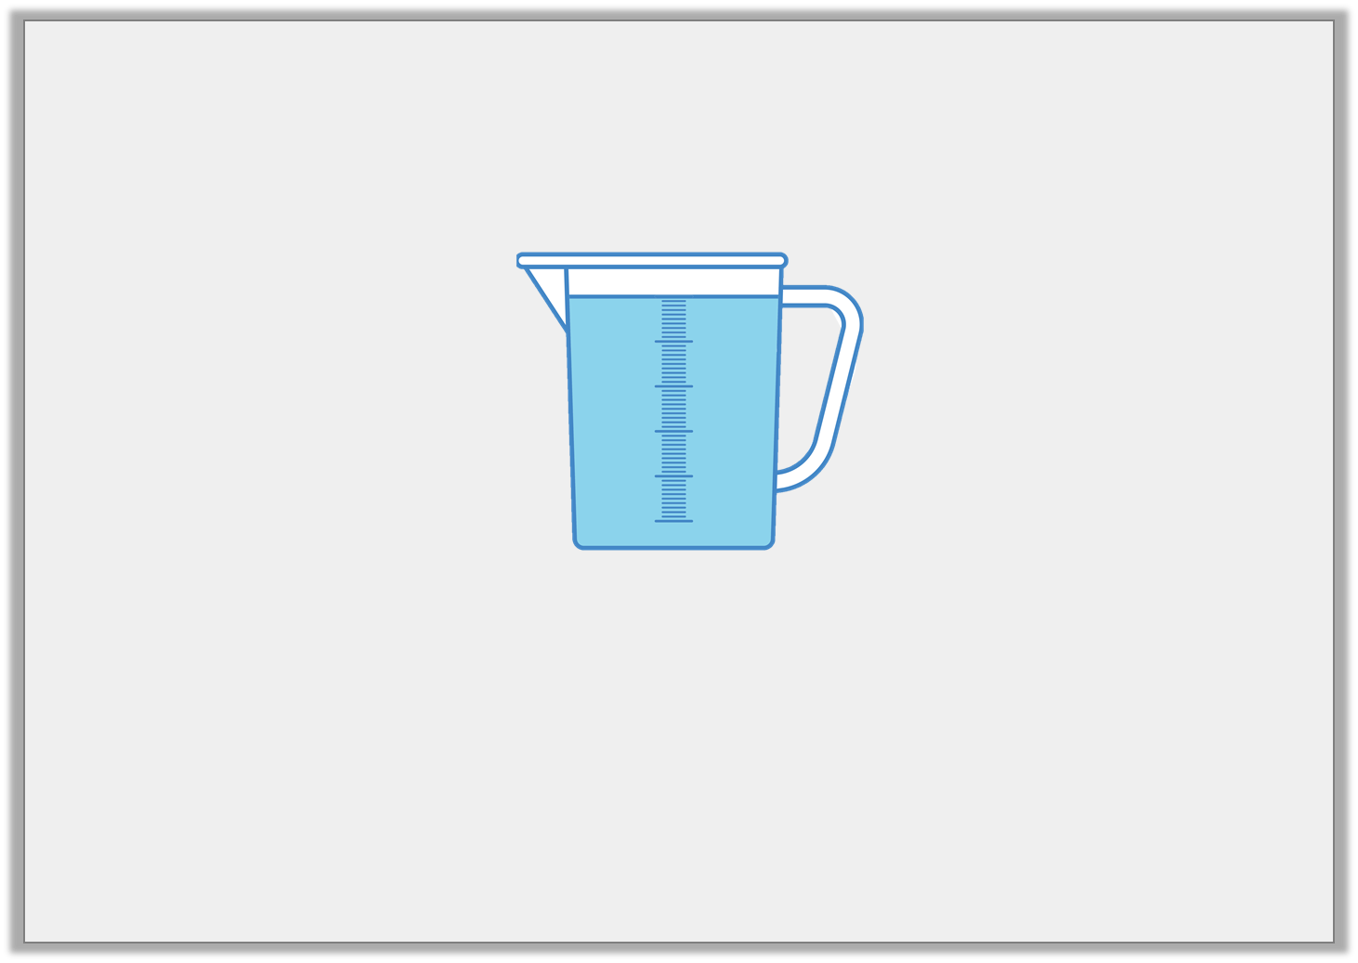
Varied Fluency 2
True or false? The jug below is nearly empty.
Y1

Slide 9
Varied Fluency 2
True or false? The jug below is nearly empty.
False, the jug is nearly full.
Y1

