Slide 1
Varied Fluency 3
Draw a line to the word that best describes
the volume of each container.
full | quarter | half | three-quarters
Y2

Slide 2
Varied Fluency 3
Draw a line to the word that best describes
the volume of each container.
full | quarter | half | three-quarters
Y2

Slide 3
Varied Fluency 4
Order these items from the
largest capacity to the smallest capacity.
Y2

Slide 4
Varied Fluency 4
Order these items from the
largest capacity to the smallest capacity.
largest capacity
smallest capacity
Y2

Slide 5
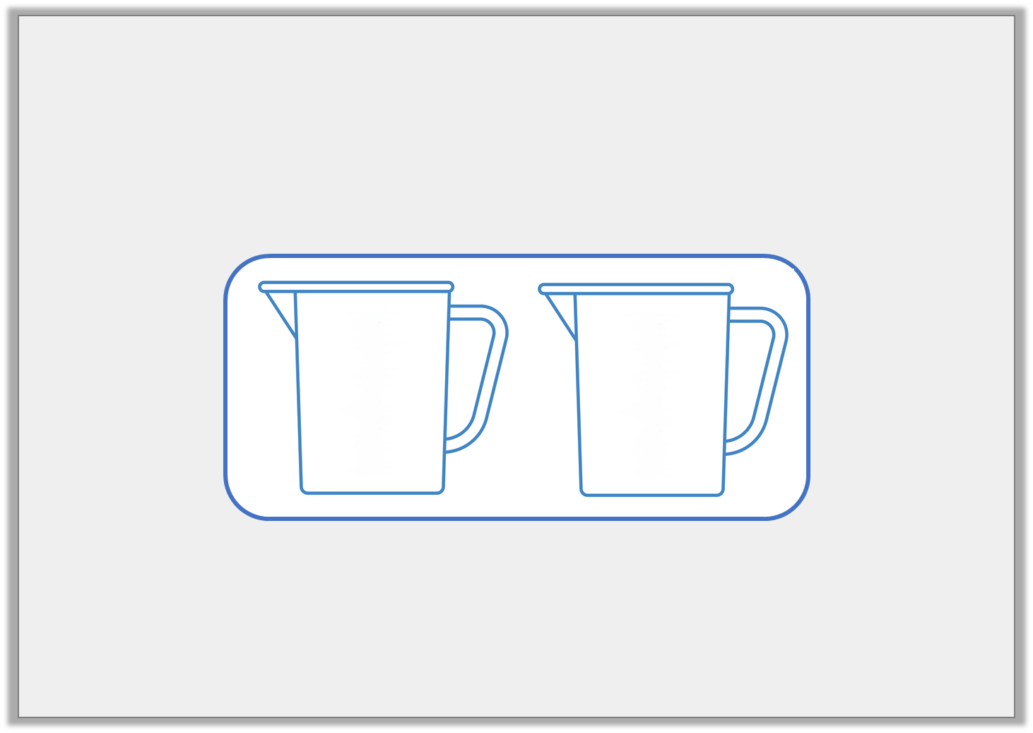
Problem Solving 1
Colour each jug to match the label.
half full
nearly empty
Y1

Slide 6
Problem Solving 1
Colour each jug to match the label.
Children should colour half of the first jug and a small amount of the second jug.
half full
nearly empty
Y1

Slide 7
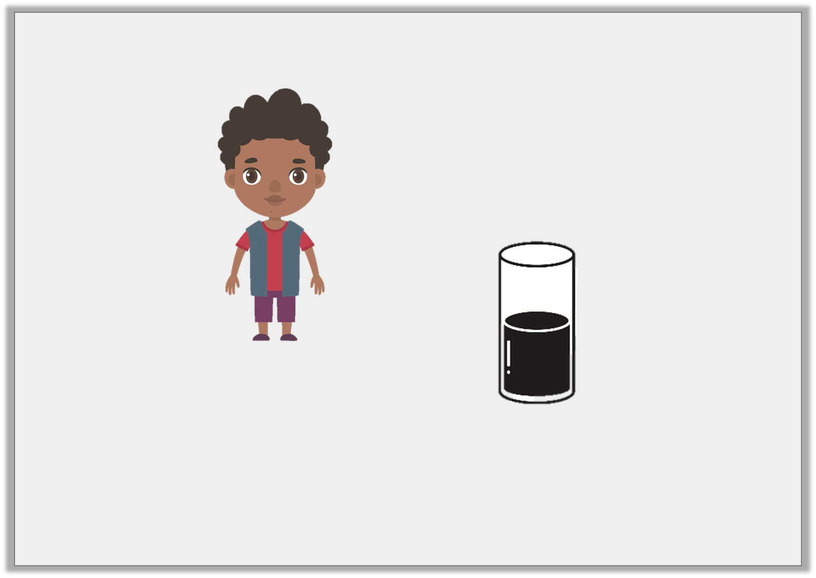
Reasoning 1
Sam says,
Is he correct? Explain your answer.
The glass is nearly full.
Y1

Slide 8
Reasoning 1
Sam says,
Is he correct? Explain your answer.
No Sam is not correct. The glass is…
The glass is nearly full.
Y1

Slide 9
Reasoning 1
Sam says,
Is he correct? Explain your answer.
No Sam is not correct. The glass is half full.
The glass is nearly full.
Y1

Slide 10
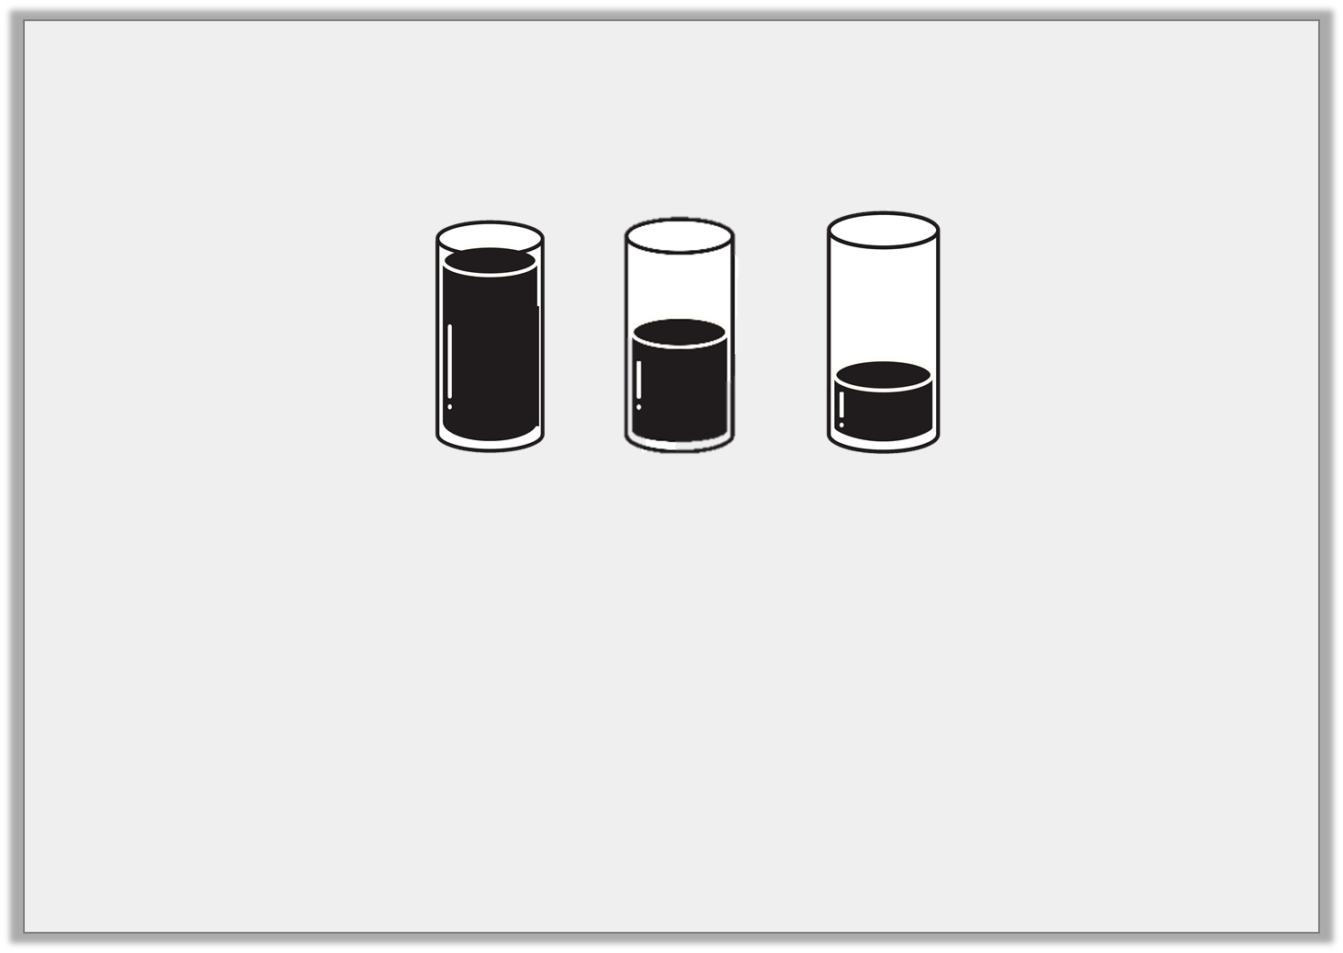
Problem Solving 2
Tick the boxes to show if the sentence is true or false.
Sentence |  | True | False
A. | Nearly empty is greater than half full.
B. | Nearly empty is greater than empty.
Y1

Slide 11
Problem Solving 2
Tick the boxes to show if the sentence is true or false.
Sentence |  | True | False
A. | Nearly empty is greater than half full. |  | 
B. | Nearly empty is greater than empty. | 
Y1

