Slide 1
Year 5/6 Block 4 – Multiplication and Division – Step 1
About This Resource: This PowerPoint has been designed to support teaching of the small steps. It includes a starter activity suitable for the year group and an example of each question from the Varied Fluency and Reasoning and Problem Solving resources also provided in the tasks. Each slide has the year group identified in the bottom right-hand corner. I recommend that you look through this PowerPoint in advance and decide whether to work through all examples provided or a selection of them depending on the needs of your child.
The PowerPoint has been dated for the week, so please work your way through it each day.

Slide 2
Year 5/6 Block 4 – Multiplication and Division – Step 1
Tuesday 16th June 2020
Year 5: Multiples
Year 6: Common Multiples

Slide 3
Introduction
Place the multiples in to the correct table.
Multiple of 4
Multiple of 6
Multiple of 7
30
20
18
44
49
40
35
Y5

Slide 4
Introduction
Place the multiples in to the correct table.
Multiple of 4
Multiple of 6
Multiple of 7
20
44
30
18
49
35
40
Y5

Slide 5
Introduction
Some of the numbers have been shaded in the hundred square.
What do these colours show?
1 | 2 | 3 | 4 | 5 | 6 | 7 | 8 | 9 | 10
11 | 12 | 13 | 4 | 15 | 16 | 17 | 18 | 19 | 20
21 | 22 | 23 | 24 | 25 | 26 | 27 | 28 | 29 | 30
31 | 32 | 33 | 34 | 35 | 36 | 37 | 38 | 39 | 40
41 | 42 | 43 | 44 | 45 | 46 | 47 | 48 | 49 | 50
51 | 52 | 53 | 54 | 55 | 56 | 57 | 58 | 59 | 60
61 | 62 | 63 | 64 | 65 | 66 | 67 | 68 | 69 | 70
71 | 72 | 73 | 74 | 75 | 76 | 77 | 78 | 79 | 80
81 | 82 | 83 | 84 | 85 | 86 | 87 | 88 | 89 | 90
91 | 92 | 93 | 94 | 95 | 96 | 97 | 98 | 99 | 100
Y6

Slide 6
Introduction
Some of the numbers have been shaded in the hundred square.
What do these colours show?
1 | 2 | 3 | 4 | 5 | 6 | 7 | 8 | 9 | 10
11 | 12 | 13 | 4 | 15 | 16 | 17 | 18 | 19 | 20
21 | 22 | 23 | 24 | 25 | 26 | 27 | 28 | 29 | 30
31 | 32 | 33 | 34 | 35 | 36 | 37 | 38 | 39 | 40
41 | 42 | 43 | 44 | 45 | 46 | 47 | 48 | 49 | 50
51 | 52 | 53 | 54 | 55 | 56 | 57 | 58 | 59 | 60
61 | 62 | 63 | 64 | 65 | 66 | 67 | 68 | 69 | 70
71 | 72 | 73 | 74 | 75 | 76 | 77 | 78 | 79 | 80
81 | 82 | 83 | 84 | 85 | 86 | 87 | 88 | 89 | 90
91 | 92 | 93 | 94 | 95 | 96 | 97 | 98 | 99 | 100
The red squares show the multiples of 4.
The blue squares show the multiples of 9.
The purple squares show the multiples of 4 and 9.
Y6

Slide 7
Varied Fluency 1
Match the number to its multiple.
Number |  | Multiple
6 |  | 32
4 |  | 35
7 |  | 54
Y5

Slide 8
Varied Fluency 1
Match the number to its multiple.
Number |  | Multiple
6 |  | 32
4 |  | 35
7 |  | 54
Y5

Slide 9
Varied Fluency 2
True or false?
54 is a multiple of 7.
Y5

Slide 10
Varied Fluency 2
True or false?
False
54 is a multiple of 7.
Y5

Slide 11
Varied Fluency 3
Complete the sequence of multiples.
24 |  |  |  | 36 |  | 42
Y5

Slide 12
Varied Fluency 3
Complete the sequence of multiples.
24 |  | 30 |  | 36 |  | 42 |  | 48 |  | 54 |  | 60
Y5

Slide 13
Varied Fluency 4
Fill in the table below with two possible multiples for each number.
Number | Multiple
4
8
7
6
Y5

Slide 14
Varied Fluency 4
Fill in the table below with two possible multiples for each number.
Various answers, for example:
Number | Multiple
4 | 8 | 24
8 | 24 | 64
7 | 14 | 56
6 | 6 | 36
Y5

Slide 15
Varied Fluency 1
Circle the common multiples of 5 and 6.
56 | 30 | 120
90 | 24 | 65
Key Facts
5 x 2 = 10 5 x 5 = 25 5 x 10 = 50 5 x 12 = 60 | 6 x 2 = 12 6 x 5 = 30 6 x 10 = 60 6 x 12 = 72
Y6

Slide 16
Varied Fluency 1
Circle the common multiples of 5 and 6.
56 | 30 | 120
90 | 24 | 65
Key Facts
5 x 2 = 10 5 x 5 = 25 5 x 10 = 50 5 x 12 = 60 | 6 x 2 = 12 6 x 5 = 30 6 x 10 = 60 6 x 12 = 72
Y6

Slide 17
Varied Fluency 2
True or false?
The lowest common multiple of 8 and 9 is 64.
Key Facts
8 x 2 = 16 8 x 5 = 40 8 x 10 = 80 8 x 12 = 94 | 9 x 2 = 18 9 x 5 = 45 9 x 10 = 90 9 x 12 = 108
Y6

Slide 18
Varied Fluency 2
True or false?
The lowest common multiple of 8 and 9 is 64.
False, the lowest common multiple of 8 and 9 is 72.
Key Facts
8 x 2 = 16 8 x 5 = 40 8 x 10 = 80 8 x 12 = 94 | 9 x 2 = 18 9 x 5 = 45 9 x 10 = 90 9 x 12 = 108
Y6

Slide 19
Varied Fluency 3
Here is part of a 100 square.
A common multiple of 4 and 12 has been circled. Circle the next 3.
51 | 52 | 53 | 54 | 55 | 56 | 57 | 58 | 59 | 60
61 | 62 | 63 | 64 | 65 | 66 | 67 | 68 | 69 | 70
71 | 72 | 73 | 74 | 75 | 76 | 77 | 78 | 79 | 80
81 | 82 | 83 | 84 | 85 | 86 | 87 | 88 | 89 | 90
91 | 92 | 93 | 94 | 95 | 96 | 97 | 98 | 99 | 100
Key Facts
4 x 2 = 8 4 x 5 = 20 4 x 10 = 40 4 x 12 = 48 | 12 x 2 = 24 12 x 5 = 60 12 x 10 = 120 12 x 12 = 144
Y6

Slide 20
Varied Fluency 3
Here is part of a 100 square.
A common multiple of 4 and 12 has been circled. Circle the next 3.
51 | 52 | 53 | 54 | 55 | 56 | 57 | 58 | 59 | 60
61 | 62 | 63 | 64 | 65 | 66 | 67 | 68 | 69 | 70
71 | 72 | 73 | 74 | 75 | 76 | 77 | 78 | 79 | 80
81 | 82 | 83 | 84 | 85 | 86 | 87 | 88 | 89 | 90
91 | 92 | 93 | 94 | 95 | 96 | 97 | 98 | 99 | 100
Key Facts
4 x 2 = 8 4 x 5 = 20 4 x 10 = 40 4 x 12 = 48 | 12 x 2 = 24 12 x 5 = 60 12 x 10 = 120 12 x 12 = 144
Y6

Slide 21
Problem Solving 1
Wednesday 17th June 2020
Kara is thinking of a number.
What could her number be?
Is there only one answer?
My number is a multiple of 6 and 7. It is even and below 50.
Y5

Slide 22
Problem Solving 1
Kara is thinking of a number.
What could her number be?
42
Is there only one answer?
Yes, there is only one answer.
My number is a multiple of 6 and 7. It is even and below 50.
Y5

Slide 23
Reasoning 1
Below is a section of a hundred square.
Why are some of the numbers shaded?
Why do some of the numbers have circles around them?
32 | 33 | 34
42 | 43 | 44
52 | 53 | 54
Y5

Slide 24
Reasoning 1
Below is a section of a hundred square.
Why are some of the numbers shaded?
Why do some of the numbers have circles around them?
Shaded numbers are multiples of…
Circled numbers are multiples of…
32 | 33 | 34
42 | 43 | 44
52 | 53 | 54
Y5

Slide 25
Reasoning 1
Below is a section of a hundred square.
Why are some of the numbers shaded?
Why do some of the numbers have circles around them?
Shaded numbers are multiples of 4.
Circled numbers are multiples of 6.
32 | 33 | 34
42 | 43 | 44
52 | 53 | 54
Y5

Slide 26
Reasoning 2
Which is the odd on out?
How do you know?
16
36
32
24
40
80
8
Y5

Slide 27
Reasoning 2
Which is the odd on out?
How do you know?
36 is the odd one out because…
16
36
32
24
40
80
8
Y5

Slide 28
Reasoning 2
Which is the odd on out?
How do you know?
36 is the odd one out because it is not a multiple of 8.
16
36
32
24
40
80
8
Y5

Slide 29
Problem Solving 1
Move from start to finish by following
the common multiples of 3 and 7. You cannot move diagonally.
START
Key Facts
3 x 2 = 6 3 x 5 = 15 3 x 10 = 30 3 x 12 = 36
84 | 63 | 28
77 | 42 | 37
39 | 126 | 21
45 | 73 | 105
Key Facts
7 x 2 = 14 7 x 5 = 35 7 x 10 = 70 7 x 12 = 84
FINISH
Y6

Slide 30
Problem Solving 1
Move from start to finish by following
the common multiples of 3 and 7. You cannot move diagonally.
START
Key Facts
3 x 2 = 6 3 x 5 = 15 3 x 10 = 30 3 x 12 = 36
84 | 63 | 28
77 | 42 | 37
39 | 126 | 21
45 | 73 | 105
Key Facts
7 x 2 = 14 7 x 5 = 35 7 x 10 = 70 7 x 12 = 84
FINISH
Y6

Slide 31
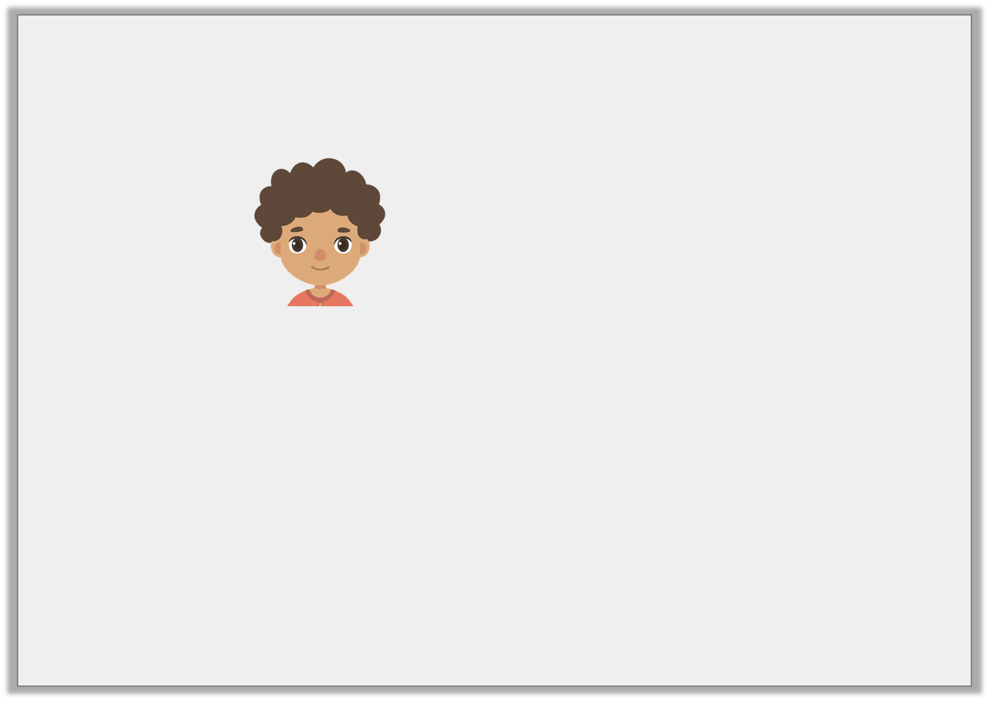
Reasoning 1
Jordan says,
Is he correct? Explain why.
The lowest common multiple of 6 and 7 is 36 because 6 x 6 = 36
and 7 x 5 = 36
Key Facts
6 x 2 = 12 6 x 5 = 30 6 x 10 = 60 6 x 12 = 72 | 7 x 2 = 14 7 x 5 = 35 7 x 10 = 70 7 x 12 = 84
Y6

Slide 32
Reasoning 1
Jordan says,
Is he correct? Explain why.
Jordan is not correct because…
The lowest common multiple of 6 and 7 is 36 because 6 x 6 = 36
and 7 x 5 = 36
Key Facts
6 x 2 = 12 6 x 5 = 30 6 x 10 = 60 6 x 12 = 72 | 7 x 2 = 14 7 x 5 = 35 7 x 10 = 70 7 x 12 = 84
Y6

Slide 33
Reasoning 1
Jordan says,
Is he correct? Explain why.
Jordan is not correct because 7 x 5 = 35. The lowest common multiple of 6 and 7 is 42 because 6 x 7 = 42.
The lowest common multiple of 6 and 7 is 36 because 6 x 6 = 36
and 7 x 5 = 36
Key Facts
6 x 2 = 12 6 x 5 = 30 6 x 10 = 60 6 x 12 = 72 | 7 x 2 = 14 7 x 5 = 35 7 x 10 = 70 7 x 12 = 84
Y6

Slide 34
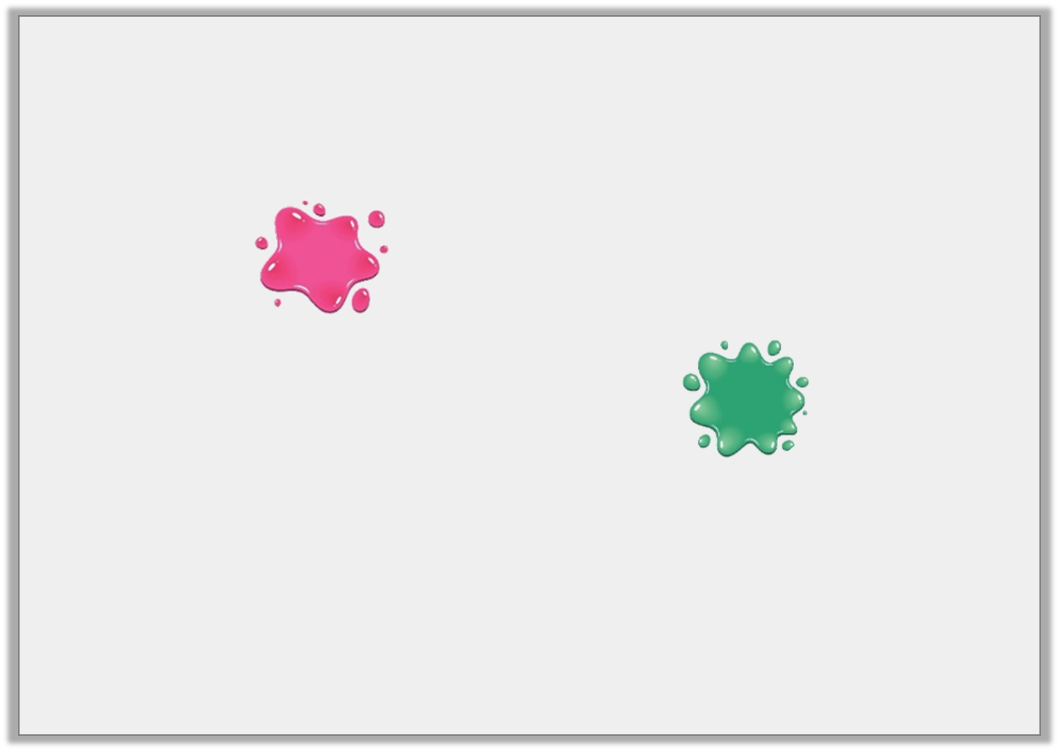
Problem Solving 2
Below are 5 common multiples of 8 and 12.
What numbers could be covered by the splats?
 |  | 72
 | 120
24
Key Facts
8 x 2 = 16 8 x 5 = 40 8 x 10 = 80 8 x 12 = 96 | 12 x 2 = 24 12 x 5 = 60 12 x 10 = 120 12 x 12 = 144
Y6

Slide 35
Problem Solving 2
Below are 5 common multiples of 8 and 12.
What numbers could be covered by the splats?
Various answers, for example:
48 |  | 72
 | 120
24 |  | 96
Key Facts
8 x 2 = 16 8 x 5 = 40 8 x 10 = 80 8 x 12 = 96 | 12 x 2 = 24 12 x 5 = 60 12 x 10 = 120 12 x 12 = 144
Y6

Slide 36
Year 5/6 – Block 3 – Multiplication and Division Thursday 18th June 2020
Step 2
Year 5: Multiplying by 10, 100 and 1,000
Year 6: Mental Calculations

Slide 37
Introduction
Complete the table below.
 | x 10 | x 100 | x 1,000
5 |  |  | 5,000
12 |  | 1,200
345 | 3,450
Y5

Slide 38
Introduction
Complete the table below.
 | x 10 | x 100 | x 1,000
5 | 50 | 500 | 5,000
12 | 120 | 1,200 | 12,000
345 | 3,450 | 34,500 | 345,000
Y5

Slide 39
Introduction
Answer these questions using mental calculations.
Calculate the difference between 180 and 820.
Double 750.
Multiply 40 x 30.
How many minutes are in three and a half hours?
The difference between a number and 35 is 15. What could the number be?
Y6

Slide 40
Introduction
Answer these questions using mental calculations.
Calculate the difference between 180 and 820.
Double 750.
Multiply 40 x 30.
How many minutes are in three and a half hours?
The difference between a number and 35 is 15. What could the number be?
640
1,500
1,200
210
20 or 50
Y6

Slide 41
Varied Fluency 1
Circle the correct answer to the following calculation.
972 x 100 =
9,270 |  | 9,720 |  | 97,200
Y5

Slide 42
Varied Fluency 1
Circle the correct answer to the following calculation.
972 x 100 =
9,270 |  | 9,720 |  | 97,200
Y5

Slide 43
Varied Fluency 2
Complete the calculation.
 | = | 3,684 | x | 10
Y5

Slide 44
Varied Fluency 2
Complete the calculation.
36,840 | = | 3,684 | x | 10
Y5

Slide 45
Varied Fluency 3
Work out the number shown below.
Multiply the number by 10.
Draw where the counters will be now.
Th | H | T | O
Th | H | T | O
Y5

Slide 46
Varied Fluency 3
Work out the number shown below.
121
Multiply the number by 10.
Draw where the counters will be now.
1,210
Th | H | T | O
Th | H | T | O
Y5

Slide 47
Varied Fluency 4
Complete the calculation.
512 | x |  | = | 51,200
Y5

Slide 48
Varied Fluency 4
Complete the calculation.
512 | x | 100 | = | 51,200
Y5

Slide 49
Varied Fluency 1
Use this fact to calculate the following:
260 x 52 =
2.6 x 520 =
260 x 520 =
2,600 x 52 =
26 x 5,200 =
26 x 52 = 1,352
Y6

Slide 50
Varied Fluency 1
Use this fact to calculate the following:
260 x 52 = 13,520
2.6 x 520 = 1,352
260 x 520 = 135,200
2,600 x 52 = 135,200
26 x 5,200 = 135,200
26 x 52 = 1,352
Y6

Slide 51
Varied Fluency 2
Use mental calculations to find the odd one out.
1
4
550 – 300
of 1,000
2,500 ÷ 10
1
2
of 5,000
25 x 10
Y6

Slide 52
Varied Fluency 2
Use mental calculations to find the odd one out.
1
4
550 – 300
= 250
of 1,000
= 250
2,500 ÷ 10
= 250
1
2
of 5,000
= 2,500
25 x 10
= 250
Y6

Slide 53
Varied Fluency 3
Match the question to the correct answer.
25 x 120 =
400
110 x 12 =
3,000
3,200 ÷ 8 =
1,320
Y6

Slide 54
Varied Fluency 3
Match the question to the correct answer.
25 x 120 =
400
110 x 12 =
3,000
3,200 ÷ 8 =
1,320
Y6

Slide 55
Varied Fluency 4
Find the missing number.
17 x x 10 = 3,400
Y6

Slide 56
Varied Fluency 4
Find the missing number.
17 x 20 x 10 = 3,400
Y6

Slide 57
Problem Solving 1
Friday 19th June 2020
Soffia has 83 pencils.
Jacob has 10 times as many pencils as Soffia.
Kye has 10 times as many pencils as Jacob.
How many do they have altogether?
Y5

Slide 58
Problem Solving 1
Soffia has 83 pencils.
Jacob has 10 times as many pencils as Soffia.
Kye has 10 times as many pencils as Jacob.
How many do they have altogether?
83 + 830 + 8,300 = 9,213
Y5

Slide 59
Reasoning 1
Nigel bounces a ball 2,478 times.
Amira bounces a ball 24,748 times.
Amira says,
Is Amira correct? Explain your answer.
I have bounced the ball 10 times as many times as you.
Y5

Slide 60
Reasoning 1
Nigel bounces a ball 2,478 times.
Amira bounces a ball 24,748 times.
Amira says,
Is Amira correct? Explain your answer.
Amira is incorrect because…
I have bounced the ball 10 times as many times as you.
Y5

Slide 61
Reasoning 1
Nigel bounces a ball 2,478 times.
Amira bounces a ball 24,748 times.
Amira says,
Is Amira correct? Explain your answer.
Amira is incorrect because 2,478 x 10 = 24,780.
I have bounced the ball 10 times as many times as you.
Y5

Slide 62
Reasoning 2
Which number is the odd one out? Convince me.
A. 945
B. 2,340
C. 94,500
D. 3,240
E. 23,400
Y5

Slide 63
Reasoning 2
Which number is the odd one out? Convince me.
D is the odd one out because…
A. 945
B. 2,340
C. 94,500
D. 3,240
E. 23,400
Y5

Slide 64
Reasoning 2
Which number is the odd one out? Convince me.
D is the odd one out because 945 x 100 = 94,500 and 2,340 x 10 = 23,400.
A. 945
B. 2,340
C. 94,500
D. 3,240
E. 23,400
Y5

Slide 65
Problem Solving 1
Give 3 different ways of calculating the following mentally:
252 x 9
Y6

Slide 66
Problem Solving 1
Give 3 different ways of calculating the following mentally:
Various answers, for example:
(252 x 10) – (252 x 1)
(200 x 9) + (50 x 9) + (2 x 9)
252 x 2 x 2 x 2 + 252
252 x 9
Y6

Slide 67
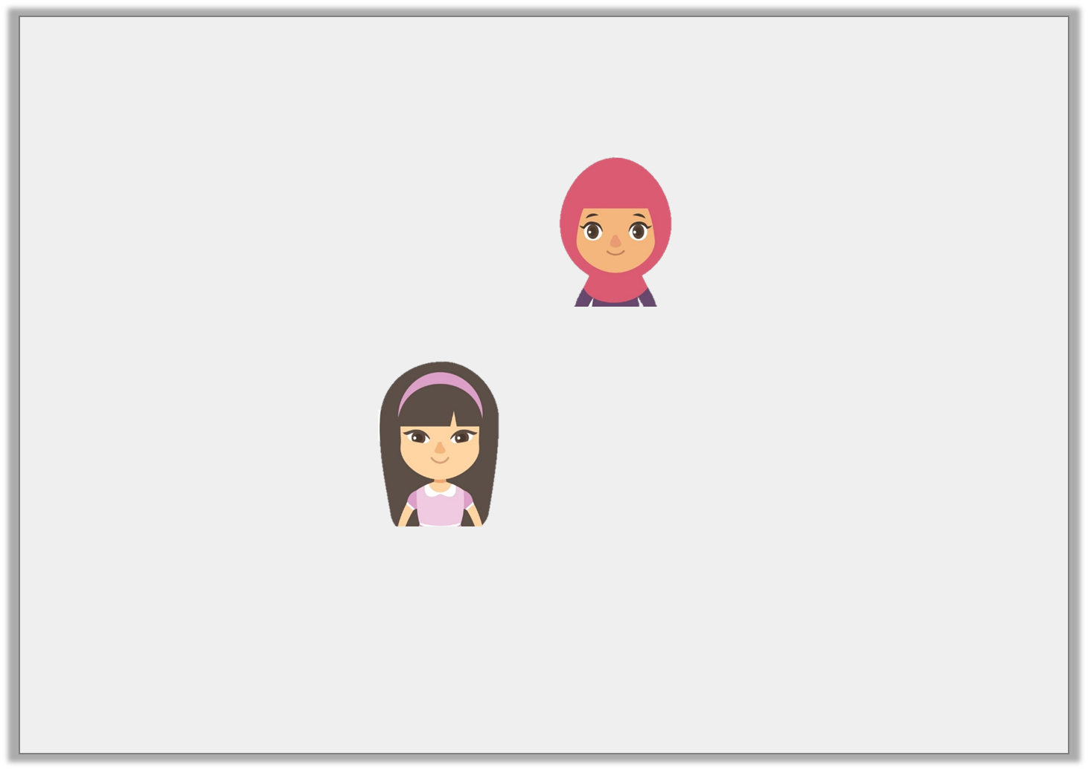
Reasoning 1
Hafsah and Lucy are solving the calculation 223 x 2 x 15.
Who is correct? Explain why.
I did 15 x 2 = 30, then 223 x 10 = 2,230, then x 3. My answer is 6,690.
Hafsah
I did 223 x 2 = 446, then I x by 10, then by 5. My answer is 22,300.
Lucy
Y6

Slide 68
Reasoning 1
Hafsah and Lucy are solving the calculation 223 x 2 x 15.
Who is correct? Explain why.
Hafsah is correct because…
Lucy is incorrect because…
I did 15 x 2 = 30, then 223 x 10 = 2,230, then x 3. My answer is 6,690.
Hafsah
I did 223 x 2 = 446, then I x by 10, then by 5. My answer is 22,300.
Lucy
Y6

Slide 69
Reasoning 1
Hafsah and Lucy are solving the calculation 223 x 2 x 15.
Who is correct? Explain why.
Hafsah is correct because she has split the calculation into parts to work out the answer.
Lucy is incorrect because she has multiplied by 50, not 15.
I did 15 x 2 = 30, then 223 x 10 = 2,230, then x 3. My answer is 6,690.
Hafsah
I did 223 x 2 = 446, then I x by 10, then by 5. My answer is 22,300.
Lucy
Y6

Slide 70
Reasoning 2
Kian is estimating the cost of 3 items.
Which calculation would give him the best estimation?
a. b.
Explain why.
T-shirt = £14.99; Jeans = £29.99; Jacket = £34.99
15 + 30 + 35
14 + 29 + 34
Y6

Slide 71
Reasoning 2
Kian is estimating the cost of 3 items.
Which calculation would give him the best estimation?
a. b.
Explain why.
Calculation a would give the best estimation because…
T-shirt = £14.99; Jeans = £29.99; Jacket = £34.99
15 + 30 + 35
14 + 29 + 34
Y6

Slide 72
Reasoning 2
Kian is estimating the cost of 3 items.
Which calculation would give him the best estimation?
a. b.
Explain why.
Calculation a would give the best estimation because the numbers have been correctly rounded up to the nearest £1 whereas calculation b has been incorrectly rounded down to the nearest £1.
T-shirt = £14.99; Jeans = £29.99; Jacket = £34.99
15 + 30 + 35
14 + 29 + 34
Y6

