Slide 1
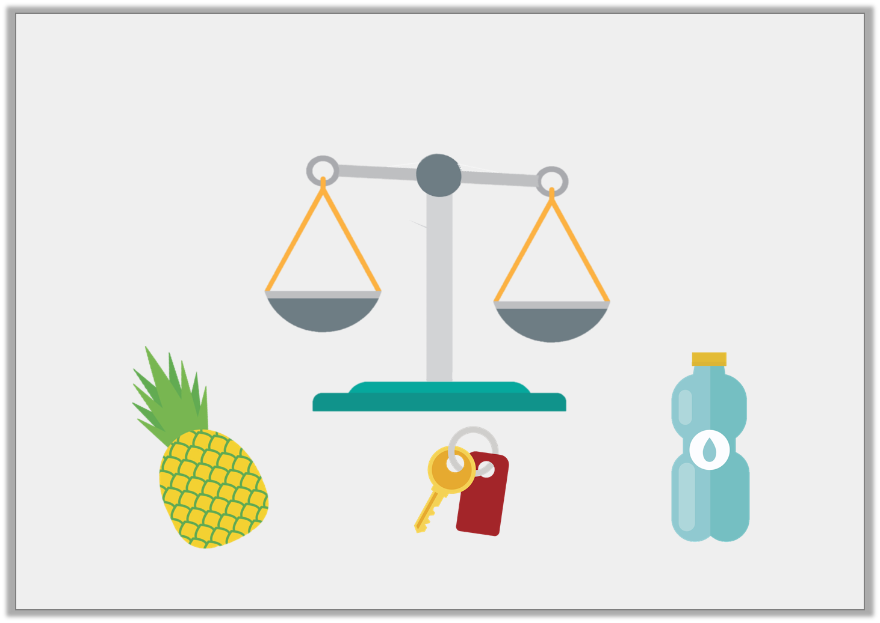
Problem Solving 2
Draw an arrow to show how you could position the objects on the scales to make them balance.
7 blocks
3 blocks
10 blocks
Y1

Slide 2
Problem Solving 2
Draw an arrow to show how you could position the objects on the scales to make them balance.
+
=
7 blocks
7 blocks
3 blocks
3 blocks
10 blocks
10 blocks
Y1

Slide 3
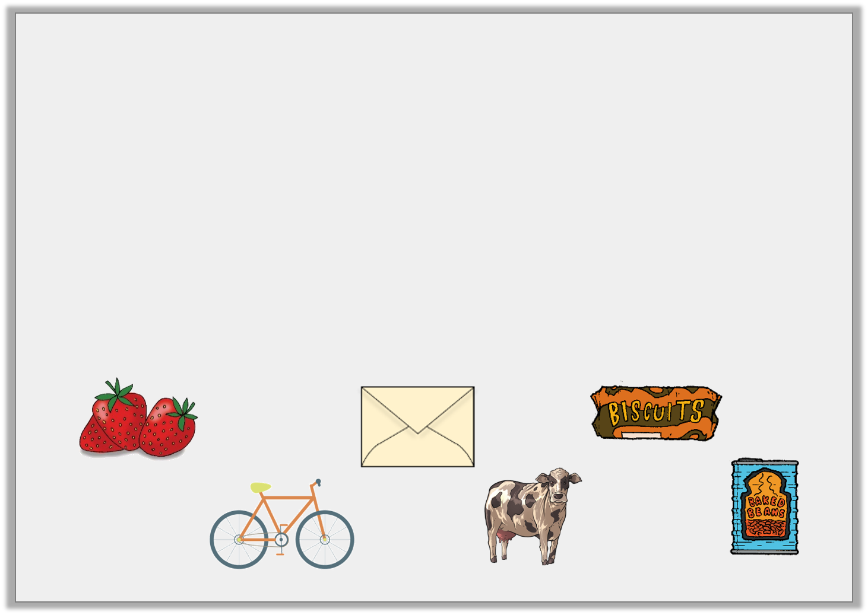
Problem Solving 1
Sort the objects into the table.
Things you would weigh in kilograms | Things you would weigh in grams
Y2

Slide 4
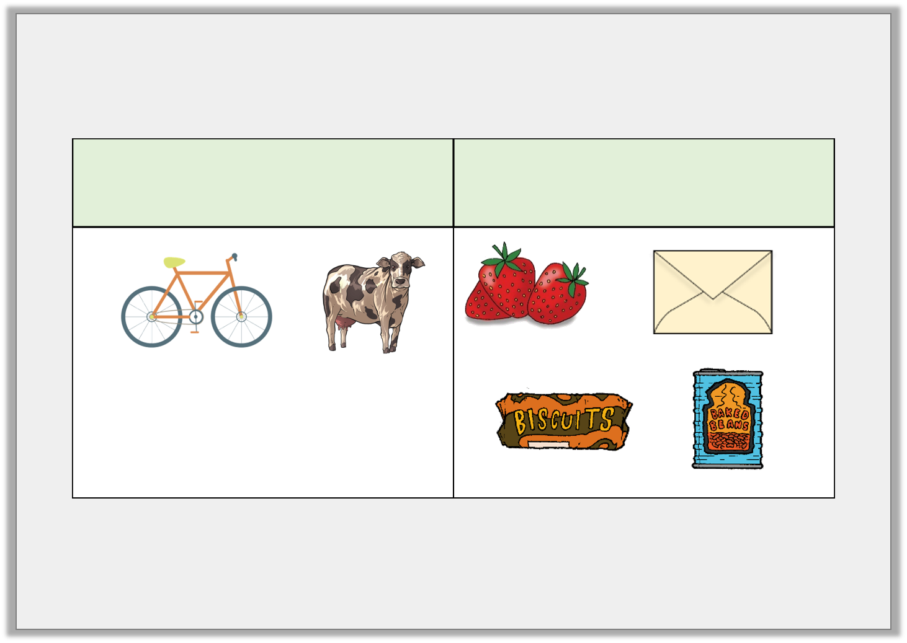
Problem Solving 1
Sort the objects into the table.
Things you would weigh in kilograms | Things you would weigh in grams
Y2

Slide 5
Problem Solving 2
Use < or > to complete this statement.
Dog |  | Cow |  | Chair
30kg |  | 290kg |  | 8kg
Y2

Slide 6
Problem Solving 2
Use < or > to complete this statement.
Dog |  | Cow |  | Chair
30kg |  | 290kg |  | 8kg
<
>
Y2

Slide 7
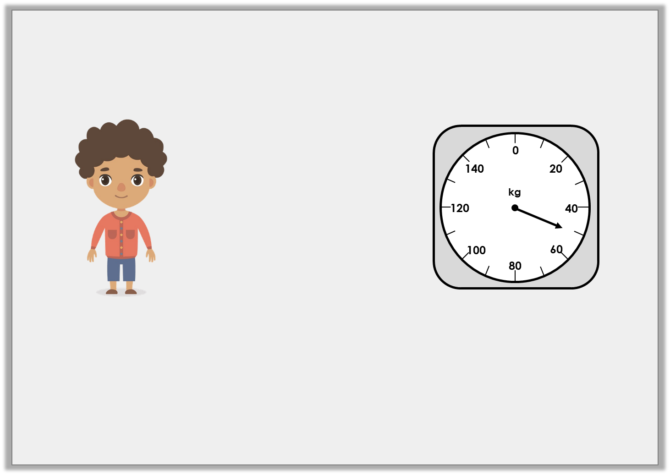
Reasoning 1
The scale shows how much a Year 2 child weighs.
Is Nick correct? How can you tell?
I weigh 41kg.
Y2

Slide 8
Reasoning 1
The scale shows how much a Year 2 child weighs.
Is Nick correct? How can you tell?
Nick is incorrect because…
I weigh 41kg.
Y2

Slide 9
Reasoning 1
The scale shows how much a Year 2 child weighs.
Is Nick correct? How can you tell?
Nick is incorrect because the scale shows 50kg.
I weigh 41kg.
Y2

