Slide 1
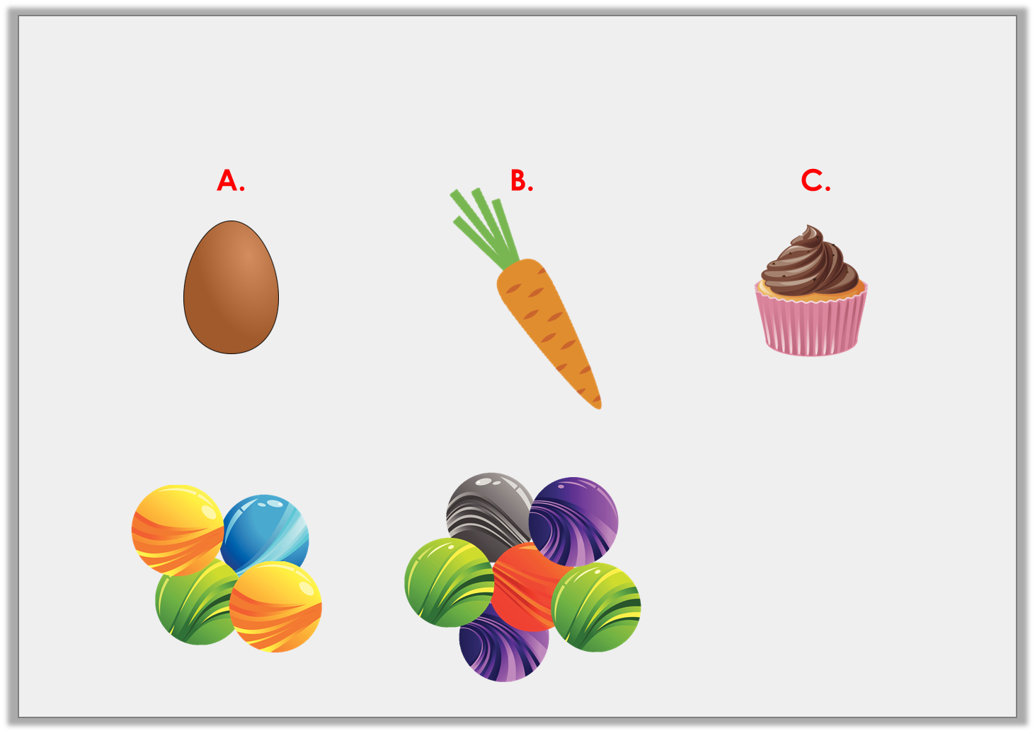
Varied Fluency 3
Order the objects, heaviest to lightest.
an egg
weighs
a carrot
weighs
a bun
weighs
2 marbles lighter than an egg
Y1

Slide 2
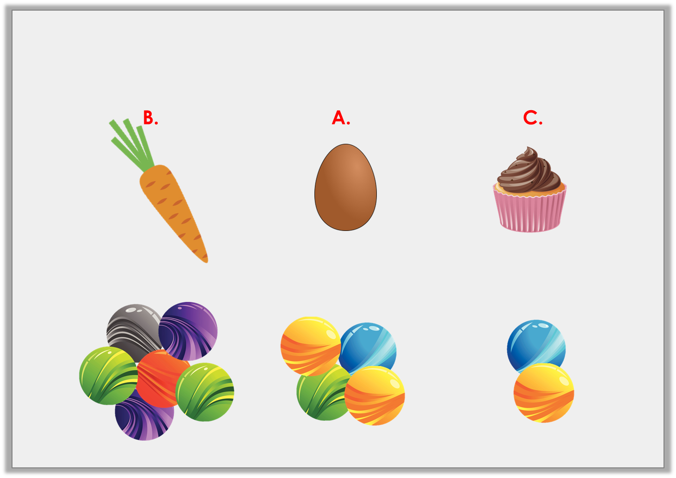
Varied Fluency 3
Order the objects, heaviest to lightest.
a carrot
weighs
an egg
weighs
a bun
weighs
Y1

Slide 3
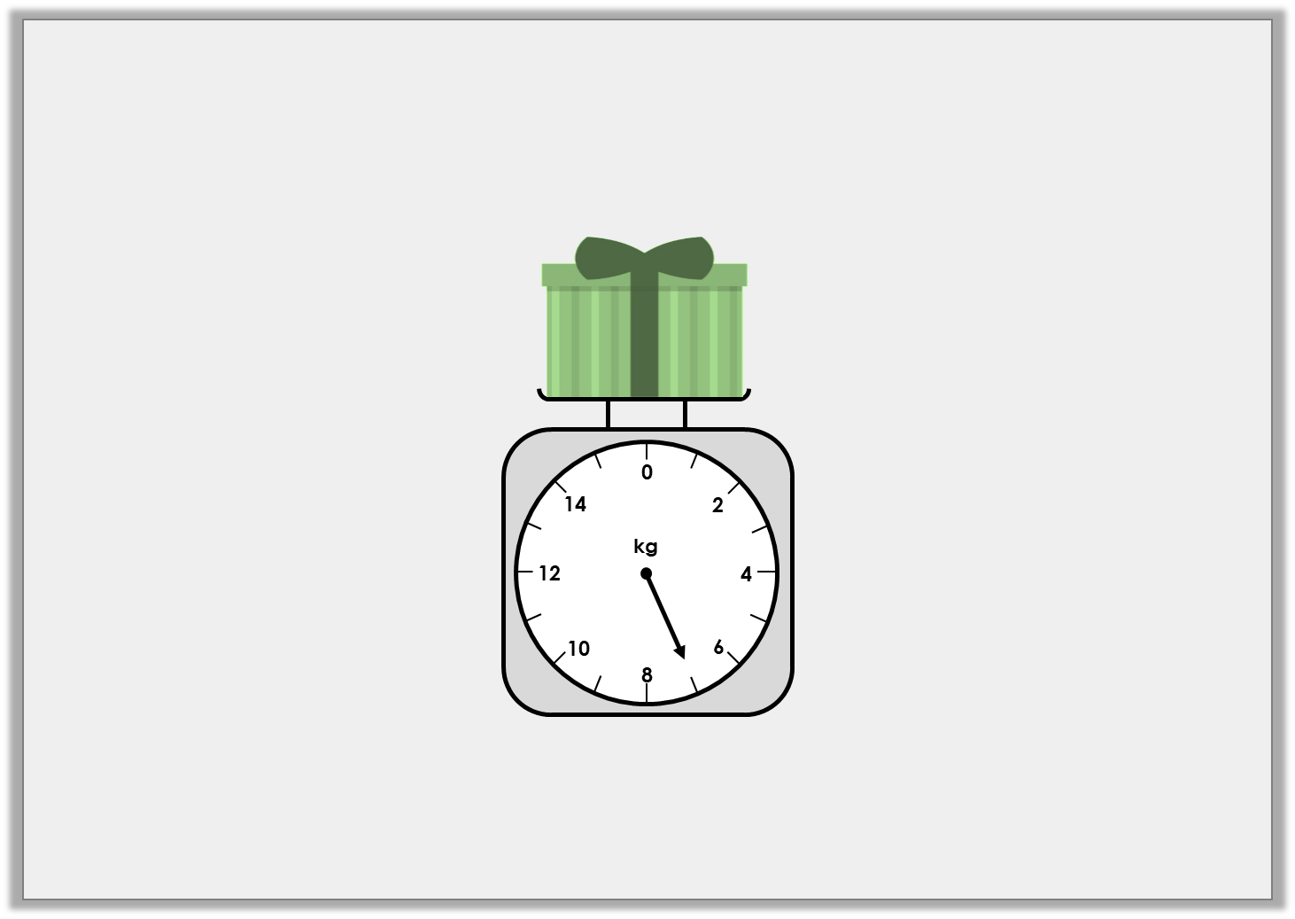
Varied Fluency 1
What weight does the scale show?
Y2

Slide 4
Varied Fluency 1
What weight does the scale show?
7kg
Y2

Slide 5
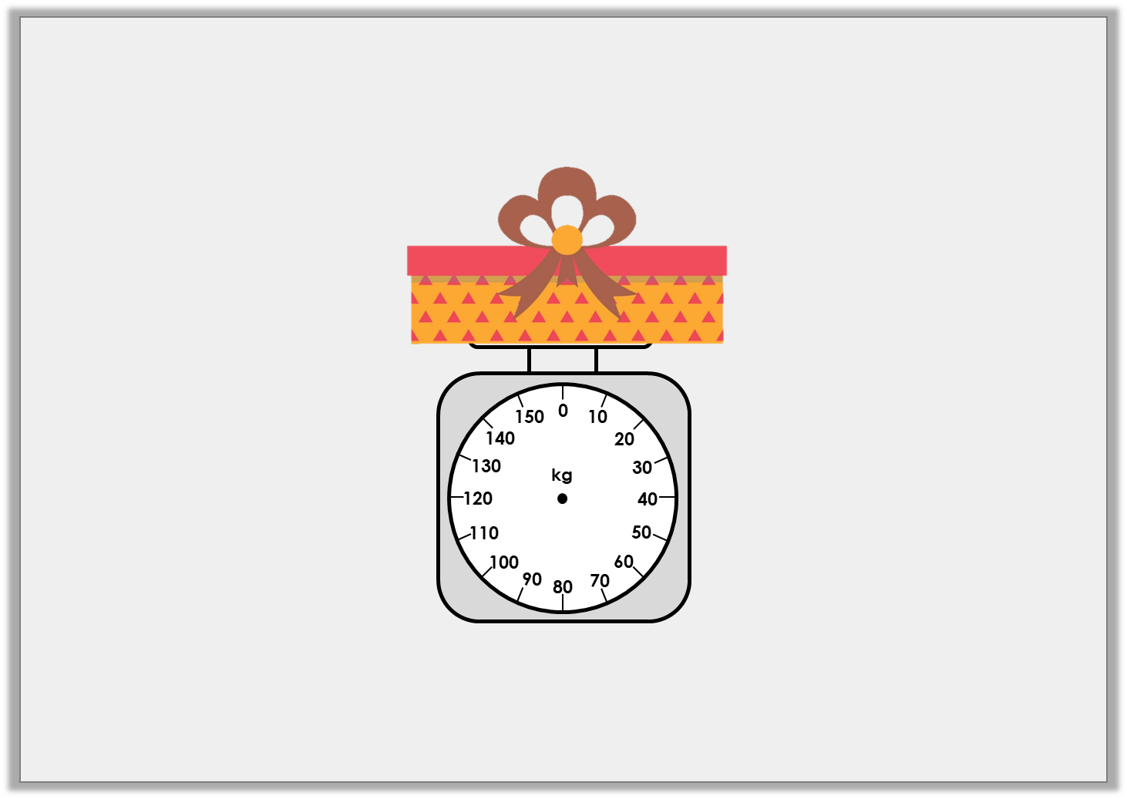
Varied Fluency 2
Add an arrow to the scale so that it shows 60kg.
Y2

Slide 6
Varied Fluency 2
Add an arrow to the scale so that it shows 60kg.
Y2

Slide 7
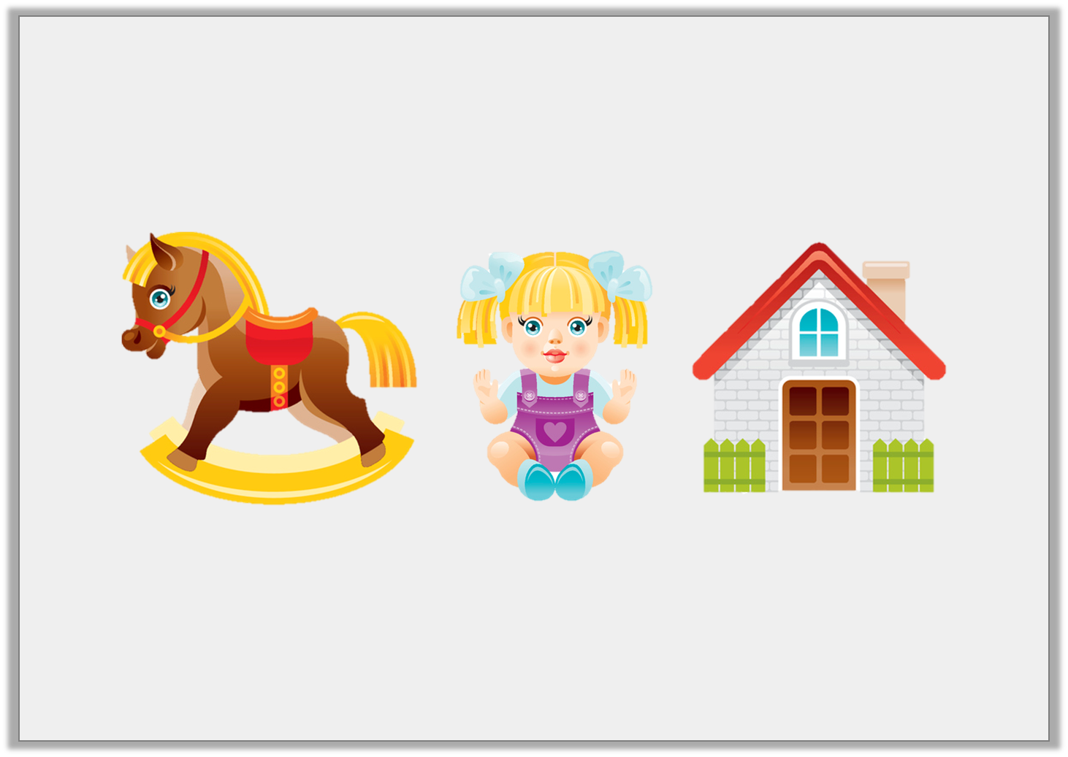
Varied Fluency 3
Order these toys from lightest to heaviest.
20kg
12kg
15kg
Y2

Slide 8
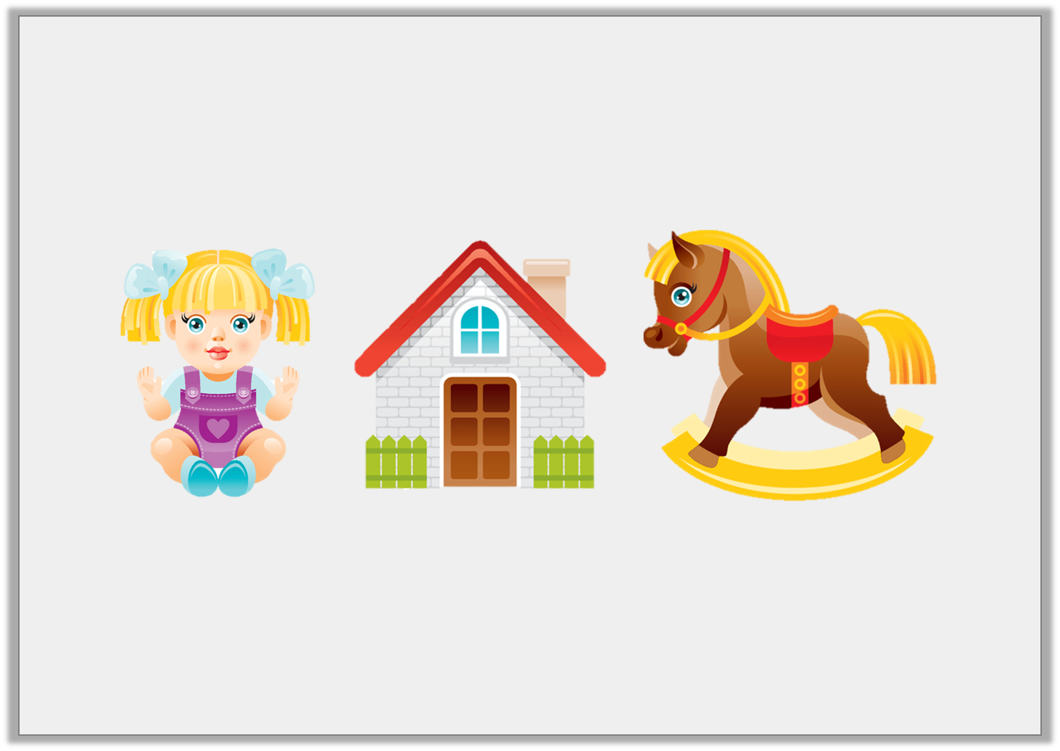
Varied Fluency 3
Order these toys from lightest to heaviest.
12kg
15kg
20kg
Y2

