Slide 1
Year 1/2 – Spring Block 4 – Weight and Volume
Step 3
Year 1: Compare Mass
Year 2: Measure Mass (kg)

Slide 2
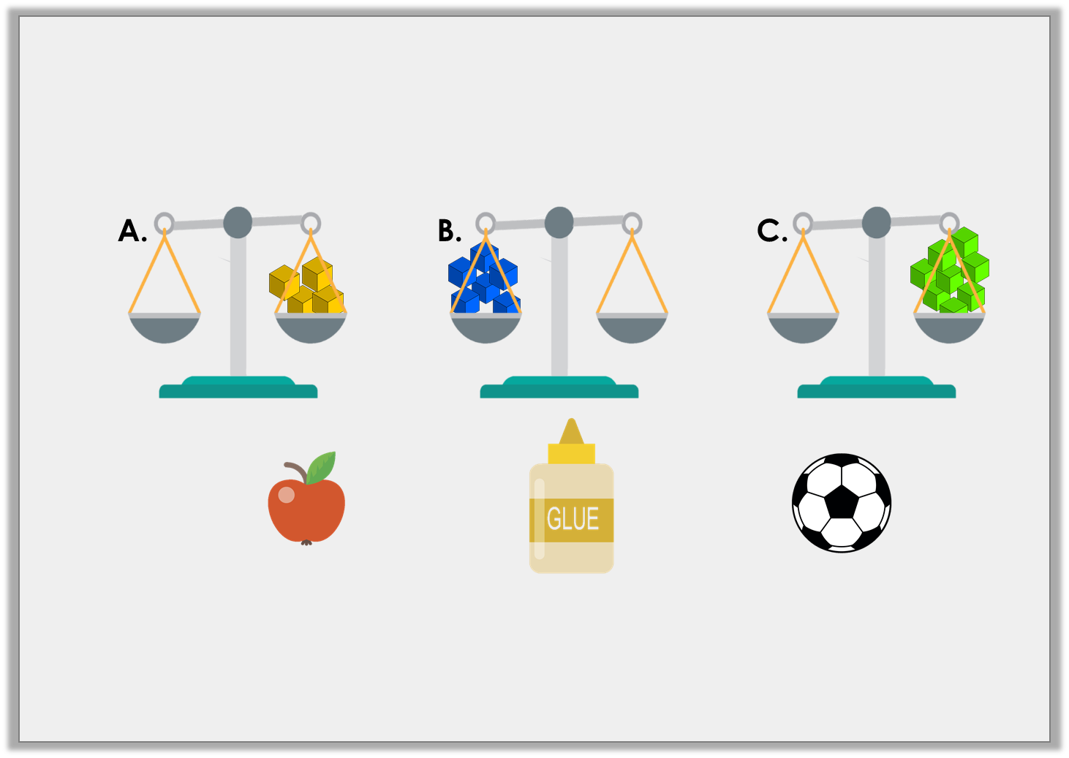
Introduction
Match the object to the correct scale.
4 cubes
8 cubes
6 cubes
Y1

Slide 3
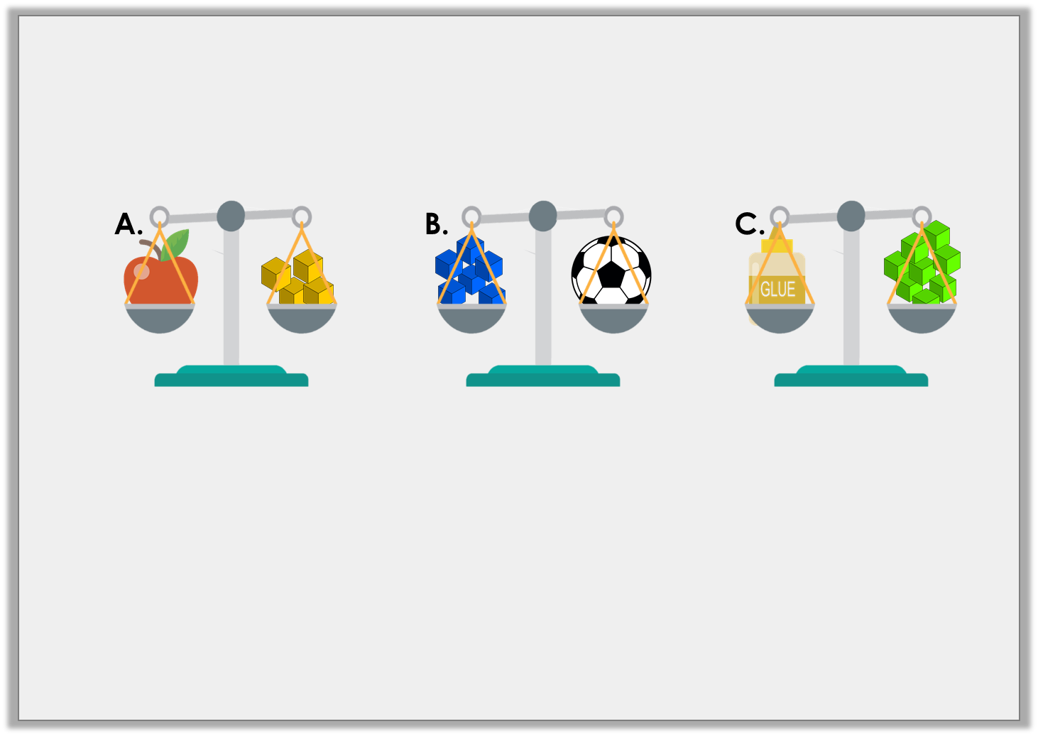
Introduction
Match the object to the correct scale.
4 cubes
6 cubes
8 cubes
Y1

Slide 4
Introduction
Identify which kilogram each arrow is pointing to on the scales.
20kg
30kg
10kg
20kg
30kg
10kg
35kg
60kg
Y2

Slide 5
Introduction
Identify which kilogram each arrow is pointing to on the scales.
20kg
25kg
30kg
10kg
20kg
26kg
30kg
10kg
20kg
35kg
60kg
Y2

Slide 6
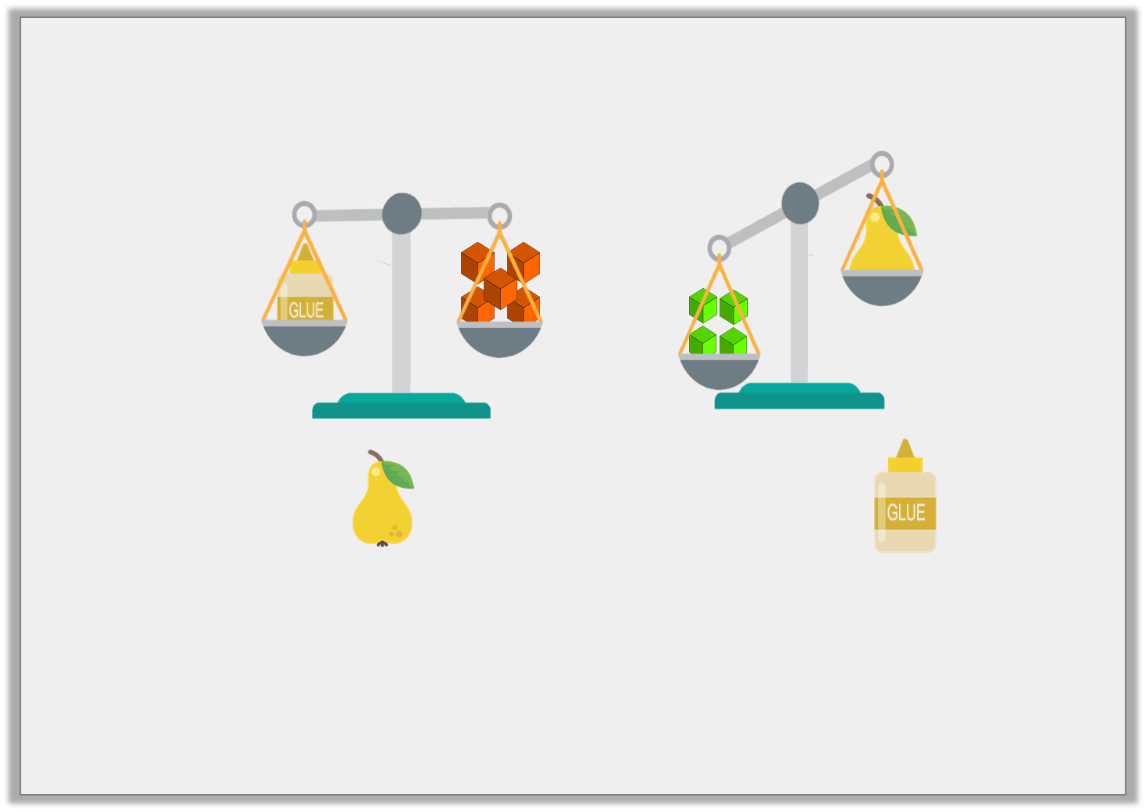
Varied Fluency 1
Choose the word to complete the sentence below.
The is than the .
heavier
lighter
Y1

Slide 7
Varied Fluency 1
Choose the word to complete the sentence below.
The is than the .
lighter
heavier
lighter
Y1

Slide 8
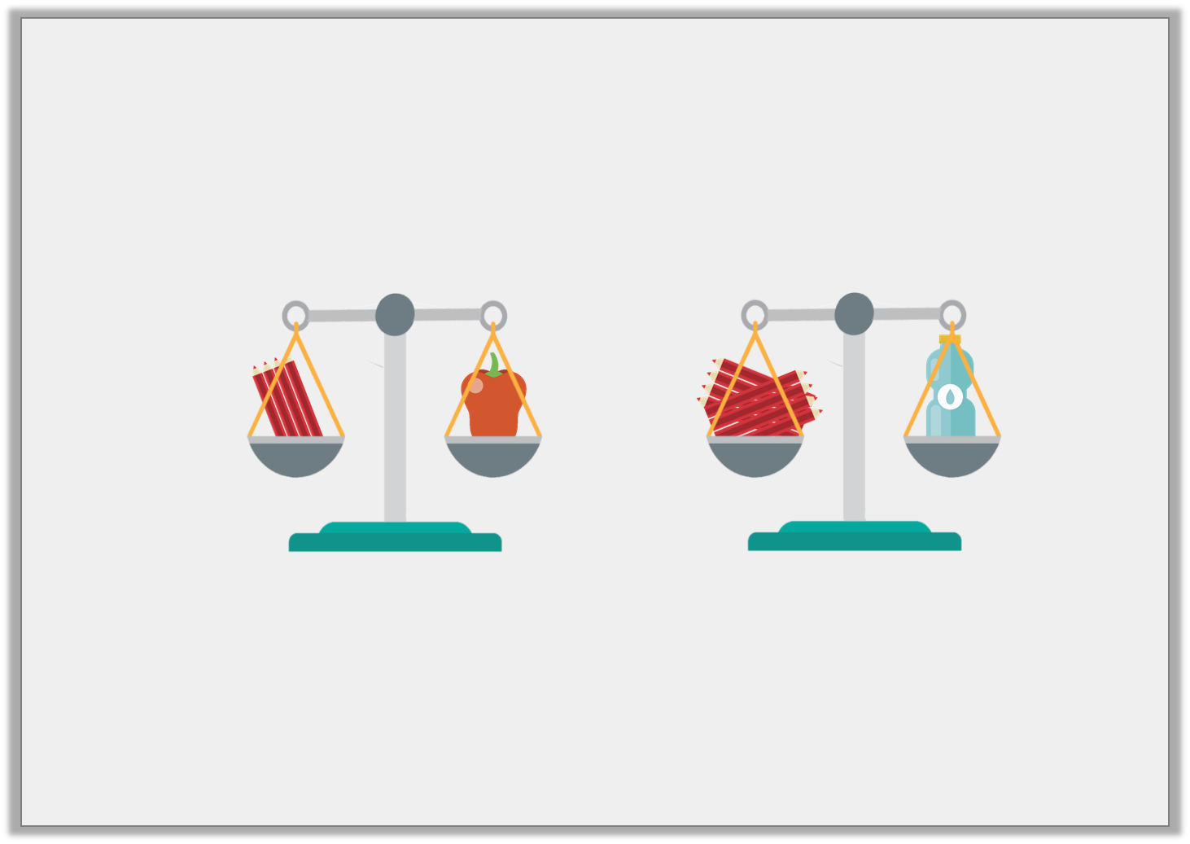
Varied Fluency 2
True or false? The bottle is heavier than the pepper.
Y1

Slide 9
Varied Fluency 2
True or false? The bottle is heavier than the pepper.
True, the bottle weighs 8 pencils and the pepper weighs 4 pencils.
Y1

