Slide 1
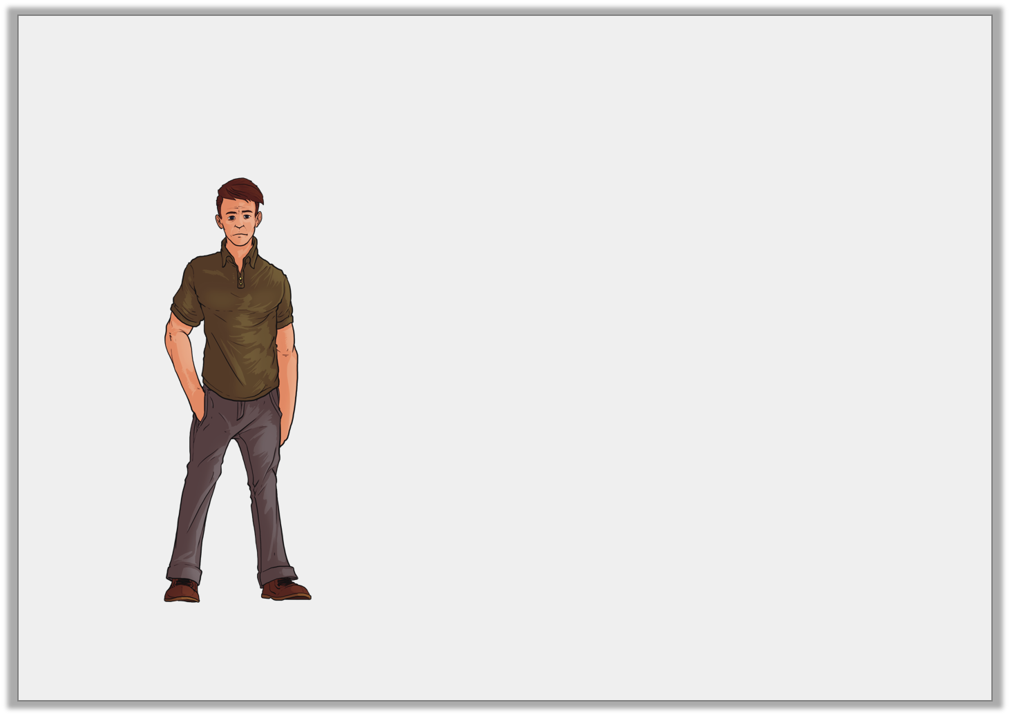
Varied Fluency 4
Circle the most reasonable estimate for the mass of this person.
10kg |  | 1kg |  | 100kg
Y2

Slide 2
Varied Fluency 4
Circle the most reasonable estimate for the mass of this person.
10kg |  | 1kg |  | 100kg
Y2

Slide 3
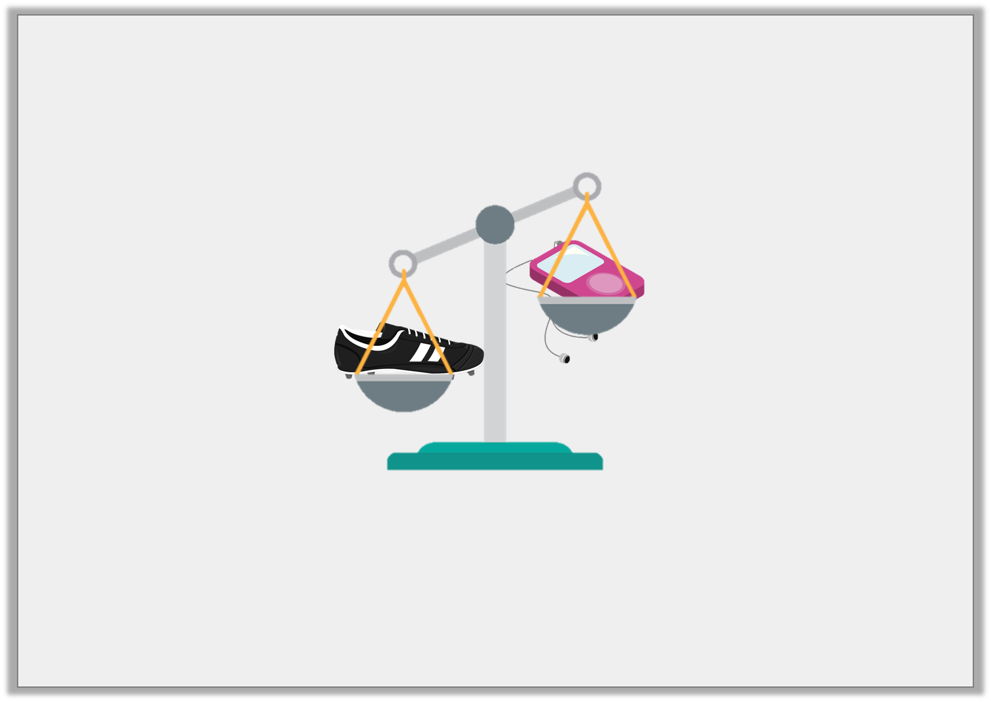
Problem Solving 1
A football boot weighs 20 pencils.
A music player weighs 7 pencils.
How many pencils are needed to make the scales balance?
5
13
3
Y1

Slide 4
Problem Solving 1
A football boot weighs 20 pencils.
A music player weighs 7 pencils.
How many pencils are needed to make the scales balance?
5
13
3
Y1

Slide 5
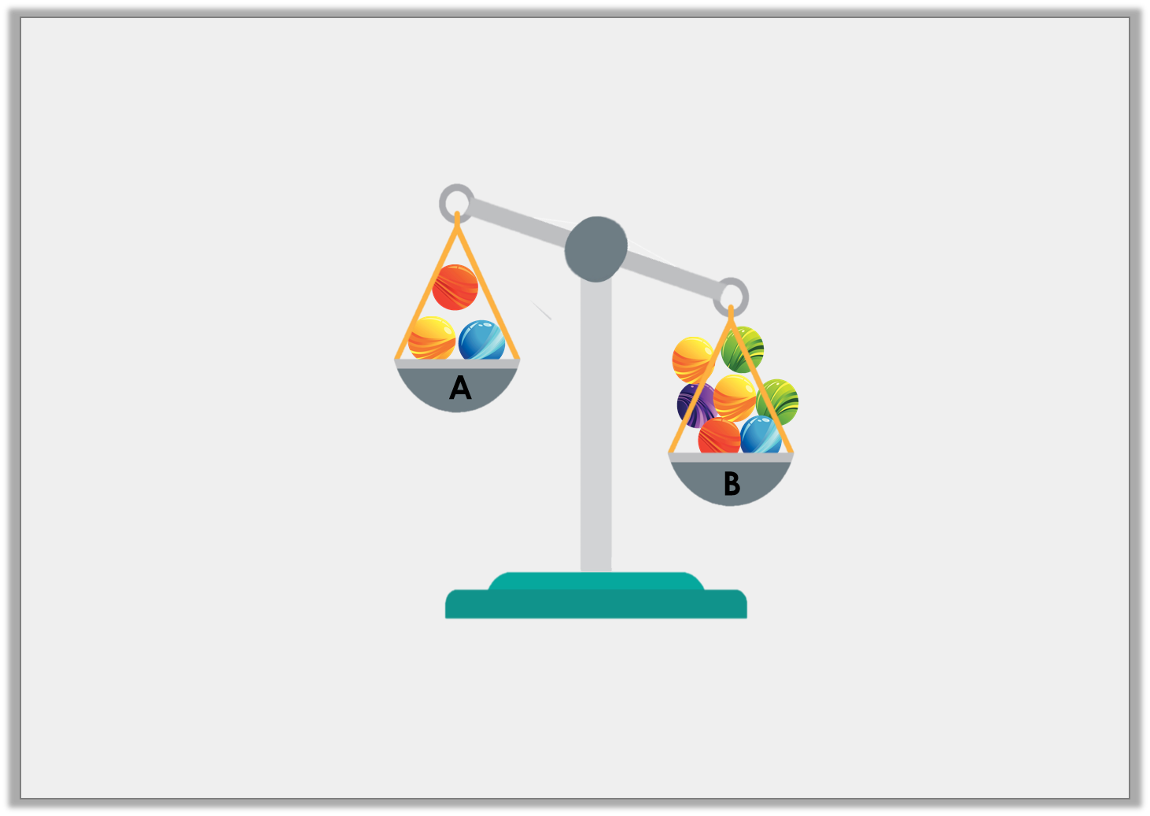
Reasoning 1
George wants the scales to balance. He thinks he could move some marbles to do this.
Is he correct? Explain your answer.
Y1

Slide 6
Reasoning 1
George wants the scales to balance. He thinks he could move some marbles to do this.
Is he correct? Explain your answer.
Y1

Slide 7
Reasoning 1
George wants the scales to balance. He thinks he could move some marbles to do this.
Is he correct? Explain your answer.
He is correct because he could move 2 marbles from tray B to tray A, so that they would then have 5 marbles on each side.
Y1

