Slide 1
NAMES OF BASIC ANIMALS

Slide 2
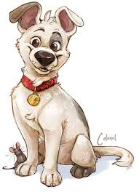
Dog - كَلْبٌ

Slide 3
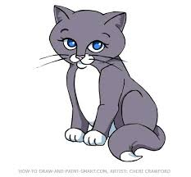
Cat- قِطٌّ

Slide 4
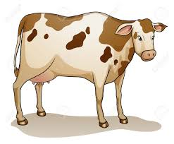
Cow - بَقَرَةٌ

Slide 5
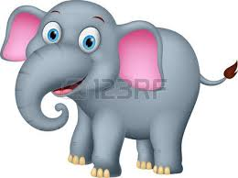
Elephant - فِيْلٌ

Slide 6
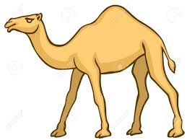
Camel - جَمَلٌ

Slide 7
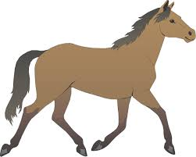
Horse – حِصَانٌ

Slide 8
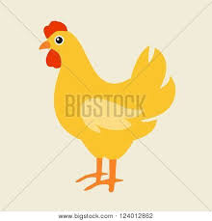
Chicken - دَجَاجَةٌ

Slide 9
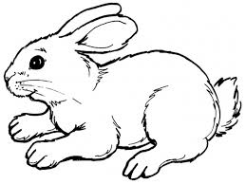
Rabbit - أَرْنَبٌ

