Slide 1
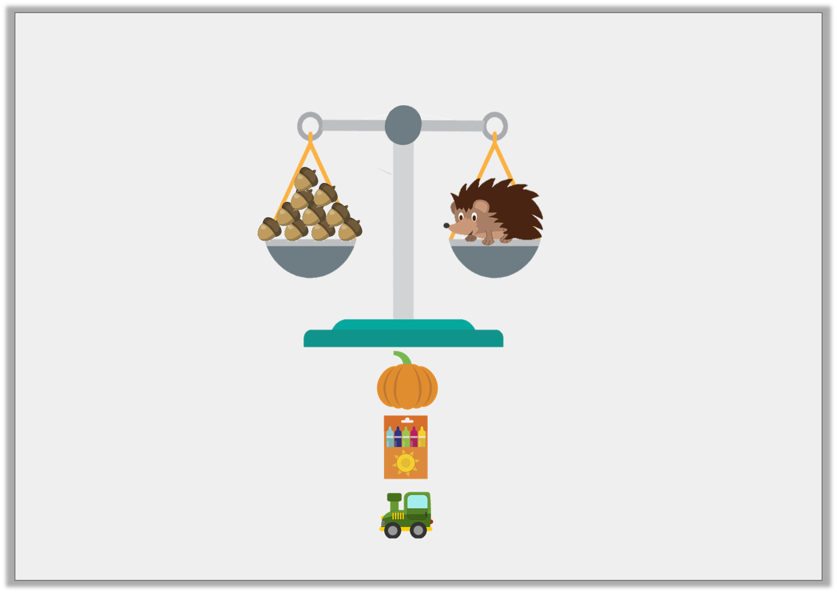
Varied Fluency 3
Which object weighs more than the hedgehog?
pumpkin
crayons
toy
12 acorns
8 acorns
10 acorns
Y1

Slide 2
Varied Fluency 3
Which object weighs more than the hedgehog?
pumpkin
crayons
toy
12 acorns
8 acorns
10 acorns
Y1

Slide 3
Varied Fluency 1
Order these amounts from smallest to largest.
62g |  | 48g |  | 46g
Y2

Slide 4
Varied Fluency 1
Order these amounts from smallest to largest.
46g, 48g, 62g
62g |  | 48g |  | 46g
Y2

Slide 5
Varied Fluency 2
Complete the sentence using ‘more’ or ‘less’.
The duck weighs _______ than the yo-yo.
240g
56g
Y2

Slide 6
Varied Fluency 2
Complete the sentence using ‘more’ or ‘less’.
The duck weighs _______ than the yo-yo.
less
240g
56g
Y2

Slide 7
Varied Fluency 3
Circle the object that weighs the most.
108g
424g
362g
Y2

Slide 8
Varied Fluency 3
Circle the object that weighs the most.
108g
424g
362g
Y2

