Slide 1
مُوَاصَلاتٌ TRANSPORTS

Slide 2
سَيَّارَةٌ
CAR

Slide 3
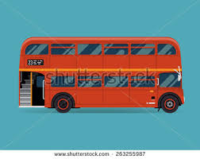
حَافِلَةٌ
BUS

Slide 4
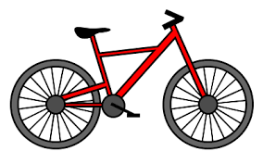
دَرَّاجَةٌ
BICYCLE

Slide 5
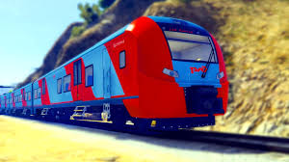
قِطَارٌ
TRAIN

Slide 6
طَاءِرَةٌ
PLANE

Slide 7
سَفِيْنَةٌ
SHIP

