Slide 1
Varied Fluency 3
Fill the circle using <, > or =.
Y1

Slide 2
Varied Fluency 3
Fill the circle using <, > or =.
=
Y1

Slide 3
Varied Fluency 4
Who has the most teddies?
Lee
Pip
Kim
Y1

Slide 4
Varied Fluency 4
Who has the most teddies?
Pip has the most teddies.
Lee
Pip
Kim
Y1

Slide 5
Varied Fluency 1
Tick the statement that is true.
A.
B.
Y2

Slide 6
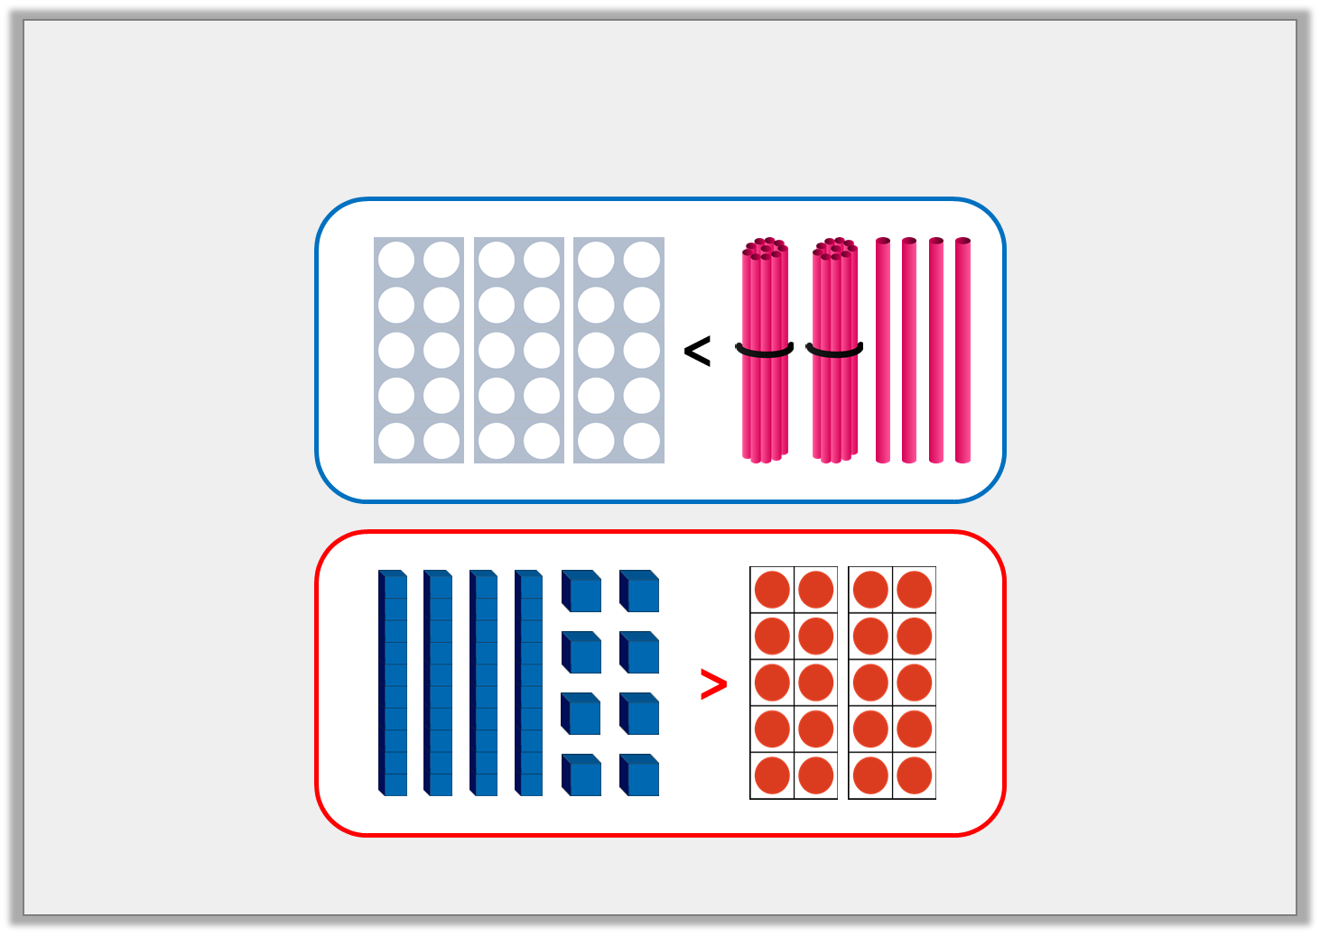
Varied Fluency 1
Tick the statement that is true.
A.
B.
✓
Y2

Slide 7
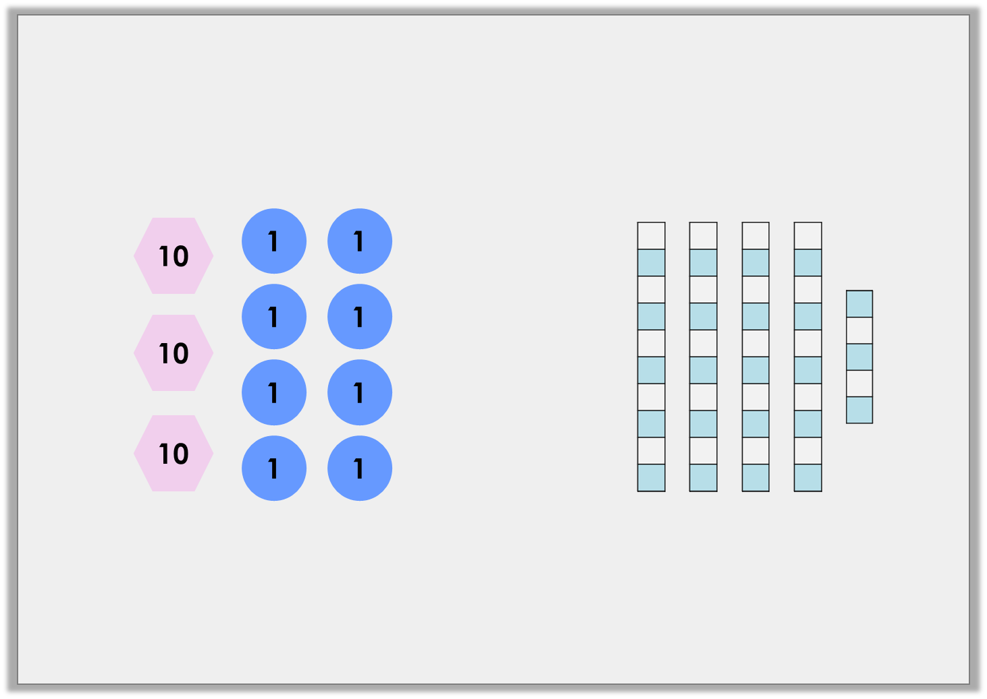
Varied Fluency 2
Which representation shows the most?
A.
B.
Y2

Slide 8
Varied Fluency 2
Which representation shows the most?
A.
B.
Y2

