Slide 1
Year 1/2 – Autumn Block 4 – Place Value – Step 7
Year 1: Compare Groups of Objects
Year 2: Compare Objects

Slide 2
Introduction
Complete the sentences using the groups below.
_______ is greater than _______
_______ is less than _______
_______ is equal to _______
A
B
C
Y1

Slide 3
Introduction
Complete the sentences using the groups below.
B is greater than A and C
A or C is less than B
A is equal to C
A
B
C
Y1

Slide 4
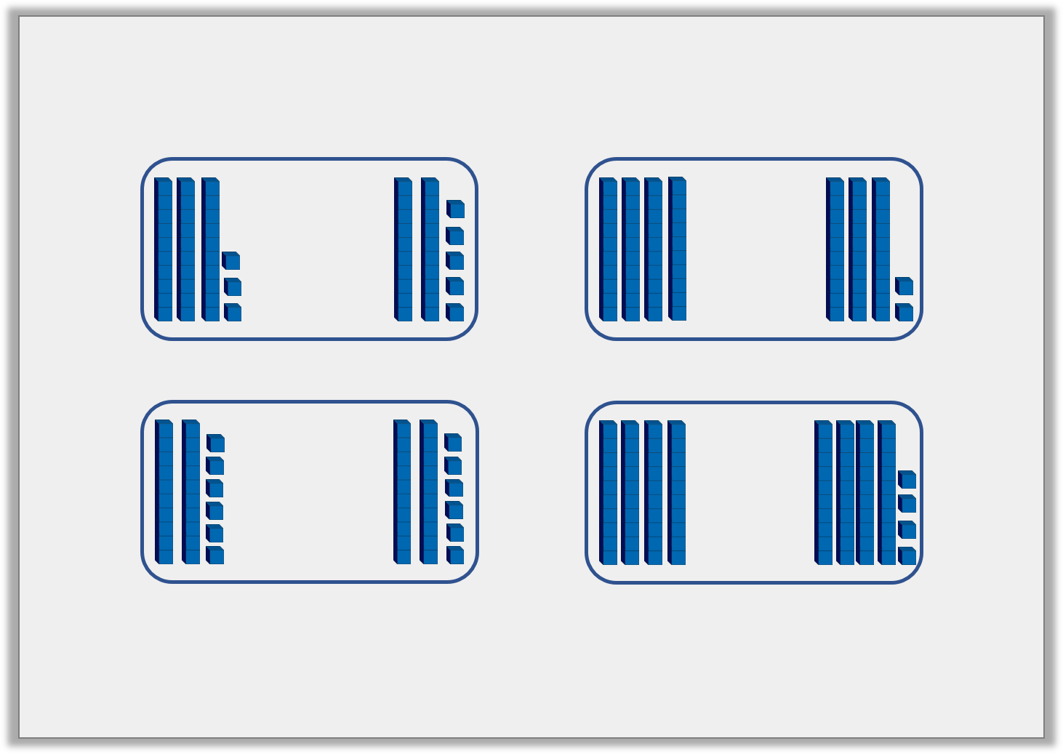
Introduction
Use the word bank below to compare the Base 10.
more than
less than
equal to
Y2

Slide 5
Introduction
Use the word bank below to compare the Base 10.
more than
more than
equal to
less than
more than
less than
equal to
Y2

Slide 6
Varied Fluency 1
Which tray has the most pencils?
A
B
C
Y1

Slide 7
Varied Fluency 1
Which tray has the most pencils?
A
A
B
C
Y1

Slide 8
Varied Fluency 2
True or false? Group B has more than group A.
A
B
Y1

Slide 9
Varied Fluency 2
True or false? Group B has more than group A.
True. A has 10 eggs whereas B has 11 eggs.
A
B
Y1

