Slide 1
Varied Fluency 3
Complete the pattern.
Give your answer in words.
15, fourteen, __________ , 12, __________ , 10
Y1

Slide 2
Varied Fluency 3
Complete the pattern.
Give your answer in words.
15, fourteen, __________ , 12, __________ , 10
thirteen
eleven
Y1

Slide 3
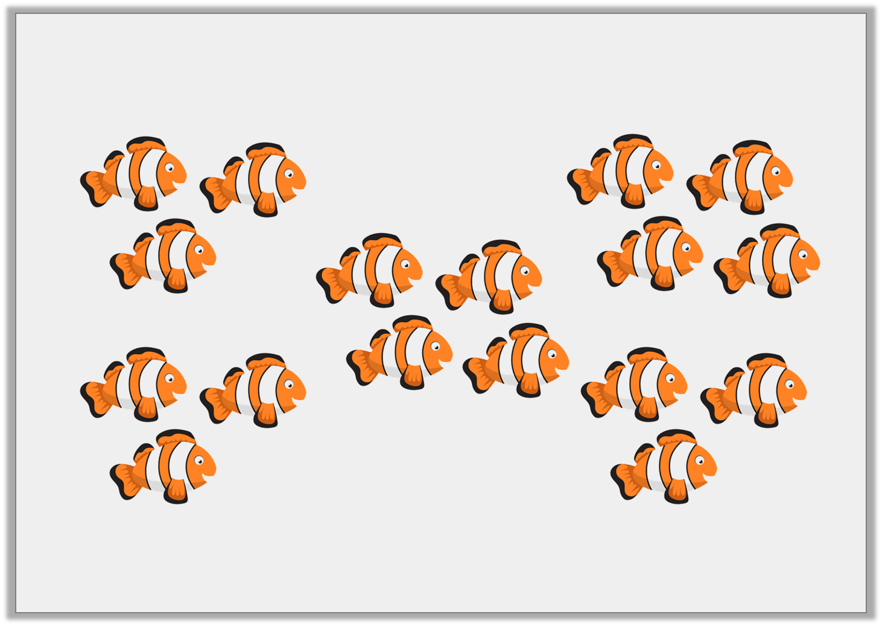
Varied Fluency 4
True or false? There are nineteen fish.
Y1

Slide 4
Varied Fluency 4
True or false? There are nineteen fish.
False, there are seventeen.
Y1

Slide 5
Varied Fluency 1
Match each diagram to its number.
A
fifty- one
16
B
sixty
C
Y2

Slide 6
Varied Fluency 1
Match each diagram to its number.
A
fifty- one
16
B
sixty
C
Y2

Slide 7
Varied Fluency 2
What number is one more than
What number is one less than
?
?
Y2

Slide 8
Varied Fluency 2
What number is one more than
What number is one less than
63
64
Y2

