Slide 1
Varied Fluency 3
Jasmine starts at eighty-three and counts
in ones on a number line.
What are the next four numbers she will say?
 | 83
Y2

Slide 2
Varied Fluency 3
Jasmine starts at eighty-three and counts
in ones on a number line.
What are the next four numbers she will say?
 | 83 |  |  | 84 |  |  | 85 |  |  | 86 |  |  | 87
Y2

Slide 3
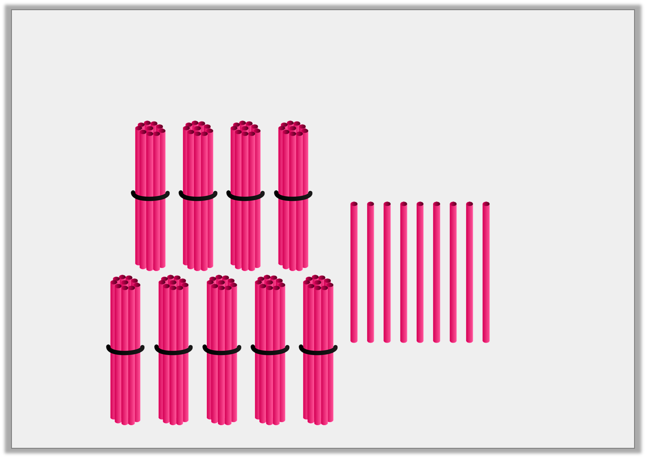
Varied Fluency 4
True or false? The number shown below is 89.
Y2

Slide 4
Varied Fluency 4
True or false? The number shown below is 89.
False. The number shown is 99.
Y2

Slide 5
Problem Solving 1
Leo Lion is making his way through the maze.
Which numbers are missing? Write them as numbers and words.
thirteen | _______ |  | 18
 | _______ | _______
out
in
Y1

Slide 6
Problem Solving 1
Leo Lion is making his way through the maze.
Which numbers are missing? Write them as numbers and words.
14 – fourteen, 15 – fifteen, 16 – sixteen
thirteen | 14 fourteen |  | 18
 | 15 fifteen | 16 sixteen
out
in
Y1

Slide 7
Problem Solving 2
Kai thinks of a number.
What could Kai’s number be?
Give your answers as numbers and as words.
My number is between 11 and 14.
Y1

Slide 8
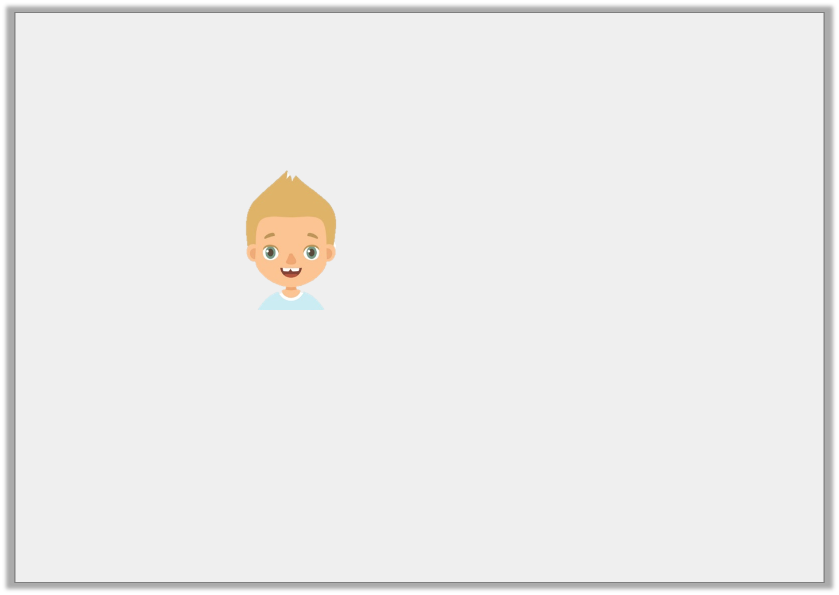
Problem Solving 2
Kai thinks of a number.
What could Kai’s number be?
Give your answers as numbers and as words.
My number is between 11 and 14.
Y1

Slide 9
Problem Solving 2
Kai thinks of a number.
What could Kai’s number be?
Give your answers as numbers and as words.
Kai’s number could be 12, twelve or 13, thirteen.
My number is between 11 and 14.
Y1

