Slide 1
Year 5 – Summer Block 1 – Converting Units – Step 4
About This Resource:
This PowerPoint has been designed to support teaching of the small steps. It includes a starter activity suitable for the year group and an example of each question from the Varied Fluency and Reasoning and Problem Solving resources also provided in the tasks. Each slide has the year group identified in the bottom right-hand corner. I recommend that you look through this PowerPoint in advance and decide whether to work through all examples provided or a selection of them depending on the needs of your child.
The PowerPoint has been dated for the week, so please work your way through it each day.
Note:
The conversions used in the Year 5 resource are:
1 inch = 2.54cm
1 pint = 568ml
1kg = 2.2lbs

Slide 2
Year 5 – Summer Block 1 – Converting Units
Tuesday 5th May 2020
Step 4
Year 5: Imperial Units

Slide 3
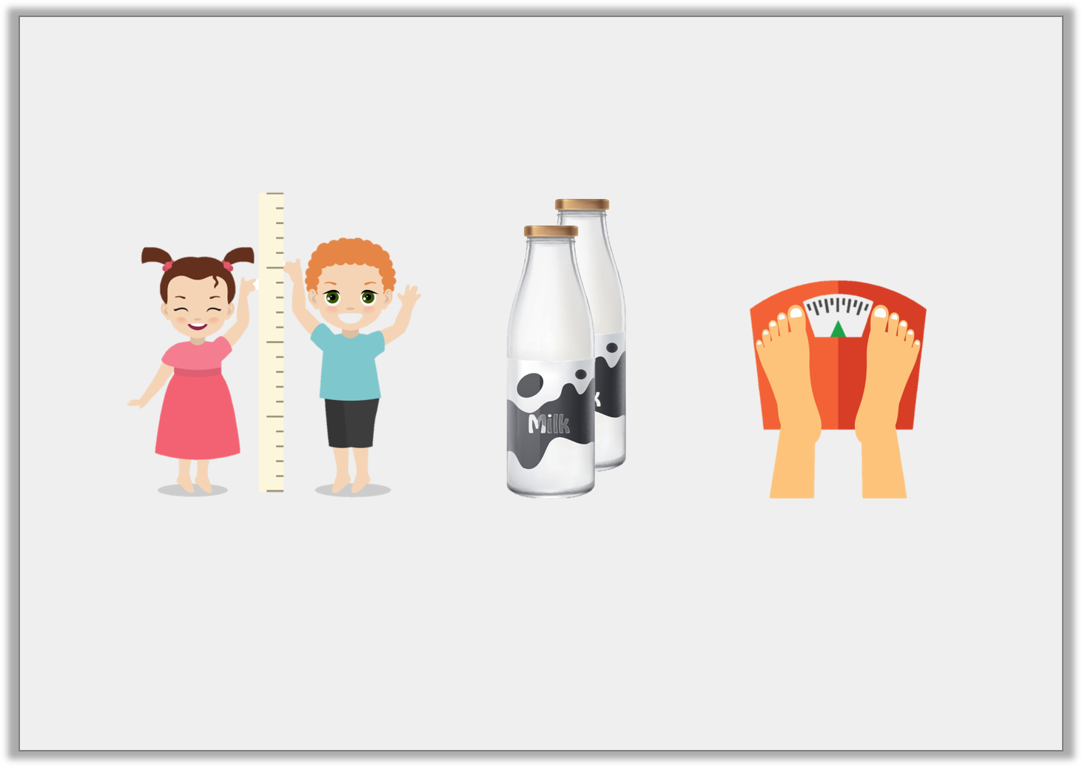
Introduction
Which imperial units of measure would you associate with these images?
When else might you see these common imperial measures used in everyday life?
inches
pounds
pints
Y5

Slide 4
Introduction
Which imperial units of measure would you associate with these images?
When else might you see these common imperial measures used in everyday life?
Various individual responses.
inches
pints
pounds
Y5

Slide 5
Varied Fluency 1
If 1 pint = 568ml, circle the measurement that are less than 5 pints.
957ml | 2419ml
2850ml | 3000ml
2951ml | 1989ml
2838ml | 7502ml
Y5

Slide 6
Varied Fluency 1
If 1 pint = 568ml, circle the measurement that are less than 5 pints.
957ml | 2419ml
2850ml | 3000ml
2951ml | 1989ml
2838ml | 7502ml
Y5

Slide 7
Varied Fluency 2
True or false?
If 1 inch = 2.54cm,
3 inches = 7.26cm.
Y5

Slide 8
Varied Fluency 2
True or false?
If 1 inch = 2.54cm,
3 inches = 7.26cm.
False
It is 7.62cm
Y5

Slide 9
Varied Fluency 3
If 1kg = 2.2lbs, how much is 28kg?
Circle the correct measurement.
60.5lbs | 75.4lbs
61.6lbs | 69.8lbs
Y5

Slide 10
Varied Fluency 3
If 1kg = 2.2lbs, how much is 28kg?
Circle the correct measurement.
60.5lbs | 75.4lbs
61.6lbs | 69.8lbs
Y5

Slide 11
Varied Fluency 4
Fill in the blank below.
If 5kg = 11lbs, 4 watering cans will weigh ________ lbs.
3kg
Y5

Slide 12
Varied Fluency 4
Fill in the blank below.
If 5kg = 11lbs, 4 watering cans will weigh ________ lbs.
26.4
3kg
Y5

Slide 13
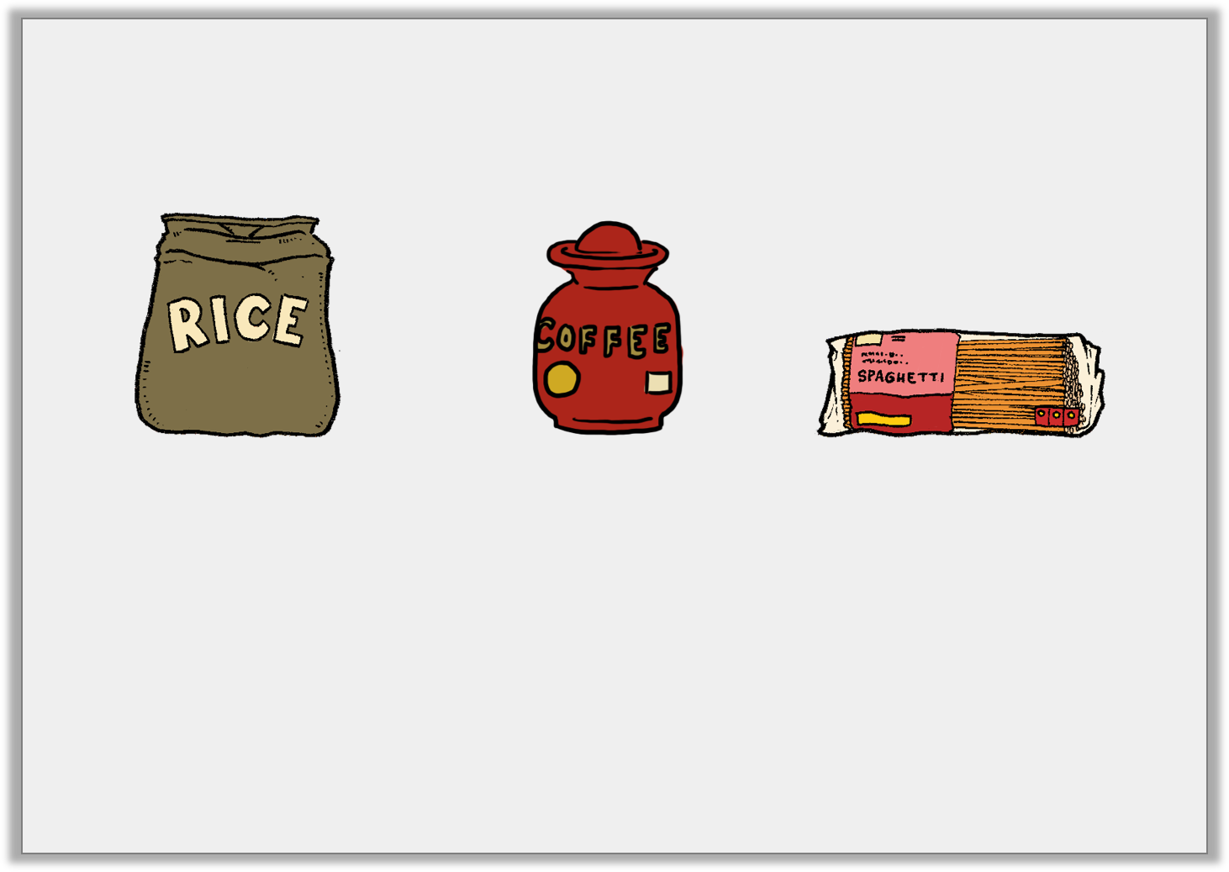
Reasoning 1
Wednesday 6th May 2020
Which weight is the odd one out? Why?
Four bags of rice
Three jars of coffee
Three packs of spaghetti
420g
0.616lbs
0.56kg
Y5

Slide 14
Reasoning 1
Which weight is the odd one out? Why?
Four bags of rice
Three jars of coffee
Three packs of spaghetti
Coffee is the odd one out because…
420g
0.616lbs
0.56kg
Y5

Slide 15
Reasoning 1
Which weight is the odd one out? Why?
Four bags of rice
Three jars of coffee
Three packs of spaghetti
Coffee is the odd one out because it weighs 0.616lbs whereas the other weighs 3.696lbs.
420g
0.616lbs
0.56kg
Y5

Slide 16
Problem Solving 1
Use all four digit cards to find three different solutions to this statement.
1
2
7
9
3 pints | < |  | ml
Y5

Slide 17
Problem Solving 1
Use all four digit cards to find three different solutions to this statement.
Various answers; must be bigger than 1,704ml, for example: 1,729ml; 1,792ml; 1,927ml; 1,972ml; 2,179ml; 2,197ml
1
2
7
9
3 pints | < |  | ml
Y5

Slide 18
Reasoning 2
Darius needs 60cm of lace for a project. Lace comes in 6 inch lengths.
Olga says,
“6 inches is 15.24cm inches so you will need 4 lengths of lace.”
If 1 inch = 2.54cm, is Olga correct?
Explain why.
Y5

Slide 19
Reasoning 2
Darius needs 60cm of lace for a project. Lace comes in 6 inch lengths.
Olga says,
“6 inches is 15.24cm inches so you will need 4 lengths of lace.”
If 1 inch = 2.54cm, is Olga correct?
Explain why.
Olga is correct because…
Y5

Slide 20
Reasoning 2
Darius needs 60cm of lace for a project. Lace comes in 6 inch lengths.
Olga says,
“6 inches is 15.24cm inches so you will need 4 lengths of lace.”
If 1 inch = 2.54cm, is Olga correct?
Explain why.
Olga is correct because 4 x 15.24 = 60.96cm, so she has enough lace for the project.
Y5

Slide 21
Year 5 – Summer Block 1 – Measurement: Converting Units
Thursday 7th May 2020
Step 5
Year 5: Imperial Measures

Slide 22
Introduction
8 pints
1 foot
0.56 litres
1 gallon
12 inches
1 inch
2.5 centimetres
1 pint
16 ounces
1 stone
14 pounds
1 ounce
28 grams
1 pound
Y6

Slide 23
Introduction
8 pints
1 foot
0.56 litres
1 gallon
12 inches
1 inch
2.5 centimetres
1 pint
16 ounces
1 stone
14 pounds
1 ounce
28 grams
1 pound
Y6

Slide 24
Varied Fluency 1
Will and Rhys are comparing the heights of their dogs.
Will’s dog is 1 foot 2 inches tall.
Rhys’ dog is 18 inches tall.
Who has the tallest dog?
Y6

Slide 25
Varied Fluency 1
Will and Rhys are comparing the heights of their dogs.
Will’s dog is 1 foot 2 inches tall.
Rhys’ dog is 18 inches tall.
Who has the tallest dog?
Rhys
Y6

Slide 26
Varied Fluency 2
Are the following statements true or false?
gallon = 1 pint
10 inches = 0.25cm
280g = 2 ounces
1
8
Y6

Slide 27
Varied Fluency 2
Are the following statements true or false?
gallon = 1 pint
10 inches = 0.25cm
280g = 2 ounces
A. True B. False C. False
1
8
Y6

Slide 28
Varied Fluency 3
Match the measurements to their conversions.
5 pounds |  | 25cm |  | 1.12 litres
2 pints |  | 80 ounces |  | 10 inches
Y6

Slide 29
Varied Fluency 3
Match the measurements to their conversions.
5 pounds = 80 ounces, 25cm = 10 inches, 1.12 litres = 2 pints
5 pounds |  | 25cm |  | 1.12 litres
2 pints |  | 80 ounces |  | 10 inches
Y6

Slide 30
Varied Fluency 4
Fill in the missing measurements.
inches | = | 100 feet
100 pints | = | litres
pints | = | 0.5 gallon
Y6

Slide 31
Varied Fluency 4
Fill in the missing measurements.
1,200 inches | = | 100 feet
100 pints | = | 56 litres
4 pints | = | 0.5 gallon
Y6

Slide 32
Reasoning 1
Friday 8th May 2020
True or false?
0.25 of a gallon is the
same as 4 pints.
Explain your answer.
Y6

Slide 33
Reasoning 1
True or false?
0.25 of a gallon is the
same as 4 pints.
Explain your answer.
False because…
Y6

Slide 34
Reasoning 1
True or false?
0.25 of a gallon is the
same as 4 pints.
Explain your answer.
False because 1 gallon = 8 pints, so 0.25 = 2 pints
Y6

Slide 35
Reasoning 2
Suzie is converting the volume of her bath.
She says:
Is Suzie correct? Explain your answer.
My bath has a volume of 100 pints which is the same as 560 litres.
Y6

Slide 36
Reasoning 2
Suzie is converting the volume of her bath.
She says:
Is Suzie correct? Explain your answer.
Suzie has multiplied 0.56 litres by 1,000 instead of 100. 1 pint = 0.56 litres so 100 pints = 56 litres.
My bath has a volume of 100 pints which is the same as 560 litres.
Y6

Slide 37
Problem Solving 1
Yusuf is ordering material for a project. He must convert the measurements to cm as they each cost £2 per 10cm.
How much will the material cost?
Amount Needed
8 inches blue
4 inches flowery
1 foot white
Y6

Slide 38
Problem Solving 1
Yusuf is ordering material for a project. He must convert the measurements to cm as they each cost £2 per 10cm.
How much will the material cost?
Blue: 20cm = £4. Flowery: 10cm = £2. White: 30cm = £6
Total cost = £12
Amount Needed
8 inches blue
4 inches flowery
1 foot white
Y6

