Slide 1
Week 7 Tuesday 5th May 2020

Slide 2
Year 3/4 – Summer Block 1 – Money
Step 3
5.05.20
Year 3/4: I can use rounding to estimate money

Slide 3
Introduction
Round each number to the nearest 100 and match
it to the number line.
851
126
575
386
100 | 200 | 300 | 400 | 500 | 600 | 700 | 800 | 900
164
849
270
548
655
Y4

Slide 4
Introduction
Round each number to the nearest 100 and match
it to the number line.
164
386
575
849
100 | 200 | 300 | 400 | 500 | 600 | 700 | 800 | 900
126
270
548
655
851
Y4

Slide 5
Varied Fluency 1
Which whole pounds does the given amount come in between?
Round the amount to the nearest pound.
£7.82
Y4

Slide 6
Varied Fluency 1
Which whole pounds does the given amount come in between?
Round the amount to the nearest pound.
£8.00
£7.82
£7.00
£8.00
Y4

Slide 7
Varied Fluency 2
Match the amounts to the letters on the number line.
A
B
C
£5
£6
£5.95
559p
£5.05
Y4

Slide 8
Varied Fluency 2
Match the amounts to the letters on the number line.
A
B
C
£5
£6
£5.95 | C
559p | B
£5.05 | A
Y4

Slide 9
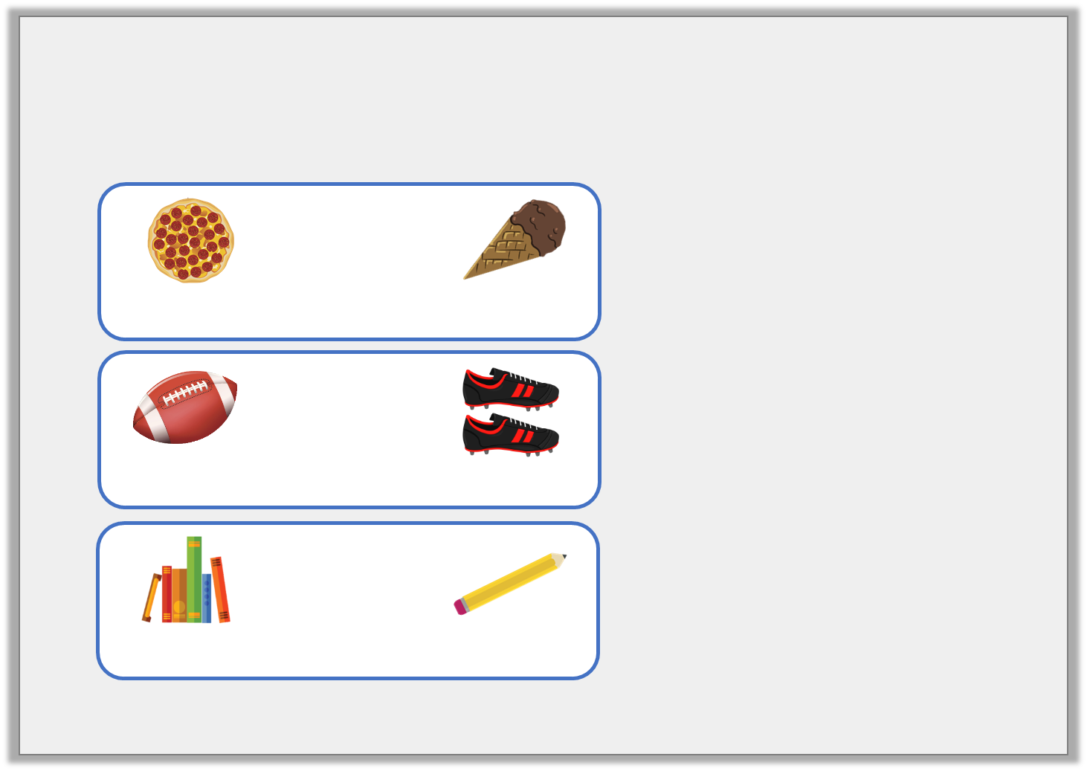
Varied Fluency 3
Match the items to the rounded totals.
 | +
468p |  | £1.67
£4.00
£7.00
£9.00
 | +
225p |  | £6.89
 | +
£3.44 |  | 72p
Y4

Slide 10
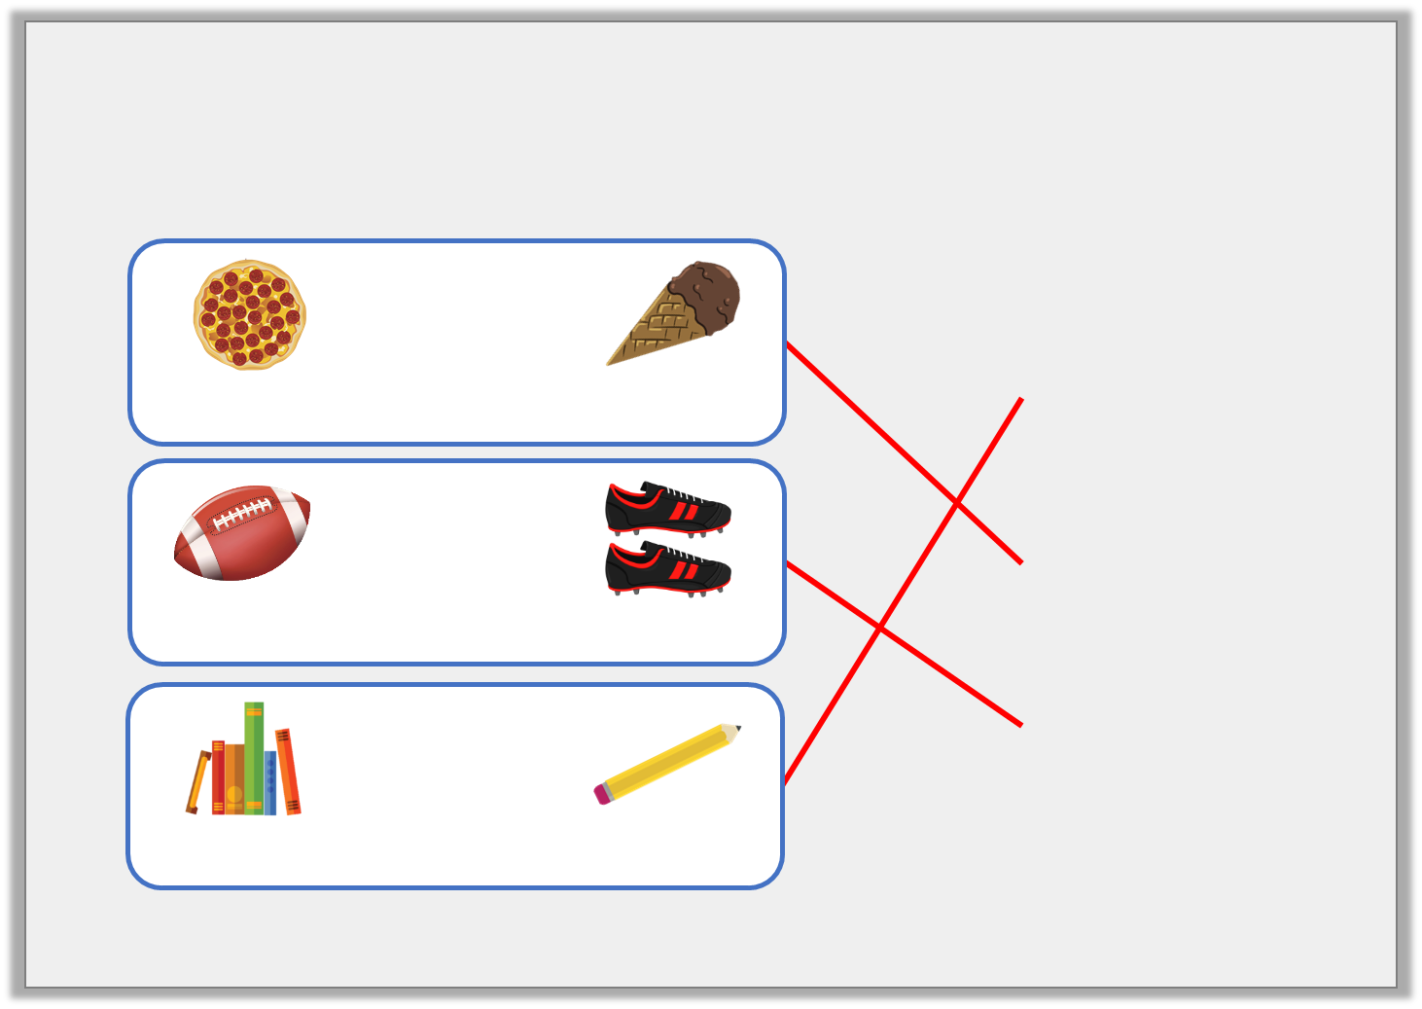
Varied Fluency 3
Match the items to the rounded totals.
 | +
468p |  | £1.67
£4.00
£7.00
£9.00
 | +
225p |  | £6.89
 | +
£3.44 |  | 72p
Y4

Slide 11
Varied Fluency 4
James wants to buy a pair of shorts for £4.54
and a t-shirt for £5.28.
What does each amount round to?
He has £12.00.
How much change will he receive approximately?
Y4

Slide 12
Varied Fluency 4
James wants to buy a pair of shorts for £4.54
and a t-shirt for £5.28.
What does each amount round to?
£5.00 and £5.00
He has £12.00.
How much change will he receive approximately?
£12 – £10 = £2.00
Y4

Slide 13
Wednesday 6th May 2020 Lo: Year 3/4: I can use rounding to estimate money using reasoning and problem – solving

Slide 14
Reasoning 1
What amount could the arrow be pointing to?
Explain why.
500p
600p
Y4

Slide 15
Reasoning 1
What amount could the arrow be pointing to?
Explain why.
The arrow is pointing to less than a quarter of the way along the number line, so the amount must be less than…
500p
600p
Y4

Slide 16
Reasoning 1
What amount could the arrow be pointing to?
Explain why.
The arrow is pointing to less than a quarter of the way along the number line, so the amount must be less than 525p or £5.25. The price could be between £5.10 or 510p and £5.20 or 520p.
500p
600p
Y4

Slide 17
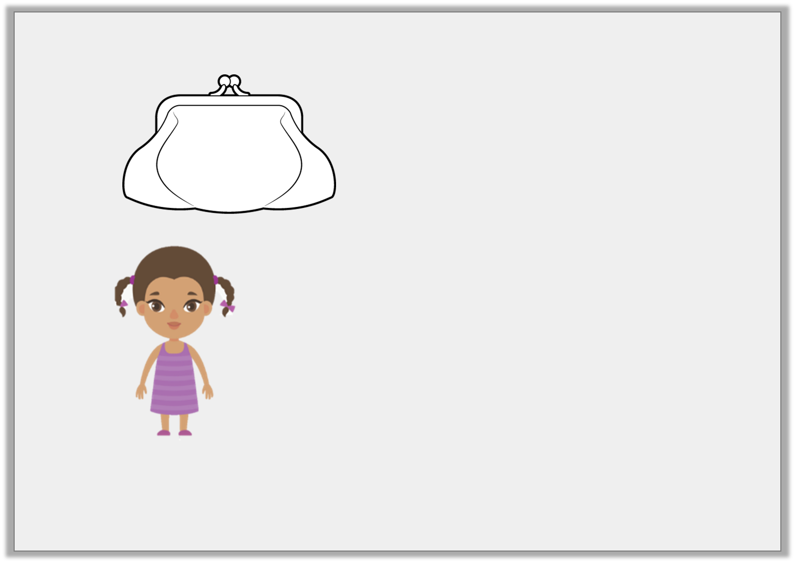
Reasoning 2
Cleo has:
She says,
Do you agree? Explain why.
£2.32
My amount rounds to £3.
Y4

Slide 18
Reasoning 2
Cleo has:
She says,
Do you agree? Explain why.
I disagree because…
£2.32
My amount rounds to £3.
Y4

Slide 19
Reasoning 2
Cleo has:
She says,
Do you agree? Explain why.
I disagree because any amount less than £2.50 rounds down to £2.00. £2.32 is less than £2.50 and is nearer to £2.00 than £3.00.
£2.32
My amount rounds to £3.
Y4

Slide 20
Problem Solving 1
Kaylum has these digit cards:
Find all the amounts he can make which round to 500p.
5
4
1
9
Y4

Slide 21
Problem Solving 1
Kaylum has these digit cards:
Find all the amounts he can make which round to 500p.
491p 514p
495p 519p
451p 541p
459p 549p
5
4
1
9
Y4

Slide 22
Thursday 7th May 2020

Slide 23
Year 3/4 – Summer Block 1 – Money
Step 4
Year 4: I can use the four operations to workout the money

Slide 24
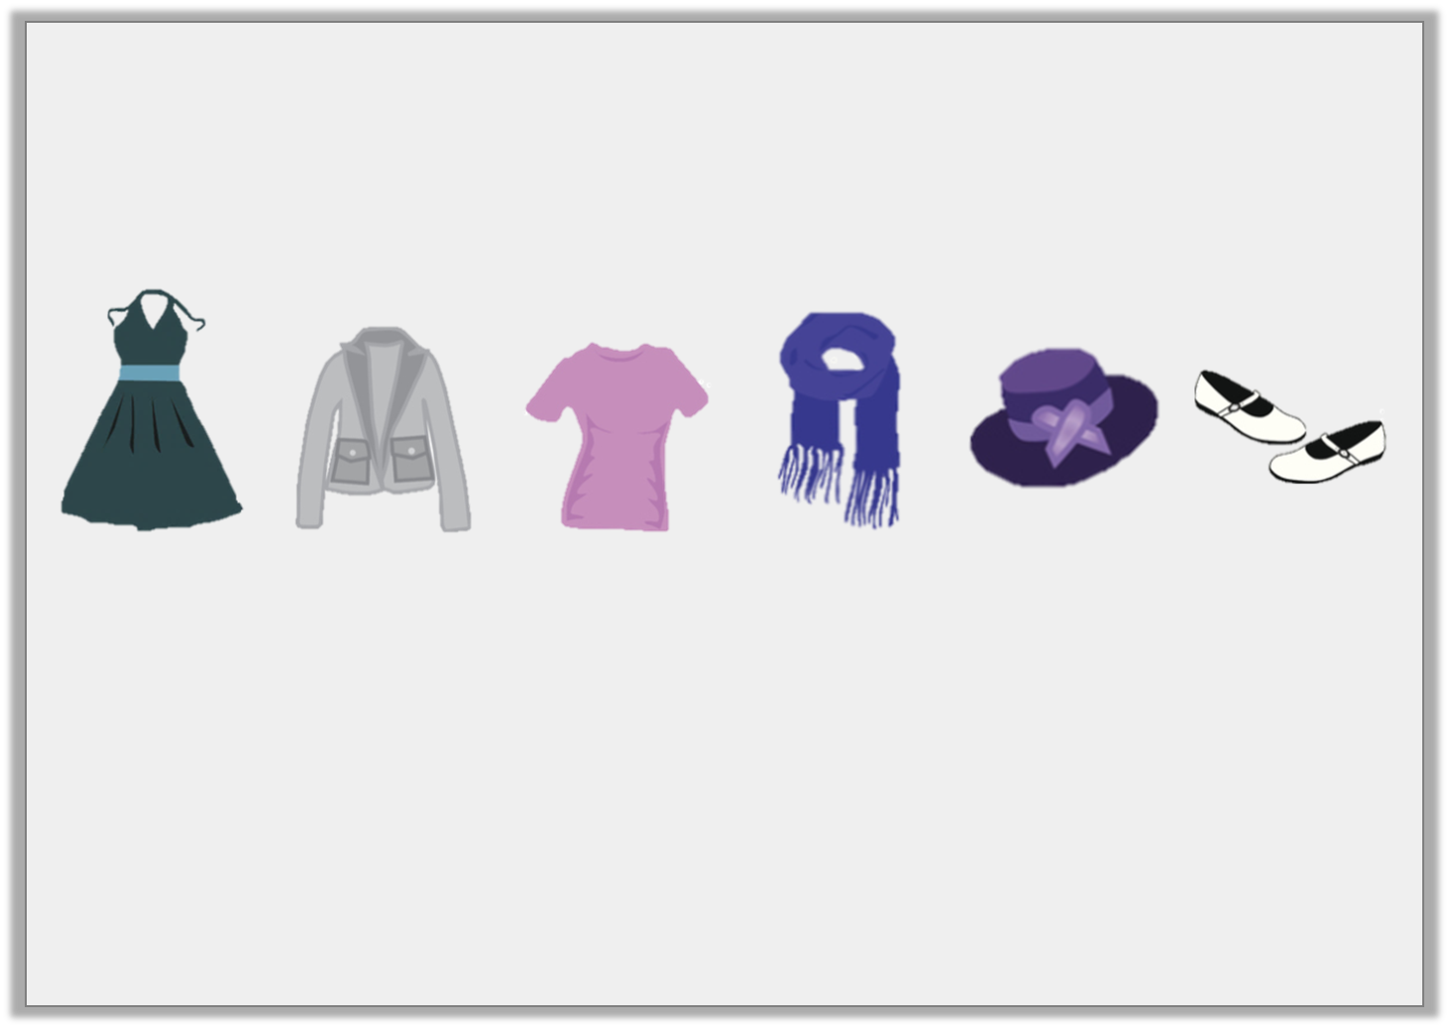
Introduction
Lana is shopping.
She has about £20 to spend.
Estimate what she could purchase.
Dress
£11.45
Jacket
£5.75
Shirt
£7.30
Scarf
£8.55
Hat
£4.95
Shoes
£6.80
Y4

Slide 25
Introduction
Lana is shopping.
She has about £20 to spend.
Estimate what she could purchase.
Dress
£11.45
Jacket
£5.75
Shirt
£7.30
Scarf
£8.55
Hat
£4.95
Shoes
£6.80
There are several possible combinations that, when estimated, will cost £20. For example, she could purchase:
the dress and the scarf (£11 + £9 = £20)
the jacket, shirt and shoes (£6 + £7 + £7 = £20)
the hat, jacket and scarf (£5 + £6 + £9 = £20)
Y4

Slide 26
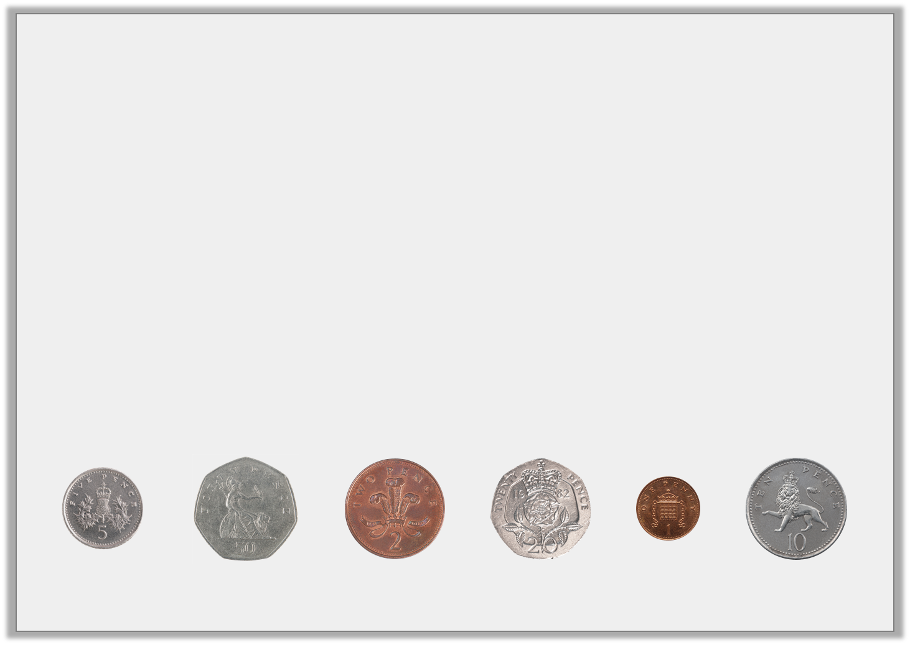
Varied Fluency 1
Which coins would complete this bar model?
You can use coins more than once.
£1.60
Y4

Slide 27
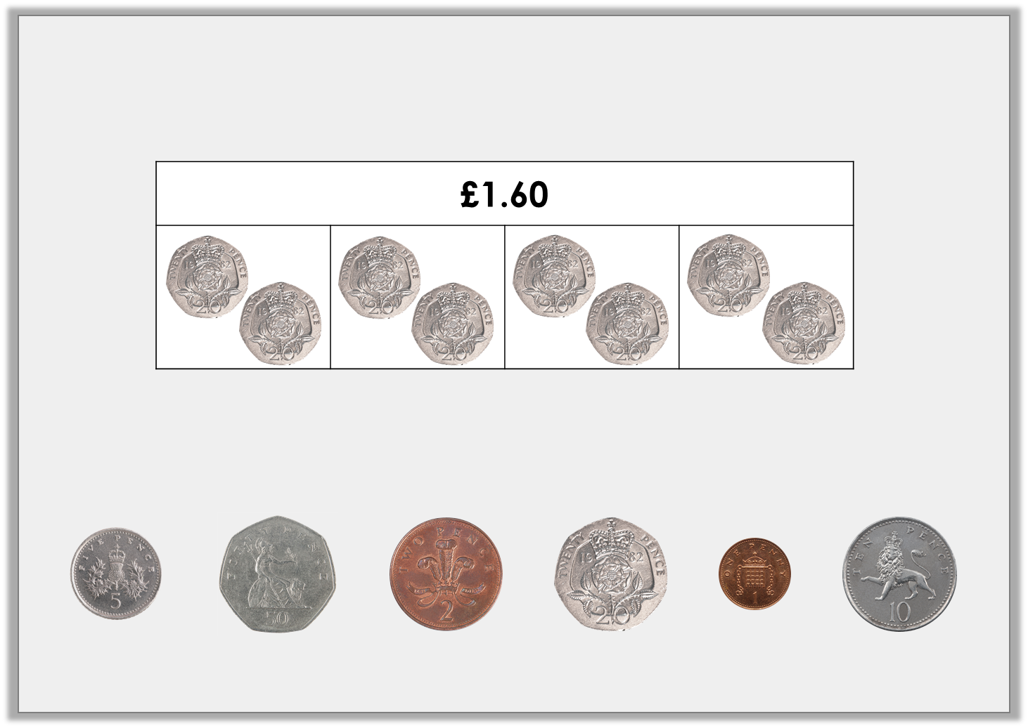
Varied Fluency 1
Which coins would complete this bar model?
You can use coins more than once.
Possible answer
Y4

Slide 28
Varied Fluency 2
Complete the bar model for the problem.
Bobby goes to the shopping centre. He spends £12.50 on a new pair of shorts and £10.80 on a t-shirt.
How much money does he spend altogether?
Y4

Slide 29
Varied Fluency 2
Complete the bar model for the problem.
Bobby goes to the shopping centre. He spends £12.50 on a new pair of shorts and £10.80 on a t-shirt.
How much money does he spend altogether?
£23.30
£12.50
£10.80
£12.50 + £10.80 = £23.30
Y4

Slide 30
Varied Fluency 3
Calculate the missing numbers:
6 | x |  | = | £1.80
 | x | 7 | = | £1.40
Y4

Slide 31
Varied Fluency 3
Calculate the missing numbers:
6 | x | £0.30 | = | £1.80
£0.20 | x | 7 | = | £1.40
Y4

Slide 32
Varied Fluency 4
The table below shows ticket prices for the theatre.
How much would it cost for two adults and two children to visit the theatre during the afternoon?
 | Afternoon | Evening
Adult | £16.25 | £20.50
Child | £8.75 | £9.50
Y4

Slide 33
Varied Fluency 4
The table below shows ticket prices for the theatre.
How much would it cost for two adults and two children to visit the theatre during the afternoon?
 | Afternoon | Evening
Adult | £16.25 | £20.50
Child | £8.75 | £9.50
£16.25 x 2 = £32.50
£8.75 x 2 = £17.50
£32.50 + £17.50 = £50
Y4

Slide 34
Friday 8th May 2020 Year 4: I can use the four operations to solve the reasoning and problem-solving questions

Slide 35
Reasoning 1
Tabitha loves to buy cookies for her friends.
She plans to buy 30 cookies to share with her friends, so she decides to buy her cookies in packs of 5. Do you agree with her decision? Explain your answer.
25p per cookie
5 for £1.50
10 for £2.20
Y4

Slide 36
Reasoning 1
Tabitha loves to buy cookies for her friends.
She plans to buy 30 cookies to share with her friends, so she decides to buy her cookies in packs of 5. Do you agree with her decision? Explain your answer.
No because….
25p per cookie
5 for £1.50
10 for £2.20
Y4

Slide 37
Reasoning 1
Tabitha loves to buy cookies for her friends.
She plans to buy 30 cookies to share with her friends, so she decides to buy her cookies in packs of 5. Do you agree with her decision? Explain your answer.
No because she should buy them in packs of 10. 3 x £2.20 = £6.60. Buying in packs of 5 would cost £9 and buying individually would cost £7.50.
25p per cookie
5 for £1.50
10 for £2.20
Y4

Slide 38
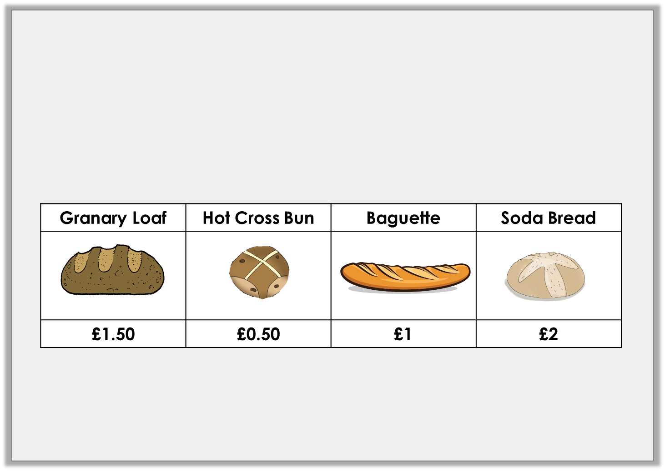
Problem Solving 1
At the bakery, Hernant spent £4 altogether.
What could she have bought?
Find more than one possibility.
Y4

Slide 39
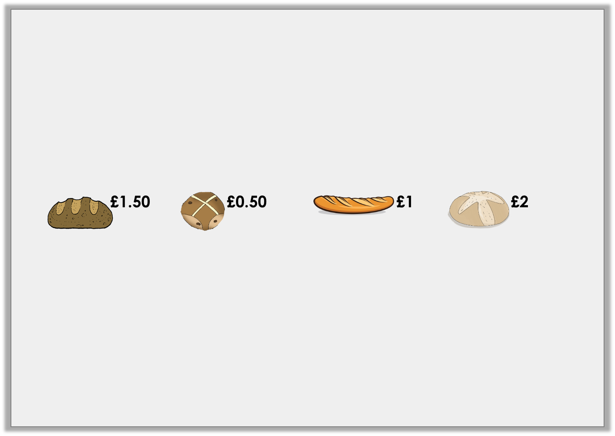
Problem Solving 1
At the bakery, Hernant spent £4 altogether.
What could she have bought?
Find more than one possibility.
Various possible answers, including:
Option | Granary loaf | Hot Cross Bun | Baguette | Soda Bread | Total
1 | 0 | 0 | 0 | 2 | £4
2 | 0 | 0 | 2 | 1 | £4
3 | 0 | 4 | 0 | 1 | £4
Y4

Slide 40
Problem Solving 2
Carice buys three sunflowers and two tulips.
She pays with £10.
How much change will she receive?
Sunflower | Tulip
£1.50 | £2.50
Y4

Slide 41
Problem Solving 2
Carice buys three sunflowers and two tulips.
She pays with £10.
How much change will she receive?
50p
Sunflower | Tulip
£1.50 | £2.50
Y4

