Slide 1
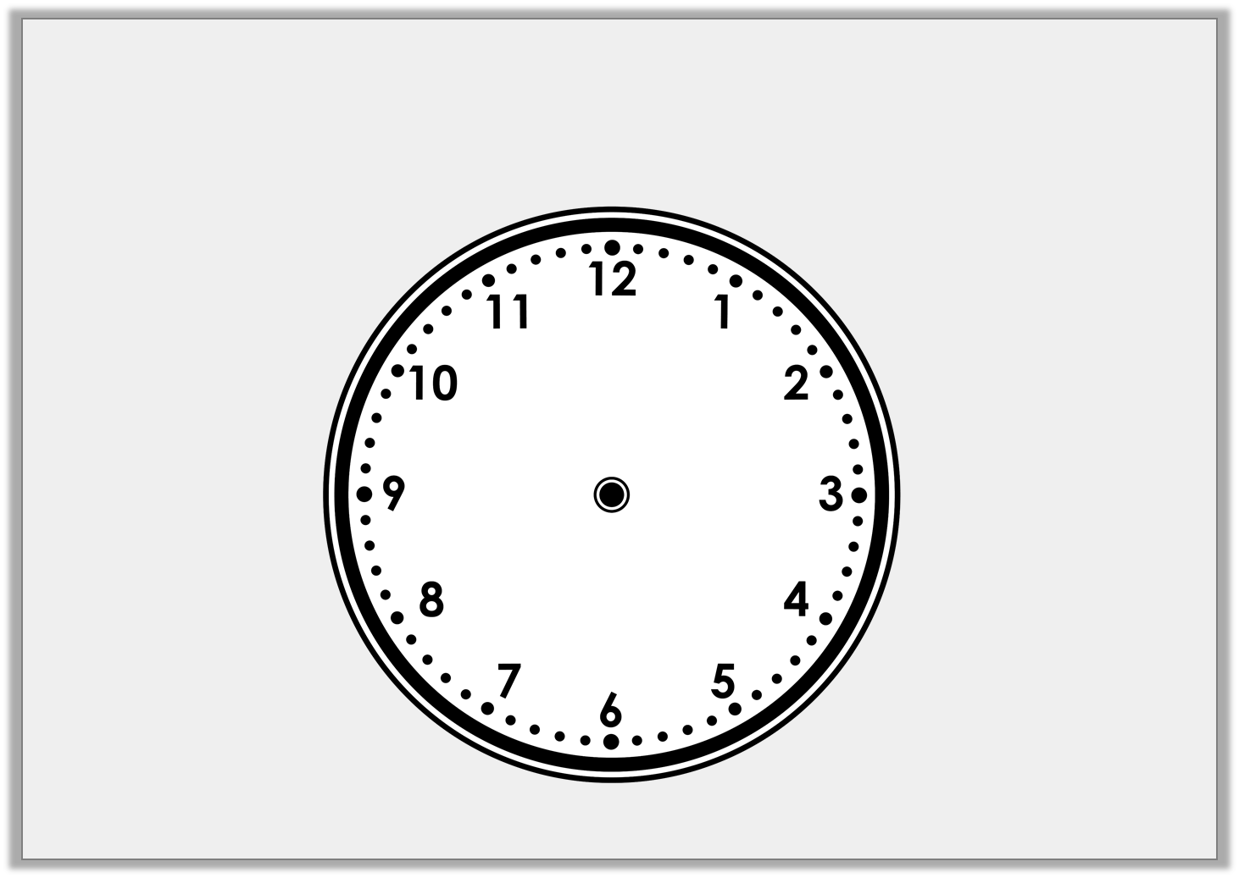
Varied Fluency 4
Draw the hour hand and the minute hand
on to the clock face to show the time half past 3.
Y1

Slide 2
Varied Fluency 4
Draw the hour hand and the minute hand
on to the clock face to show the time half past 3.
Y1

Slide 3
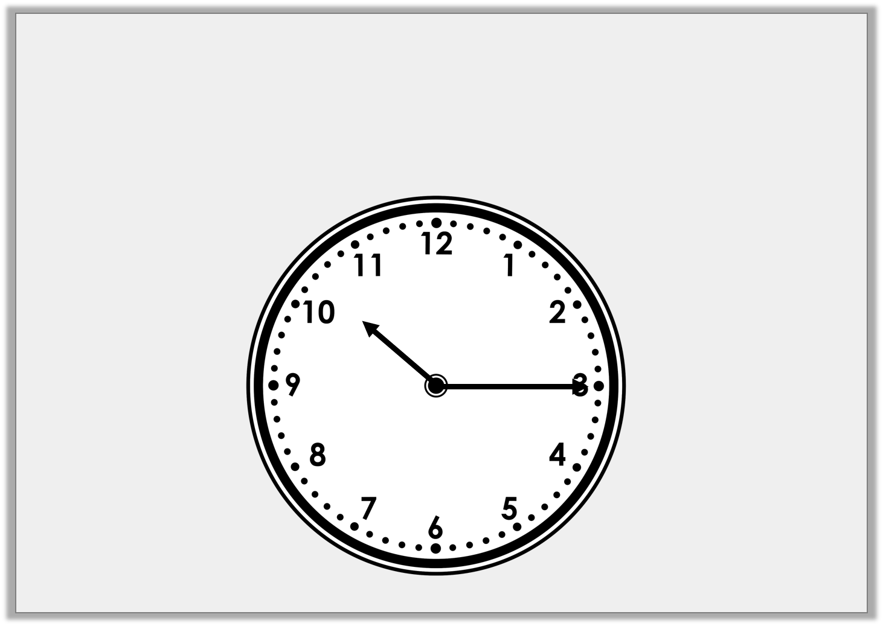
Varied Fluency 1
Write the time shown on this clock.
Y2

Slide 4
Varied Fluency 1
Write the time shown on this clock.
Quarter past 10
Y2

Slide 5
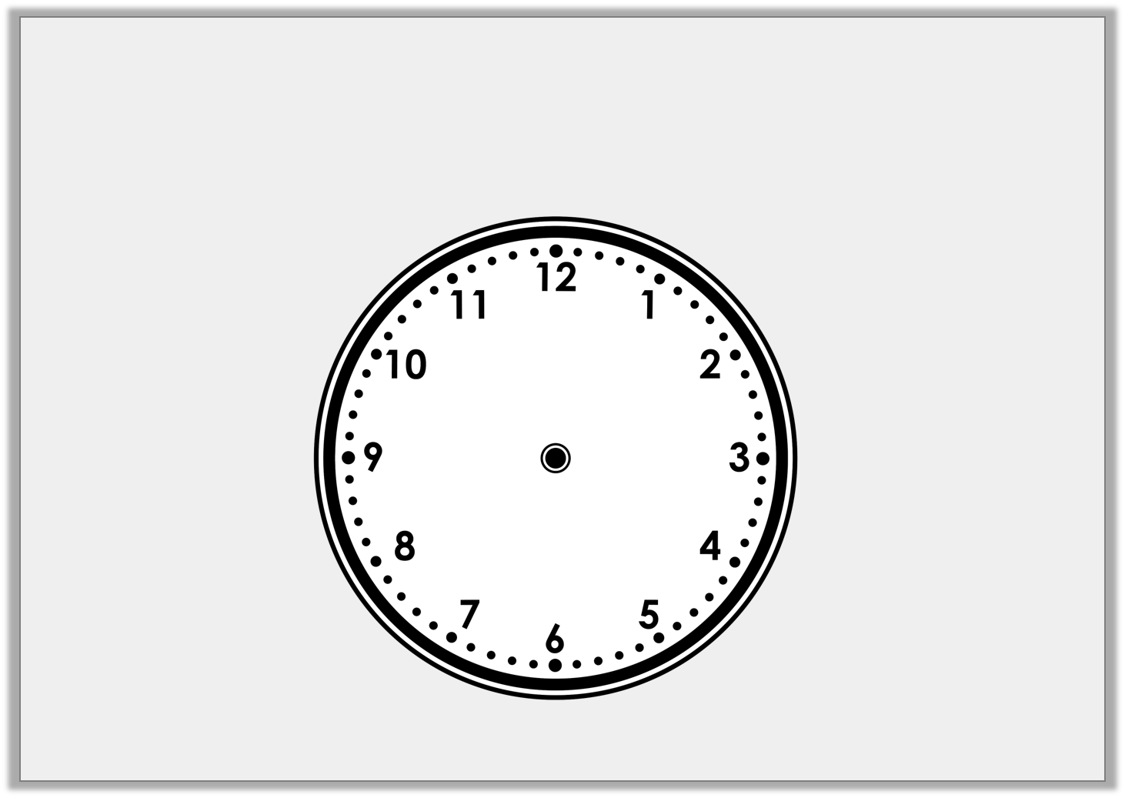
Varied Fluency 2
Draw the missing hands on the clock so that it shows the correct time written beneath it.
Quarter past 1
Y2

Slide 6
Varied Fluency 2
Draw the missing hands on the clock so that it shows the correct time written beneath it.
Quarter past 1
Y2

Slide 7
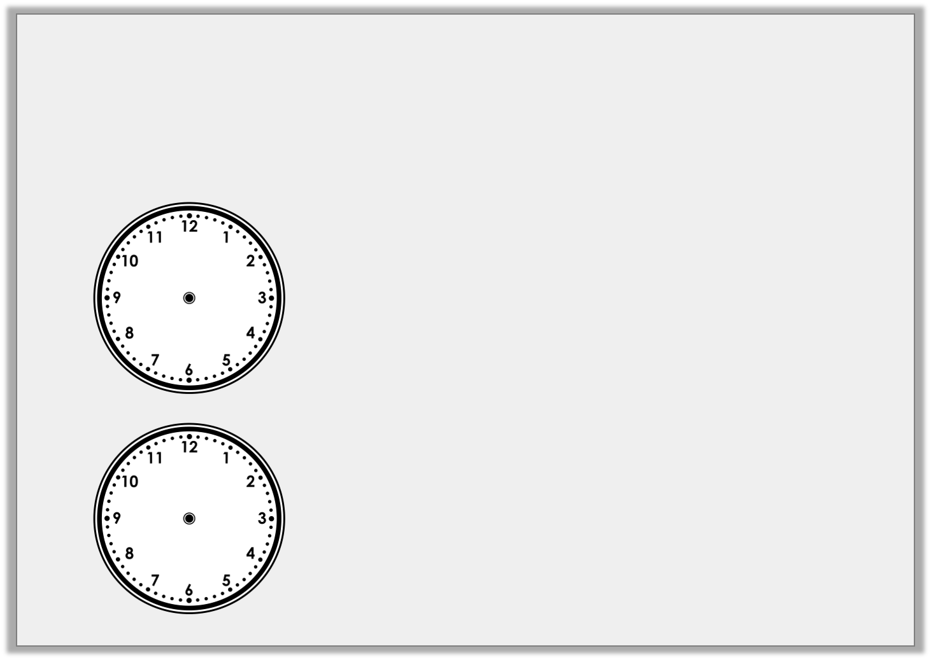
Varied Fluency 3
Draw a line to match the clocks to the correct written time.
Quarter past 3
Quarter to 7
Quarter past 12
Y2

Slide 8
Varied Fluency 3
Draw a line to match the clocks to the correct written time.
Quarter past 3
Quarter to 7
Quarter past 12
Y2

Slide 9
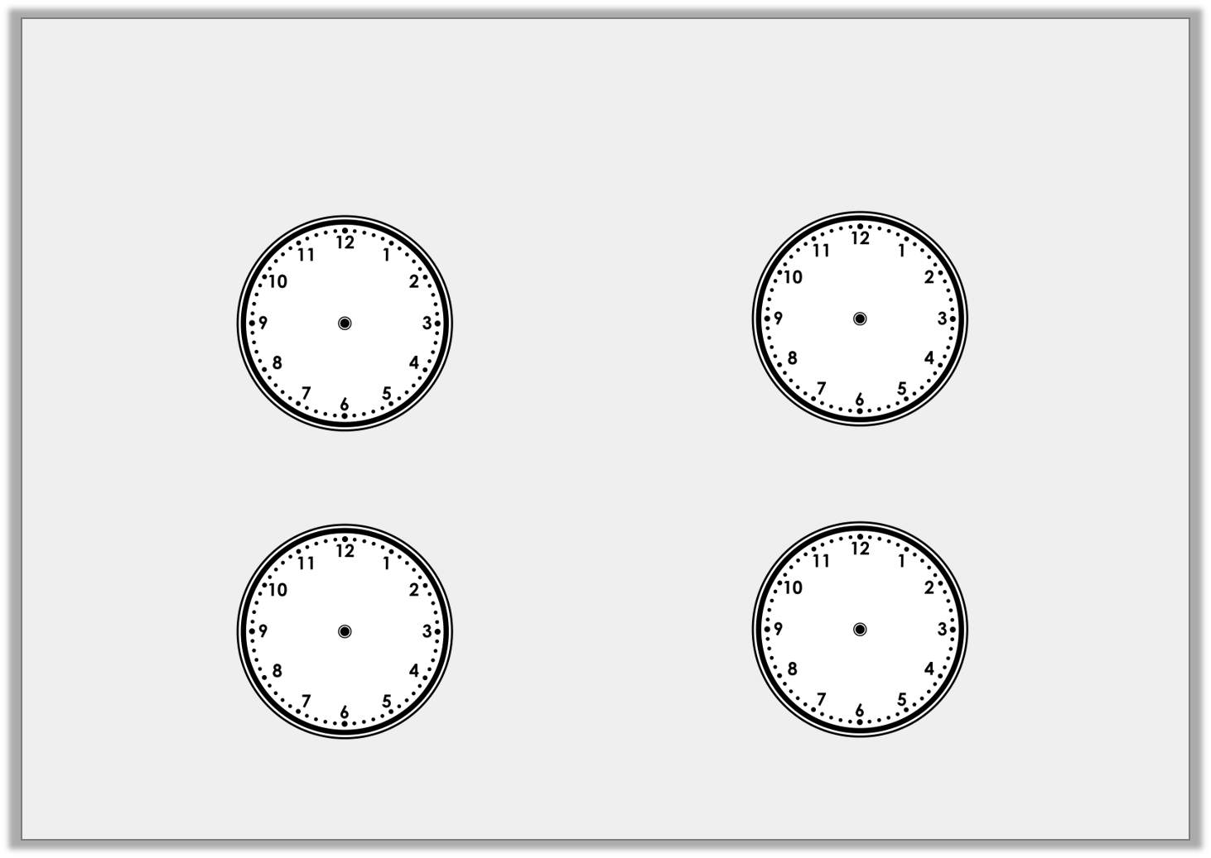
Varied Fluency 4
Draw where the minute hand will be in 15 minutes time (a quarter turn).
Half past 10 |  | Quarter to 11
8 o’clock |  | Quarter past 8
Y2

Slide 10
Varied Fluency 4
Draw where the minute hand will be in 15 minutes time (a quarter turn).
Half past 10 |  | Quarter to 11
8 o’clock |  | Quarter past 8
Y2

