Slide 1
Year 1/2 – Summer Block 1 – Time
Step 2
Year 1: Time to the Half Hour Year 2: Quarter Past and Quarter To

Slide 2
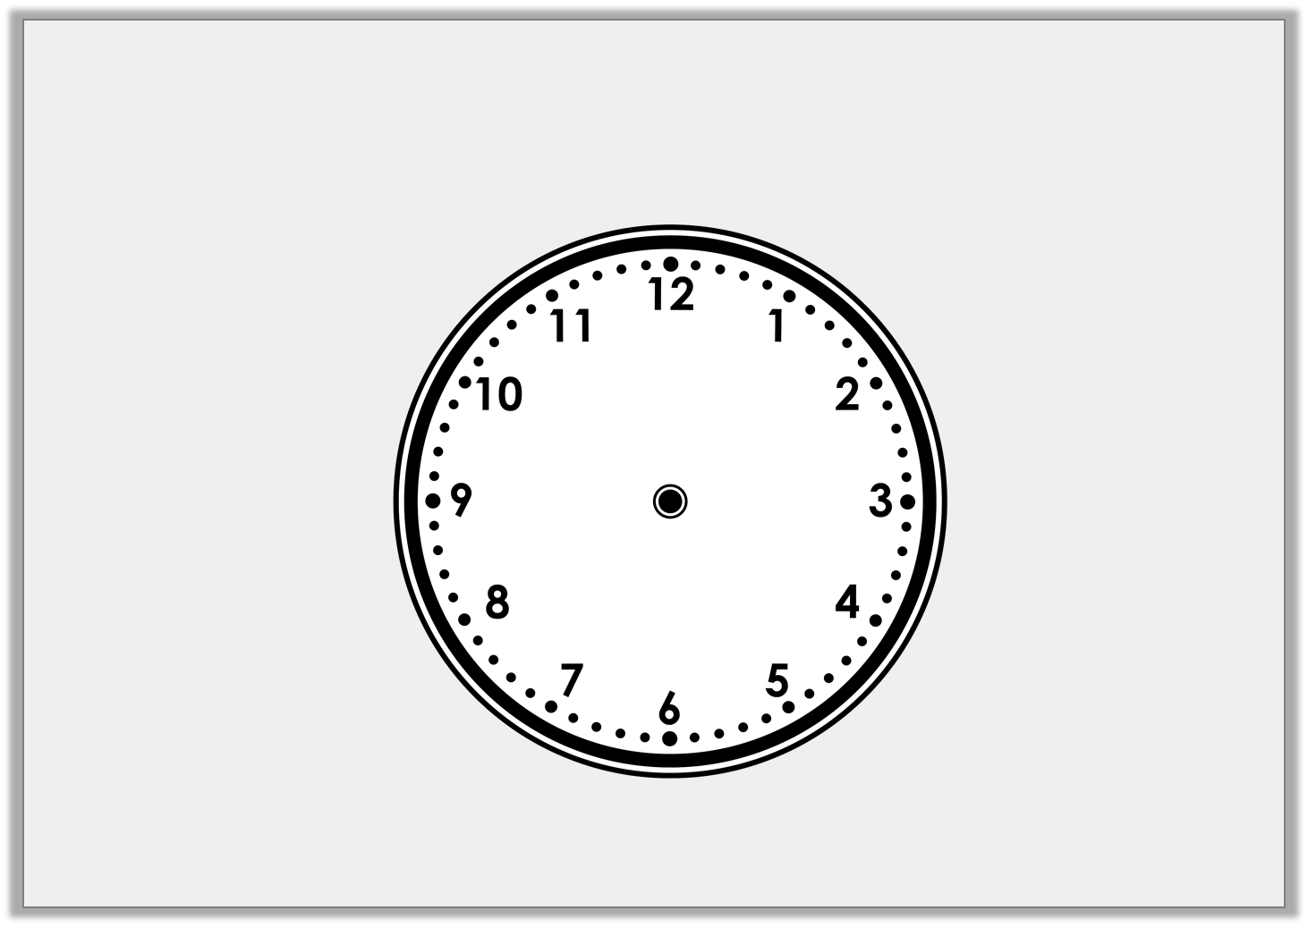
Introduction
The hour hand is missing from the clock face.
What time could it be?
Y1

Slide 3
Introduction
The hour hand is missing from the clock face.
What time could it be?
It could be half past any hour.
Y1

Slide 4
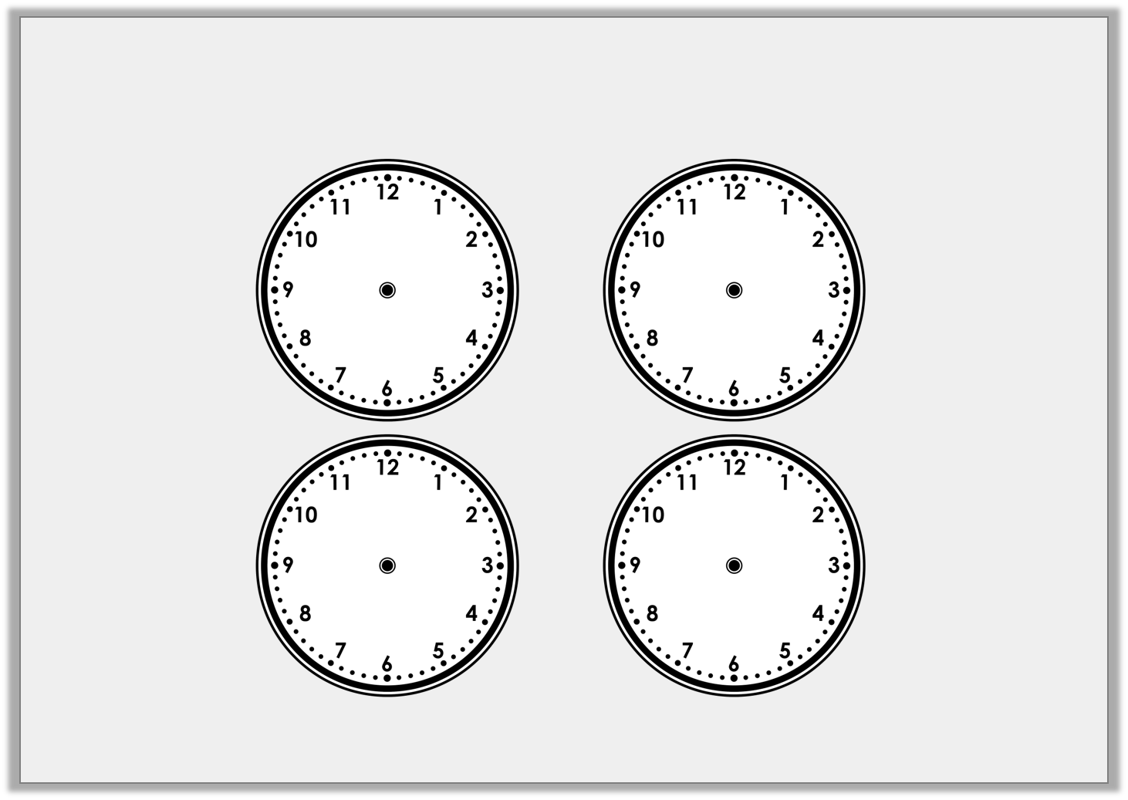
Introduction
Use the position of the minute hand to help you label each clock.
Y2
quarter past
quarter to
half past
o’clock

Slide 5
Introduction
Use the position of the minute hand to help you label each clock.
o’clock
quarter past
half past
quarter to
Y2

Slide 6
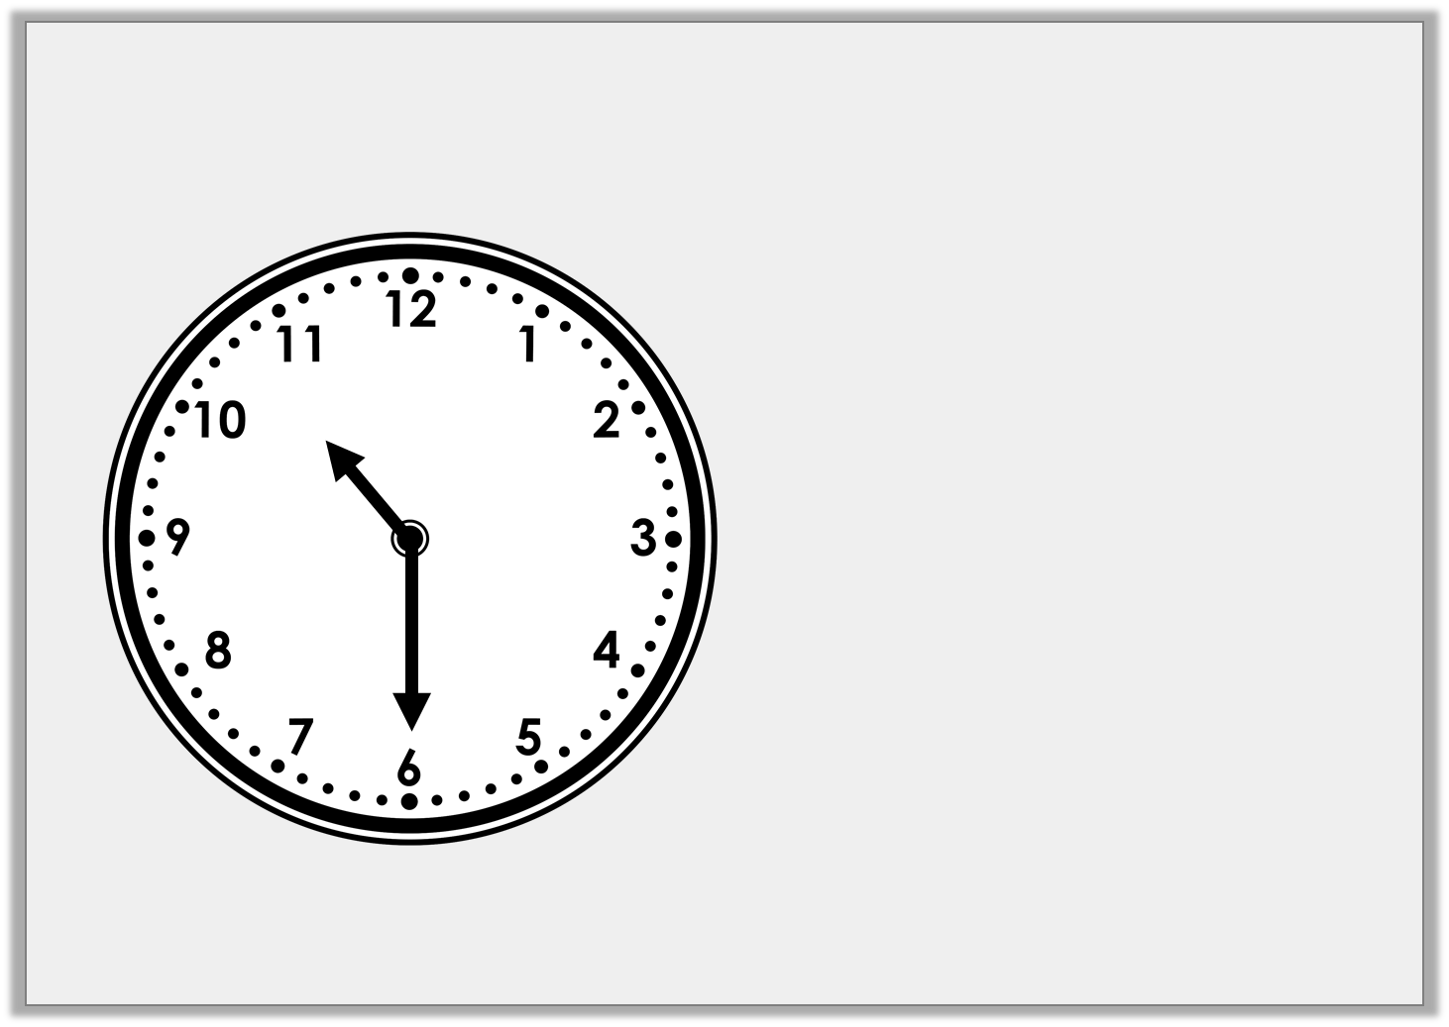
Varied Fluency 1
What time does the clock show?
Half past 9
Half past ten
Half past 6
Y1

Slide 7
Varied Fluency 1
What time does the clock show?
Half past 9
Half past ten
Half past 6
Y1

Slide 8
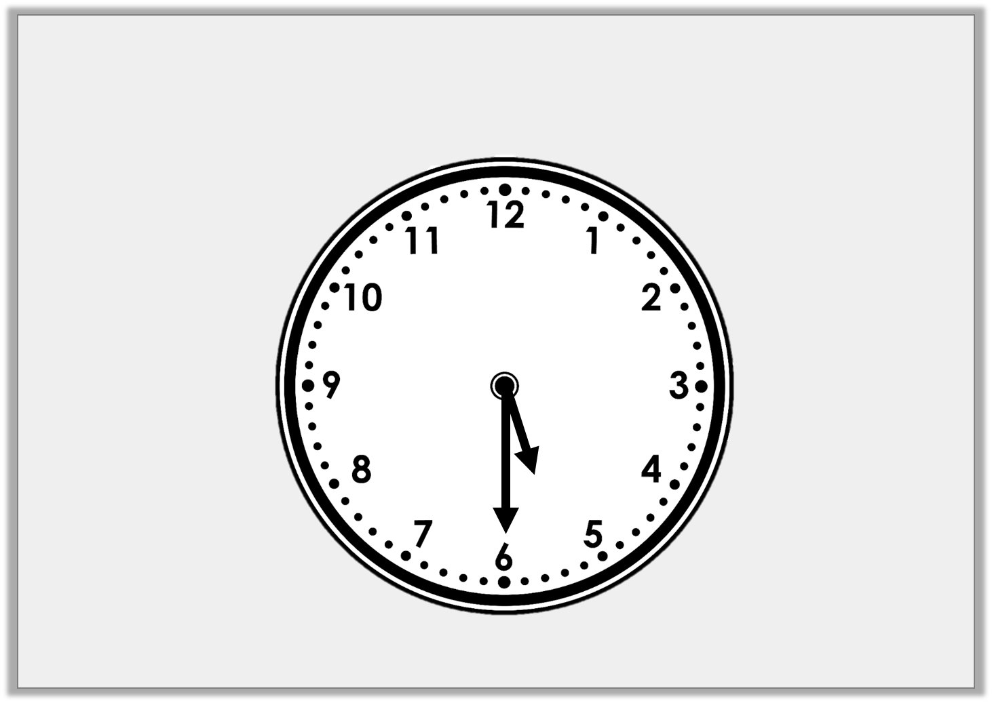
Varied Fluency 2
True or false? The clock shows half past five.
Y1

Slide 9
Varied Fluency 2
True or false? The clock shows half past five.
True
Y1

Slide 10
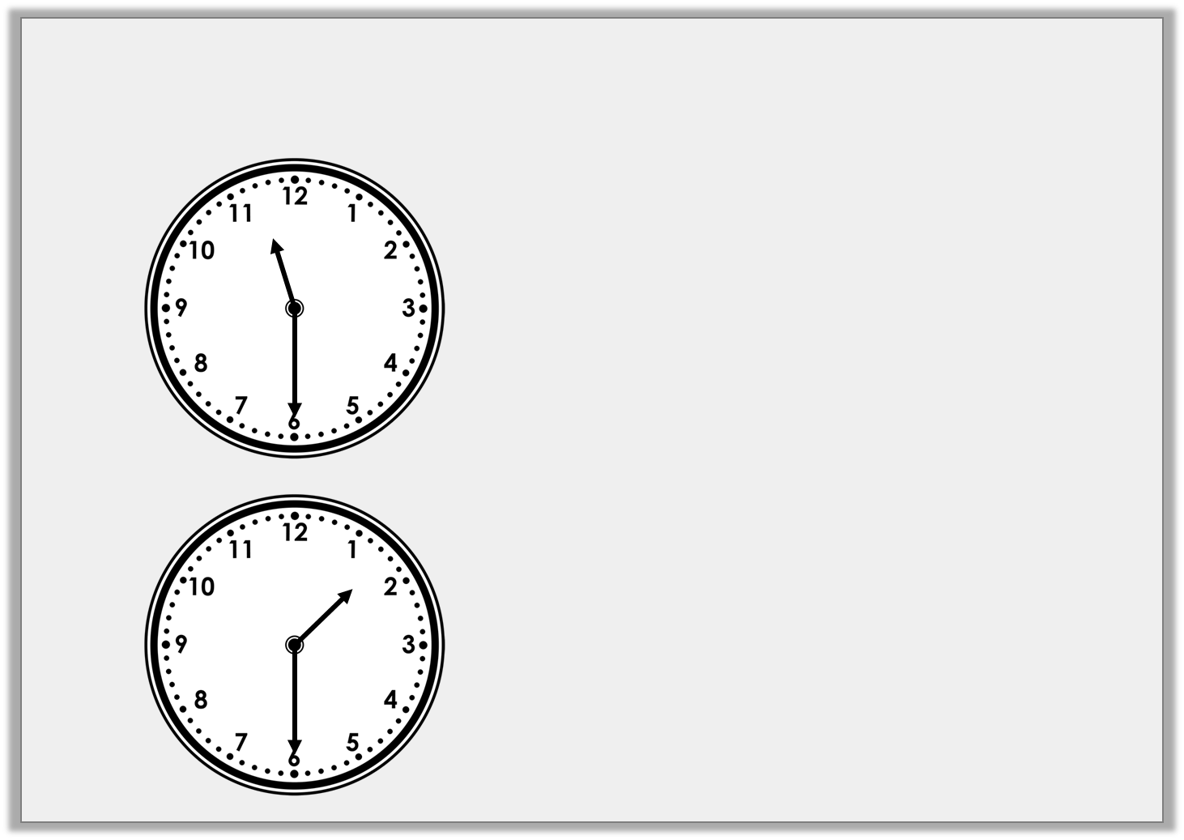
Varied Fluency 3
Draw a line to match the clocks to the correct written time.
Half past 11
Half past one
Half past ten
Y1

Slide 11
Varied Fluency 3
Draw a line to match the clocks to the correct written time.
Half past 11
Half past one
Half past ten
Y1

Slide 12
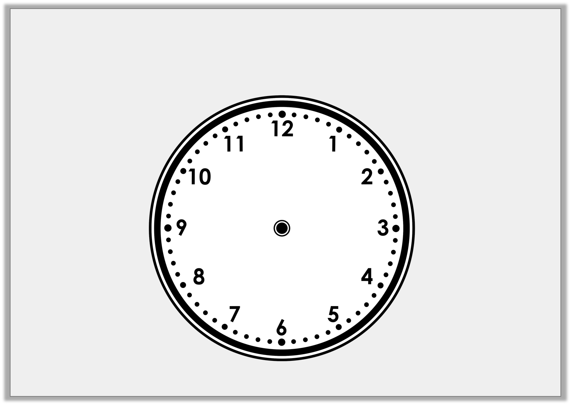
Varied Fluency 4
Draw the hour hand and the minute hand
on to the clock face to show the time half past 3.
Y1

Slide 13
Varied Fluency 4
Draw the hour hand and the minute hand
on to the clock face to show the time half past 3.
Y1

