Slide 1
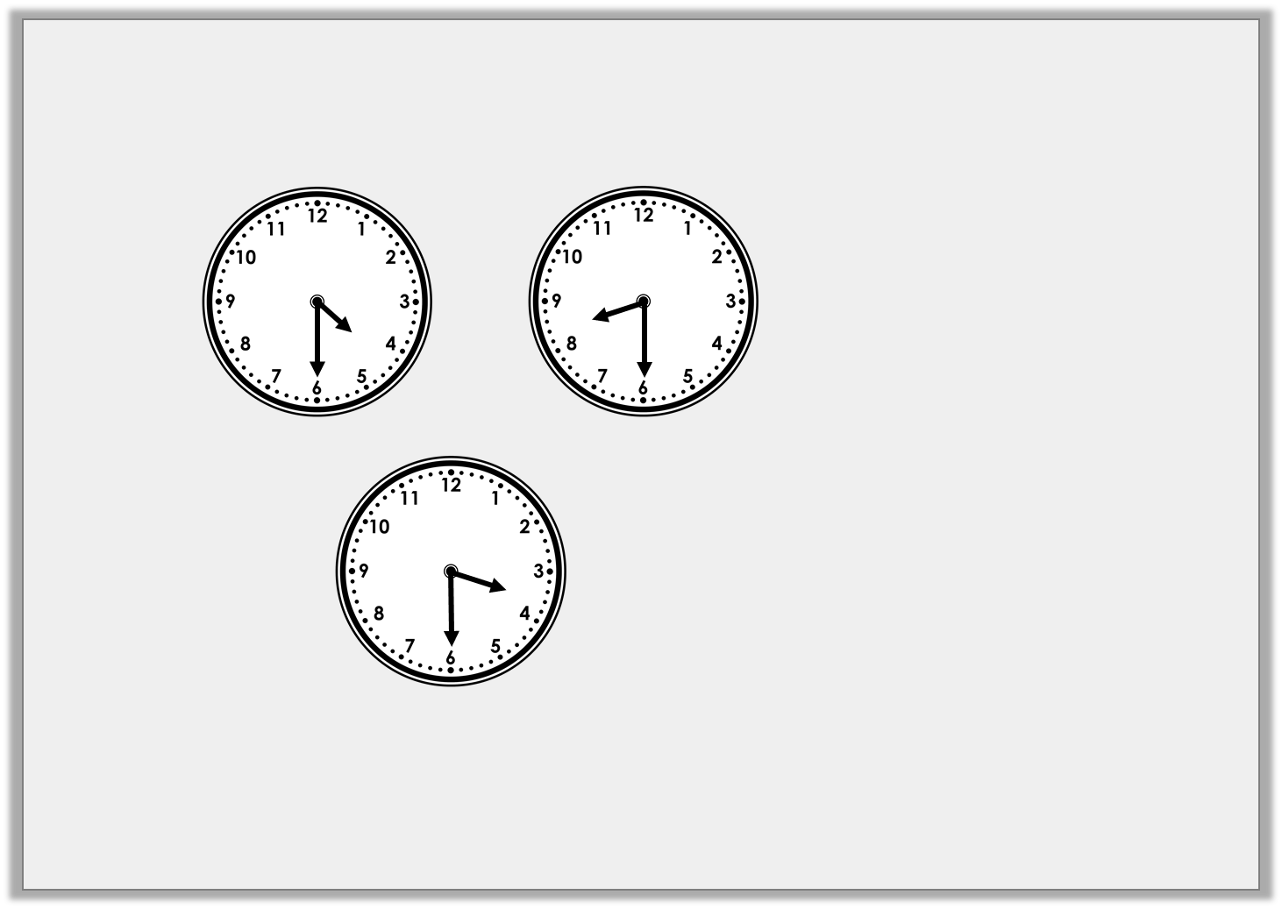
Reasoning 1
Which is the odd one out? Explain your answer.
A
B
C
Half past 3
D
E
Half past 8
Y1

Slide 2
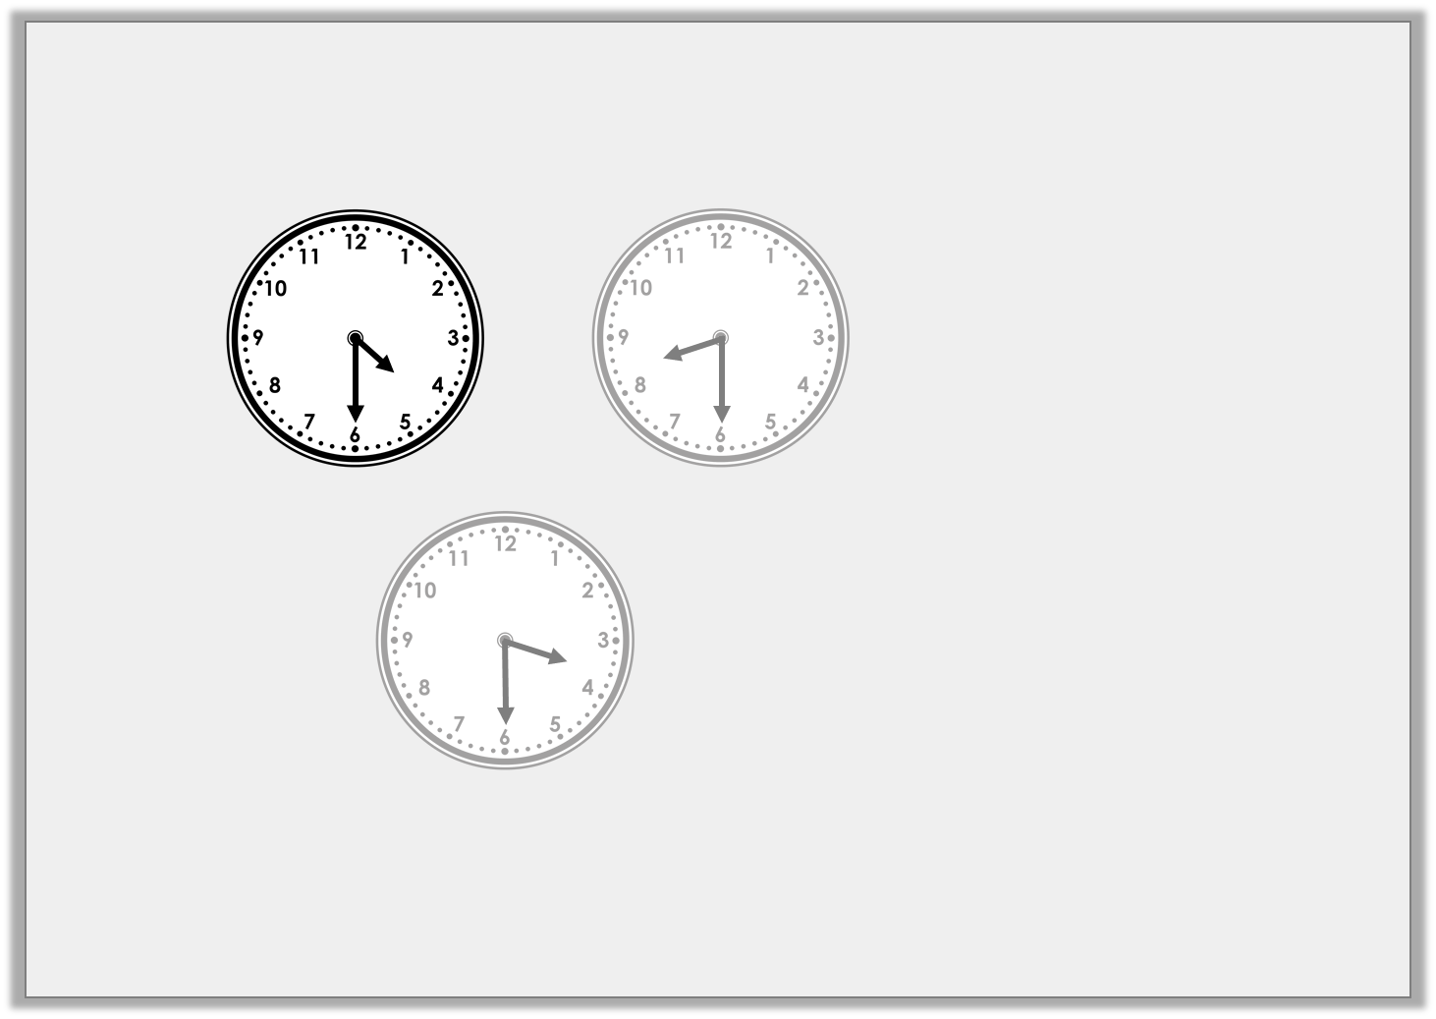
Reasoning 1
Which is the odd one out? Explain your answer.
A is the odd one out because…
A
B
C
Half past 3
D
E
Half past 8
Y1

Slide 3
Reasoning 1
Which is the odd one out? Explain your answer.
A is the odd one out because it is the only clock which shows half past 4. B and E show half past 8 and C and D show half past 3.
A
B
C
Half past 3
D
E
Half past 8
Y1

Slide 4
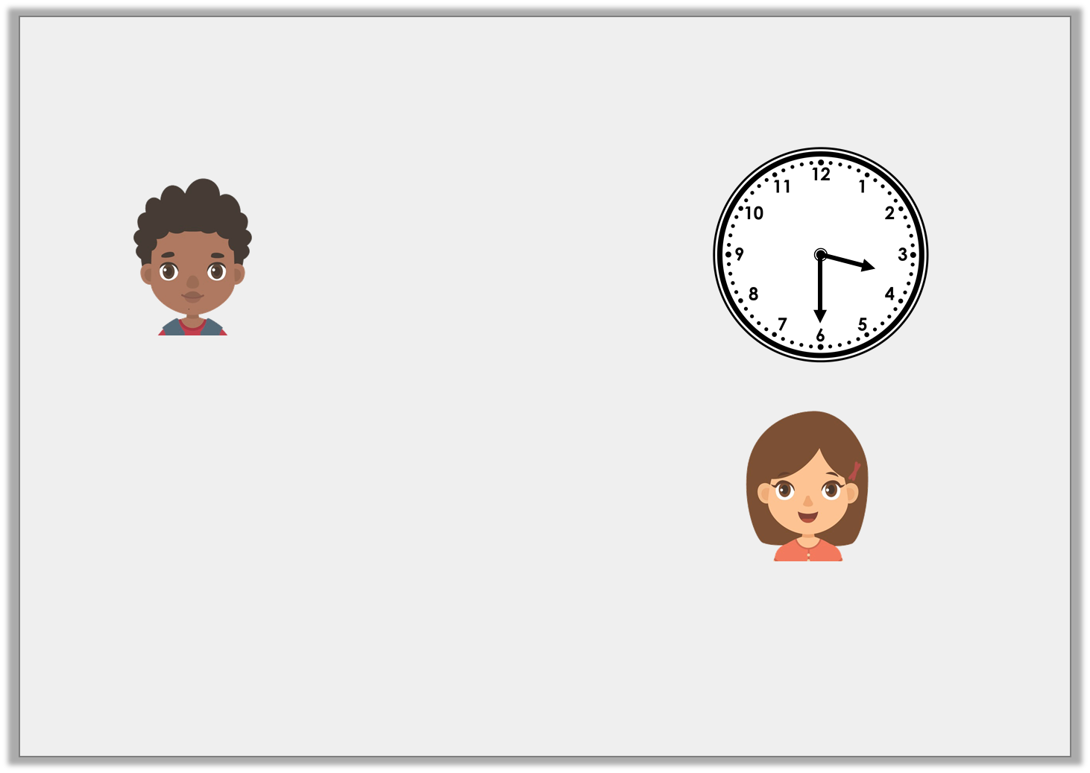
Reasoning 2
Samuel and Ellan are discussing the time.
Who is correct? Explain your answer.
It is half past three.
Samuel
No, it is half past four.
Ellan
Y1

Slide 5
Reasoning 2
Samuel and Ellan are discussing the time.
Samuel is correct because…
It is half past three.
Samuel
No, it is half past four.
Ellan
Y1

Slide 6
Reasoning 2
Samuel and Ellan are discussing the time.
Samuel is correct because the hour hand is pointing in between the 3 and the 4 so the time shown is half past three.
It is half past three.
Samuel
No, it is half past four.
Ellan
Y1

Slide 7
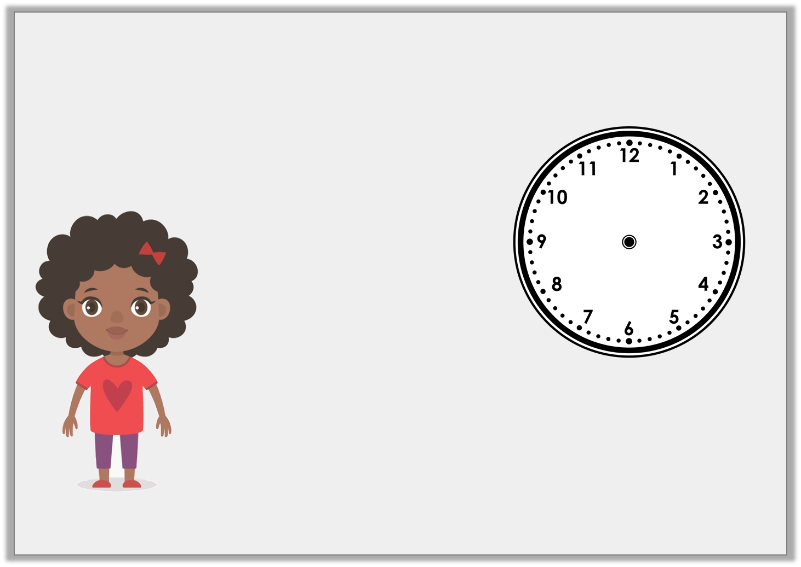
Problem Solving 1
Nicola is describing the time. Use the clues to work out what time Nicola is thinking of.
The minute hand is pointing to the 6. The hour hand is pointing in between the 11 and the 12.
Y1

Slide 8
Problem Solving 1
Nicola is describing the time. Use the clues to work out what time Nicola is thinking of.
The time Nicola is thinking of is half past 11.
The minute hand is pointing to the 6. The hour hand is pointing in between the 11 and the 12.
Y1

Slide 9
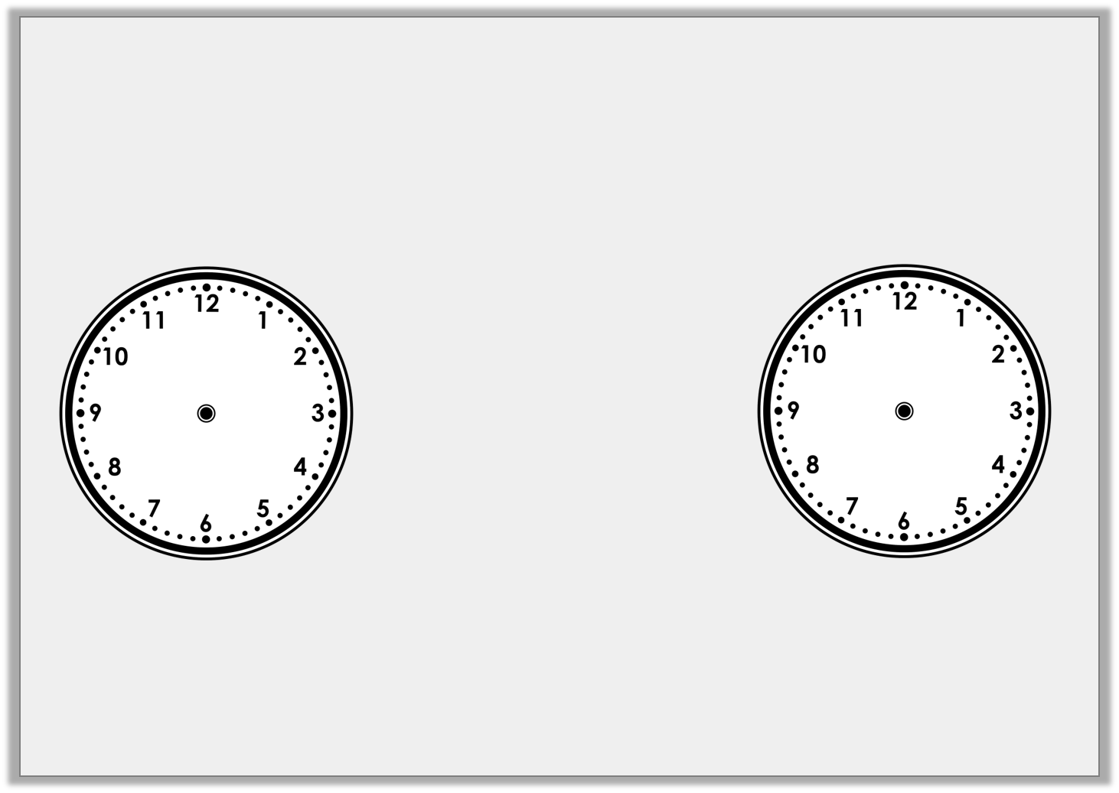
Problem Solving 1
How many quarters of an hour are between 2 o’clock and half past 4?
Y2

Slide 10
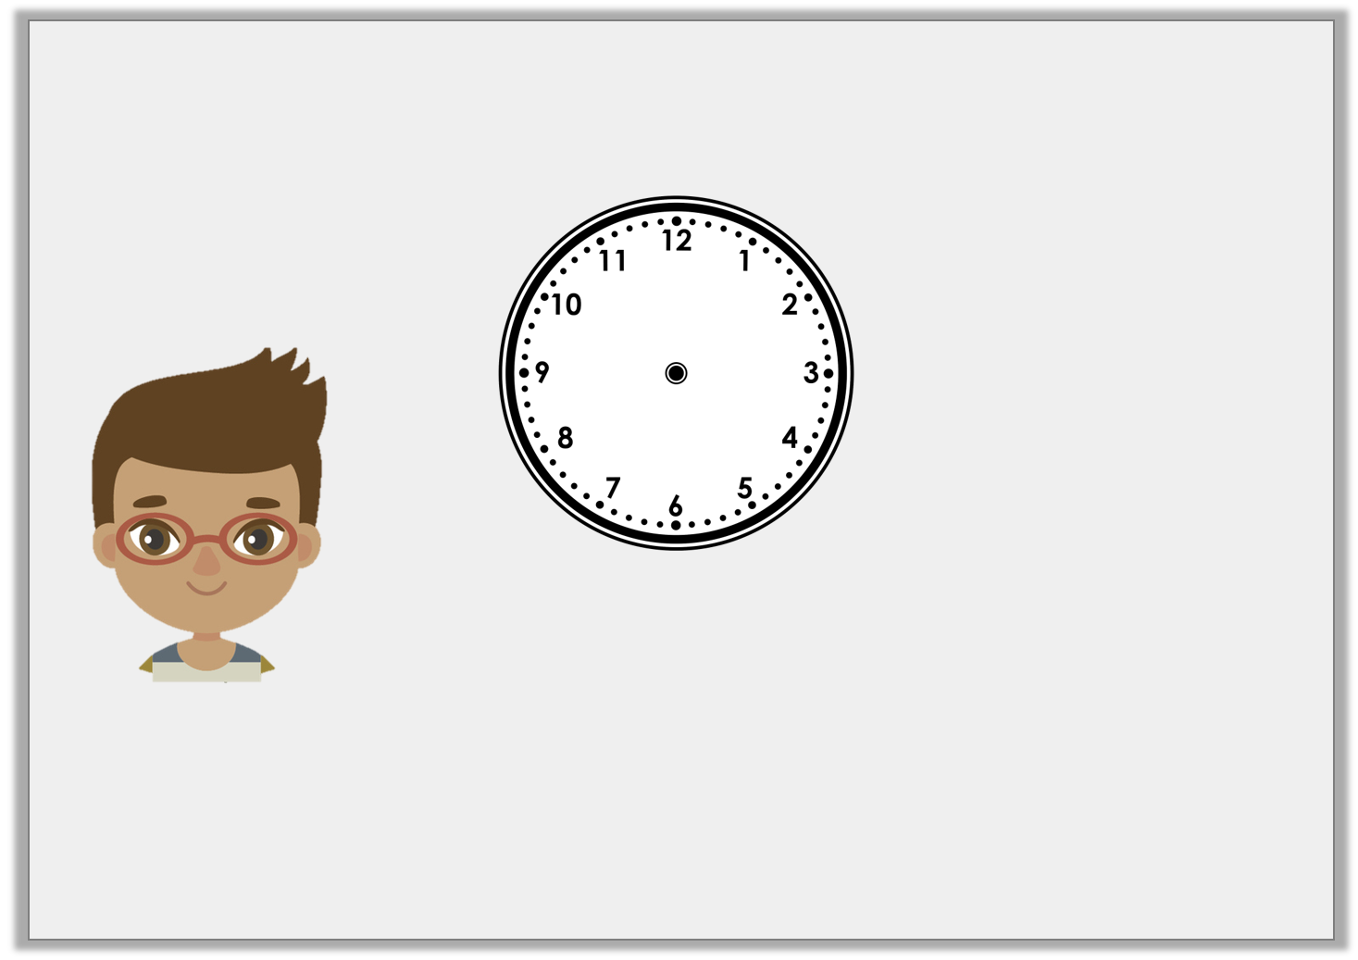
Reasoning 1
Mark is trying to tell the time.
Is Mark right? How do you know?
In quarter of an hour it will be half past 3.
Y2

Slide 11
Reasoning 1
Mark is trying to tell the time.
Is Mark right? How do you know?
Mark is right because…
In quarter of an hour it will be half past 3.
Y2

Slide 12
Reasoning 1
Mark is trying to tell the time.
Is Mark right? How do you know?
Mark is right because the time shown on the clock is quarter past 3.
In quarter of an hour it will be half past 3.
Y2

Slide 13
Problem Solving 2
Playtime is 15 minutes long. What time would it finish if it started at the time shown on the clock?
Draw the hands and write the answer.
Y2

Slide 14
Problem Solving 2
Playtime is 15 minutes long. What time would it finish if it started at the time shown on the clock?
Draw the hands and write the answer.
Half past 10
Y2

