Slide 1
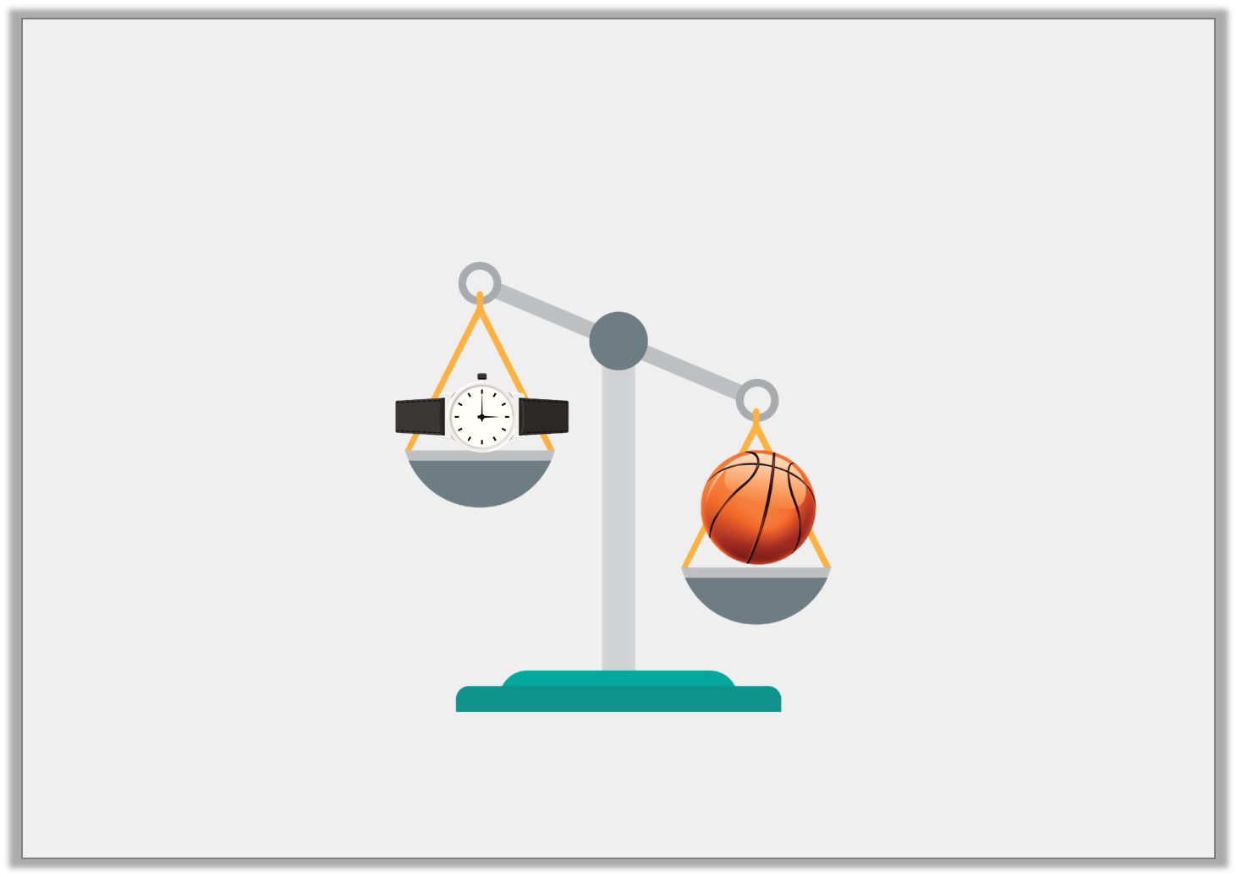
Varied Fluency 3
Is the watch heavier or lighter than the basketball?
Y1

Slide 2
Varied Fluency 3
Is the watch heavier or lighter than the basketball?
Lighter
Y1

Slide 3
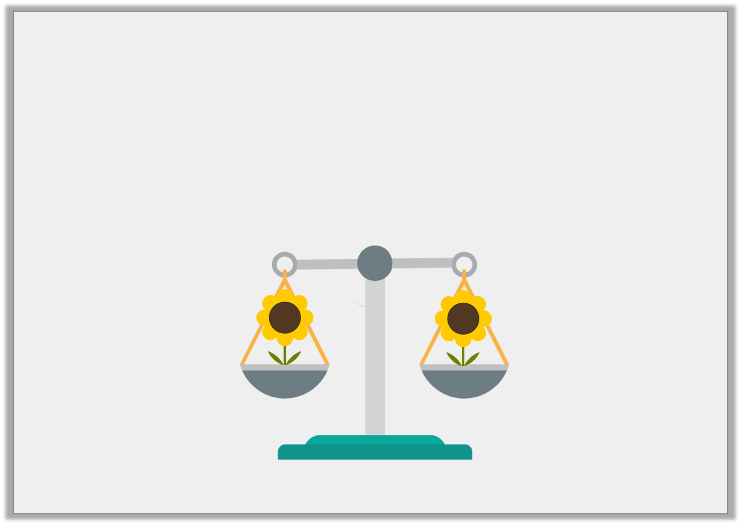
Varied Fluency 4
The balance scale is level.
Circle the word that describes the weight of the flowers.
Heavier |  | Equal |  | Lighter
Y1

Slide 4
Varied Fluency 4
The balance scale is level.
Circle the word that describes the weight of the flowers.
Heavier |  | Equal |  | Lighter
Y1

Slide 5
Varied Fluency 1
Draw lines to show which side of the
balance the objects belong.
Y2

Slide 6
Varied Fluency 1
Draw lines to show which side of the
balance the objects belong.
Y2

Slide 7
Varied Fluency 2
Use the words ‘more’ or ‘less’ to complete the sentence.
A feather weighs __________
than a pebble.
Y2

Slide 8
Varied Fluency 2
Use the words ‘more’ or ‘less’ to complete the sentence.
A feather weighs __________
than a pebble.
less
Y2

