Slide 1
Varied Fluency 3
Order these objects from heaviest to lightest.
Y2

Slide 2
Varied Fluency 3
Order these objects from heaviest to lightest.
Y2

Slide 3
Varied Fluency 4
Which symbol could you swap for the underlined words?
A football is lighter than a bowling ball.
An elephant is heavier than a bat.
<
>
Y2

Slide 4
Varied Fluency 4
Which symbol could you swap for the underlined words?
A football is lighter than a bowling ball.
An elephant is heavier than a bat.
<
>
<
>
Y2

Slide 5
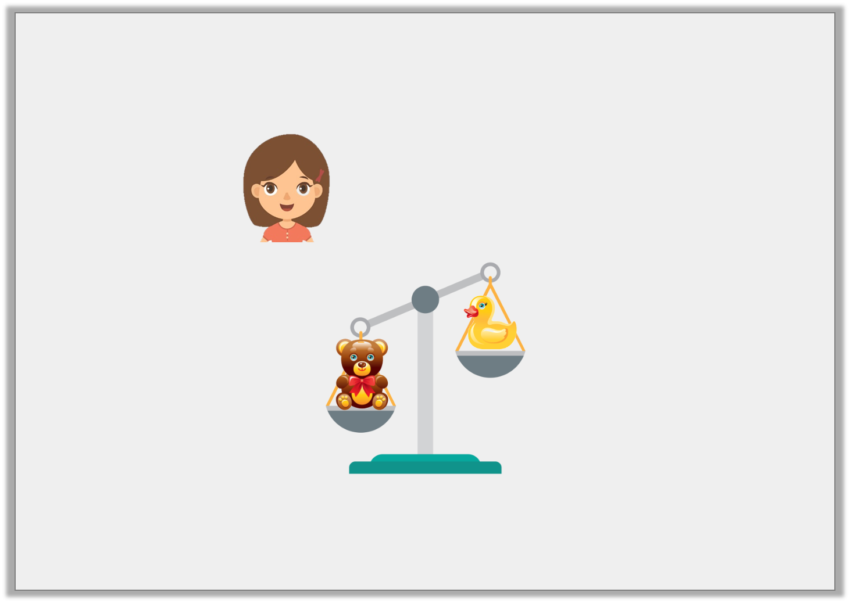
Reasoning 1
Is Aubrey correct?
Explain why.
The duck is heavier than the teddy.
Y1

Slide 6
Reasoning 1
Is Aubrey correct?
Explain why.
Aubrey is incorrect because…
The duck is heavier than the teddy.
Y1

Slide 7
Reasoning 1
Is Aubrey correct?
Explain why.
Aubrey is incorrect because the balance scale with the teddy is down. This means that the teddy is the heaviest, not the duck.
The duck is heavier than the teddy.
Y1

Slide 8
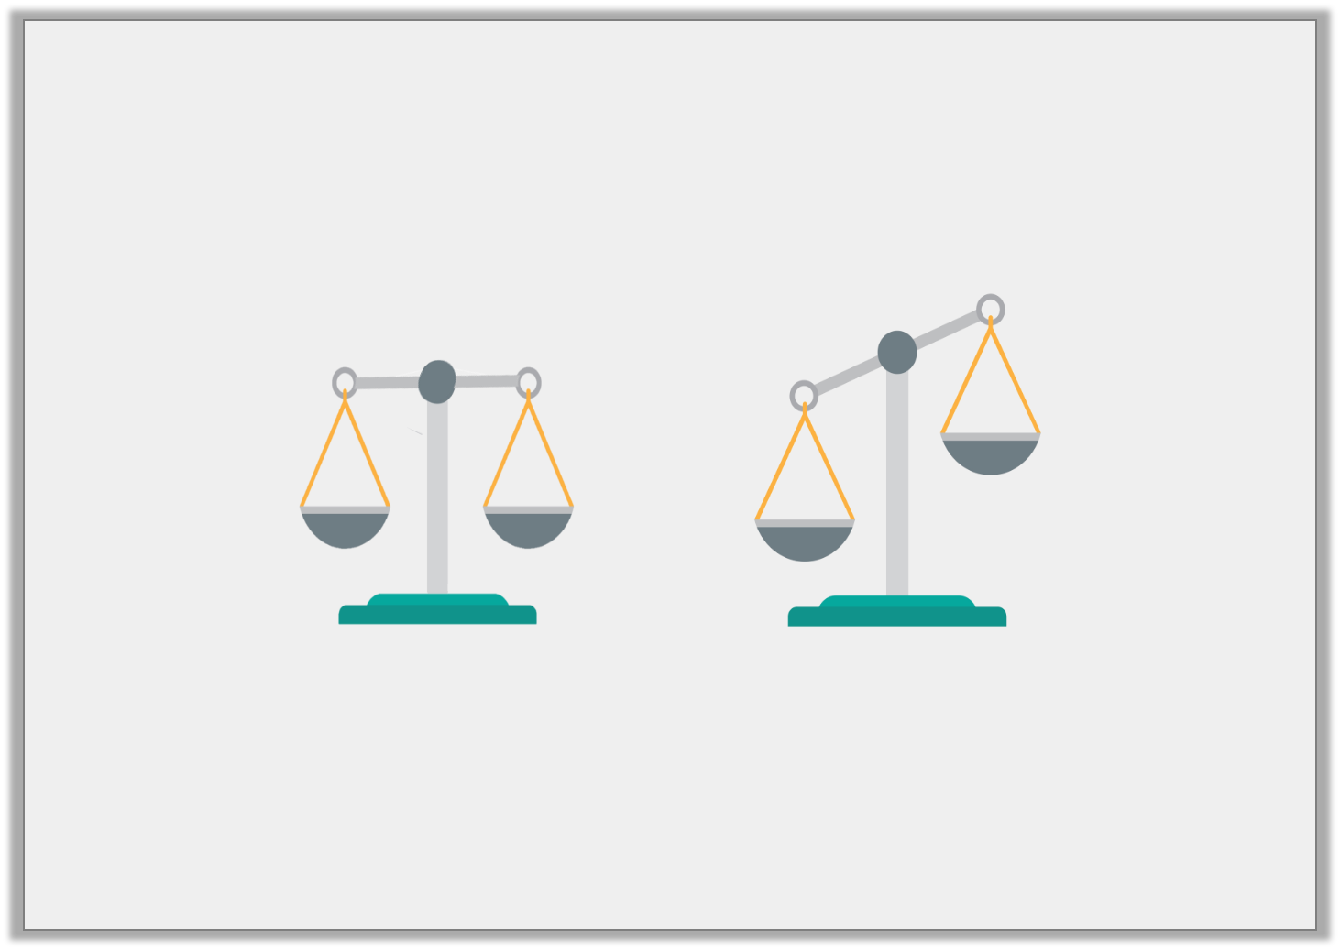
Problem Solving 1
Two identical oranges were put on each side of the balance scales.
Would the balance scales look like A or B?
A |  | B
Y1

Slide 9
Problem Solving 1
Two identical oranges were put on each side of the balance scales.
Would the balance scales look like A or B?
A |  | B
Y1

