Slide 1
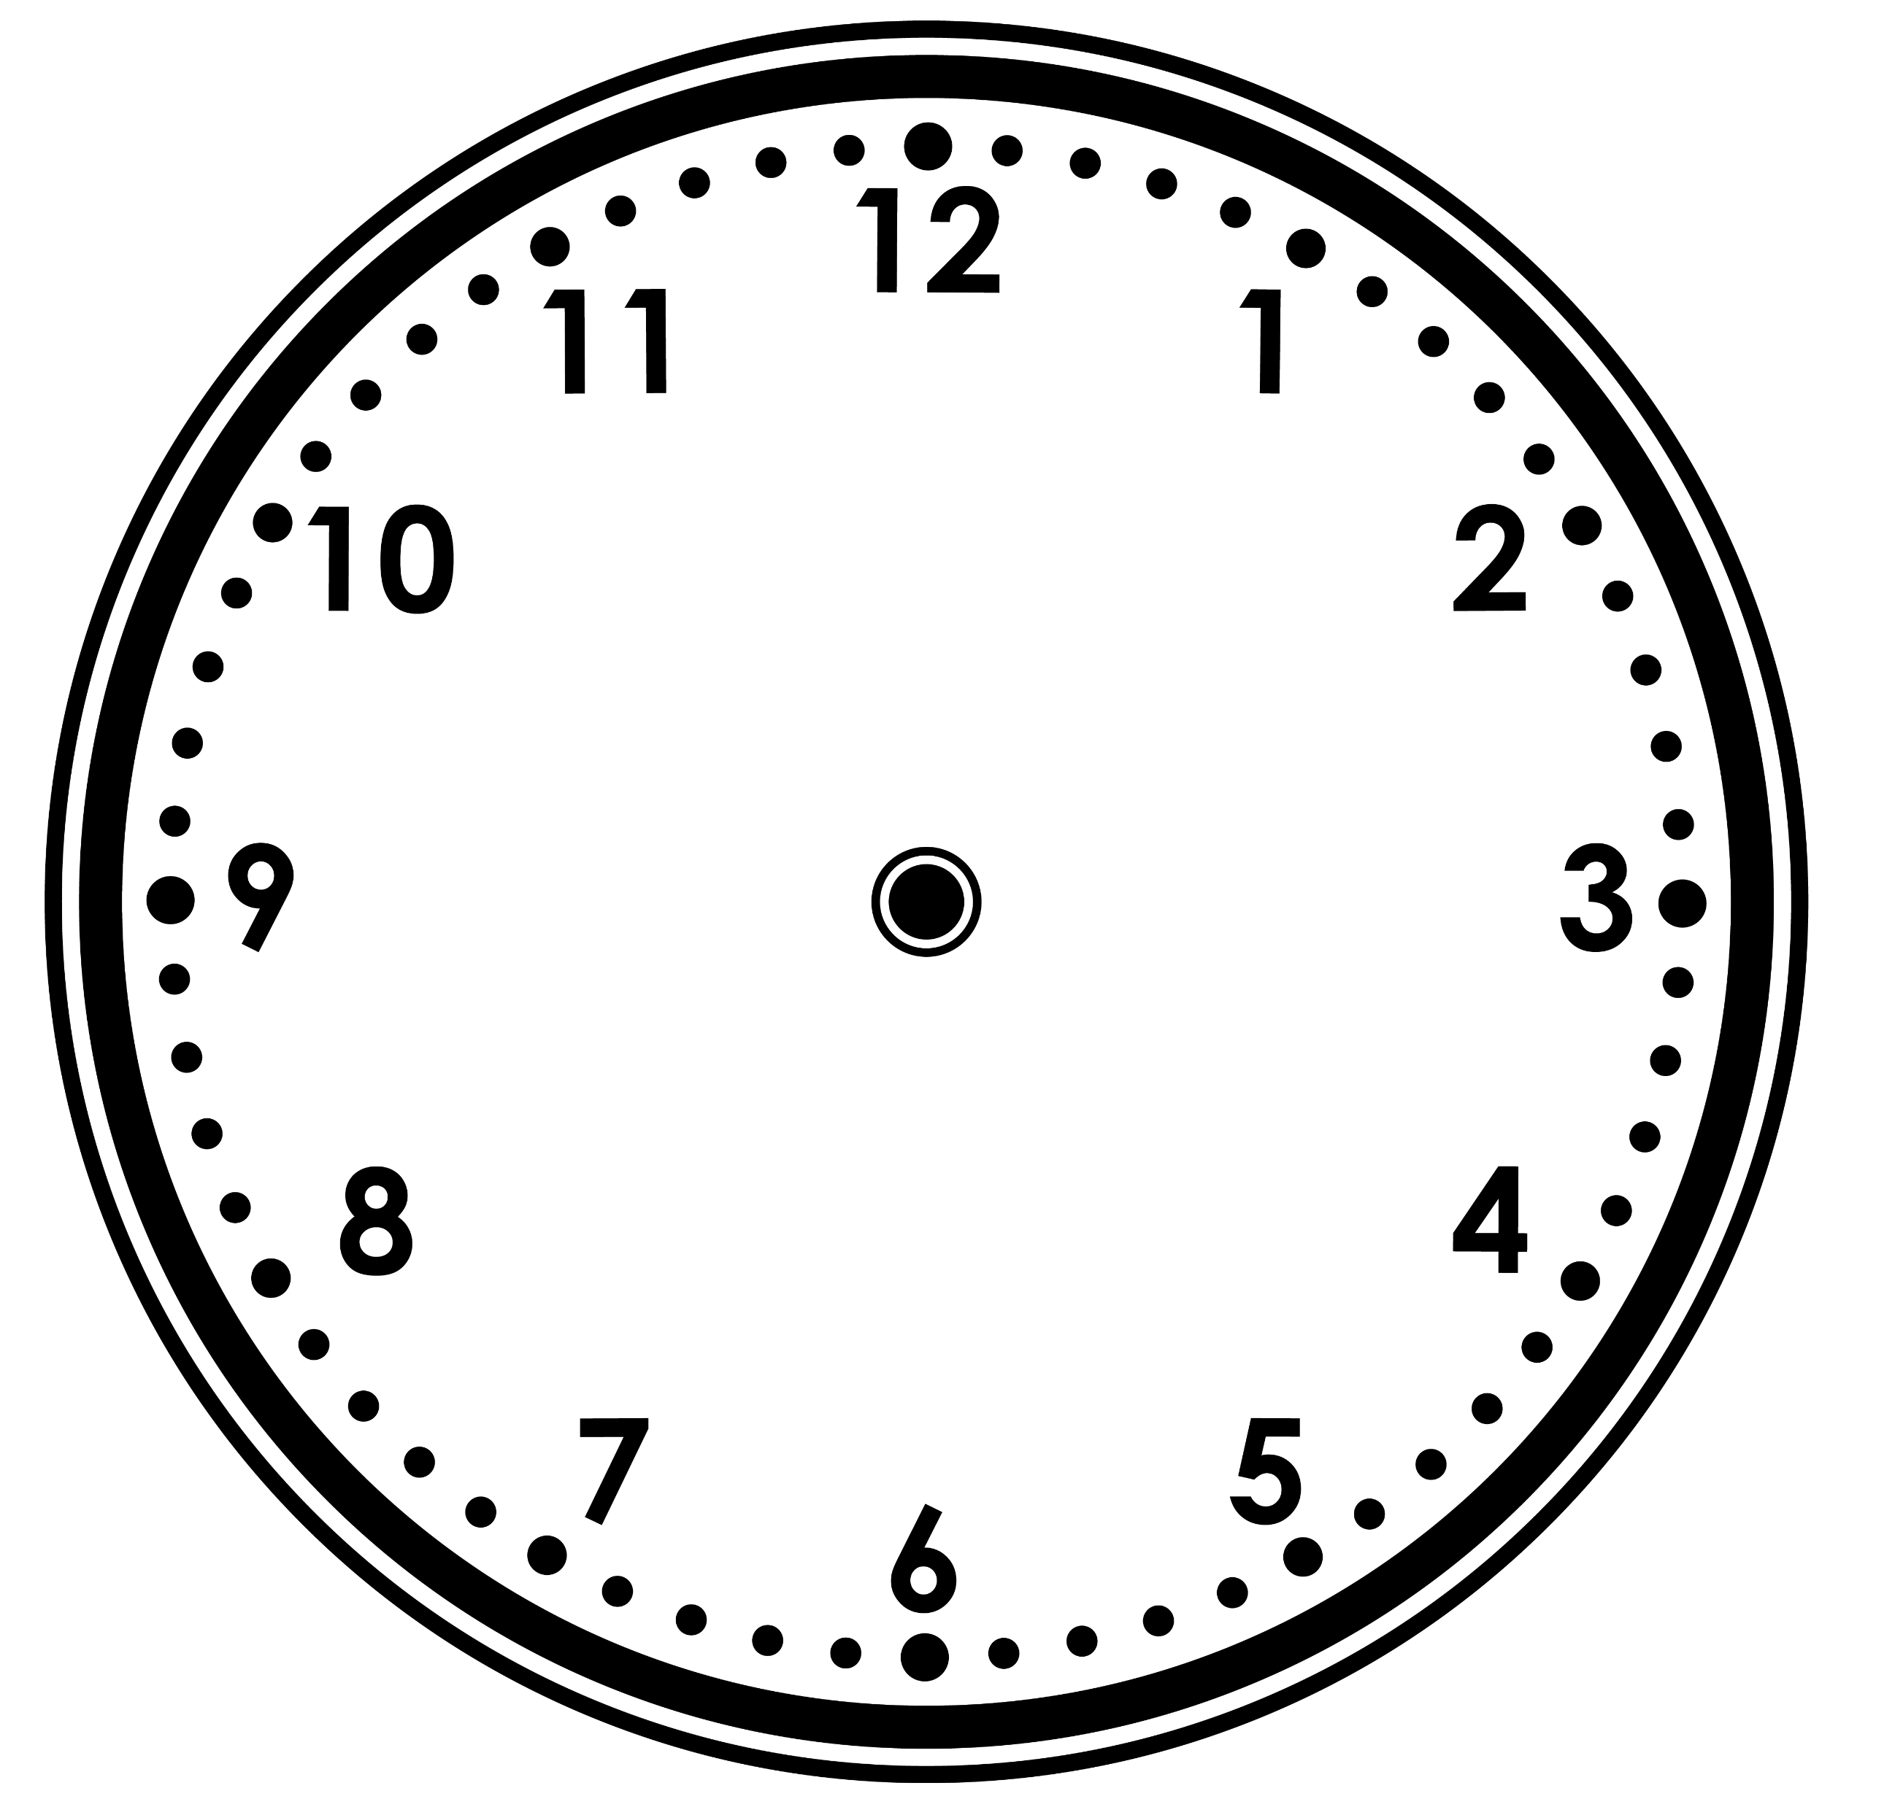
Varied Fluency 2
Write the time shown on each clock in words.
Y1

Slide 2
Varied Fluency 2
Write the time shown on each clock in words.
ten o’clock
eight o’clock
Y1

Slide 3
Varied Fluency 3
Draw the hands to show eight o’clock.
Y1

Slide 4
Varied Fluency 3
Draw the hands to show eight o’clock.
Y1

Slide 5
Varied Fluency 4
True or false? The time is six o’clock.
Y1

Slide 6
Varied Fluency 4
True or false? The time is six o’clock.
True
Y1

Slide 7
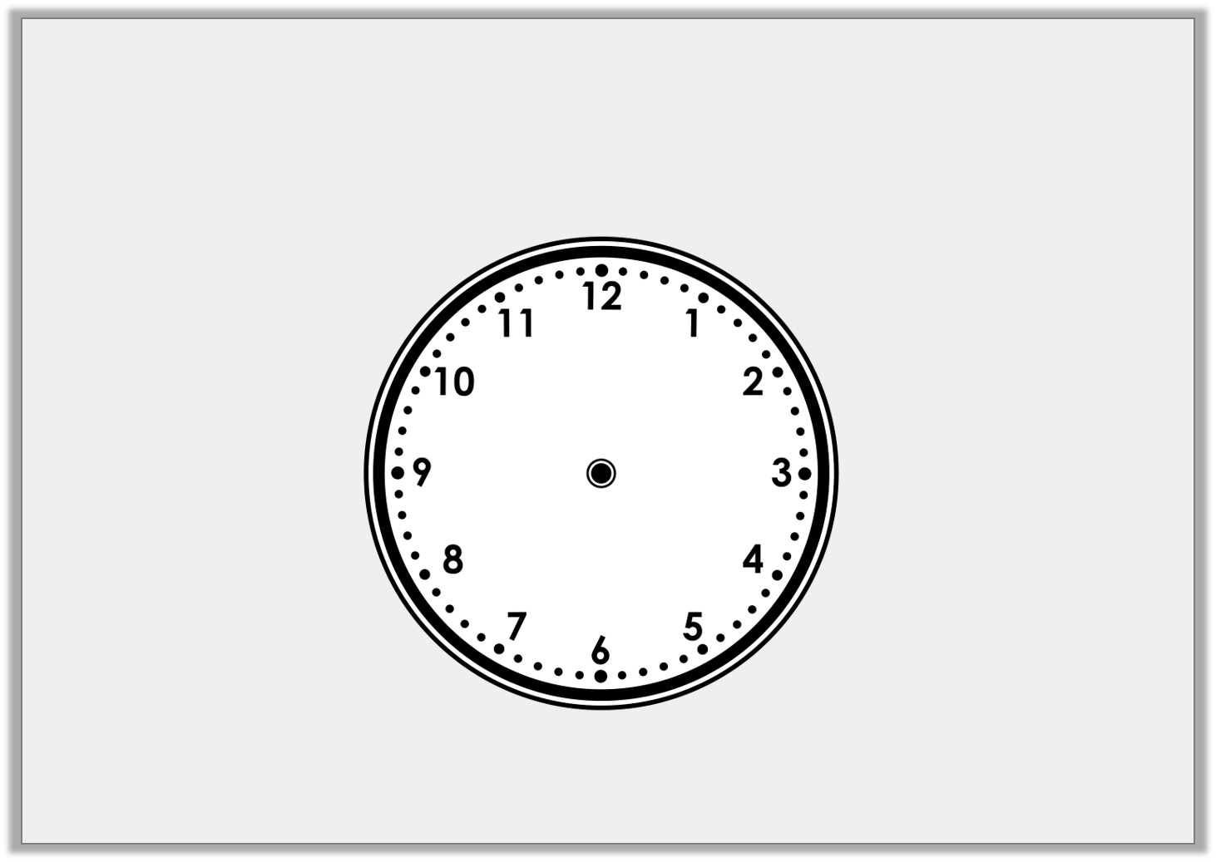
Varied Fluency 1
Write the time shown on this clock.
Y2

Slide 8
Varied Fluency 1
Write the time shown on this clock.
Half past 12
Y2

Slide 9
Varied Fluency 2
Draw the missing hands on the clock so that it shows the correct time written beneath it.
Half past 6
Y2

Slide 10
Varied Fluency 2
Draw the missing hands on the clock so that it shows the correct time written beneath it.
Half past 6
Y2

