Slide 1
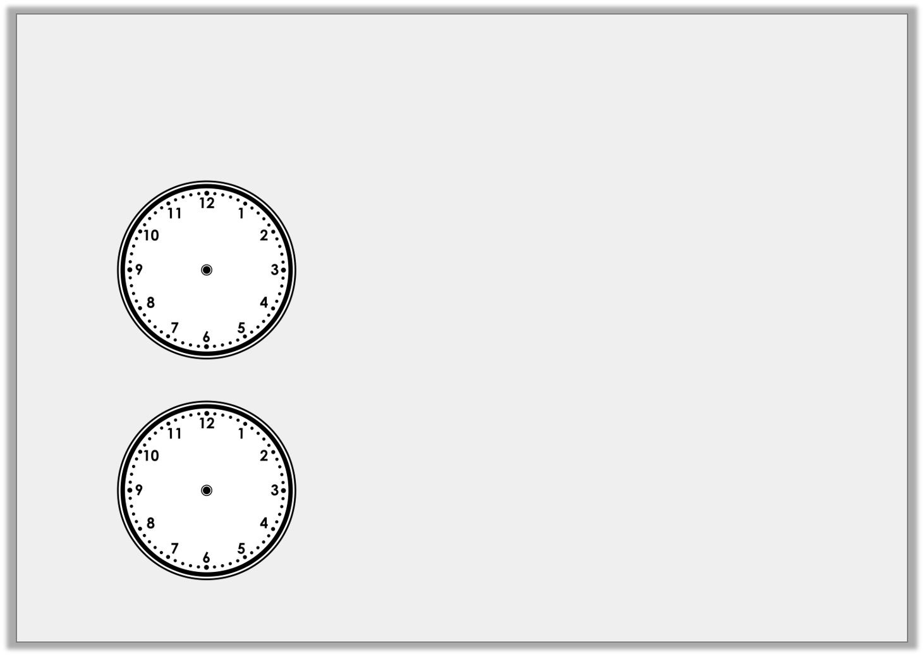
Varied Fluency 3
Draw a line to match the clocks to the correct
written time.
Half past12
3 o’clock
Half past 6
Half past 12
3 o’clock
Half past 6
Y2

Slide 2
Varied Fluency 3
Draw a line to match the clocks to the correct
written time.
Half past12
3 o’clock
Half past 6
Half past 12
3 o’clock
Half past 6
Y2

Slide 3
Varied Fluency 4
Draw a line to match the clocks to the correct
written time.
Eat lunch
Go home
Go to school
Y2

Slide 4
Varied Fluency 4
Draw a line to match the clocks to the correct
written time.
Eat lunch
Go home
Go to school
Y2

Slide 5
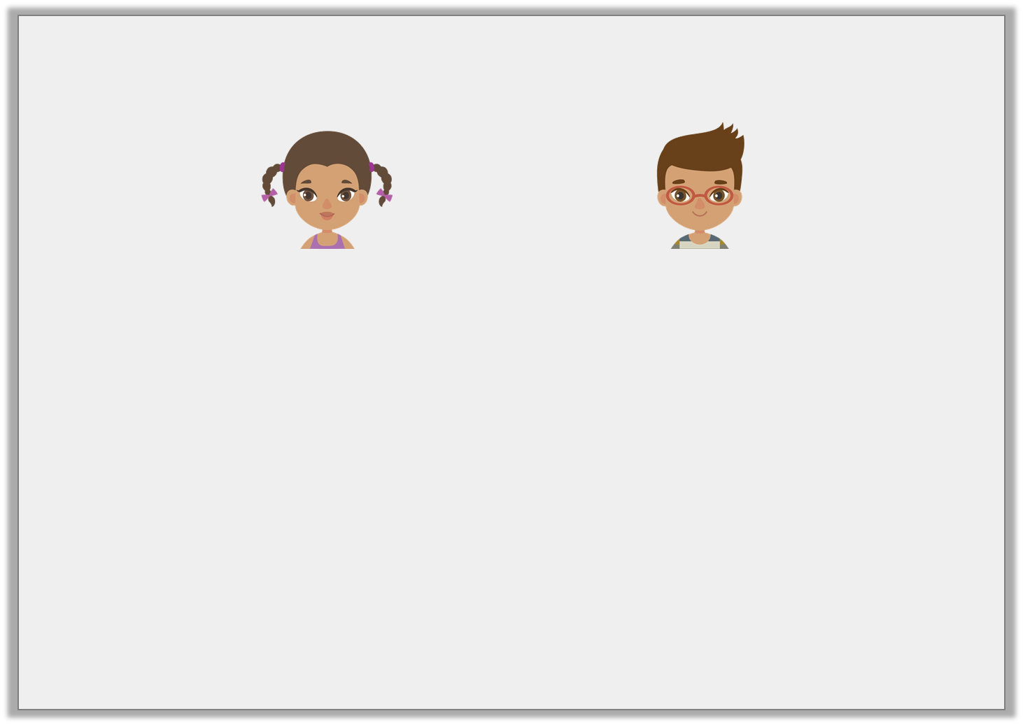
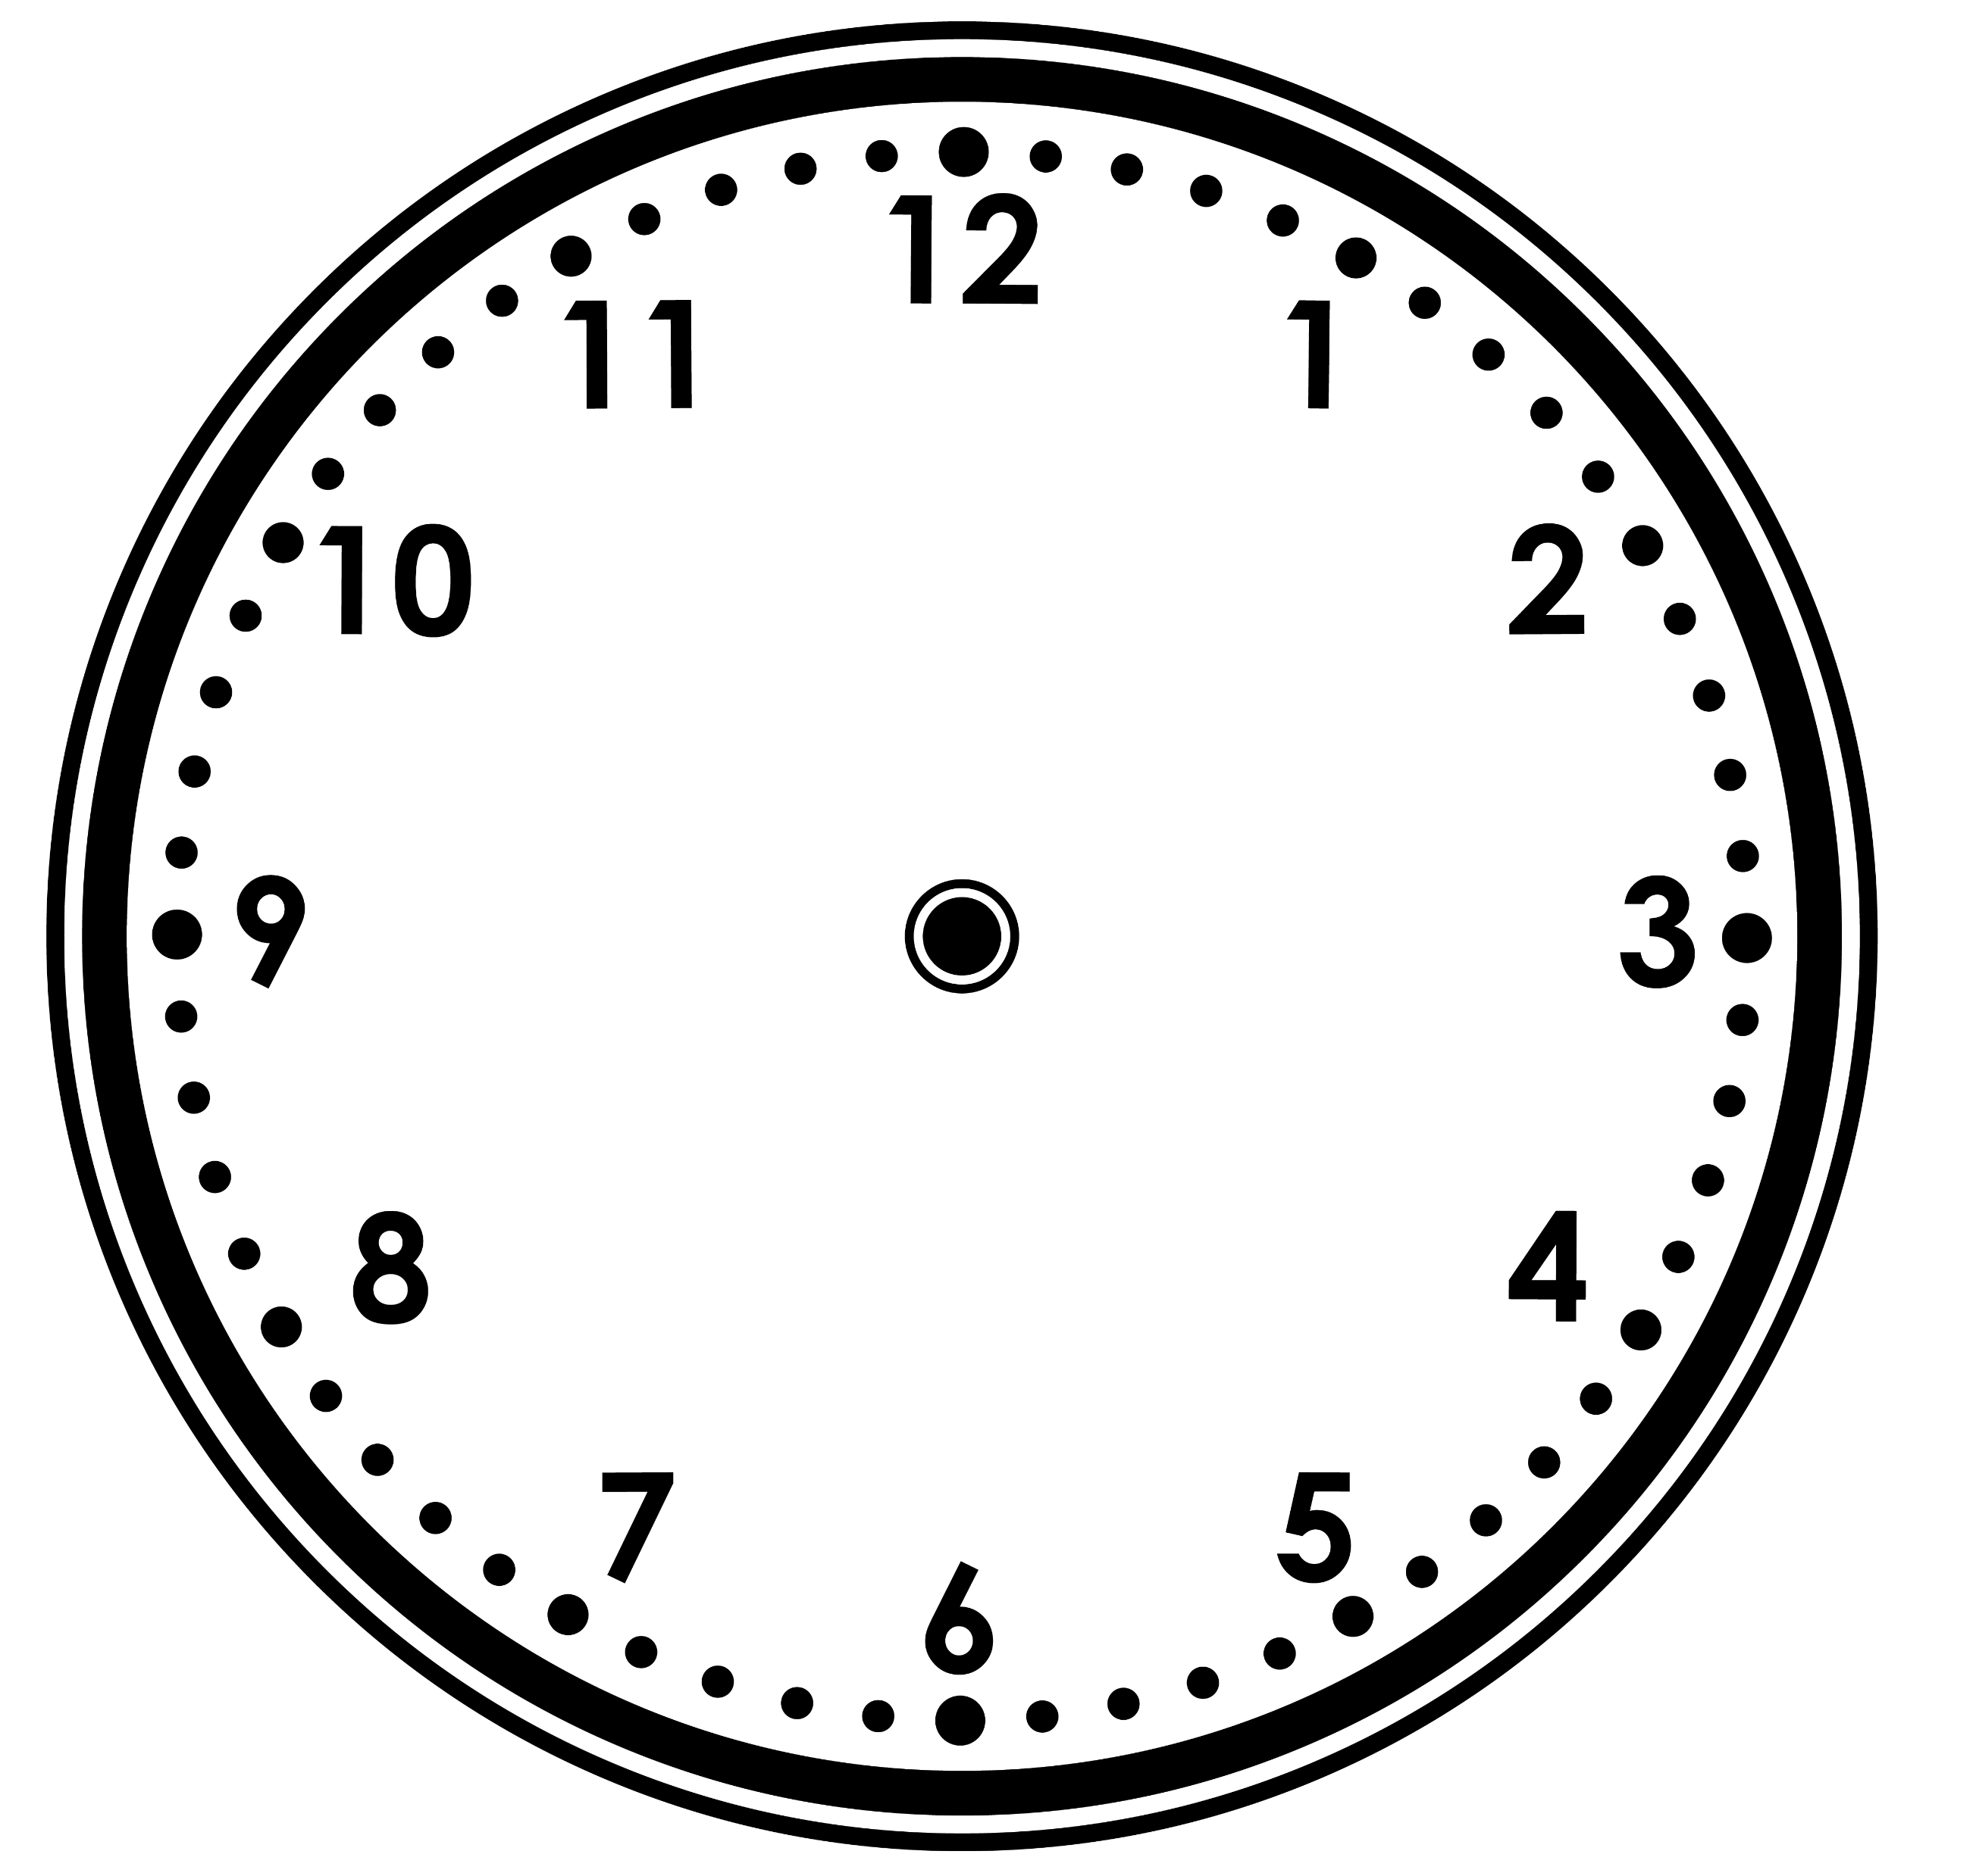
Reasoning 1
Two children show nine o’clock on a clock.
Who is correct?
Explain how you know.
Chloe
Ryan
Y1

Slide 6
Reasoning 1
Two children show nine o’clock on a clock.
Who is correct?
Explain how you know.
Chloe is correct because …
Chloe
Ryan
Y1

Slide 7
Reasoning 1
Two children show nine o’clock on a clock.
Who is correct?
Explain how you know.
Chloe is correct because the hour hand is pointing to 9 and the minute hand is pointing to 12. Ryan is incorrect because the hands are the wrong way round.
Chloe
Ryan
Y1

Slide 8
Problem Solving 1
Match two pairs to find the odd one out.
two o’clock
ten o’clock
Y1

Slide 9
Problem Solving 1
Match two pairs to find the odd one out.
two o’clock
ten o’clock
Y1

