Slide 1
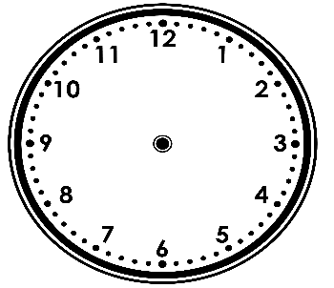
Problem Solving 2
Add the hands to each clock and write the time in words to complete the pattern.
_____ o’clock
seven o’clock
6 _____________
Y1

Slide 2
Problem Solving 2
Add the hands to each clock and write the time in words to complete the pattern.
8 o’clock
seven o’clock
6 o’clock
Y1

Slide 3
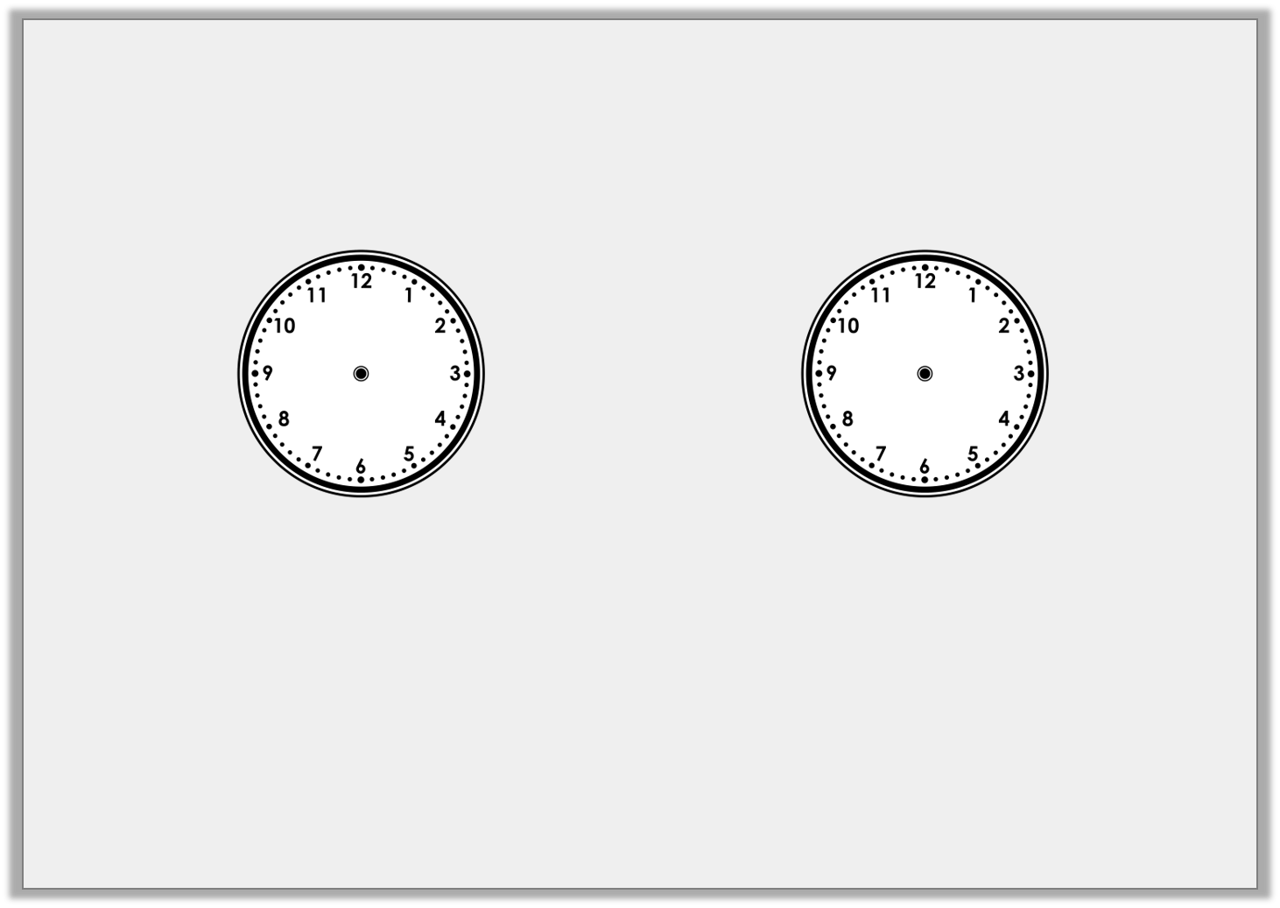
Problem Solving 1
Match the clocks to the time
and the most likely event.
Half past 8 |  | Half past 3 |  | 12 o’clock
Having lunch |  | Going to school |  | Going home
Y2

Slide 4
Problem Solving 1
Match the clocks to the time
and the most likely event.
Half past 8 |  | Half past 3 |  | 12 o’clock
Having lunch |  | Going to school |  | Going home
Y2

Slide 5
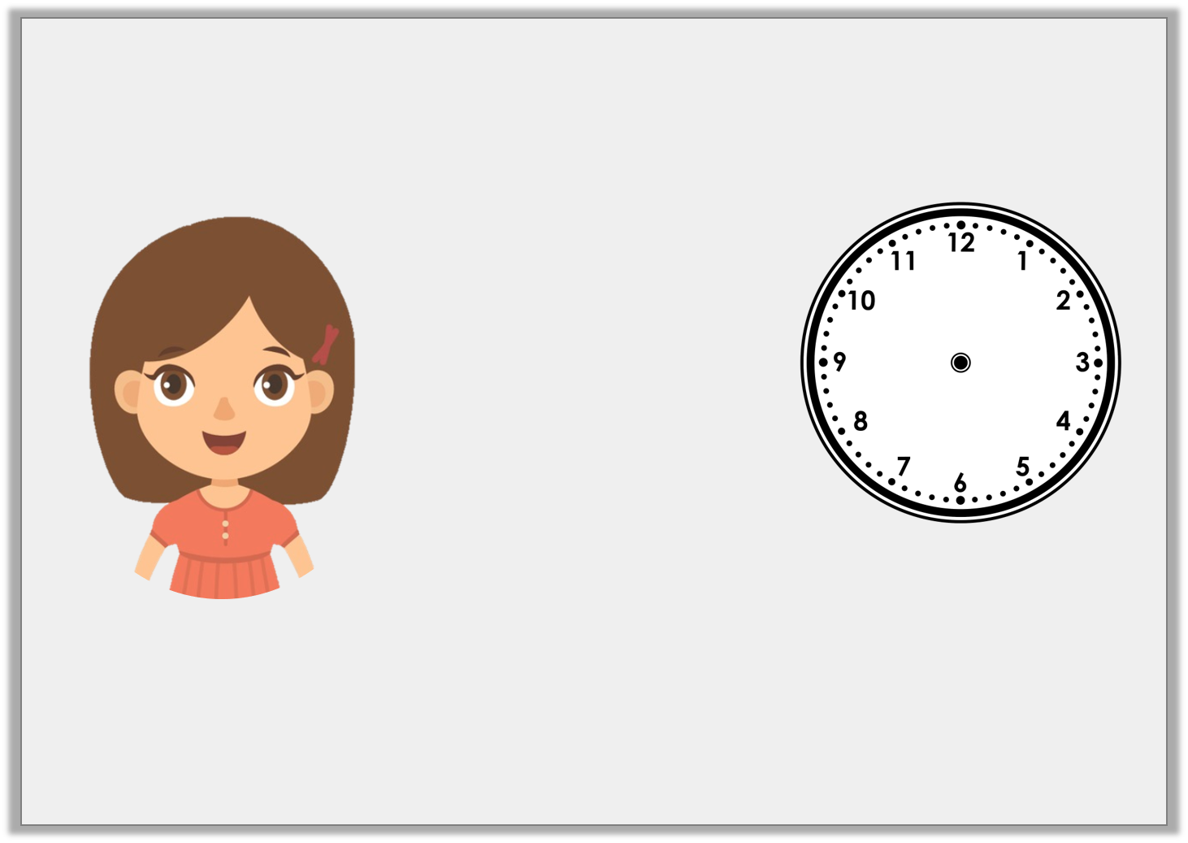
Reasoning 1
Jen is trying to tell the time.
Is Jen right? How do you know?
It’s 5 past 6.
Y2

Slide 6
Reasoning 1
Jen is trying to tell the time.
Is Jen right? How do you know?
Jen is wrong because…
It’s 5 past 6.
Y2

Slide 7
Reasoning 1
Jen is trying to tell the time.
Is Jen right? How do you know?
Jen is wrong because she has mixed up the hour hand and the minute hand. It is half past 5.
It’s 5 past 6.
Y2

Slide 8
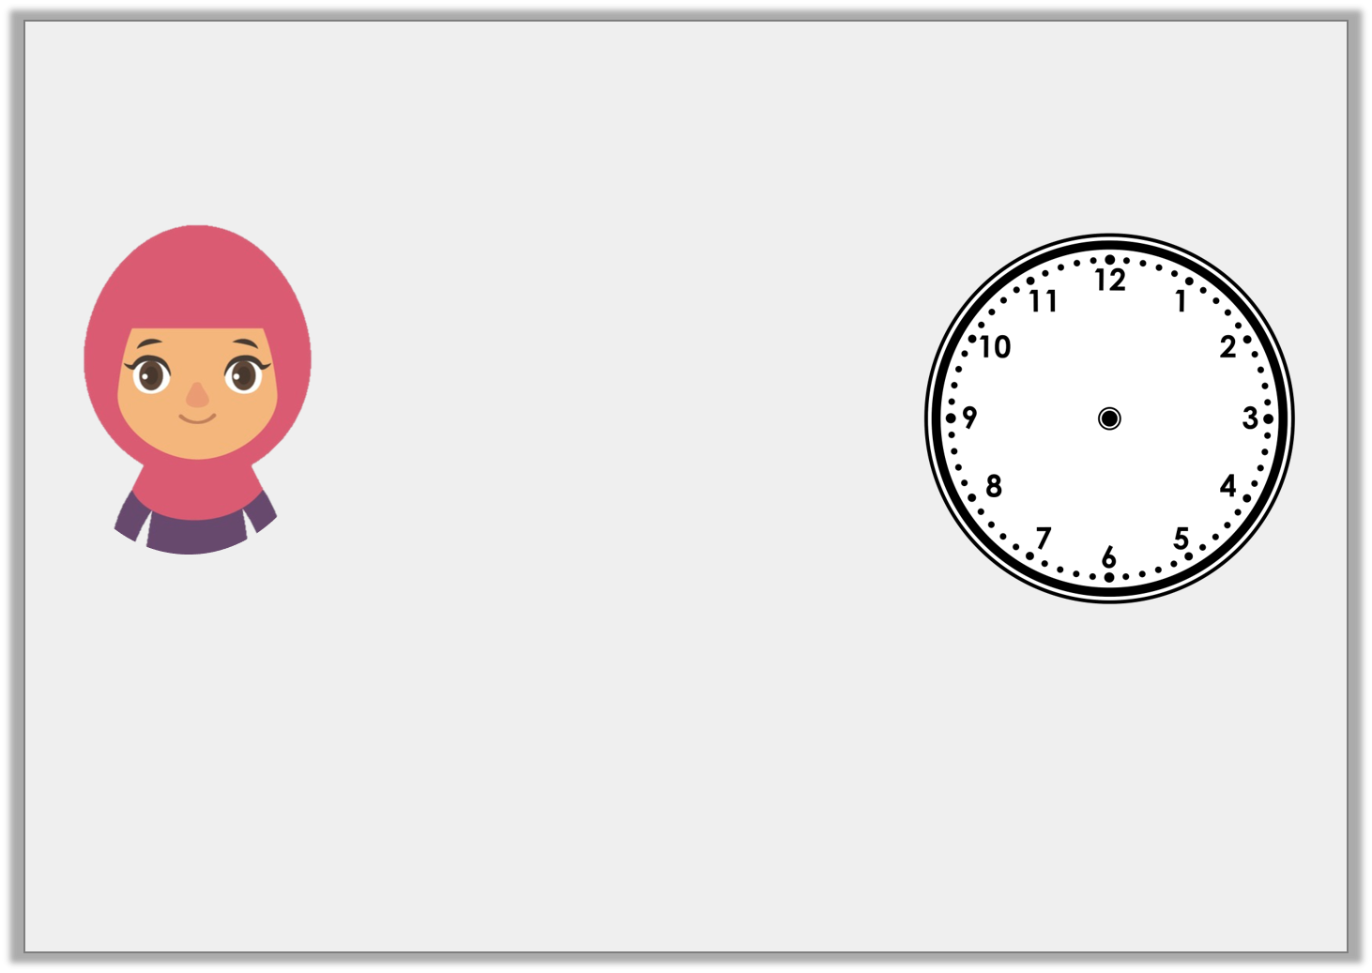
Reasoning 2
The hands have fallen off this clock. Aisha says:
Is Aisha right? How do you know?
Aisha is right about… but wrong about…
It’s half past 4 so the minute hand should be pointing down and the hour hand should be at 4.
Y2

Slide 9
Reasoning 2
The hands have fallen off this clock. Aisha says:
Is Aisha right? How do you know?
Aisha is right about the minute hand but wrong about the hour hand. If it is half past then then the hour hand should be between 4 and 5.
It’s half past 4 so the minute hand should be pointing down and the hour hand should be at 4.
Y2

