Slide 1
Year 1/2 – Spring Block 2 – Fractions
Step 8
Year 2: Unit Fractions

Slide 2
Introduction
Work out how many counters are in each of these five fractions.
Put them in order from the most counters to the fewest.
One third of 6 counters
One quarter of 16 counters
1 | of 12
4
1 | of 12
2
1 | of 15
3
Most
Fewest
Y2

Slide 3
Introduction
Work out how many counters are in each of these five fractions.
Put them in order from the most counters to the fewest.
One quarter of 16 counters
One third of 6 counters
1 | of 12
2
1 | of 15
3
1 | of 12
4
Most
Fewest
Y2

Slide 4
Varied Fluency 1
Use the picture to fill in the fraction.
 | 1 | of 27 = 9
Y2

Slide 5
Varied Fluency 1
Use the picture to fill in the fraction.
 | 1 | of 27 = 9
 | 3
Y2

Slide 6
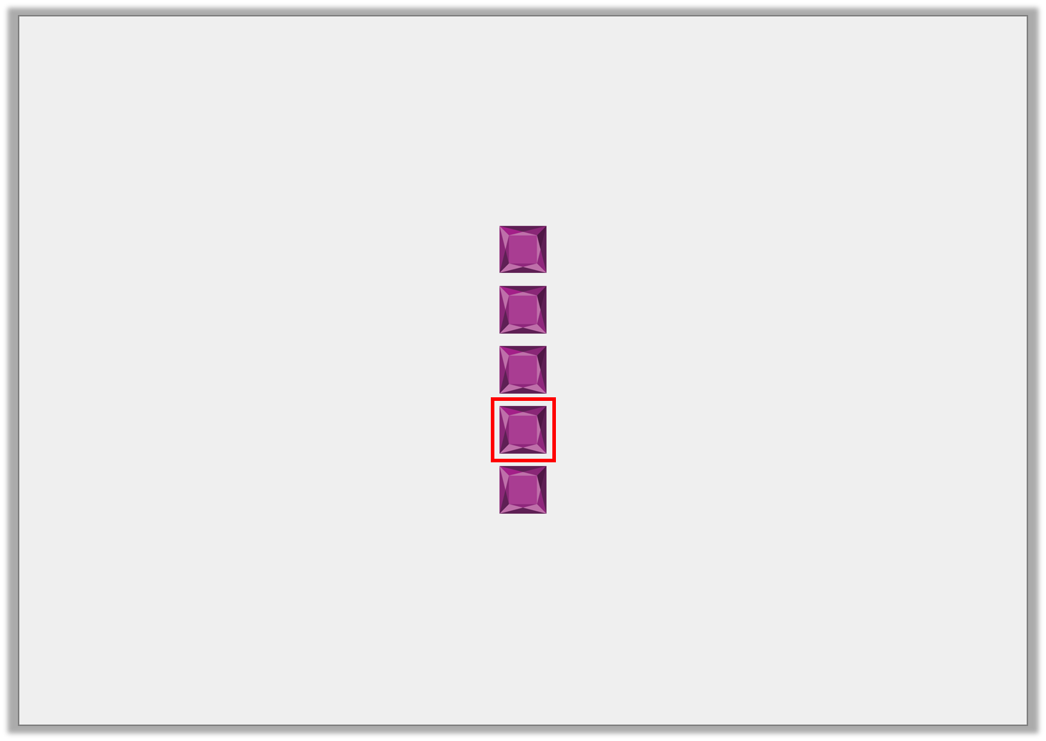
Varied Fluency 2
Which of the images represents ?
1
2
A
B
C
Y2

Slide 7
Varied Fluency 2
Which of the images represents ?
1
2
A
B
C
Y2

Slide 8
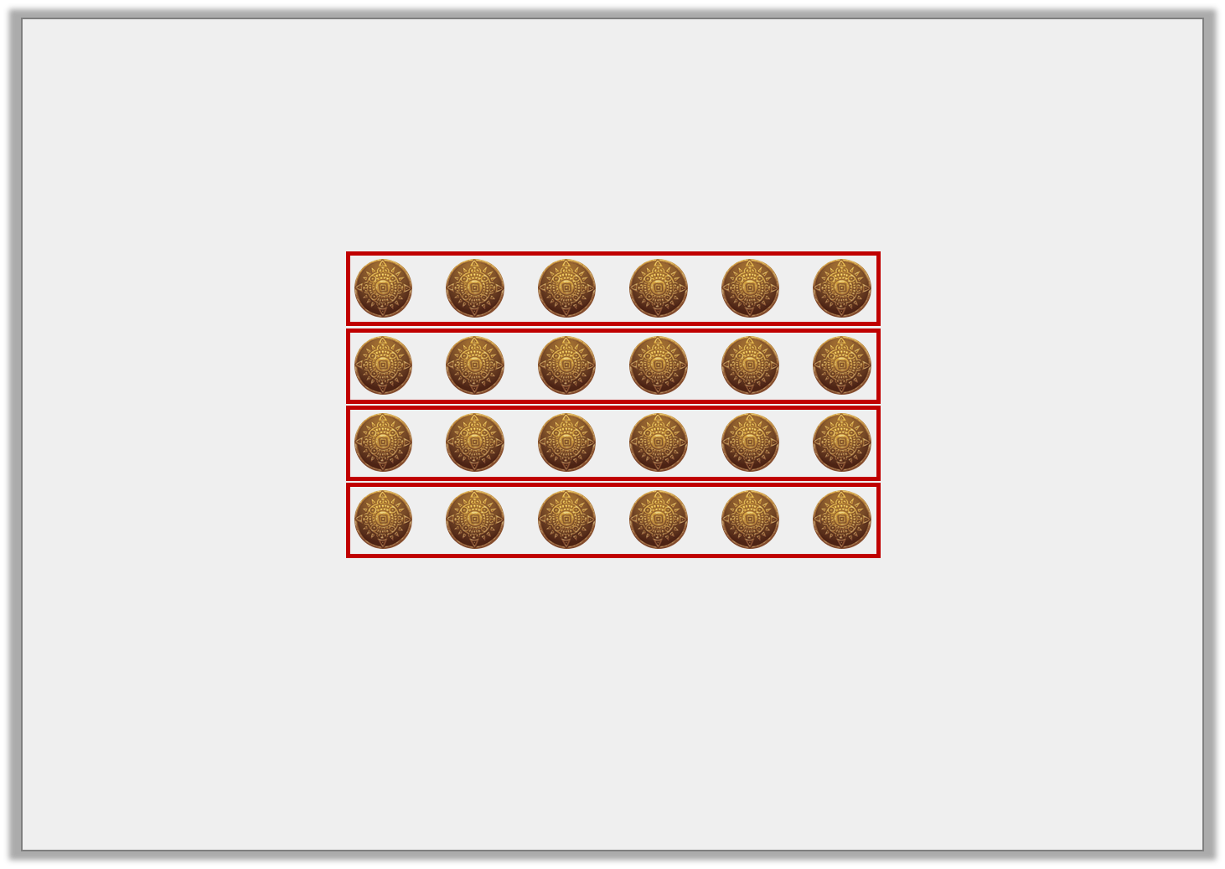
Varied Fluency 3
Use the picture to fill in the gaps.
1 | of 24 = 24 ÷ |  | =
4
Y2

Slide 9
Varied Fluency 3
Use the picture to fill in the gaps.
1 | of 24 = 24 ÷ |  | =
 |  | 4 |  | 6
4
Y2

Slide 10
Varied Fluency 4
Use the picture to help you fill in the table.
 |  |  | Number of groups | Number in each group
 | 1 | of 6
 | 3
 | 1 | of 6
 | 2
Y2

Slide 11
Varied Fluency 4
Use the picture to help you fill in the table.
 |  |  | Number of groups | Number in each group
 | 1 | of 6 | 3 | 2
 | 3
 | 1 | of 6 | 2 | 3
 | 2
Y2

Slide 12
Problem Solving 1
Here is a fraction of a total:
How many objects are there in of the total?
What is the total?
1 | =
4
1
2
Y2

Slide 13
Problem Solving 1
Here is a fraction of a total:
How many objects are there in of the total? 4 objects
What is the total? 8 objects
1 | =
4
1
2
Y2

Slide 14
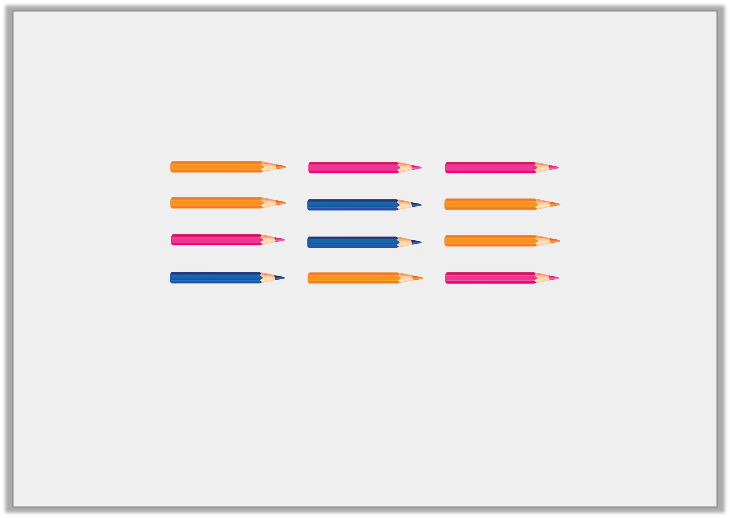
Problem Solving 2
Zoe is collecting pencils:
She wants of her total to equal 5.
How many more pencils does she need?
1
3
Y2

Slide 15
Problem Solving 2
Zoe is collecting pencils:
She wants of her total to equal 5.
How many more pencils does she need? 3 pencils
1
3
Y2

Slide 16
Reasoning 1
Amelia is going to find one half of the objects below:
Is her idea true or false? Prove it.
One half will be a smaller amount than one third of 15.
Y2

Slide 17
Reasoning 1
Amelia is going to find one half of the objects below:
Is her idea true or false? Prove it.
False, because…
One half will be a smaller amount than one third of 15.
Y2

Slide 18
Reasoning 1
Amelia is going to find one half of the objects below:
Is her idea true or false? Prove it.
False, because one third of 15 is 5 and half of the number of objects is 7. Seven is a bigger amount than 5.
One half will be a smaller amount than one third of 15.
Y2

