Slide 1
Year 1 – Summer Block 2 – Fractions
Step 4: Quarter of a Quantity

Slide 2
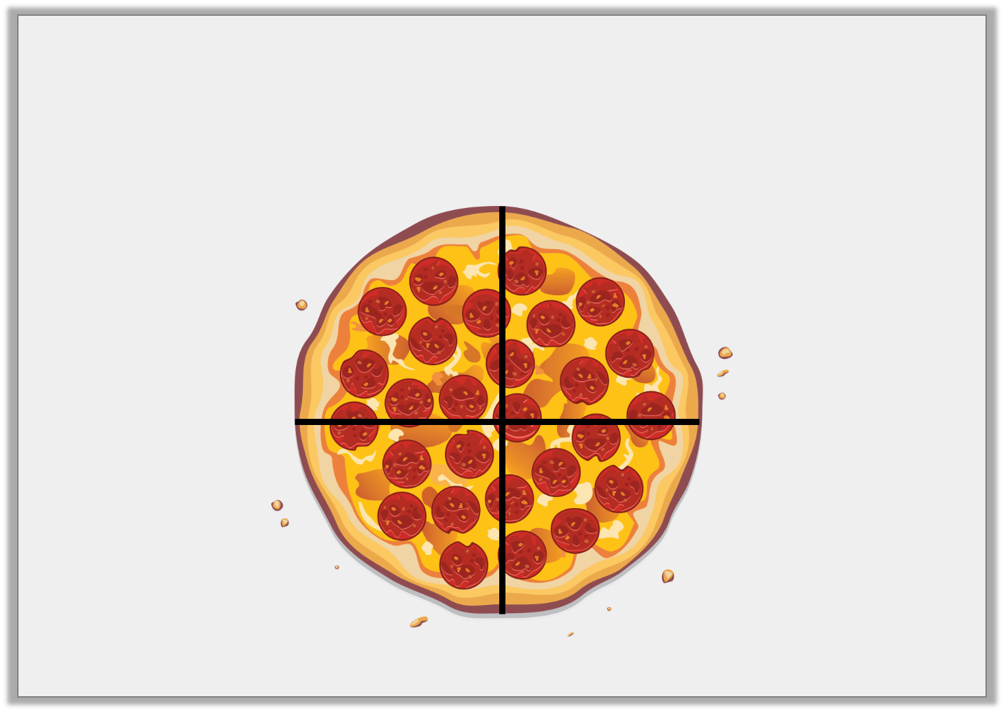
Introduction
How is the pizza split equally?

Slide 3
Introduction
How is the pizza split equally?
The pizza is cut into 4 equal slices.

Slide 4
Varied Fluency 1
Complete the statement based on the picture below.
There are _________ boxes. One quarter of _________ is _________ .

Slide 5
Varied Fluency 1
Complete the statement based on the picture below.
There are _________ boxes. One quarter of _________ is _________ .
20
20
5

Slide 6
Varied Fluency 2
Use the counters to complete the statement.
One quarter of 16 is ________ .

Slide 7
Varied Fluency 2
Use the counters to complete the statement.
One quarter of 16 is ________ .
4

Slide 8
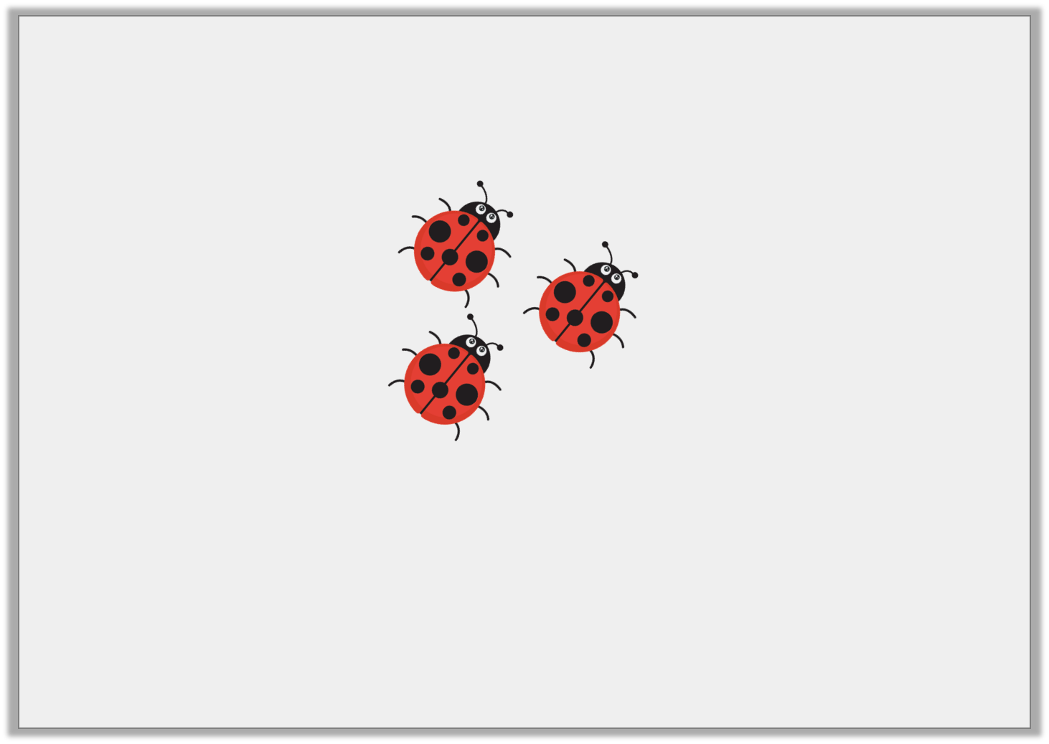
Varied Fluency 3
Here is one quarter.
What is the total?

Slide 9
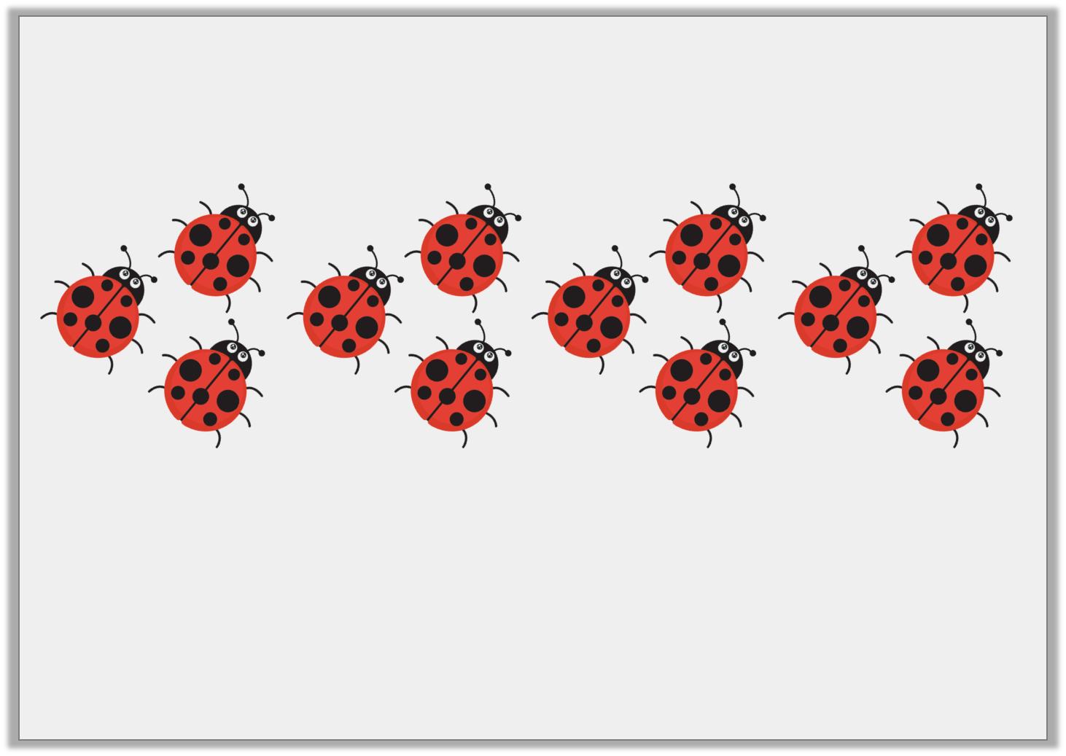
Varied Fluency 3
Here is one quarter.
What is the total?
12

Slide 10
Varied Fluency 4
Colour one quarter of the triangles.

Slide 11
Varied Fluency 4
Colour one quarter of the triangles.

Slide 12
Reasoning 1
Lydia thinks she has coloured in one quarter of the cubes. Is she correct?
How do you know?

Slide 13
Reasoning 1
Lydia thinks she has coloured in one quarter of the cubes. Is she correct?
How do you know?
Lydia is incorrect because…

Slide 14
Reasoning 1
Lydia thinks she has coloured in one quarter of the cubes. Is she correct?
How do you know?
Lydia is inocrrect because there are 12 equal parts and one quarter of 12 is 3.
She needs to colour 3 parts, not 4.

Slide 15
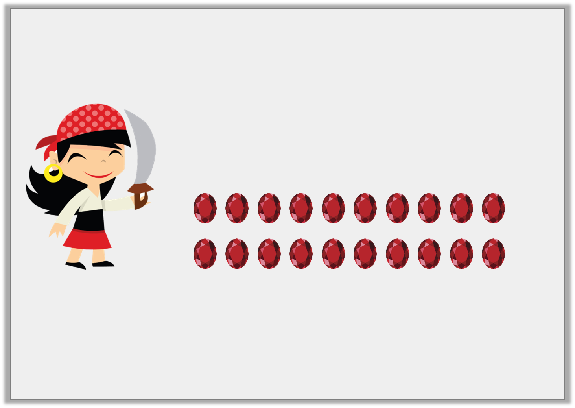
Reasoning 1
Pirate Paula needs to put one quarter of her gems in her treasure chest.
What mistake has Pirate Paula made?
I have put 4 of my gems in my treasure chest.

Slide 16
Reasoning 1
Pirate Paula needs to put one quarter of her gems in her treasure chest.
What mistake has Pirate Paula made?
Pirate Paula has not shared her gems…
I have put 4 of my gems in my treasure chest.

Slide 17
Reasoning 1
Pirate Paula needs to put one quarter of her gems in her treasure chest.
What mistake has Pirate Paula made?
Pirate Paula has not shared her gems into 4 equal groups. She should have put away 5 gems.
I have put 4 of my gems in my treasure chest.

Slide 18
Problem Solving 1
Find three different ways to shade a quarter of the shapes.

Slide 19
Problem Solving 1
Find three different ways to shade a quarter of the shapes.
Any 5 parts need to be shaded, e.g.

