Slide 1
Year 3/4 – Summer Block 5 – Mass and Capacity
31.03.20
Year 3: I can add and subtract mass
© Classroom Secrets Limited 2018

Slide 2
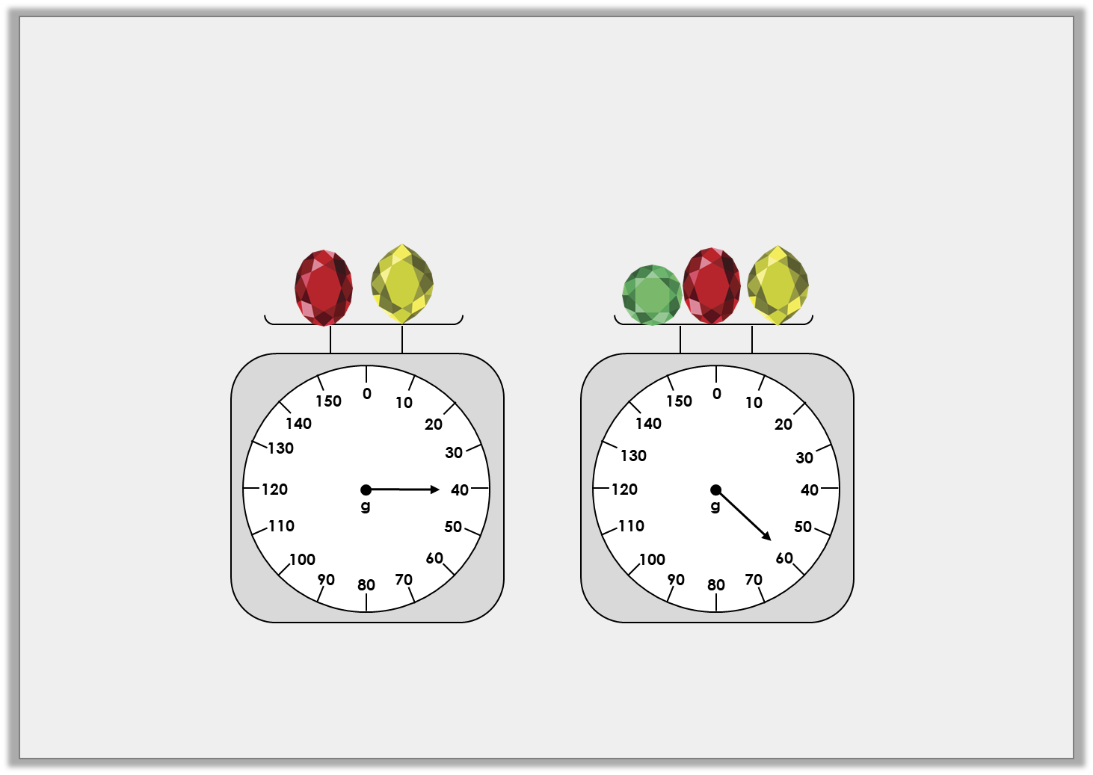
Introduction
One yellow jewel weighs 10g.
How much does each red and green jewel weigh?
How much would two of each jewel weigh in total?
Y3
© Classroom Secrets Limited 2018

Slide 3
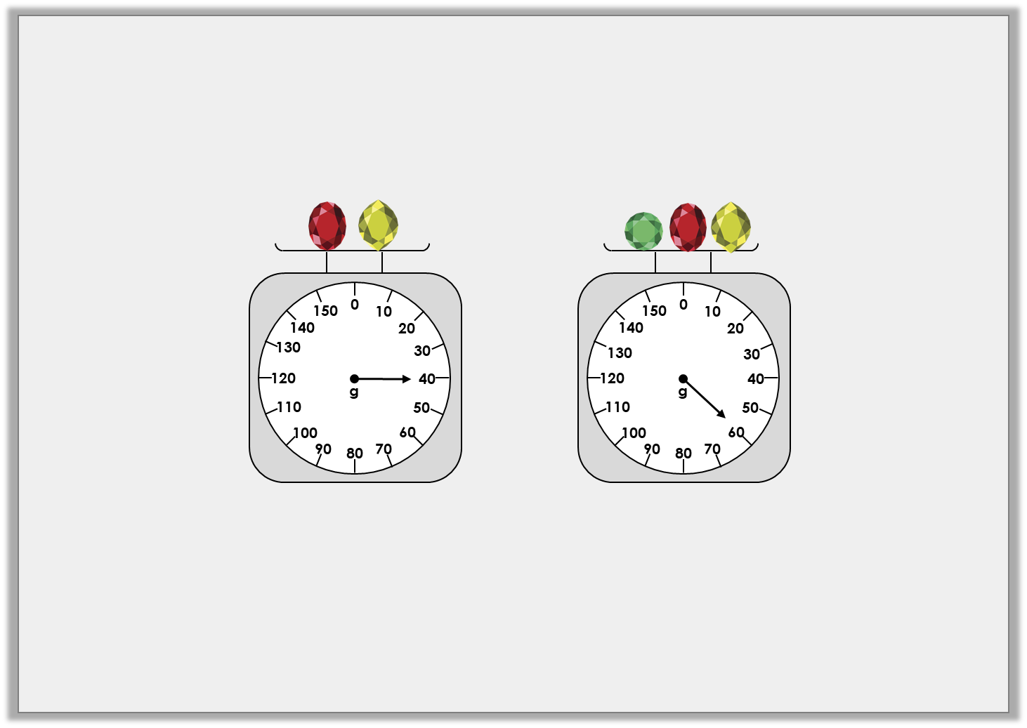
Introduction
One yellow jewel weighs 10g.
How much does each red and green jewel weigh?
40g – 10g = 30g. The red jewel weighs 30g.
60g – 30g – 10g = 20g. The green jewel weighs 20g.
How much would two of each jewel weigh in total?
10g + 10g + 20g + 20g + 30g + 30g = 120g
Y3
© Classroom Secrets Limited 2018

Slide 4
Varied Fluency 1
Complete the part-whole model.
2kg and 450g
1kg and 285g
kg
1
2
Y3
© Classroom Secrets Limited 2018

Slide 5
Varied Fluency 1
Complete the part-whole model.
2kg and 450g
1kg and 285g
kg
1
2
665g
Y3
© Classroom Secrets Limited 2018

Slide 6
Varied Fluency 2
Complete the bar model.
3kg and 100g | 450g
4kg and 650g
Y3
© Classroom Secrets Limited 2018

Slide 7
Varied Fluency 2
Complete the bar model.
3kg and 100g | 450g | 1kg and 100g
4kg and 650g
Y3
© Classroom Secrets Limited 2018

Slide 8
Varied Fluency 3
Use place value counters to find the difference between 4kg and 750g and 2 kg.
1
2
Thousands | Hundreds | Tens
1000
1000
100
100
10
10
1000
1000
100
100
10
10
100
100
10
100
Y3
© Classroom Secrets Limited 2018

Slide 9
Varied Fluency 3
Use place value counters to find the difference between 4kg and 750g and 2 kg.
2,250g or 2kg and 250g
1
2
Thousands | Hundreds | Tens
1000
1000
100
100
10
10
1000
1000
100
100
10
10
100
100
10
100
Y3
© Classroom Secrets Limited 2018

Slide 10
Varied Fluency 4
Find the total mass of these items.
A
C
0
50
1500
0
100
1
2
kg
1400
200
100
B
1300
300
450
150
1200
g
400
400
kg/g
1100
500
350
200
0
1000
600
250
750
50
900
800
700
300
700
100
650
150
600
g
200
550
250
500
300
450
400
350
Y3
© Classroom Secrets Limited 2018

Slide 11
Varied Fluency 4
Find the total mass of these items.
450g + 600g + 1kg and 400g = 2kg and 450g
A
C
0
50
1500
0
100
1
2
kg
1400
200
100
B
1300
300
450
150
1200
g
400
400
kg/g
1100
500
350
200
0
1000
600
250
750
50
900
800
700
300
700
100
650
150
600
g
200
550
250
500
300
450
400
350
Y3
© Classroom Secrets Limited 2018

