Slide 1
Dua’s in Salah

Slide 2
What to say when beginning the Salah

Slide 3
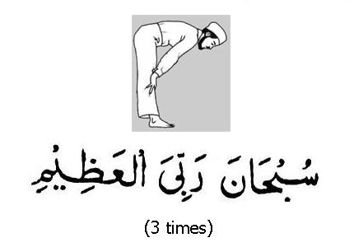
What to say in Ruku

Slide 4
What to say in Sujud (sajdah)

Slide 5
What to say in between the 2 prostrations (sajdah)

Slide 6
What to read when sitting down (Tashahhud)

Slide 7
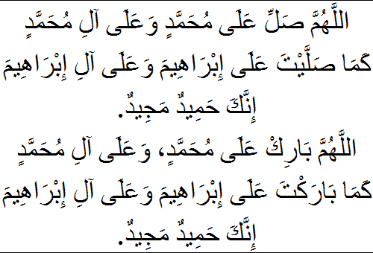
Durood Ibraheem

Slide 8
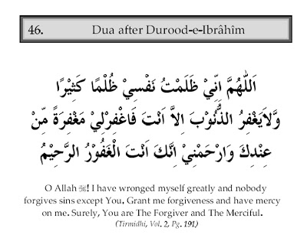
Dua after Durood

